Slide 1
Predicting “Shooting high alert” using NYPD Shooting Incident Data
Manpreet Singh

Slide 2
Index
Data
Data cleaning
EDA & Analysis
Modelling

Slide 3
Data
Data is provided by NYPD Police department*
Involves every shooting incident that occurred in NYC from 2006 to 2023
Each incident contains information about time, date, precinct, Borough, victim profile (age, gender, race), perp profile (age, gender, race) and location information wherever available.
*source: https://data.cityofnewyork.us/Public-Safety/NYPD-Shooting-Incident-Data-Historic-/833y-fsy8/about_data

Slide 4
Problem Statement
Predict “shooting high alert” given month, hour and borough in NYC

Slide 5
Data cleaning
Geographical data is dropped as it not accurately mapped
All the missing/incorrect data has been labelled “Unknown”
Shooting time has been categorised in time window of 1 hour
Gender, age, race information has been removed

Slide 6
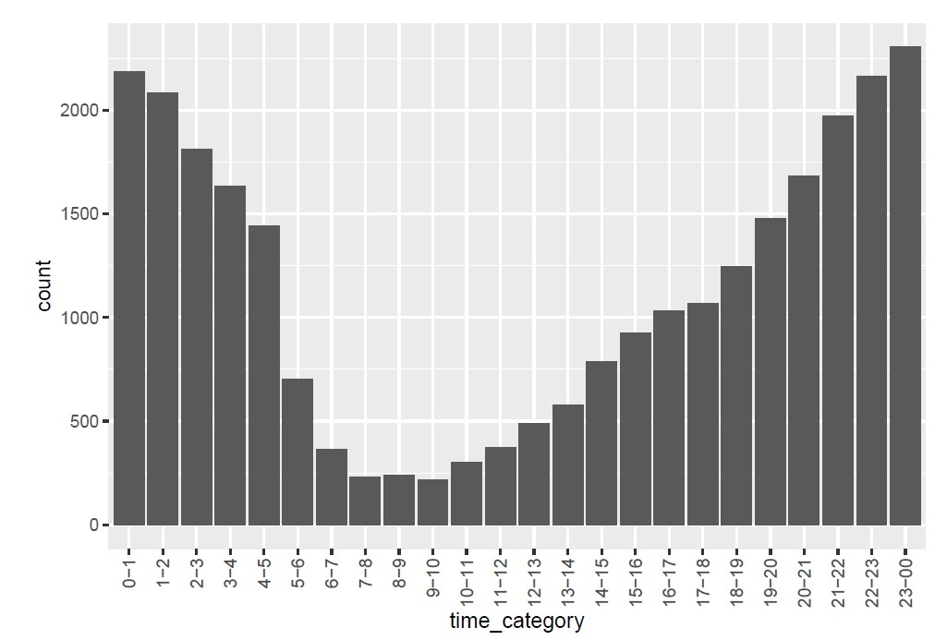
Incidents by time of the day

Slide 7
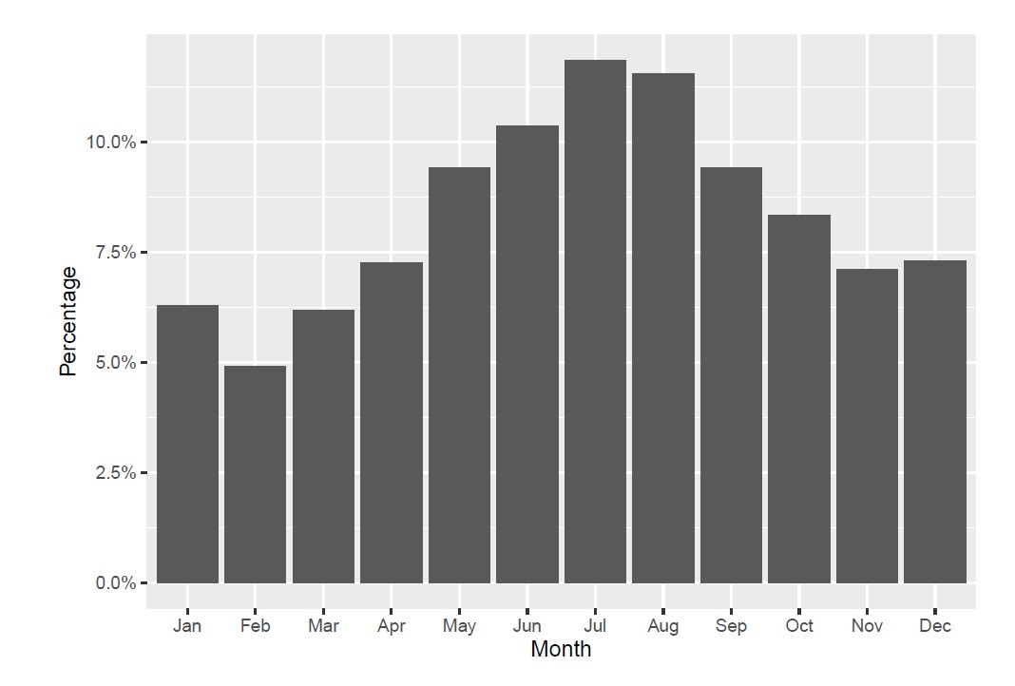
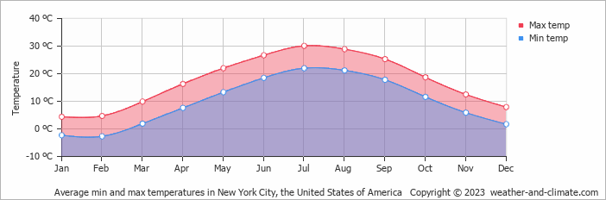
Incidents by month
Source : weather-and-climate.com

Slide 8
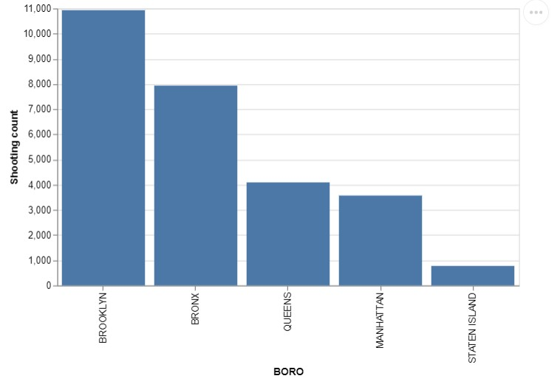
Incidents by Borough

Slide 9
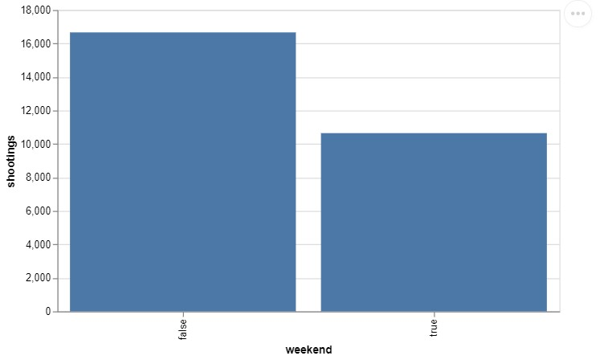
Incidents by weekends

Slide 10
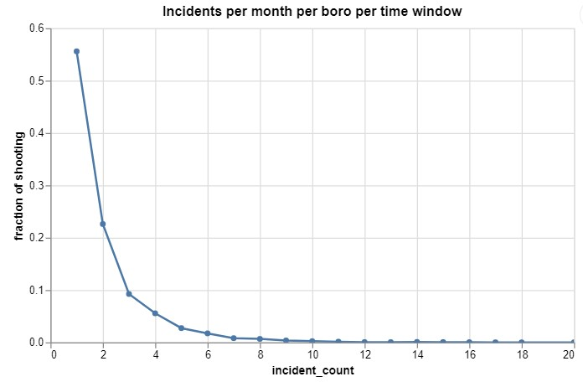
Modelling considerations
Shooting incidents per month
Statistics
Min. : 1.000
1st Qu.: 1.000
Median : 2.000
Mean : 2.527
3rd Qu.: 3.000
Max. :26.000
Shooting above 3 in a month is unusual

Slide 11
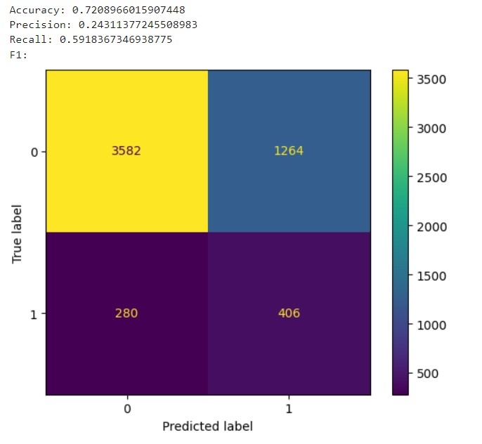
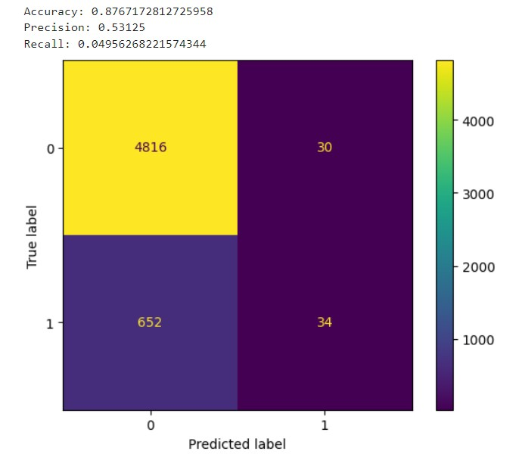
Model predictions
Random Forest Xgboost

Slide 12
Demo
Demo app

Slide 13
Thank you

