Slide 1


COVID-19 ANALYSIS
​🇲​​🇦​​🇳​​🇵​​🇷​​🇪​​🇪​​🇹​ ​🇸​​🇮​​🇳​​🇬​​🇭​ ​🇦​​🇲​​🇦​​🇳​ ​🇲​​🇦​​🇸​​🇰​​🇦​​🇷​​🇪​ ​🇾​​🇦​​🇩​​🇳​​🇪​​🇸​​🇭​ ​🇸​​🇮​​🇳​​🇬​​🇭​ ​🇦​​🇳​​🇦​​🇩​​🇮​ ​🇧​​🇷A​​🇲​​🇭

Slide 2

CONTENTS:
INTRODUCTION
AIM OF PROJECT
INSIGHTS AND INFORMATION
COMPLICATIONS AND TROUBLES
MEASURES
CONCLUSION

Slide 3

INTRODUCTION:
Coronaviruses are a large family of viruses that are known to cause illnesses ranging from the common cold to more severe diseases such as Middle East Respiratory Syndrome (MERS) and Severe Acute Respiratory Syndrome (SARS).
A novel coronavirus (COVID-19) was identified in 2019 in Wuhan, China. This is a new coronavirus that has not been previously identified in humans.

Slide 4

Aim of Project:
The project aims to provide insights into the impact of the COVID-19 pandemic on various aspects of life.
The project will analyze data to better understand the trends and patterns of COVID-19 cases, deaths, and recoveries across India and in specific regions or States.
The project will use data visualization tools to better communicate the insights and trends in the data.

Slide 5
CASES AND DECEASED:
Total Number of Cases
Total Number of Deceased
34 M
450 K

Slide 6
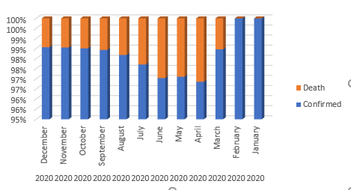
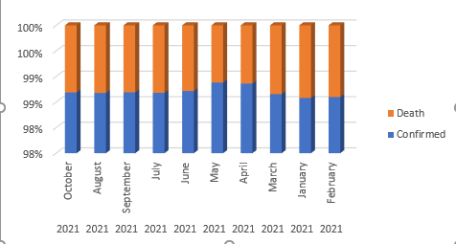
MONTHLY TREND
YEAR: 2020
YEAR: 2021
The monthly graph of confirmed cases recovered cases, and vaccinated numbers reveal a direct correlation between the increase in confirmed cases and the rise in the number of deceased individuals. This underscores the critical importance of public health measures to control the spread of COVID-19.

Slide 7
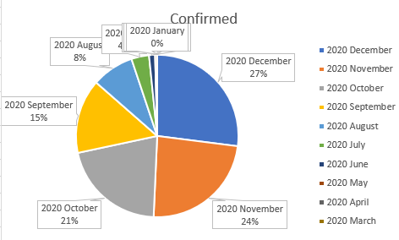
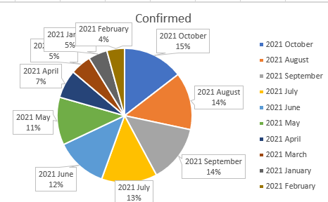
MOST SEVERE MONTH
YEAR : 2020
According to the pie chart, December was
the most affected month during the
COVID-19 pandemic in 2020, while
October was the most affected month
in 2021. This information is crucial for
policymakers and public health officials
to target resources and interventions to
mitigate the spread of the virus
during high-risk periods.
YEAR : 2021

Slide 8

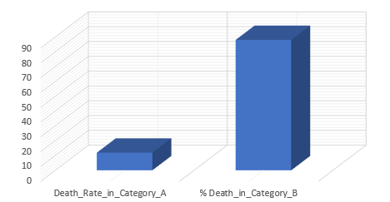



Testing Ratio(TR) = (Number of Tests Done) /(Population)
Category A: 0.05 ≤ tr ≤ 0.1
Category B: 0.1 < tr ≤ 0.3
Category C: 0.3 < tr ≤ 0.5
Category D: 0.5 < tr ≤ 0.75
Category E: 0.75 < tr ≤ 1.0

Slide 9
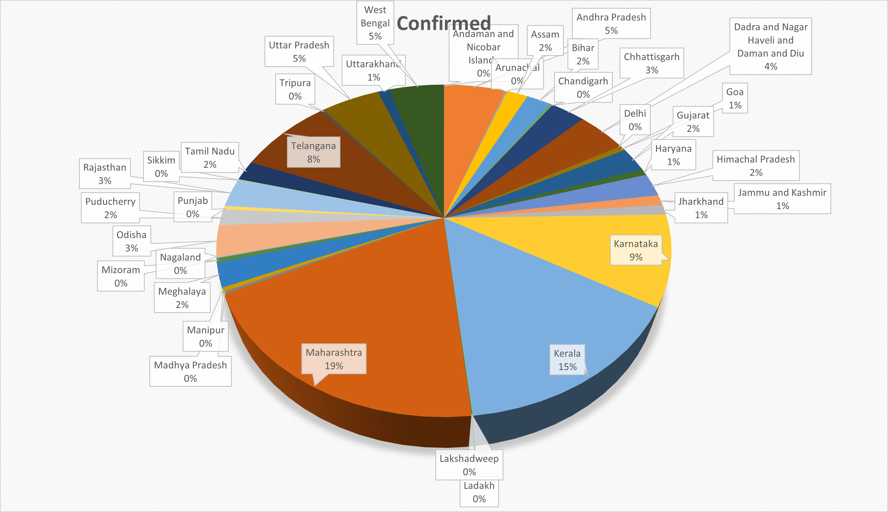
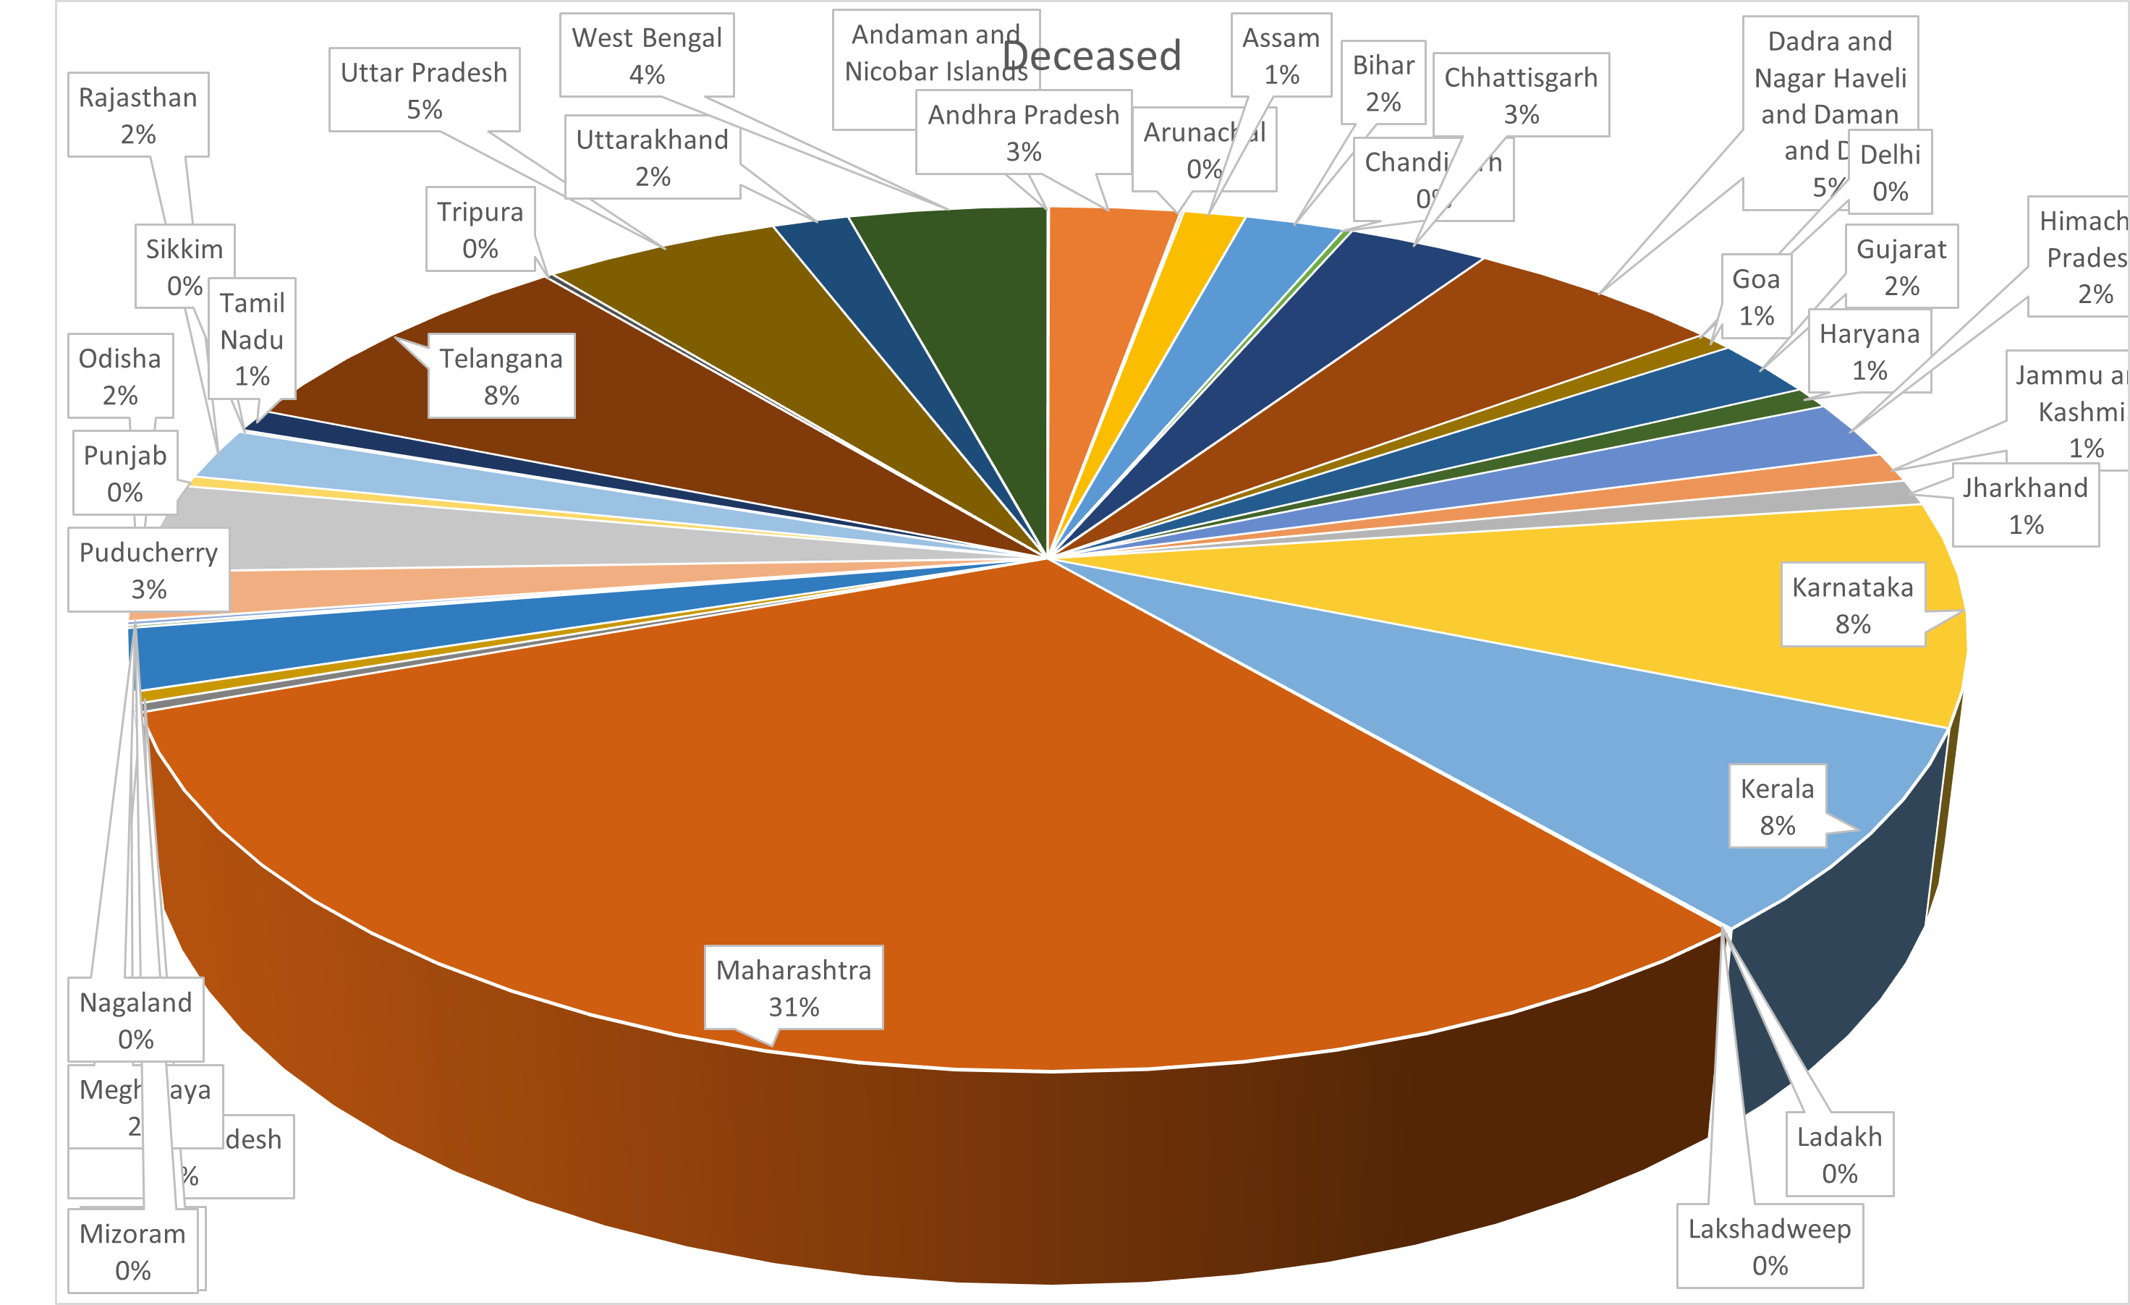
POSITIVE CASES AND FATALITIES
CONFIRMED
DECEASED

Slide 10
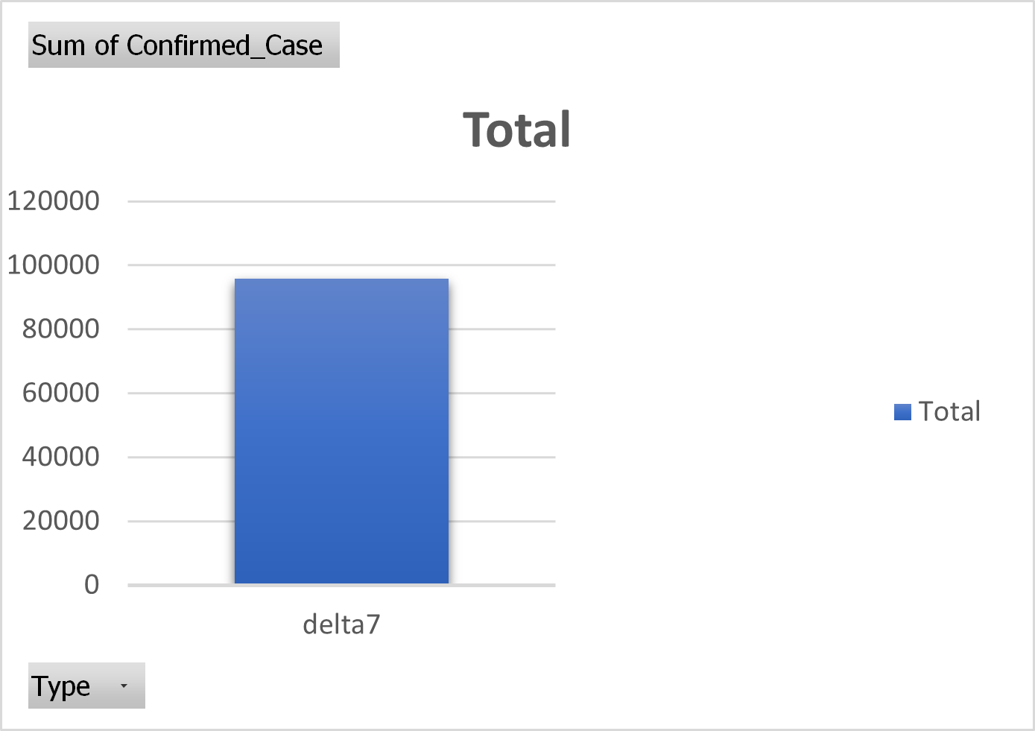
DELTA7 CONFIRMED CASE:
This visual represents the number of Delta 7 cases in India.
It provides important information for public health officials
They can monitor and respond to the spread of this COVID-19 variant in the country.

Slide 11
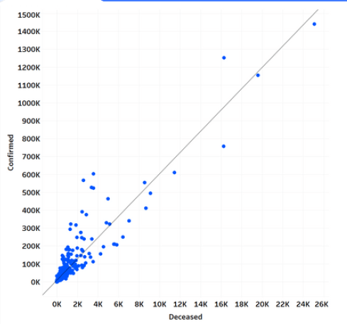
RELATION BETWEEN CONFIRMED AND DECEASED
The observed direct correlation between confirmed cases and deceased individuals underscores the critical need for effective public health measures to control the spread of COVID-19. This highlights the urgency of implementing preventative measures and interventions to reduce the number of confirmed cases and, subsequently, the number of fatalities.

Slide 12
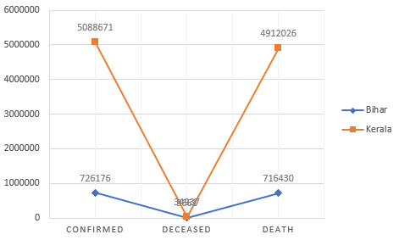
BIHAR VS KERALA
KERALA HAS A HIGHER NUMBER OF CONFIRMED AND DECEASED CASES COMPARED TO BIHAR REGION,
WHILE THE DEATH PERCENTAGE REMAINS CONSISTENT.
THIS HIGHLIGHTS THE NEED FOR CONTINUED MONITORING AND ANALYSIS TO INFORM
PUBLIC HEALTH INTERVENTIONS.

Slide 13
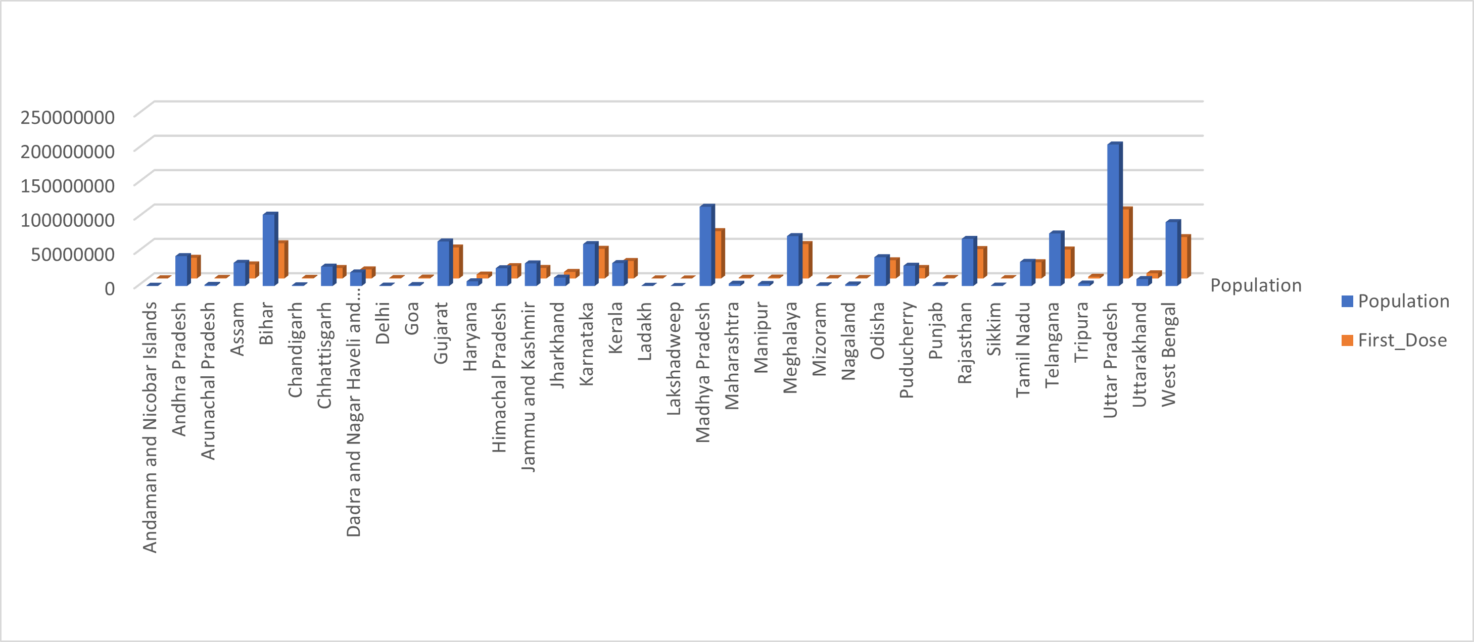
POPULATION VS VACCINE Comparison per state and UT’s

Slide 14
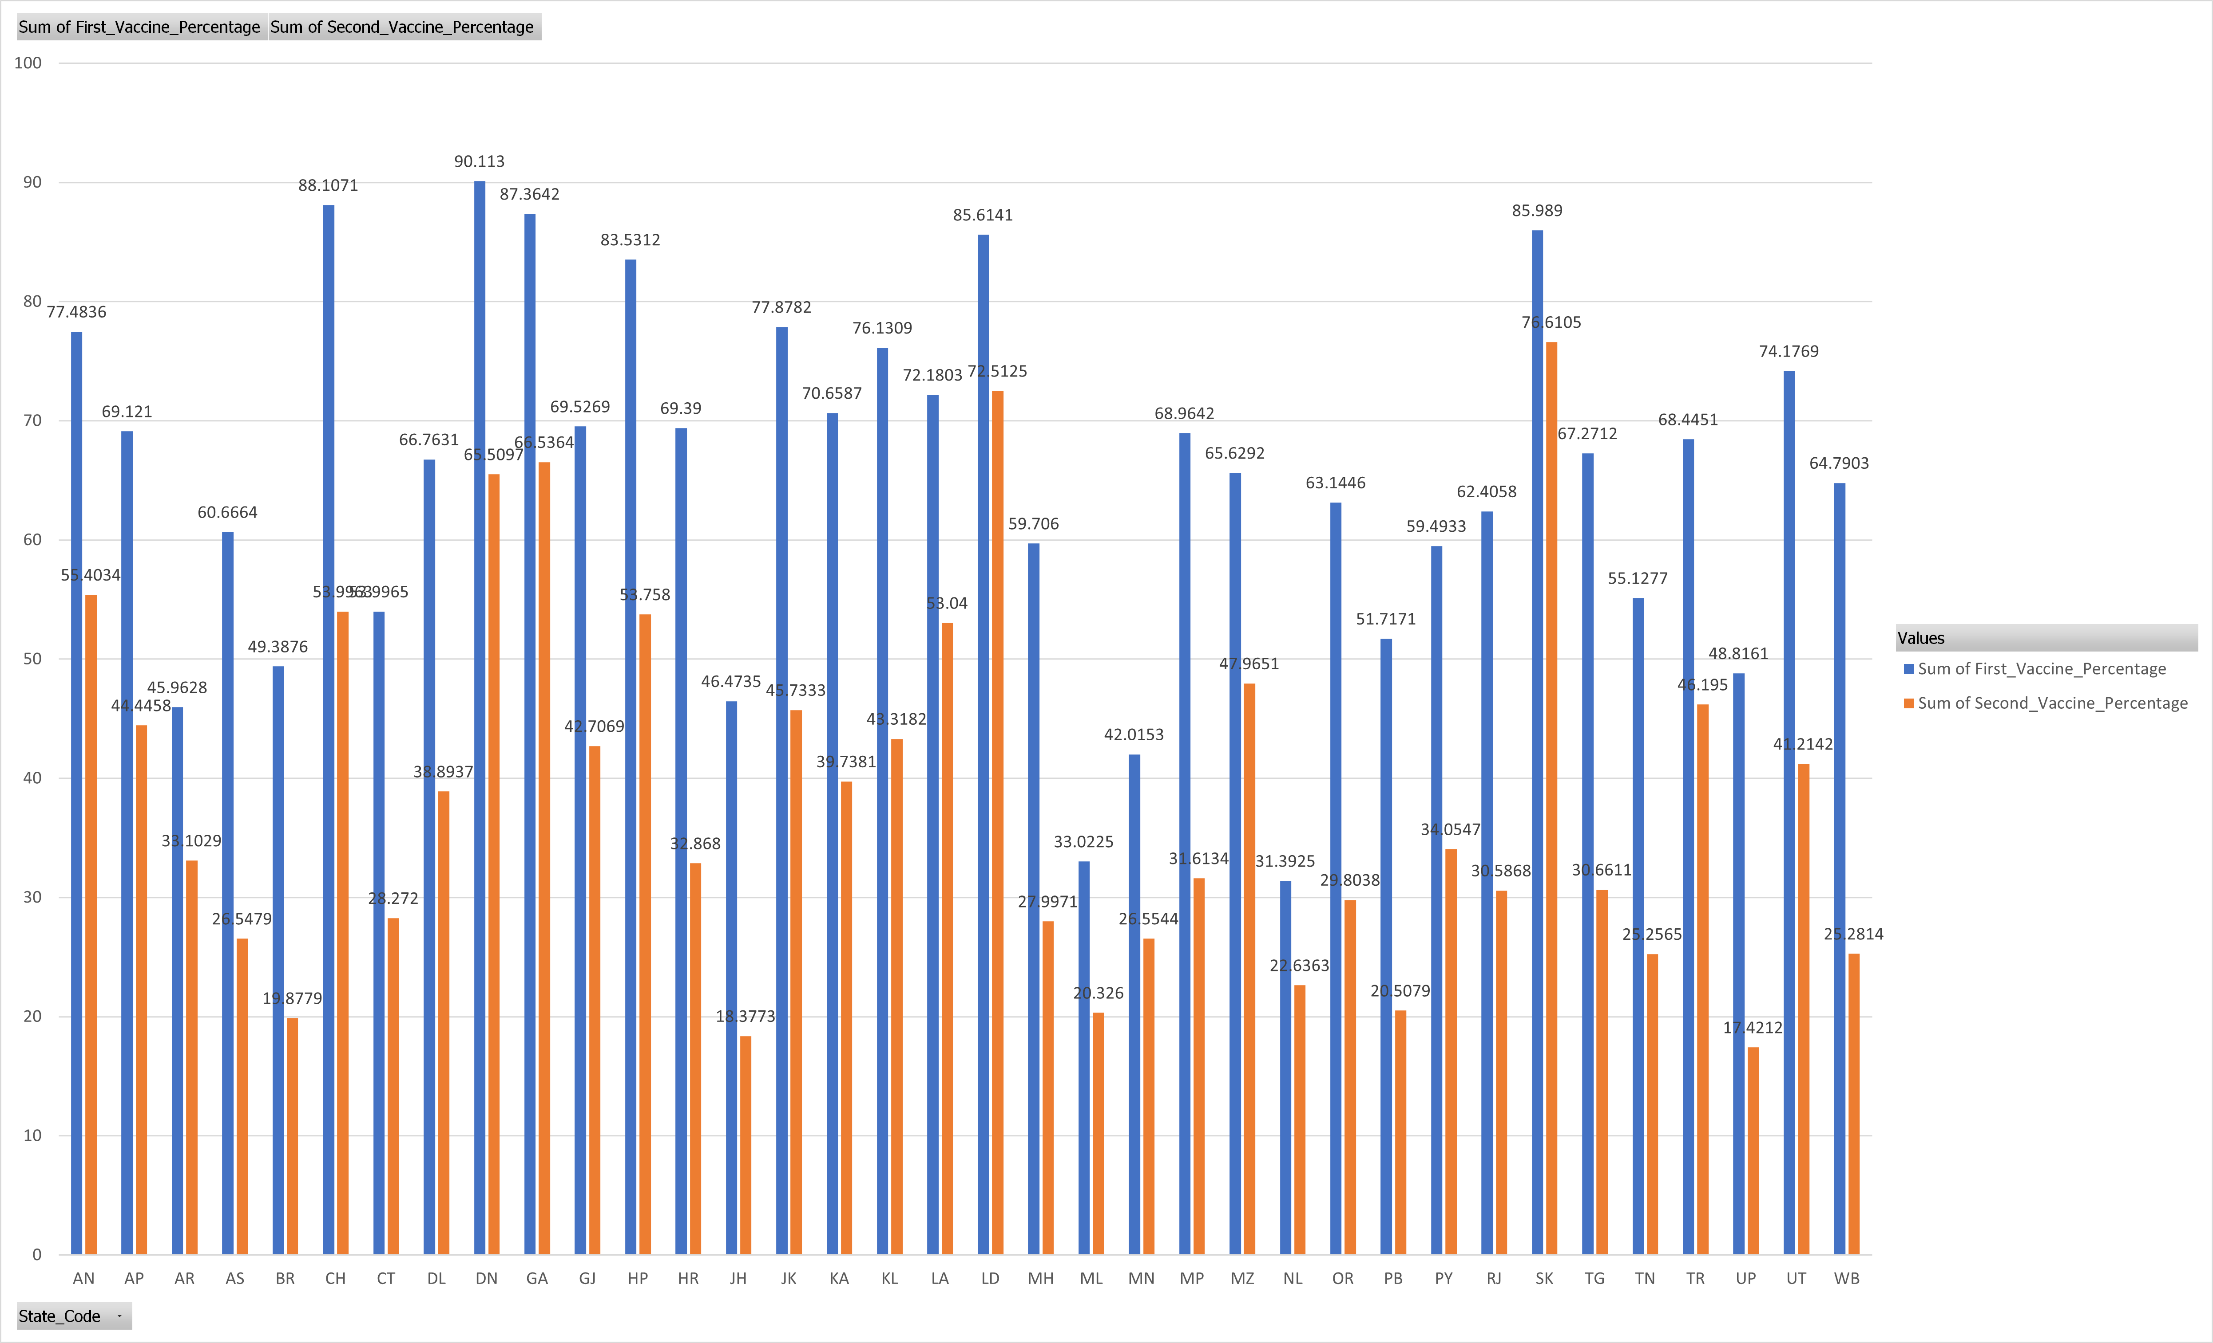
VACCINATIONS SHOTS:
This bar chart displays the number of people in each district who have received both doses of the COVID-19 vaccine.
It provides valuable information for public health officials and policymakers to assess vaccination coverage
and identify areas that require additional outreach and resources to increase vaccine uptake.

Slide 15
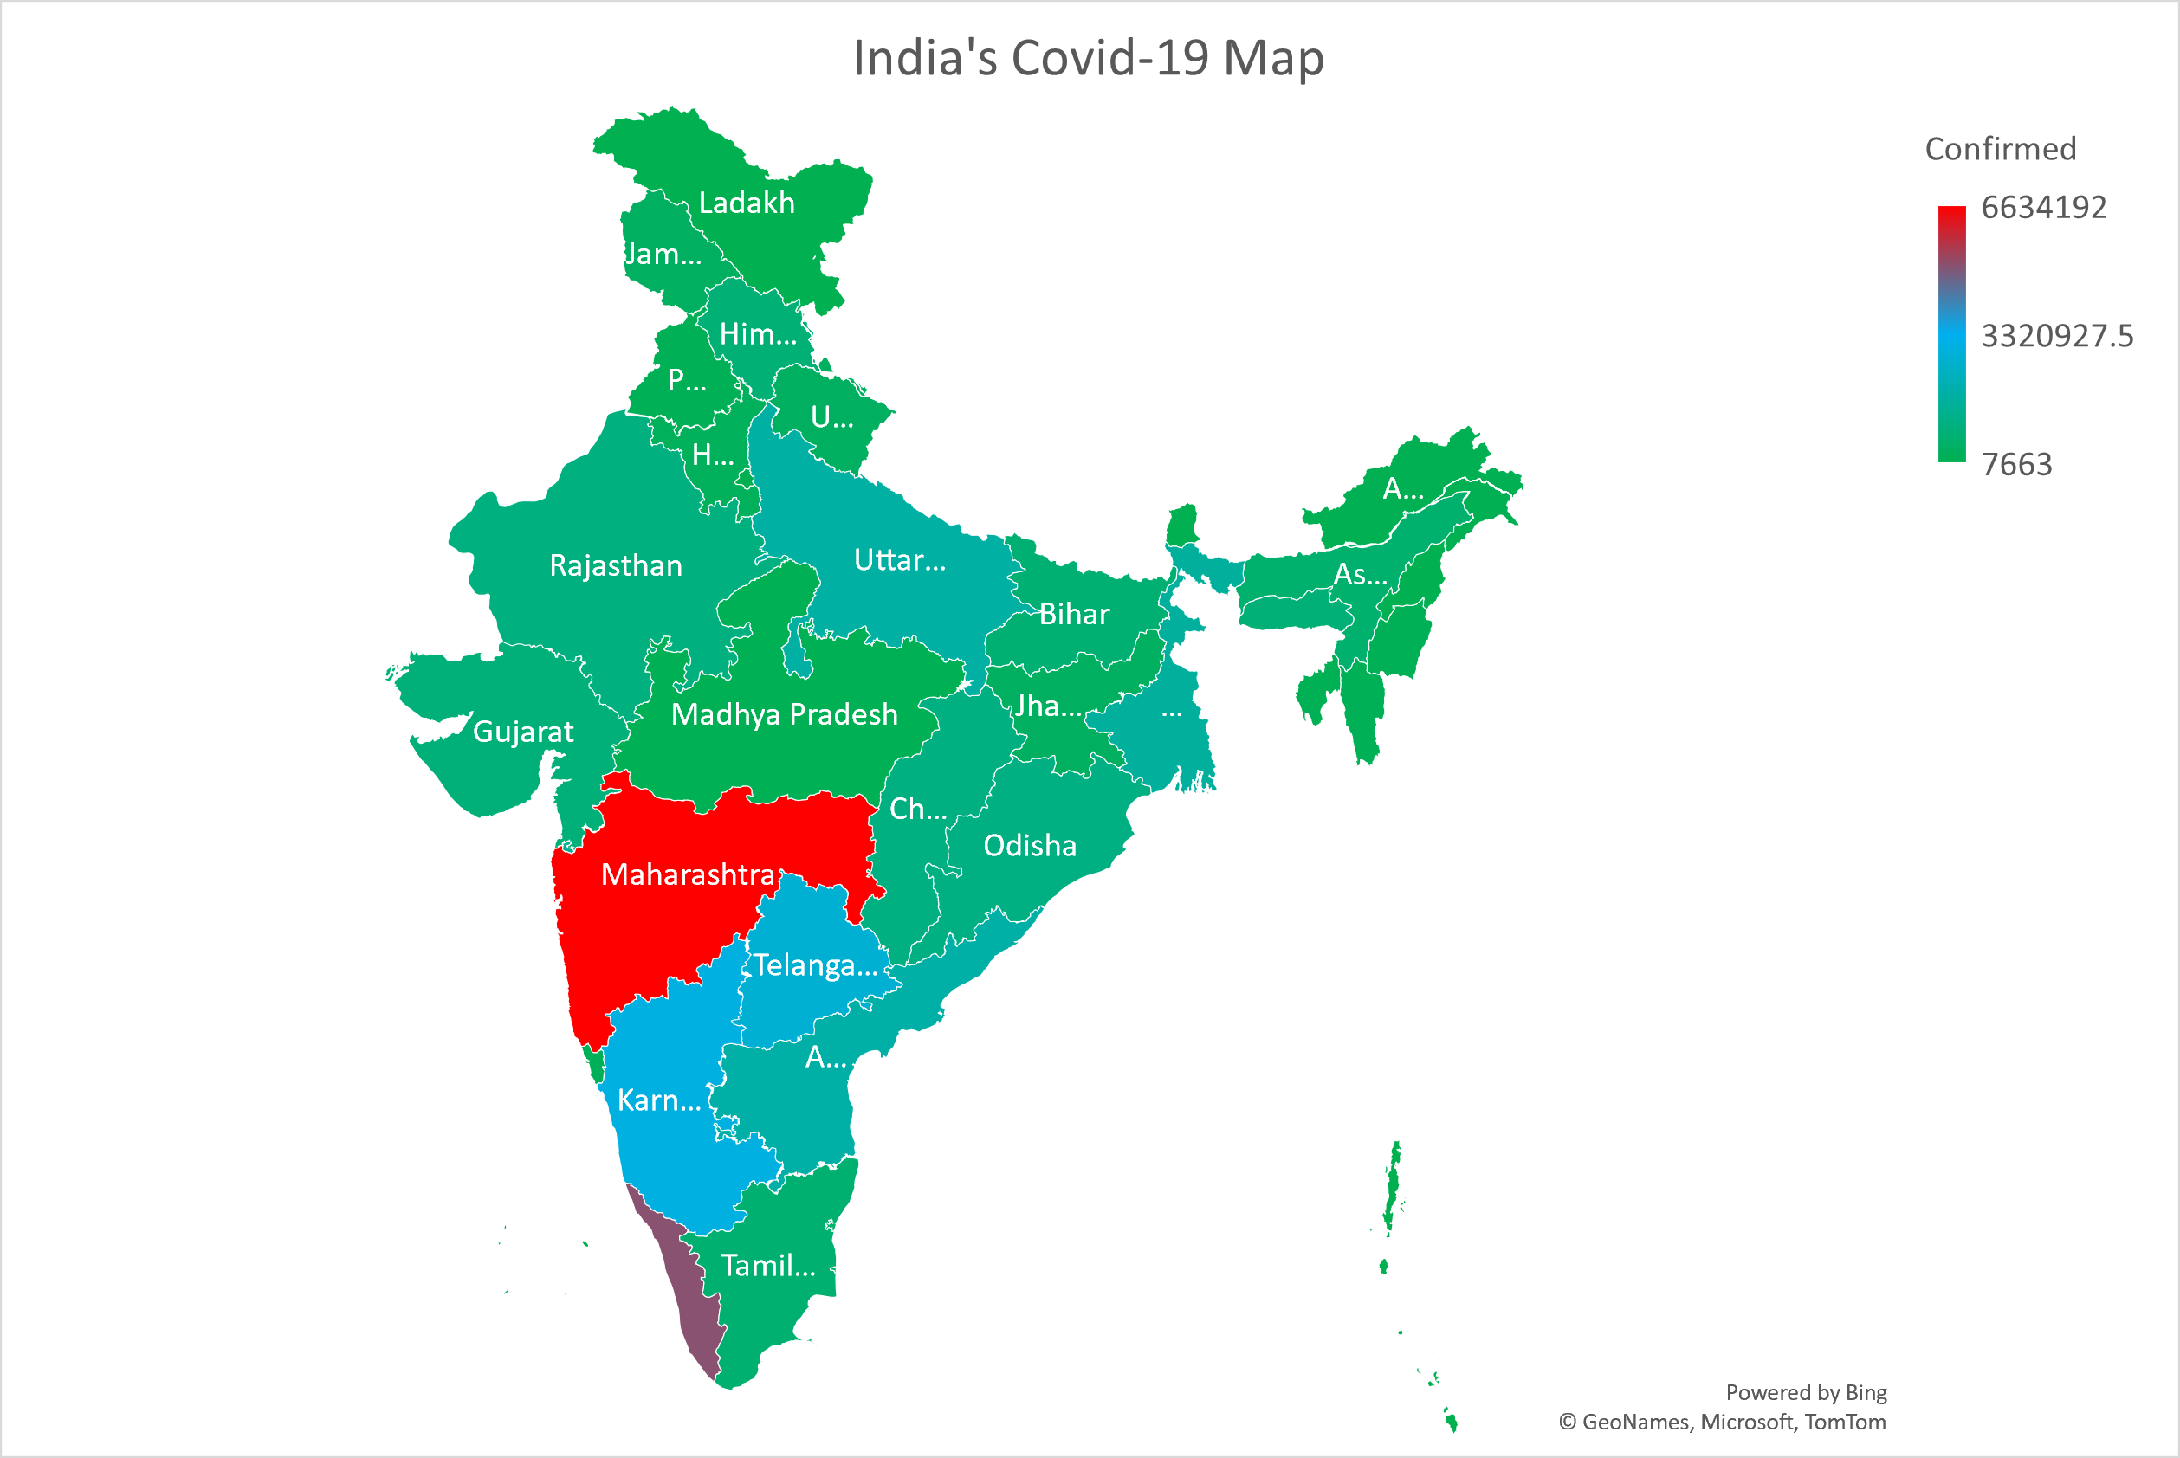
INDIA’S COVID-19 MAPS
The India map shows the highest
number of confirmed COVID-19
cases in red, followed by
medium-range cases in blue
and the lowest number of
cases is in green. This visual
representation can assist
public health officials in
identifying areas with the
The highest burden of
COVID-19 and allocating
resources accordingly.

Slide 16
COMPLICATIONS AND TROUBLES:
Data from different sources may need to be integrated or merged, which can be challenging if the data is stored in different formats or structures.
There are many tools available for data extraction, but choosing the right tool for a particular task can be challenging.
Extracted data may need to be transformed into a different format or structure to be useful for analysis.
There are many tools available for data extraction, but choosing the right tool for a particular task can be challenging.

Slide 17
MEASURES:
More and more testing should be our priority whenever this kind of unknown pandemic erupts.
Places with high population density should have strict rules to avoid further spread.
To prevent the spread of COVID-19, it is essential to take preventive measures such as getting vaccinated, wearing a mask, washing hands frequently, practicing physical distancing, and avoiding large gatherings.

Slide 18
CONCLUSION:
COVID-19 is a highly contagious respiratory illness caused by the SARS-CoV-2 virus. It has caused a global pandemic with significant social and economic impacts.
States or UTs with high population density were mostly affected more and States or UTs with less migration or isolated from big cities or states were less affected.
The virus spreads primarily through respiratory droplets when an infected person talks, coughs, or sneezes. The symptoms of COVID-19 can range from mild to severe and can include fever, cough, fatigue, and loss of taste or smell.
Vaccines are highly effective in preventing severe illness, hospitalization, and death from COVID-19, and everyone eligible should get vaccinated as soon as possible.

Slide 19
THANK YOU

