Slide 1
1강
개발환경 구축과 HTML/CSS

Slide 2
개발환경
Company LOGO
Bullet point
  Sub Bullet
AWS(Amazon Web Service) EC2
Linux(Ubuntu)
Python-Flask
PostgreSQL
Sublime Text 2

Slide 3
AWS 시작하기
Company LOGO
Aws.amazon.com
따라하세용
putty, puttyGen
→http://www.chiark.greenend.org.uk/~sgtatham/putty/download.html
Bullet point
  Sub Bullet

Slide 4
서버 세팅
Company LOGO
Sudo apt-get install postgresql postgresql-server-dev-all
→ DB Management Tool(ORDBMS)
Sudo apt-get install python-dev python-pip
→ python-dev: package for development
→ python-pip: A tool for installing and managing python packages
sudo pip install psycopg2
→ python-postgresql library
Sudo pip install flask
→ web framework for python
Bullet point
  Sub Bullet

Slide 5
서버 세팅(cont.)
Company LOGO
Sudo pip install SQLAlchemy
→ python SQL Toolkit
Sudo pip install flask-SQLalchemy
→ Extension of flask which is connecting SQLalchemy
Bullet point
  Sub Bullet

Slide 6
리눅스의 기본적인 명령어
Company LOGO
Cd (change directory)
Sudo
Ls (list files)
Top (show process)
Mv (move file or directory)
Rm (remove *)
Mkdir (make directory)
Vi (vi text editor)
Ps, kill (process kill), lsof -i
실습1 루트로 가보기
실습2 홈페이지가 만들어질 디렉토리 만들기
실습3 vi로 헬로월드 출력하기
Bullet point
  Sub Bullet

Slide 7
헬로 월드 웹페이지에 출력하기
Company LOGO
[hello.py]
from flask import Flask
app = Flask(__name__)
@app.route(‘/’)
def hello_world():
  return ‘Hello World!’
if __name__ == ‘__main__’
app.run(debug=True, host=‘0.0.0.0’)
Bullet point
  Sub Bullet

Slide 8




정리
Company LOGO
Postgre SQL
Bullet point
  Sub Bullet
SQLAlchemy
Python
port 5000
hello.py
Flask
웹서버, 프레임워크
Linux
SERVER

Slide 9
코딩 환경(텍스트 편집기)
Company LOGO
Vi (Vim), Emacs – Linux Editor (in session)
Apatana Studio, Sublime Text – Windows Editor
  Apatana Studio – Synchronous FTP
  Sublime Text – Asynchronous FTP
저사양의 실행환경(서버)에서는 Asynchronous FTP를 추천
Bullet point
  Sub Bullet

Slide 10
코딩 환경(텍스트 편집기)
Company LOGO
Bullet point
  Sub Bullet
Vim, Emacs
Aptana
Sublime
Linux
Windows, Mac
SERVER
CLIENT

Slide 11
서브라임 텍스트로 쉽게 작업하기
Company LOGO
http://www.sublimetext.com/
폴더 생성 → SFTP/FTP → Map to Remote
upload_on_save: True
sync_skip_deletes: True
host: AWS Sever Ip Address
user: Ubuntu
remote_path: 받을 디렉토리 주소
ssh_key_file: private key directory
C:\\Users\\yu\\Documents\\HTML,CSS,PHP,Mysql,JQuery,Server\\Server Key Files\\shcoach\\shcoach_official.ppk
remote_encoding: UTF-8
Bullet point
  Sub Bullet

Slide 12

잠깐! 권한에 대해서
Company LOGO
chmod와 chown
소유자, 그룹, 다른 사용자
ls –l : 세부 목록 표시
ex)
read, write, execute 권한 (100,010,001)
sudo chown ubuntu:ubuntu [파일,디렉토리명]
Bullet point
  Sub Bullet

Slide 13
잠깐! 권한에 대해서
Company LOGO
ex)
sudo chmod 755 [파일,디렉토리명]
-R (Recursive) : 하위 파일,디렉토리에도 적용
Bullet point
  Sub Bullet

Slide 14
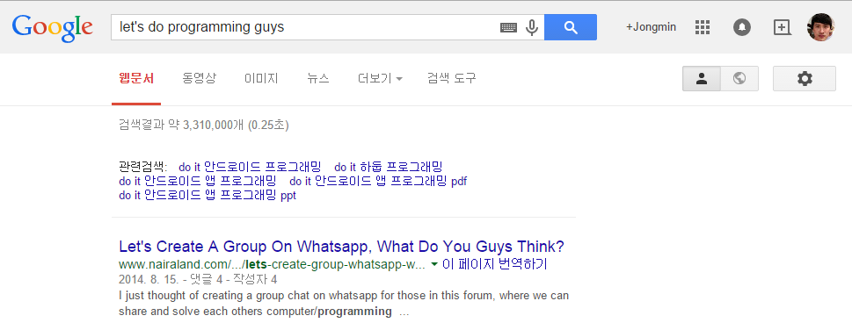
홈페이지의 Layout
Company LOGO
Bullet point
  Sub Bullet

Slide 15
홈페이지의 Layout
Company LOGO
Bullet point
  Sub Bullet
<html> - identifier, root of document
<head> - title, style, link, script, meta..
<body>
  <header>
  <footer> - X
http://www.w3schools.com/tags/default.asp

Slide 16
홈페이지의 Layout
Company LOGO
<header>
<div><img></img><input /></div>
<div><a></a><img></img></div>
</header>
<body>
<div id=“category”>
<div><ul><li></li>..</ul></div>
<div><input /></div>
</div>
<div id=“main-wrap”>
<p></p>
<span></span>
</div>
</body>
<footer> - X
Bullet point
  Sub Bullet

Slide 17
본격 홈페이지 구조 만들기
Company LOGO
디렉토리구조
- [Homepage name]
- static (static assets, css..)
- templates (layout and pages)
- __init__.py (initiater)
Bullet point
  Sub Bullet

Slide 18
본격 홈페이지 구조 만들기(cont.)
Company LOGO
MVC 패턴 (Model View Controller)
Code Igniter, Kohana
Bullet point
  Sub Bullet
Model
Updates
Manipulates
View
Controller
User
Sees
Request

Slide 19


본격 홈페이지 구조 만들기(cont.)
Company LOGO
Bullet point
  Sub Bullet
resources
static
style.css
정적인 엘리먼트
templates
layout.py
__init__.py
동적인 페이지
웹서버 구동 및 경로 연결
home.py
동적인 페이지
board.py

Slide 20
본격 홈페이지 구조 만들기(cont.)
Company LOGO
[__init__.py]
from flask import Flask, render_template
app = Flask(__name__)
@app.route(‘/’)
def hello_world():
  return render_template(‘home.html’)
@app.route(‘/test/<tempvar>’)
def test(tempvar):
return ‘tempvar’
if __name__ == ‘__main__’
app.run(debug=True, host=‘0.0.0.0’)
Bullet point
  Sub Bullet

Slide 21
본격 홈페이지 구조 만들기(cont.)
Company LOGO
[layout.py]
<!DOCTYPE HTML>
<title>hello world</title>
<link rel=stylesheet type=text/css href="{{ url_for('static', filename='style.css') }}">
<div class=page>
<h1>Is Working???</h1>
<div class=metanav>
</div>
{% for message in get_flashed_messages() %}
<div class=flash>{{ message }}</div>
{% endfor %}
{% block body %}{% endblock %}
</div>
Bullet point
  Sub Bullet

Slide 22
본격 홈페이지 구조 만들기(cont.)
Company LOGO
[home.html]
{% extends 'layout.html' %}
{% block body %}
<p>whowhowho</p>
{% endblock %}
→ Jinja Template Engine
Bullet point
  Sub Bullet

Slide 23
GET과 POST (데이터의 전달)
Company LOGO
GET 방식
URL에 String을 포함하여 데이터를 전달
www.funnycoding.com/main?id=3&name=jongmin
id라는 변수와 name이라는 변수에 값을 넣어 전달
예약어의 한계 및 쿼리 스트링 길이에 제한(약2000자)
보안에 취약
POST 방식
페이지의 헤더에 String을 포함하여 전달
Bullet point
  Sub Bullet

Slide 24
Query String 실습 (GET)
Company LOGO
[__init__.py]
from flask import Flask, render_template, request
app = Flask(__name__)
@app.route(‘/’)
def hello_world():
  return render_template(‘home.html’, temp=request.args[‘temp’])
@app.route(‘/test/<tempvar>’)
def test(tempvar):
return ‘tempvar’
if __name__ == ‘__main__’
app.run(debug=True, host=‘0.0.0.0’)
Bullet point
  Sub Bullet

Slide 25
Query String 실습 (GET)
Company LOGO
[home.html]
{% extends 'layout.html' %}
{% block body %}
{{ temp }}
{% endblock %}
→ Jinja Template Engine
Bullet point
  Sub Bullet

Slide 26
POST 파라미터 전달
Company LOGO
[__init__.py]
@app.route(‘/login’)
def login():
user_id = request.form[‘user_id’]
user_pw = request.form[‘password’]
if user_id == ‘maulufia’:
if user_pw = ‘1234’:
session[‘logged_in’] = true
session[‘username’] = request.form[‘user_id’]
return ‘login success!’
else:
return ‘login failed~’
else:
return ‘login failed~’
Bullet point
  Sub Bullet

Slide 27
POST 파라미터 전달
Company LOGO
[home.html]
{% extends 'layout.html' %}
{% block body %}
<form action=“/login” method=“POST”>
<input id=“user_id” name=“user_id” type=“text” />
<input id=“password” name=“password” type=“password” />
<button type=“submit”>로그인</button>
</form>
{% endblock %}
Bullet point
  Sub Bullet

Slide 28
참고
Company LOGO
Flask Documentation
→http://flask-docs-kr.readthedocs.org/ko/latest/index.html
Jinja – template engine for python
http://jinja.pocoo.org/docs/dev/
HTML과 CSS의 기초적인 문법
→https://opentutorials.org/course/11
→http://www.codecademy.com/en/tracks/web
Bullet point
  Sub Bullet

Slide 29
참고
Company LOGO
점프 투 파이썬
https://wikidocs.net/book/1
Bullet point
  Sub Bullet

Slide 30
과제
Company LOGO
플라스크를 이용한 팀 소개 페이지 만들기(팀소개, 팀원소개, 미니게임, 등등)
- 필수조건(헤드(메뉴)를 통한 하이퍼링크, 디자인 요소)
Bullet point
  Sub Bullet

Slide 31
Company LOGO
Bullet point
  Sub Bullet
End Of Document

Slide 32
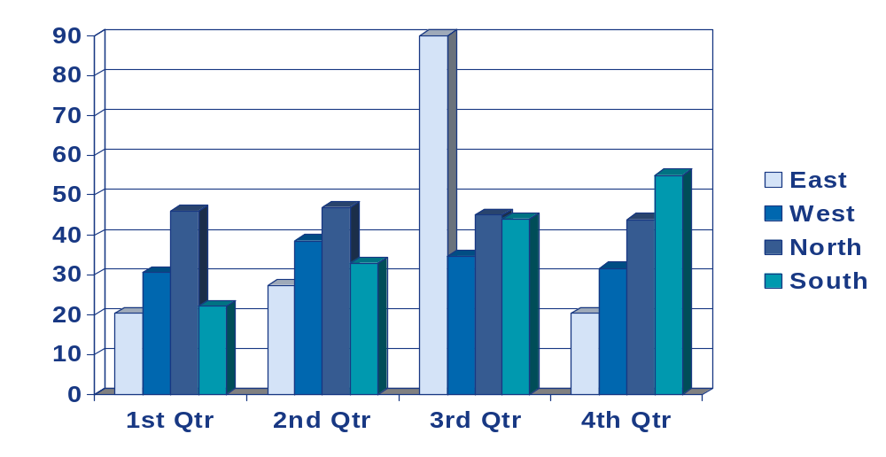
Example of a chart
Company LOGO

Slide 33

Picture slide
Company LOGO
Bullet 1
Bullet 2

Slide 34
Examples of default styles
Company LOGO
Text and lines are like this
Hyperlinks like this
Visited hyperlinks like this
Table
Text box
Text box
With shadow

Slide 35
Use of templates
Company LOGO
You are free to use these templates for your personal and business presentations.
We have put a lot of work into developing all these templates and retain the copyright in them. They are not Open Source templates. You can use them freely providing that you do not redistribute or sell them.
Do
Use these templates for your presentations
Display your presentation on a web site provided that it is not for the purpose of downloading the template.
If you like these templates, we would always appreciate a link back to our website. Many thanks.
Don’t
Resell or distribute these templates
Put these templates on a website for download. This includes uploading them onto file sharing networks like Slideshare, Myspace, Facebook, bit torrent etc
Pass off any of our created content as your own work
  You can find many more free templates on the Presentation Magazine website www.presentationmagazine.com

