Slide 1

Bengali Dialect Conversion To Standard Bengali Language Using Deep Learning
Presented By
Md. Ashab Mohiuddin (190104128)
Md. Younus Hossain Ahsan (190104131)
Md. Abid Rahman (190104141)
Fahim Ahmed (190104149)

Slide 2
Contents
Introduction
Related Works
Dataset
Future Work
Methodology
Result
Conclusion

Slide 3
Introduction
Dialect is a unique variation of a language.
Over 7,000 dialects worldwide.
Bengali Language has a rich variety of dialects.
Dialect conversion enhances universal communication.
Common Bengali dialects include Rajshahi, Noakhali, and Sylhet etc.

Slide 4
Related Works
Paper | Summery
Paper 1 | Islam et al. has used Encoder-Decoder based RNN method with attention and sequence to sequence learning model in their work translating Bangla to English and they have achieved 75% precision.
Paper 2 | Dhar et al. has used a transformer model consisting of NN based encoders and decoders and has achieved a BLEU score of 21.33.
Paper 3 | Zahurul et al. has used a phrase-based Statistical Machine Translation (SMT) system that translates English sentences to Bangla and they have achieved a BLEU score of 11.7 for long sentences and for short sentences it is 23.3.

Slide 5
Related Works
Paper | Summery
Paper 4 | Parida et al. has developed a Multimodal Machine Translation (MMT) utilizing bi-lingulal text for English to Bangla and achieved 51.1 BLEU score.
Paper 5 | Jawaid et al. [11] has built baseline phrase-based MT (PBMT) and hierarchical MT systems where hierarchical MT significantly outperformed PMT. The highest single reference BLEU score is achieved by the hierarchical system and reaches 21.58%.

Slide 6
Dataset
We gathered 686 words and sentences, but our model didn't improve.
We filtered and added sentences with at least 4 words to our dataset.
We now have 420 sentences in our dataset.
Our dataset was verified by:
Name: Md. Nurul Hasnat Fahim
Home District: Laxmipur
Department: Finance
Year: 4th Year
Institution: Govt. Titumir College, Dhaka

Slide 7
Future Work
Will try to add more popular dialects in the model.
Try to add more data related to Noakhali dialect.
Try to improve the BLEU score of the model.

Slide 8
Methodology
Data preprocessing:
Excluding sentences with words out of dictionary.
Each sequence must have at most 30 words.
Excluding punctuation marks except question mark

Slide 9
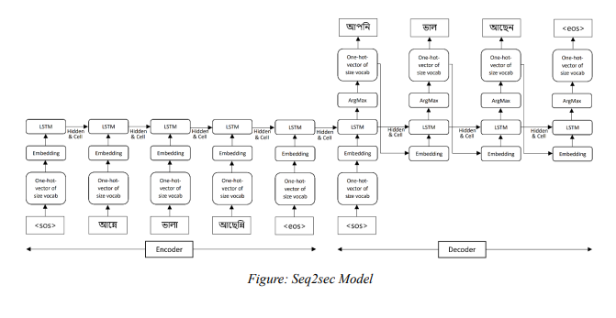
Methodology
Seq2seq Model:

Slide 10
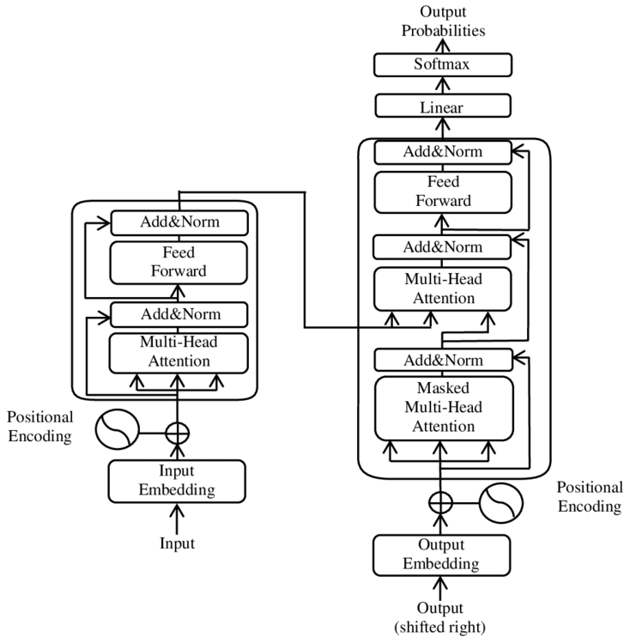
Methodology
Transformer Model:

Slide 11
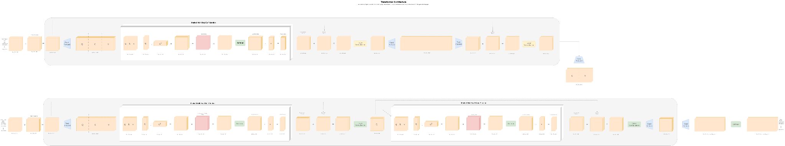
Methodology
In-depth Architecture:

Slide 12
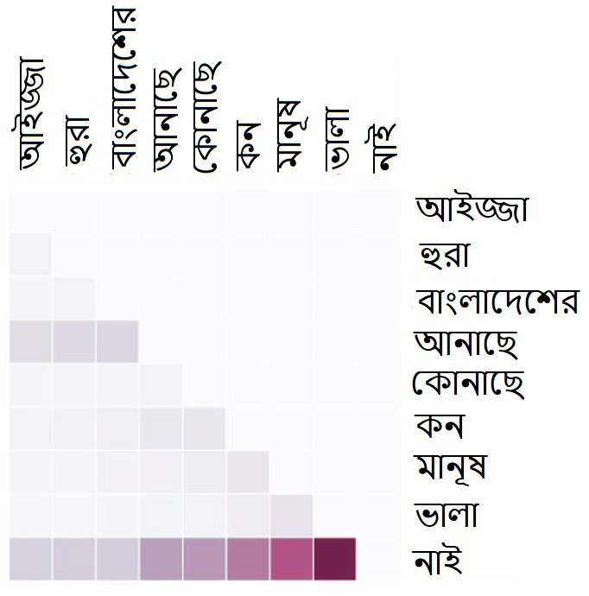
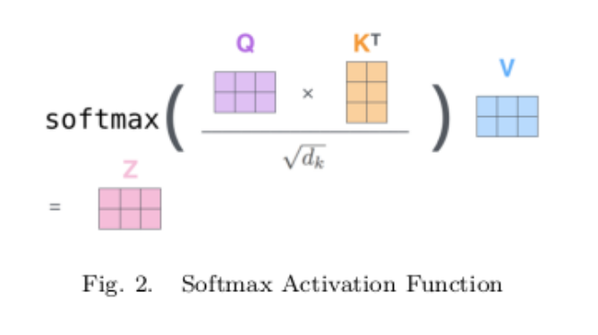
Methodology
Self-Attention & Cross-Attention:

Slide 13
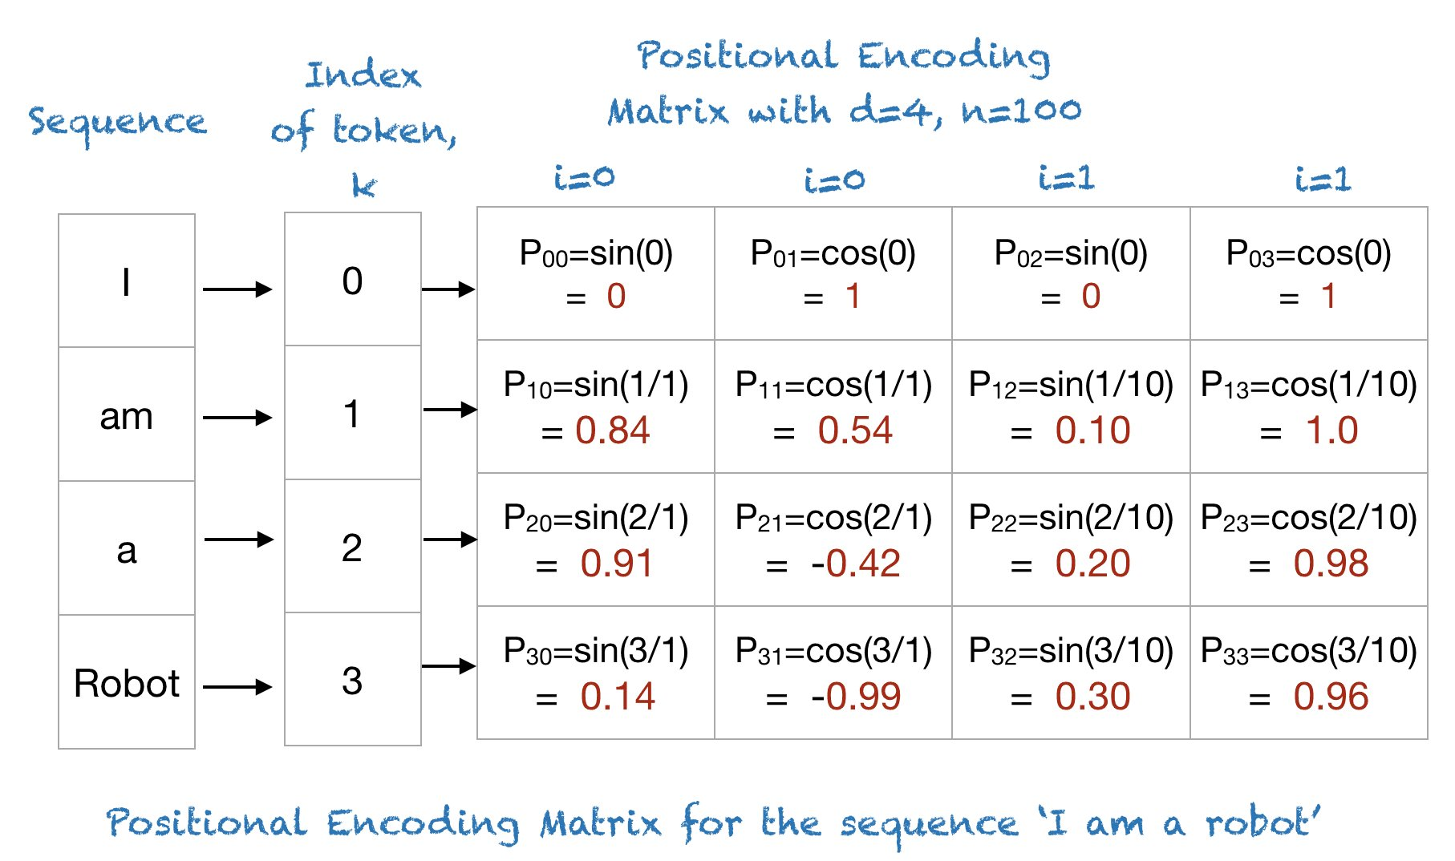
Methodology
Positional Encoding:

Slide 14
Methodology
Encoder only uses padding mask.
Decoder uses both padding and attention masks.

Slide 15
Methodology
Hyper-parameters:
500 epochs
0.1 learning rate
8 attention heads 512 embedding output and model-dimension
142 one hot vector and 5 layers of encoder and decoders
30x30 attention units
100 batch-size
feed-forward in encoder output size 2048

Slide 16
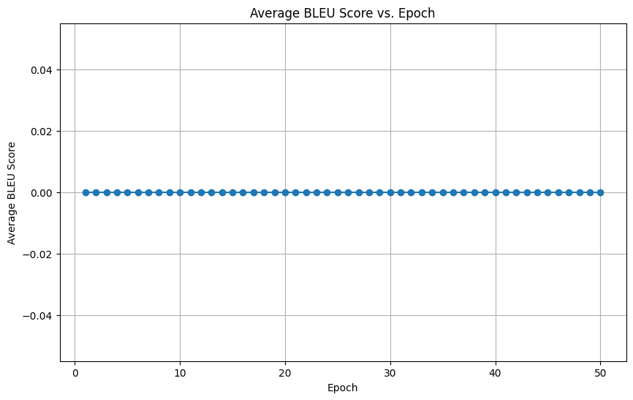
Result
Seq2seq:
Poor performance relative to others
BanglaBert:
Fine-tuning it could achieve great result for technical limitation

Slide 17
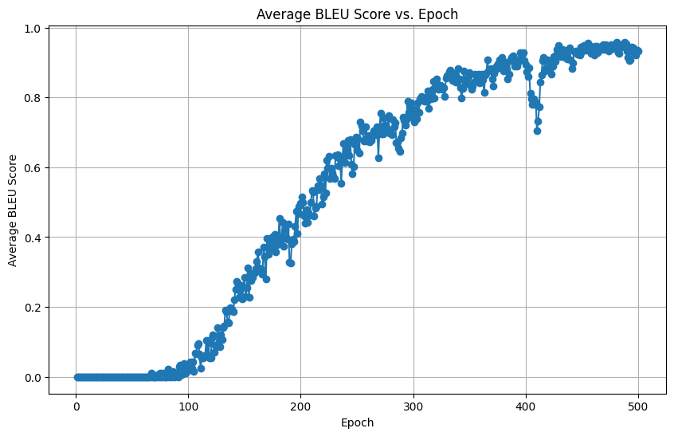
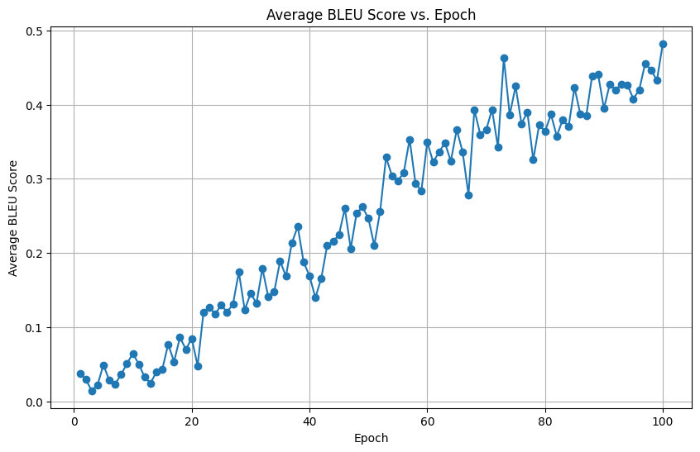
Result
Transformer Model with train dataset:
Figure: 500 epochs Figure: 100 epochs

Slide 18
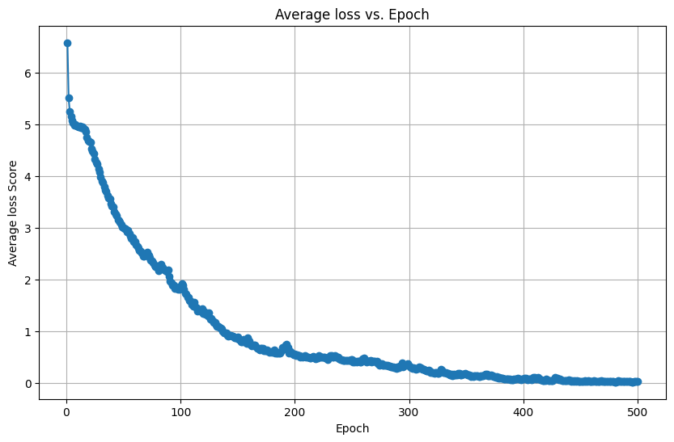
Result
Transformer Model with train dataset:
Average Loss for every epoches

Slide 19
Result
Transformer Model with validation dataset:

Slide 20
Conclusion
Limited work on Noakhali Dialect to Standard Bangla Language Translation.
Rare research, unique dataset creation.
Seq2seq performed poorly for translation.
BanglaBert fine-tuning not successful.
Transformer model outperformed others.
Validation data didn't achieve great performance.
Future research explores various approaches.

