Slide 1
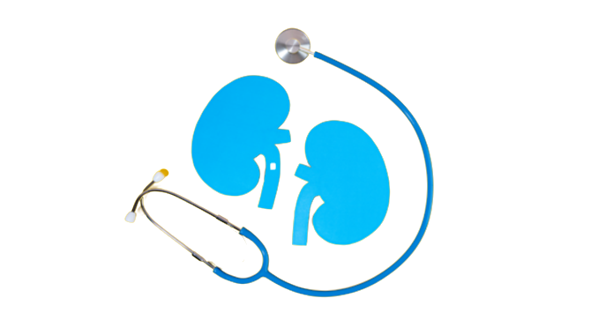
Chronic Kidney Disease (CKD) Detection
Presented by:
Md. Ashab Mohiuddin - 190104128
Md. Younus Hossain Ahsan - 190104131
Md. Abid Rahman - 190104141
Fahim Ahmed - 190104149

Slide 2
Introduction
CKD is characterized by a gradual loss of kidney function over time.
Primary causes of CKD include diabetes, high blood pressure, heart disease, and family history.
The study employs Random Forest (RF), Support Vector Machine (SVM), and Decision Tree for CKD detection.
The study addresses the challenge of treatment recommendations, taking into account the varying severity of CKD.

Slide 3
Related Works
Paper | Summary
paper1 | Charleonnan et al.’s [8] study on the Indian Chronic Kidney Disease dataset found SVM to be the most effective predictive model, achieving 98.3% accuracy and 0.99 sensitivity.
paper2 | Salekin et al.’s [9] tested K-NN, RF, and ANN on 400 datasets, with RF achieving the highest classification accuracy of 98\% with a RMSE of 0.11.
paper3 | S. Tekale et al. [10] used machine learning algorithms to predict chronic kidney disease using a preprocessed dataset with 14 features, with SVM showing a 96.75% accuracy rate.
paper4 | Xiao et al. [11] compared various models for predicting chronic kidney disease progression using 551 patients' data. They found logistic regression performed better with an AUC of 0.873 and sensitivity and specificity of 0.83 and 0.82, respectively.

Slide 4
Dataset
Attributes: 10
Instances: 1200+
Vital Attributes: Patient age, Blood pressure (bp), Sugar level (su).
Source: Kaggle, GitHub repositories, and some other hospital resources.

Slide 5
Methodology [1]
Feature Extraction:
Performs several tasks like preprocessing, feature selection, and visualization using the Pandas, scikit-learn, Seaborn, and Matplotlib libraries.
Columns which contain categorical values need to be converted.
The use of chi-square is utilized to provide additional data for classification.
Machine learning models:
We used various machine learning models like Logistic Regression, KNN, SVM, and Decision Tree.

Slide 6
Methodology [2]

Slide 7
Result [1]
Machine Learning Models | Accuracy
Logistic Regression | 75.23%
Random Forest | 78.55%
SVM | 79.51%
Decision Tree | 70.35%

Slide 8
Result [2]
Classification Report For Logistic Regression:
 | Precision | Recall | F1-Score
0 | 0.73 | 0.92 | 0.81
1 | 0.95 | 0.04 | 0.02

Slide 9
Result [3]
Classification Report For Random Forest:
 | Precision | Recall | F1-Score
0 | 0.73 | 0.92 | 0.81
1 | 0.95 | 0.04 | 0.02
 | Precision | Recall | F1-Score
0 | 0.68 | 0.84 | 0.76
1 | 0.62 | 0.40 | 0.48

Slide 10
Result [4]
Classification Report For Support Vector Machine:
 | Precision | Recall | F1-Score
0 | 0.73 | 0.92 | 0.81
1 | 0.95 | 0.04 | 0.02
 | Precision | Recall | F1-Score
0 | 0.68 | 0.84 | 0.76
1 | 0.62 | 0.40 | 0.48
 | Precision | Recall | F1-Score
0 | 0.66 | 0.91 | 0.72
1 | 0.69 | 0.29 | 0.40

Slide 11
Result [5]
Classification Report For Decision Tree:
 | Precision | Recall | F1-Score
0 | 0.73 | 0.92 | 0.81
1 | 0.95 | 0.04 | 0.02
 | Precision | Recall | F1-Score
0 | 0.68 | 0.84 | 0.76
1 | 0.62 | 0.40 | 0.48
 | Precision | Recall | F1-Score
0 | 0.66 | 0.91 | 0.72
1 | 0.69 | 0.29 | 0.40
 | Precision | Recall | F1-Score
0 | 0.67 | 0.66 | 0.66
1 | 0.49 | 0.50 | 0.50

Slide 12
Result [6]
Classification Report For KNN:
 | Precision | Recall | F1-Score
0 | 0.73 | 0.92 | 0.81
1 | 0.95 | 0.04 | 0.02
 | Precision | Recall | F1-Score
0 | 0.68 | 0.84 | 0.76
1 | 0.62 | 0.40 | 0.48
 | Precision | Recall | F1-Score
0 | 0.66 | 0.91 | 0.72
1 | 0.69 | 0.29 | 0.40
 | Precision | Recall | F1-Score
0 | 0.68 | 0.74 | 0.71
1 | 0.53 | 0.46 | 0.49
 | Precision | Recall | F1-Score
0 | 0.67 | 0.66 | 0.66
1 | 0.49 | 0.50 | 0.50

Slide 13
Conclusion
CKD should be diagnosed at an early stage.
After being diagnosed with CKD, the patient needs proper treatment by a doctor, and the patient should follow the advice of the doctor.
Must control all the parameters that are related to CKD.
Prevention is better than cure. To prevent CKD, maintain a healthy lifestyle.
In a single day, a person should drink 5 liters of water to maintain the good functionality of the kidneys.

Slide 14
Future Work
Add more data for better classification of CKD.
Will also try other classification models to classify CKD according to the large scale of data.
Will also try for other diseases that people can be benefited from it.

Slide 15


