Slide 1
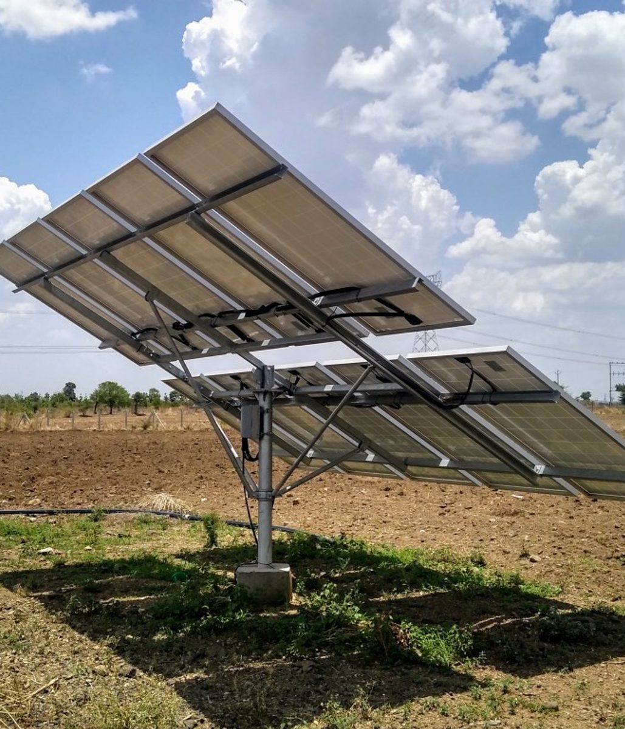
SOLAR SMART IRRIGATION
SOLAR · SENSORS · VOICE AI
The right amount of water, at the right time, powered by the sun and controlled by a phone call.
Sustainable development
AI and automation
Photo: Shailsh Telang (CC BY-SA 4.0) · Wikimedia Commons
Notes:
Title slide. Solar-powered, sensor-driven irrigation that a farmer can control with a phone call. Photo shows a real solar water-pump array on an Indian farm.

Slide 2
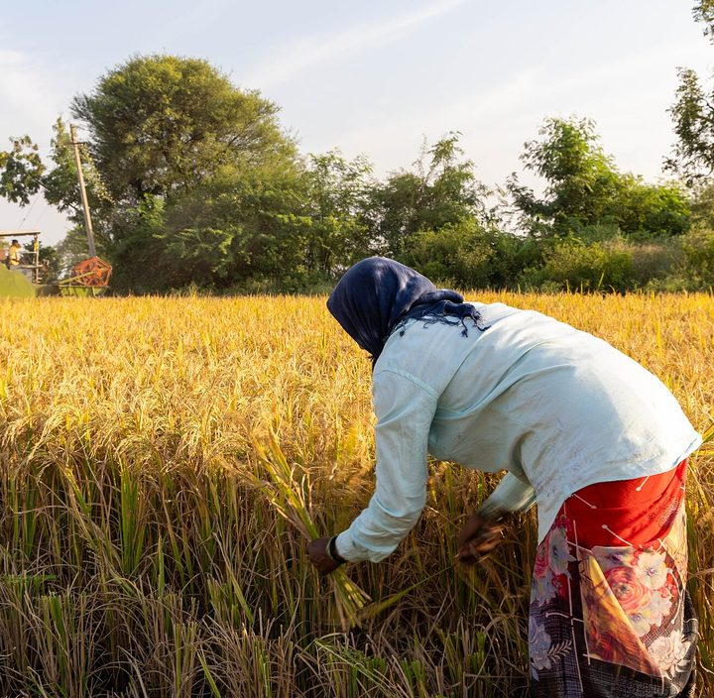
The problem on small farms, in numbers
01 · PROBLEM
14 lakh
~87%
standalone solar pumps targeted under PM-KUSUM Component B
of the groundwater India extracts goes to agriculture
Rajya Sabha reply, Feb 2025
CGWB groundwater assessment
30–60%
~85%
less water with drip than flood irrigation, depending on crop and study
of Indian landholders are small and marginal farmers
India Water Portal; Vikaspedia
NSSO, 2014, via Vikaspedia
Our goal: give small farmers a pump that decides for itself, runs on sunlight, and explains why.
Photo: Nanditha Gogate, WELL Labs (CC BY-SA 4.0) · Wikimedia Commons
Notes:
Context numbers. PM-KUSUM Component B target is 14 lakh standalone solar pumps (Rajya Sabha reply, 4 Feb 2025). Groundwater and landholder shares come from secondary summaries of CGWB and NSSO data; verify against the original reports before presenting formally. Drip savings vary widely by crop and region.

Slide 3



The farmer’s daily risk
01 · PROBLEM
SNAKEBITE · NALGONDA
ELECTROCUTION · BHUPALPALLY
FALLING GROUNDWATER
A 41-year-old farmer died of a snakebite while checking his field during power cuts.
A father and son were electrocuted by a live wire while switching on a motor at a farm well.
Groundwater is falling, borewells have run dry, and outages have sparked farmer protests.
Source: Telangana Today
Notes:
Real incidents reported by Telangana Today: a snakebite during a power cut in Nalgonda, an electrocution at a farm well in Bhupalpally, and falling groundwater. A pump that can be started by phone removes the need to walk to the field in the dark.

Slide 4
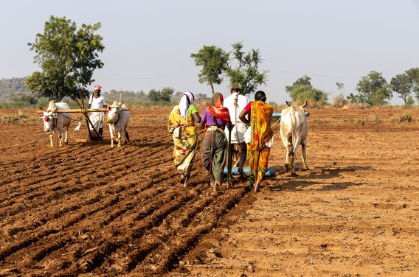
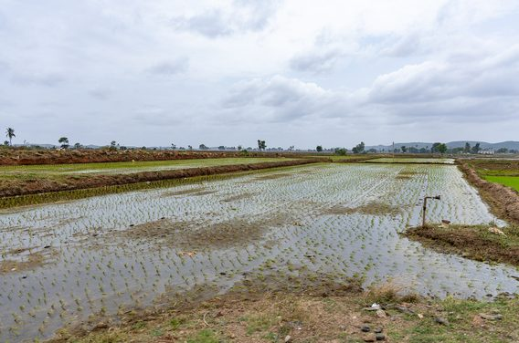
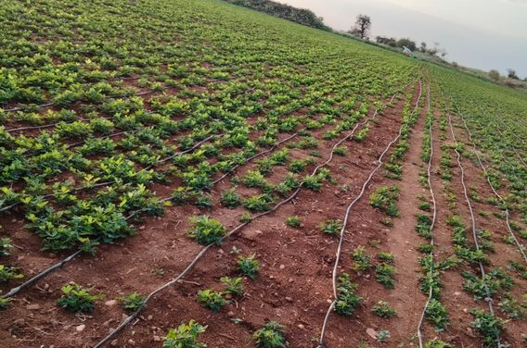
Built for the crops farmers actually grow
01 · PROBLEM · WHERE IT APPLIES
Groundnut sowing
Paddy on borewell water
Drip-irrigated groundnut
Water-sensitive at flowering and pod fill; too much water invites rot.
Fields are flooded from borewells; alternate wetting and drying can cut pumping.
Drip lines deliver water at the roots, a natural fit for sensor-driven zones.
Photo: N. Gogate, V. Acharya (WELL Labs); N. Lakshmi Devi · CC BY-SA 4.0 · Wikimedia Commons
Notes:
Photos are from Karnataka and elsewhere in India; the crops (groundnut and paddy) match the crops targeted by the prototype. Caption each photo with its actual location.

Slide 5
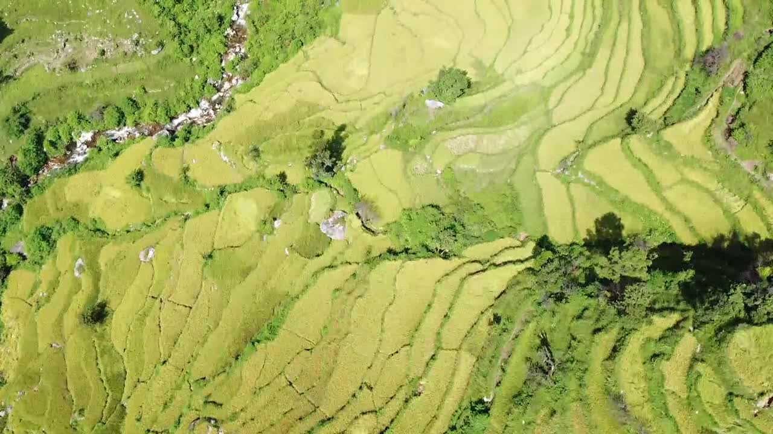
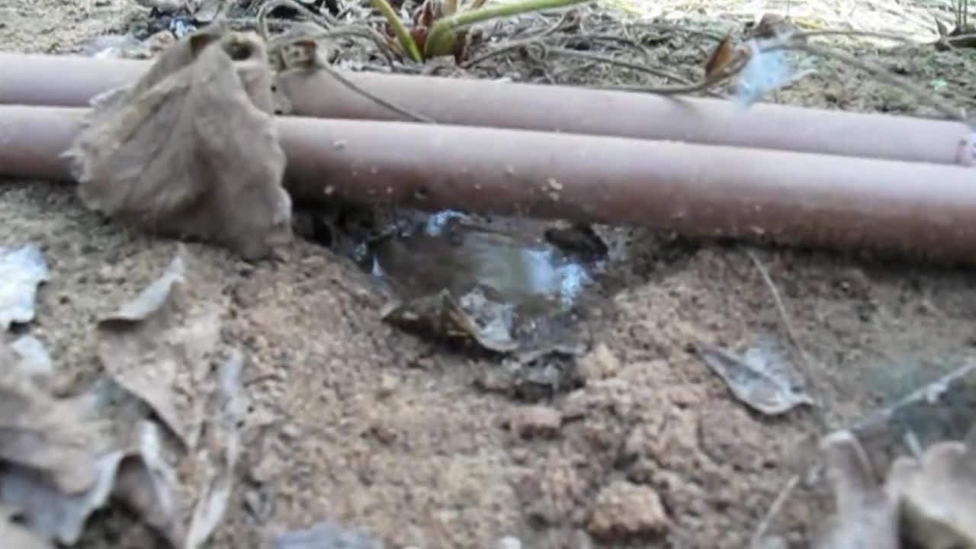
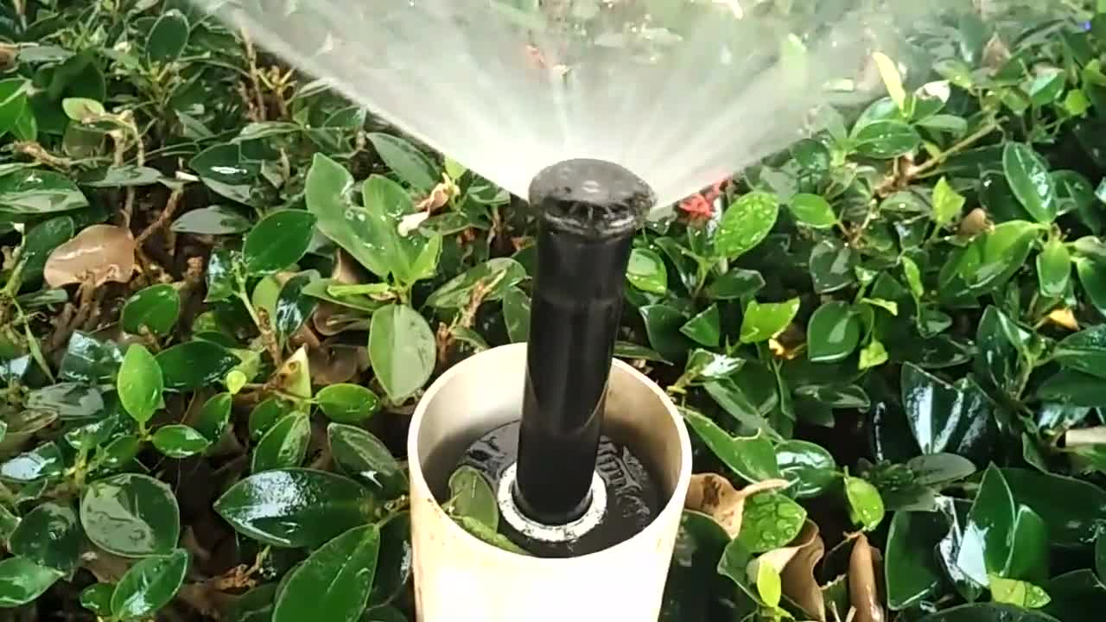
Irrigation in action
01 · PROBLEM · REAL FOOTAGE
Terraced paddy fields
Drip at the roots
Sprinkler irrigation
Rice terraces seen from above: water has to reach every level.
A drip pipe wets just the soil beside the plant.
Tamil Nadu: water sprays whether or not the soil needs it.
Video: B. Uniyal; Juandev; T. Maari · CC BY-SA · Wikimedia Commons
Notes:
Click a video to play it. Clips are from Wikimedia Commons under CC BY-SA licences: Bhuvi Uniyal (paddy terraces), Juandev (drip irrigation), Thamizhpparithi Maari (sprinkler irrigation in Perunthurai).

Slide 6



WATER ONLY WHEN THE SOIL ASKS. POWER IT WITH THE SUN.
02 · SOLUTION · FOUR STEPS
STEP 1
STEP 2
STEP 3
STEP 4
Sense
Decide
Water
Talk
Soil sensors read moisture in every zone.
Moisture, weather and crop rules set the dose.
A solar pump runs only as long as needed.
One phone call runs the pump and answers crop questions.
The loop repeats continuously on the ESP32 controller, even with no network signal.
Notes:
The whole system in four verbs: sense, decide, water, talk.

Slide 7
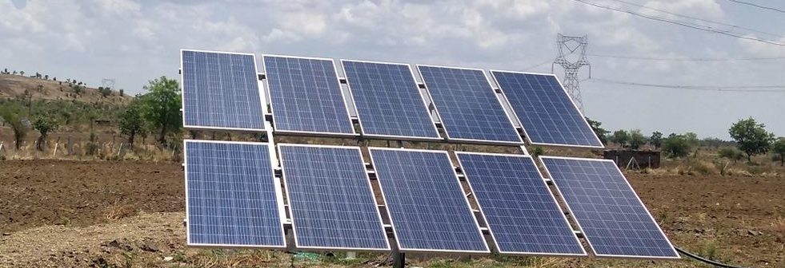
Solar power for the pump
02 · SOLUTION · POWER LAYER
Daylight becomes a practical operating window for the pump, giving the farmer a clearer, more predictable moment to water.
1
Sunlight — panels catch the sun.
2
Power — the panels run the pump.
BENCH PROTOTYPE
3
Water — irrigation flows to the field.
A 10–20 W panel feeds a charge controller and 12V battery, which power a 12V pump.
Designed to reduce dependence on grid availability and diesel.
FIELD SCALE (PROPOSED)
Solar array → solar pump drive → pump. No battery or inverter is assumed, pending confirmation of the pump and drive model.
Photo: Shailsh Telang (CC BY-SA 4.0) · Wikimedia Commons
Notes:
Two scales: a 12V bench prototype with a battery, and a proposed field scale with a solar pump drive and no battery. The field design depends on confirming the pump and drive model.

Slide 8
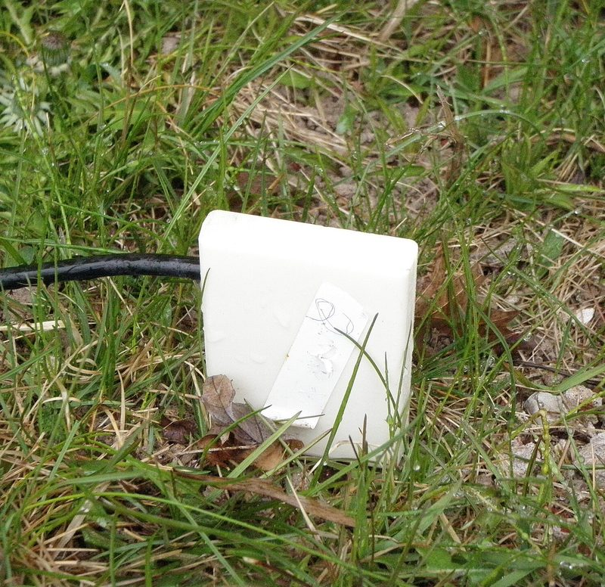




Sensing the soil: what the controller reads
02 · SOLUTION · SENSING LAYER
Capacitive probe
Reads soil wetness as a voltage, without the corrosion of cheap resistive probes.
One per zone, at root depth
Place probes where the roots are; a second, deeper probe shows drainage.
Calibrate on the farm
Record a dry-air reading as 0% and a glass of water as 100%, then map the ESP32 reading to a percentage.
Smooth the signal
Average several readings so one noisy value never starts the pump.
Photo: Christianjhart1 (CC0) · Wikimedia Commons
Notes:
The ESP32 reads each probe as an analogue value. Calibration converts it to a moisture percentage for that soil type. Photo is a generic soil-moisture sensor.

Slide 9

The pump’s decision, step by step
02 · SOLUTION · DECISION LAYER
Read soil moisture
Below dry limit?
Rain forecast?
Run the pump
Stop and report
Yes
No
No: keep sensing, pump stays off
Yes: skip watering and tell the farmer
Timer and float switches guard the run
Target reached, timer ends or tank full
Auto mode
Voice start
Timer limit
Crop rules decide when to start and stop.
Always read back and confirmed with a yes.
Every run ends on a timer, even if signal is lost.
Notes:
The decision loop. A rain forecast skips watering; otherwise the pump starts when moisture is below the dry limit. Auto mode follows crop rules; any voice start needs a spoken yes. Every run has a timer.

Slide 10
Irrigation by phone call
02 · SOLUTION · VOICE LAYER
1
2
3
4
5
Call
Listen
Confirm
Send
Run
Call the pump’s number in Telugu, Hindi or English.
The AI listens and picks one safe command.
The AI asks for a yes or no before acting.
An SMS is sent to the pump site.
The pump runs with timer and float-switch protection.
The farmer can call again at any time to stop the pump, check its status or ask for help.
Notes:
Five-step voice journey from the call to a running pump. The farmer can call again at any time.

Slide 11

An AI crop assistant that cites its sources
02 · SOLUTION · AI ASSISTANT
Collect
Chunk
Index
Retrieve
Answer
5–10 free ICAR and FAO guides on 2–3 crops
Split each PDF into short passages
Store passage embeddings in a vector database
Find the passages that match the farmer’s question
The LLM replies in simple language and cites the source
We use retrieval (RAG) instead of training a model on books, so every answer cites its source. Example: “Which fertilizer suits groundnut at flowering?” returns the answer and the guide it came from.
If no passage matches, the assistant says so and escalates instead of guessing.
Notes:
Retrieval-augmented generation: collect guides, chunk, index, retrieve, answer with citation. No model training required.

Slide 12
System architecture
03 · PROTOTYPE · SYSTEM
INPUTS
CLOUD
CONTROLLER
FIELD HARDWARE
Voice call + SMS
Moisture sensors
Telugu, Hindi, English
One per field zone
Phone app
Firebase or MQTT
ESP32 controller
Monitor and control
Solar power
Syncs commands, status and readings
Auto rules, works offline. SIM800L for SMS and calls
Panel, controller, battery
Weather API
Open-Meteo forecast
Pump and valves
AI assistant
Relay and float switches
RAG on ICAR and FAO
Commands flow right; readings and status flow back
Notes:
Inputs go through a cloud relay to the ESP32 controller, which drives the field hardware and keeps working offline using its own rules.

Slide 13
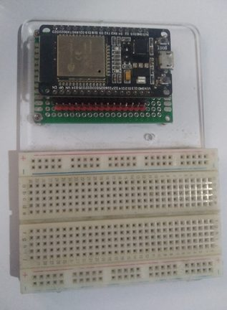
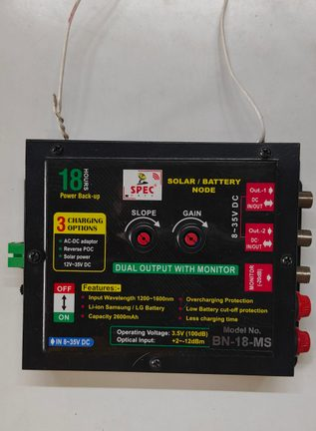
What the prototype needs
03 · PROTOTYPE · PARTS
ESP32 board
Reads sensors, runs the pump logic and connects over Wi-Fi
Estimated hardware budget
₹3,000–6,000
Capacitive moisture sensor
Measures soil wetness without corroding like cheap resistive probes
12V pump + relay module
Moves the water; the ESP32 switches it on and off
Solar panel kit
10–20 W panel, charge controller and 12V battery power everything
Buck converter (12V to 5V)
Gives the ESP32 a safe supply
Float switches
Source and tank-full floats stop the pump at the right moment
SIM800L GSM module
SMS and missed-call control for farmers with basic phones
ESP32 dev board
Solar charge controller
Optional: flow sensor, DHT22
Dry-run protection, temperature and humidity readings
Build order: breadboard, app, weather logic, AI chat, then solar
Photo: Edwiyanto (CC BY-SA 4.0); Ranjithkumar Murugesan (CC0) · Wikimedia Commons
Notes:
Bill of materials for the bench prototype. Photos show a typical ESP32 dev board and a small solar charge controller.

Slide 14
Evaluating the basic prototype: test plan
03 · PROTOTYPE · EVALUATION
Test | What we measure | Pass target (proposed)
1. Sensor accuracy | Sensor reading vs a weighed, oven-dried soil sample | Within ±5 percentage points after calibration
2. Auto start and stop | Pump starts below the dry limit and stops at the target | Correct in 10 of 10 cycles
3. Voice and SMS command | Time from call or SMS to pump running; read-back and yes honoured | Under 30 s; no start without a yes
4. Safety cut-offs | Timer, tank-full float and dry-run protection stop the pump | Stops every time in 10 trials
5. Offline operation | Network unplugged; controller keeps its rules running | Auto mode still works
6. Solar supply | Panel energy per day vs pump energy used | Panel output covers the daily run
Pass targets are proposed starting points. Agree final values with your guide before testing.
Notes:
Six bench tests for the basic prototype. The pass targets are proposed starting points, not measured results; change them to match your project requirements.

Slide 15
Proof and next steps
03 · PROTOTYPE · PROOF
WATER USED
SOLAR ENERGY
COST SAVED
[__ L]
[__ Wh]
[₹__]
vs a fixed-timer pot
drawn from the panel, not the grid
per season, as an estimate
Validation plan
Next up
Read back every command, require a yes
Pilot with 5–10 farmers on real calls
Qualified electrician for all wiring
Crop-aware targets for paddy, groundnut
Solar-aware pumping, multi-zone valves
Flow-sensor protection for dry runs
Right amount of water, at the right time, powered by the sun.
Notes:
The three headline metrics are placeholders to fill in after bench and pilot testing: litres of water used, watt-hours drawn from the panel, and estimated cost saved per season.

