Slide 1


Waste Sorting Assistance For Recycling
BE – IT
LDRP Institute of Technology & Research
Panchal Mansi (23BEIT30080) Internal Faculty: Ms. Megha Shah
Pandey Kajal (23BEIT30082)
Patel Khushi (23BEIT30118)

Slide 2
Abstract
Sortify is a digital platform that helps users sort waste easily and recycle correctly.
It connects households with recycling centers and promotes eco‑friendly habits.
Digitize waste management, offering disposal guides anytime, anywhere.​
It provides smart guidance for identifying recyclable materials, reducing pollution, and promoting sustainable habits across India.​

Slide 3
Problem Statement
Waste is mixed :
Indians don’t have the proper knowledge about the waste segregation.
People don’t sort in the dedicated bins.
Recyclables get contaminated
No simple guidance as there are no such proper instructions provided as of which waste should be disposed in which bin.

Slide 4
Aim
To build a beginner‑friendly platform (That simplifies waste sorting and supports recycling.)
Reduce Pollution (Minimize mixed waste in landfills.)
Bridge Knowledge Gap (Centralized, beginner-friendly info hub.)
Enhance Accessibility (Disposal guides anytime, anywhere.)
Support Local Ecosystems (Connect users with local recycling centers.)

Slide 5
Objectives
Easy categorization
Reduce landfill waste
Recycling guidance
Local centers

Slide 6
Proposed Solution
Web platform for waste identification, disposal guidance and recycling mapping.
Educating the community on the importance of waste segregation.
Connecting users through the AI.

Slide 7
Key Features
Smart categories :
Smart Categories refers to an automated classification system that intelligently organizes waste into specific streams—such as sanitary pads, wipes, diapers, paper cups and metal—to prevent contamination and ensure each material is sent to the correct recycling facility.
Search disposal guide :
'what is this?' and 'where does it go?'
Simple UI
Local recycling information

Slide 8
Project Working Flow
User Uploads Waste
Sortify Identifies
Category Shown
Recycling Center

Slide 9
Technologies
Frontend: HTML, CSS, JS for accessible UI and interactive elements.​
Backend: Python / C , C++ for logic processing and API integration (e.g. AI for waste identification).​
Database: SQL for managing user data, recycling centers, and material types.

Slide 10
Algorithms Used
Classification Algorithms
Logistic Regression
Decision Tree
KNN (K-Nearest Neighbor)
K-Means Clustering

Slide 11
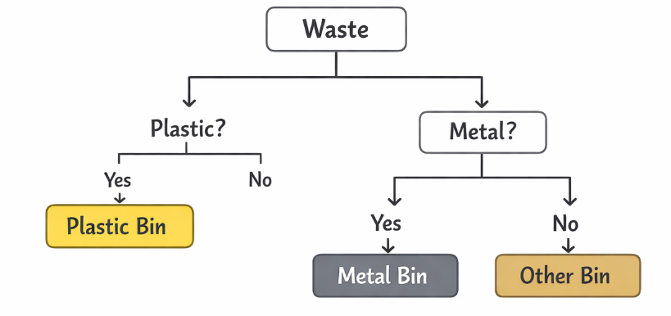
Decision Tree
The Decision Tree is used to classify different types of waste
such as plastic, metal, paper, and organic waste.
It works by creating a tree-like structure
where each internal node represents a decision based on a
feature.

Slide 12
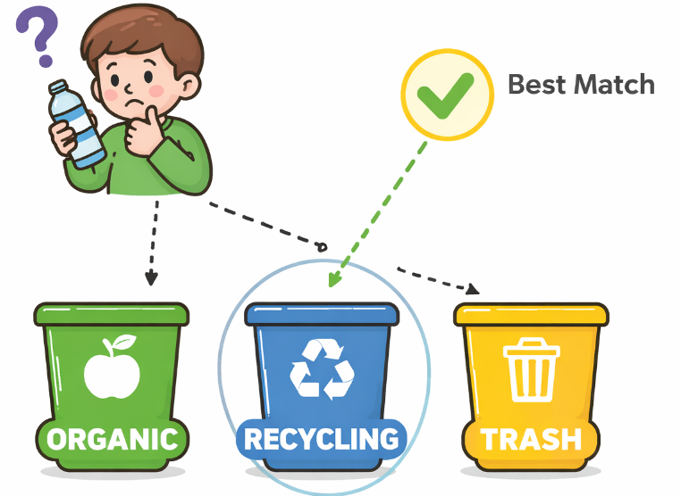
K-Nearest Neighbours (KNN)
KNN classifies an object by looking at the closest similar examples and deciding which category it belongs to.

Slide 13
K-Means Clustering
K-Means clustering helps the system automatically group waste items with similar characteristics such as color, texture, and shape.
Simple Example
If K = 4, the algorithm may create 4 clusters:
Cluster 1 → Plastic
Cluster 2 → Metal
Cluster 3 → Paper
Cluster 4 → Organic
This helps the waste sorting system automatically organize waste into the correct category. ♻️

Slide 14
User Benefits
Easy recycling
Less confusion
Clean environment
ASUMPSTIONS:
User wants to sort waste.​
Smartphone & internet access in target areas.​
Basic education for visual instructions.​
Accurate third-party data (municipalities, centers).​
Standard waste categories (Organic, Plastic, etc.).​
Dependencies:
Robust SQL database availability.​
Modern web browser compatibility.​
Active internet connectivity.​
External APIs (maps, AI image recognition).​
Local recycling infrastructure cooperation.​

Slide 15
Future Scope
Live AI image detection
Mobile App
Government link
Reward system

Slide 16
Recycling Improvement

Slide 17
THANK YOU

