Slide 2
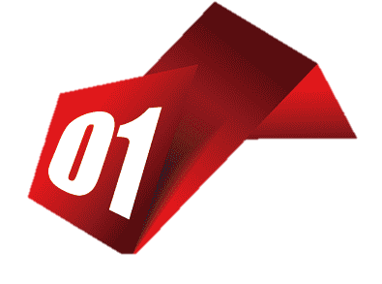
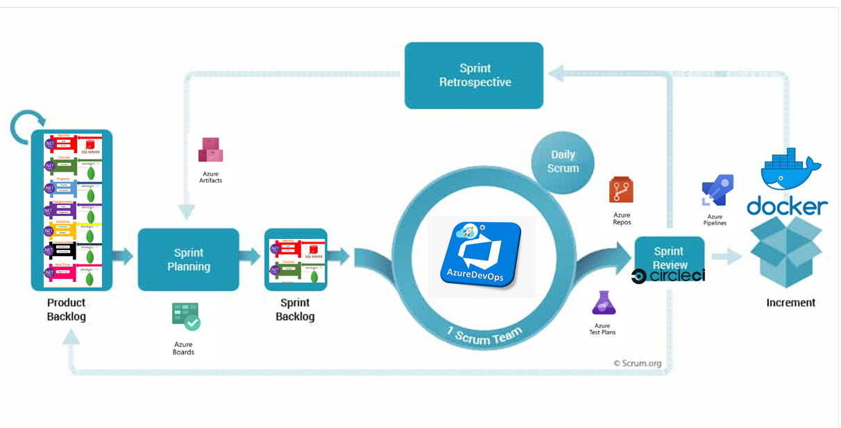
Abstract
The business vision of the project takes the student into a lifecycle of 4 levels (Skills Building – Entertainment - Interaction – Career development) using Internal services integrated with External services.
Applying different design patterns that can integrate any type of services or platforms or programming languages using the Microservices Architecture & patterns.
The Microservice Systems development can be managed using DEVOPS /Scrum framework:
The Scrum/DevOps framework lifecycle begin from the product backlog that contains all the project user stories.
The team begin what sections will start to develop in Sprint planning phase and package them up to the sprint backlog.
Sprint backlog contains what the team develop in their days.
After work the packages will be reviewed using CI/CD tools.
Then operation team can release the sources to increment them on the running environment (docker).
Finishing up the sprint by checking out if there are artifacts or issues to get red of them in next sprints.

Slide 3
Business Vision
Abstract

