Slide 1
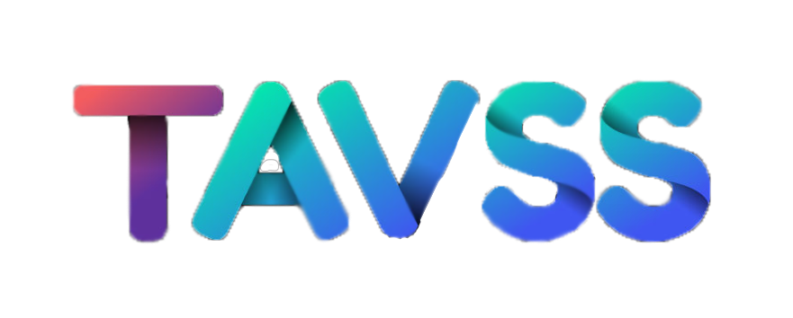



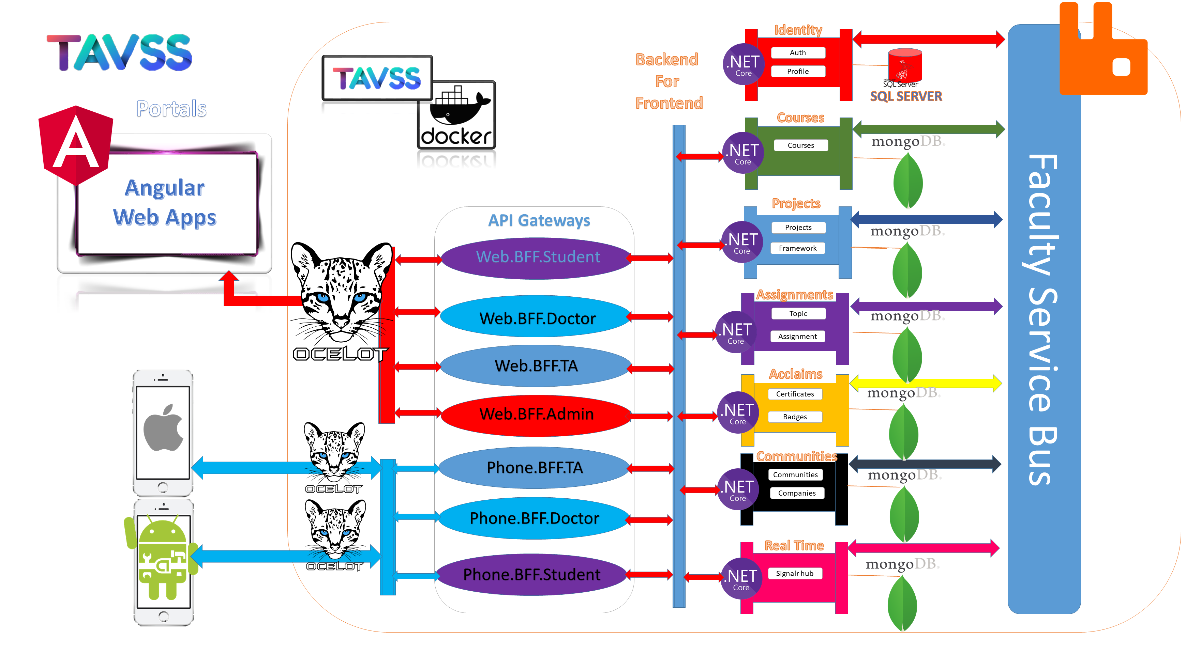






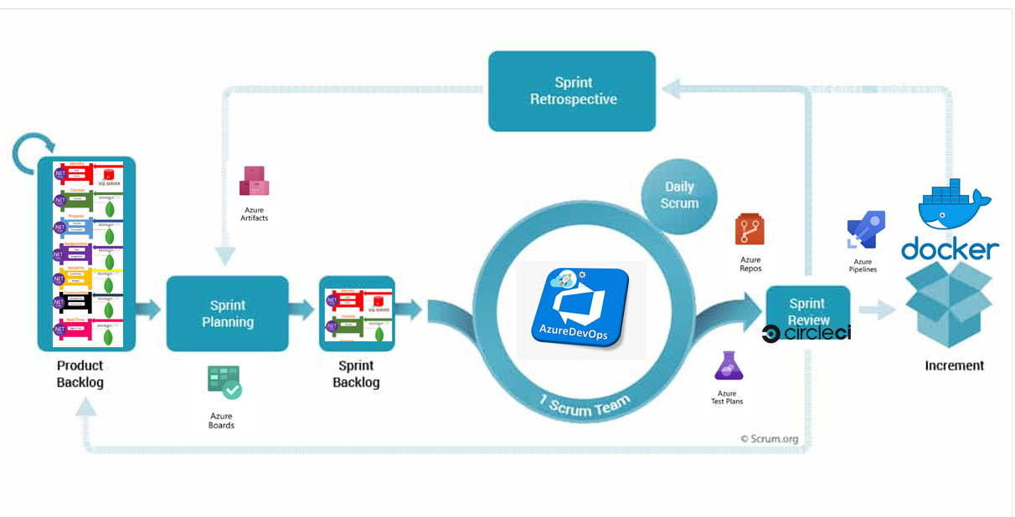
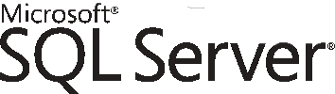
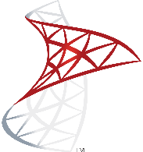
System Architecture
Teaching Assistant Versus Student Services
Microservice Interactive Learning system
for student services
Abstract
The business vision of the project takes the student into a lifecycle of 4 levels (Skills Building – Entertainment - Interaction – Career development) using Internal services integrated with External services.
Applying different design patterns that can integrate any type of services or platforms or programming languages using the Microservices Architecture & patterns.
Is an enterprise open source massage broker that can be the middleware where the microservices send asynchronous messages to trigger an event as publish subscriber design pattern
Is an open-source project for automating the deployment of applications as portable, self sufficient containers that can run on the cloud or on-premises.
Is a general purpose, document- based, distributed database built for modern application developers and for the cloud era. No database makes you more productive.
The Microservice Systems development can be managed using DEVOPS /Scrum framework:
.NET Core is a free and open-source, managed computer software framework for Windows, Linux, and macOS operating systems. It is a cross-platform and successor to .NET Framework.
A modern fast, scalable API gateway built on asp.net core ... Ocelot is fast, scalable and provides authentication, routing, request aggregation among many microservices.
Is a relational database management system developed by Microsoft. As a database server, it is a software product with the primary function of storing and retrieving data as requested by other software applications

Slide 2

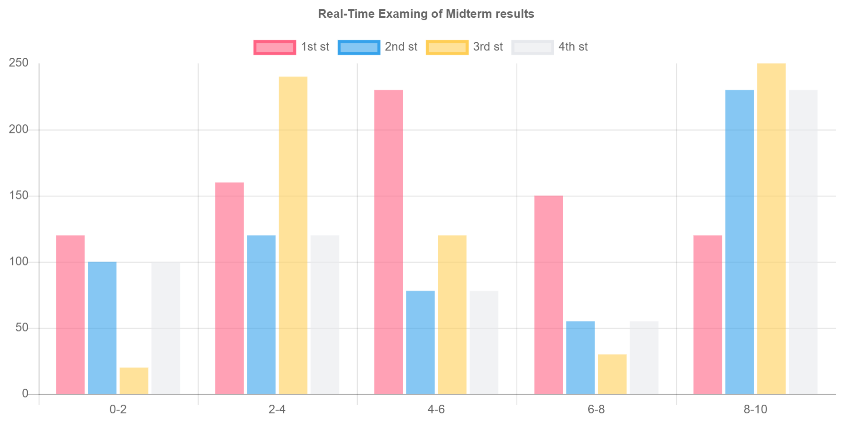
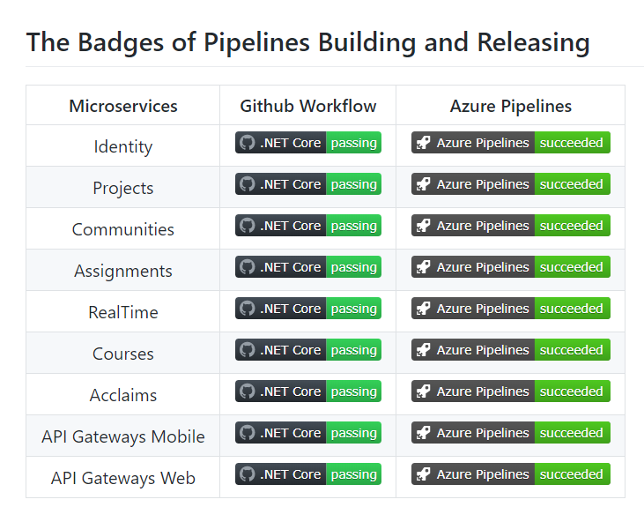
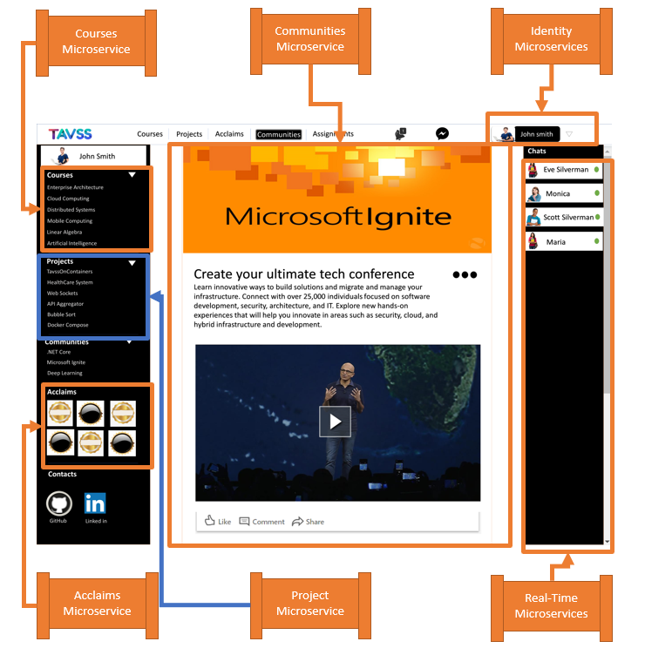
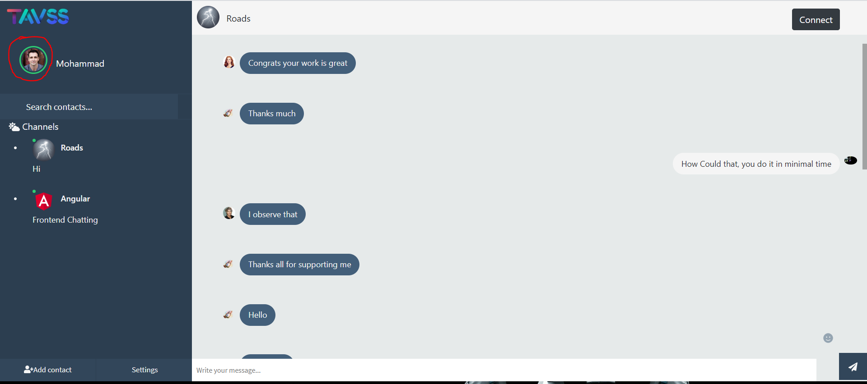
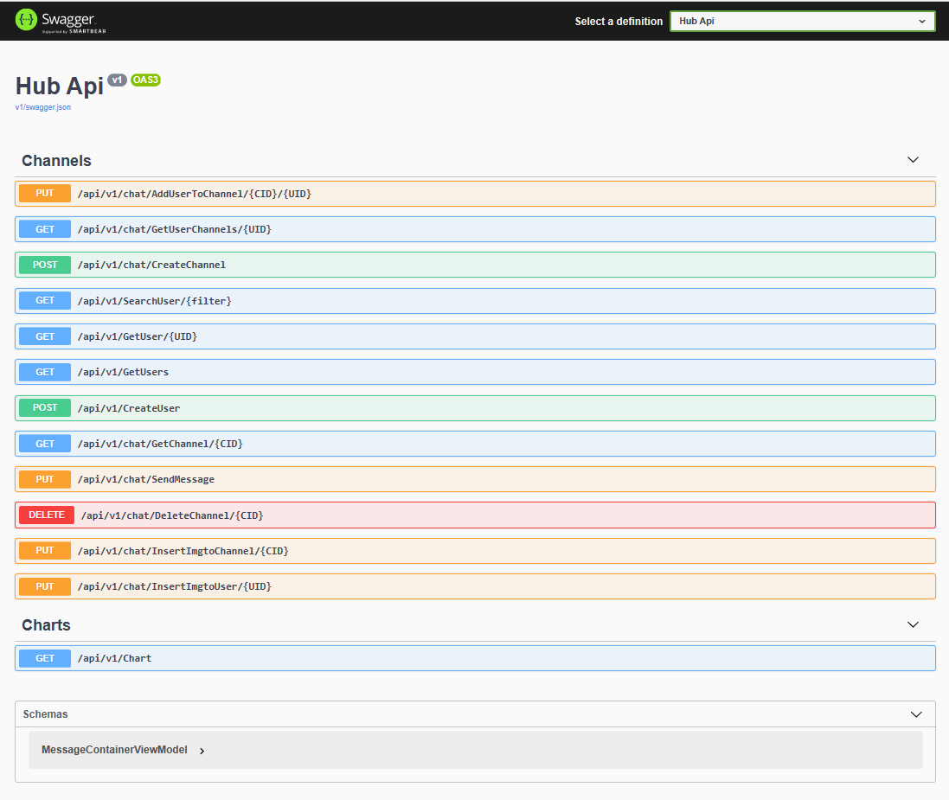
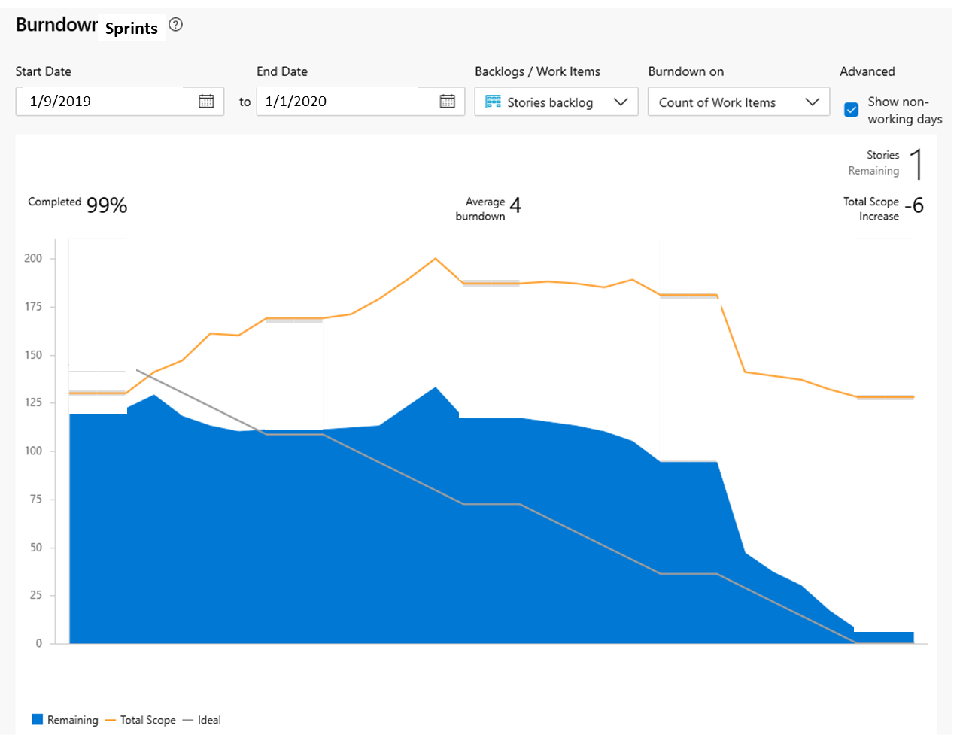
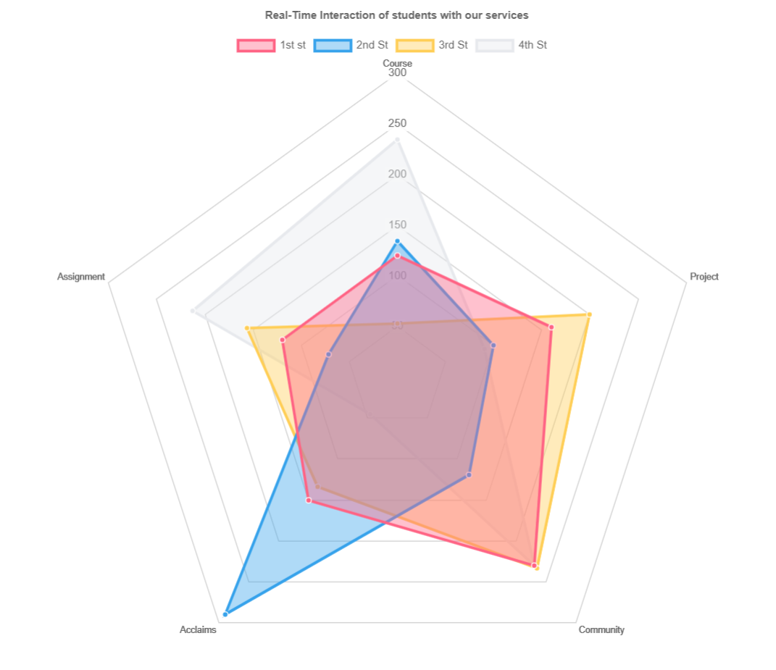
Real-Time Exam Midterm Chart results of student
Continuous Integration Results
RESULTS
Composite UI Consumes Microservices
REAL-TIME Group Chatting rooms
Using Azure DEVOPS framework to manage the team working on the pipelines, the following figure is a burn down chart explain the effort of the SCRUM:
Real-Time RADAR Chart as report for
microservices consuming
SWAGGER OPEN API for every Microservice

