Slide 1


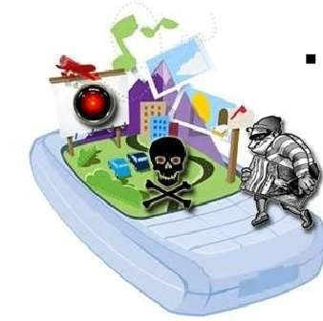
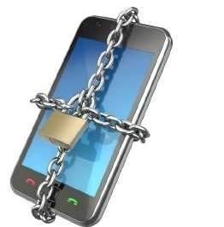
Mobile Device Security
Presented by :
MANSOOR AHMED 18b-129-se
SUMMAIYA SAEED 18b-081-se
SYEDA MAHAM WADOOD 18b-029-se
JAVERIA MUGHAL 18b-119-se

Slide 2


CONTENTS
INTRODUCTION
SECURITY ISSUE WITH MOBILE PHONE
TYPES OF MOBILE SECURITY
MOBILE THREATS
TIPS TO STAY SAFE
COMPARISION(ANDRIOD VS IOS)
CONCLUSION

Slide 3

INTRODUCTION
Mobile security is the protection of portable devices such as smartphones, smartwatches, and tablets from threats and vulnerabilities. People are now commonly using mobile devices for tasks that involve classified data like credit card numbers, social security numbers, and important banking information.

Slide 4
SECURITY ISSUE WITH MOBILE PHONE
Physical Security
A phone can be confiscated or stolen. We should always enable some kind of password protection on our phone.
Voice
Although the voice on a mobile phone channel is encrypted, this encryption was hacked some time ago and is not considered safe anymore. Normal voice communications are very insecure as they are not encrypted.

Slide 5

Text messages are sent in plain text over the network, so they are also not considered Secure.
SMS
IMEI No.
Beware that your phone also has a unique identifier,
(known as the IMEI number i.e (International Mobile Equipment Identity)) so switching SIM cards will not guarantee to protect your privacy.

Slide 6

Mobile Threats and Attacks:
Mobile devices make attractive targets:
– People store much personal info on them: email, calendars, contacts, pictures, etc.
– Sensitive organizational info too
– Can fit in pockets, easily lost/stolen – Built-in billing system: SMS/MMS (mobile operator), in-app purchases (credit card), etc.
• Many new devices have near field communications
(NFC), used for contactless payments, etc.
• Your device becomes your credit card – Location privacy issues
• NFC-based billing system vulnerabilities

Slide 7
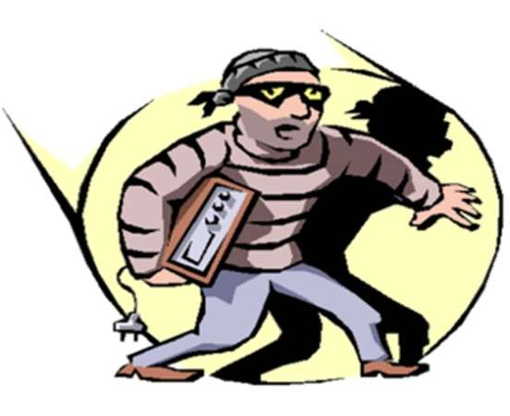
TYPES OF MOBILE SECURITY
Mobile device security.
Mobile application security.

Slide 8

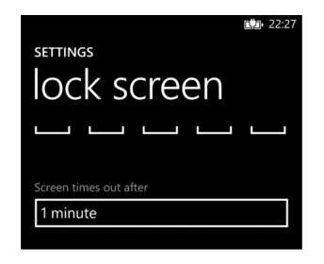
Mobile Device Security
Screen locks.
All mobile devices (e.g., phones, tablets, and laptops) should have the screen lock set.

Slide 9

Lockout settings.
After a specific no. of unsuccessful unlock attempts, the device will get locked which can only be opened through user’s ID.
GPS.
Many mobile devices have GPS capabilities, allowing the device to be located if it is lost or stolen.
Remote wiping.
Some mobile devices allow for the device to be wiped (all data and applications are removed) remotely. This can be used if a device is unrecoverable.

Slide 10
Mobile Access Control
Very easy for attacker to control a mobile device if he/she has physical access
– Especially if there’s no way to authenticate user
– Then device can join botnet, send SMS spam, etc.
Need access controls for mobile devices
–Authentication, authorization, accountability
– Authentication workflow:
Request access
Supplication (user provides identity, e.g., John Smith)
Authentication (system determines user is John)
Authorization (system determines what John can/cannot do)

Slide 11

Mobile Application Security
Encryption.
Ensure that mobile applications are encrypting sensitive data that is stored on the device. Encryption keys must also be created and stored securely.
Authentication.
A best practice is for the mobile application to authenticate the user and to base access to data on the user’s authentication level.

Slide 12

Geotagging.
Geotagging is most commonly used for photographs and can help people get a lot of specific information about where the picture was taken or the exact location of friend who logged on to service.
Application whitelisting.
It is a device administration practice used to prevent unauthorized application from running. The purpose is primarily to protect device and networks from harmful application.

Slide 13

Mobile Threats
Application Based Threats
Web Based Threats.
Network Threats.

Slide 14

Application Based Threats.
Downloadable applications present many security issues on mobile devices, including both software specifically designed to be malicious as well as software that can be exploited for malicious purposes. It contains
(Malware, Spyware, Privacy Threats, Vulnerable application)
Web –Based Threats.
Because mobile devices are often constantly connected to the Internet and used to access web-based services, web-based threats that have historically been a problem for PCs also pose issues for mobile devices
It contains (Phishing Scams, Drive-By Download, Browser Exploits).

Slide 15
Network Threats
Mobile devices typically support cellular networks as well as local wireless networks. It contains (Network Exploits, Wi-Fi Sniffing).

Slide 16

TIPS TO STAY SAFE
Keep Your Phone Locked.
Set Secure Passwords.
Keep Your Device's OS Up-To-Date.
Connect to Secure Wifi.
Beware of Downloads.
Don't Jailbreak or Root Your Phone.
Encrypt Your Data.
Install Anti-Virus Software.

Slide 17
ANDRIOD VS IOS:
In some circles, Apple's iOS operating system has long been considered the more secure of the two operating systems. Android is more often targeted by hackers, too, because the operating system powers so many mobile devices today
iOS:
In some circles, Apple’s iOS operating system has long been considered the more secure of the two operating systems. Why? Apple’s operating system is a closed system. Apple doesn’t release its source code to app developers, and the owners of iPhones and iPads can't modify the code on their phones themselves. This makes it more difficult for hackers to find vulnerabilities on iOS-powered devices.

Slide 18
ANDRIOD VS IOS:
ANDRIOD:
Android devices are the opposite, relying on an open-source code, meaning that the owners of these devices can tinker with their phone’s and tablet’s operating systems. Too much tinkering, and owners might create a weakness in their devices’ security. Then there are manufacturers themselves. If a phone maker puts out a new device with a modification to the Android operating system and there’s a vulnerability in that code, hackers will find it.

Slide 19
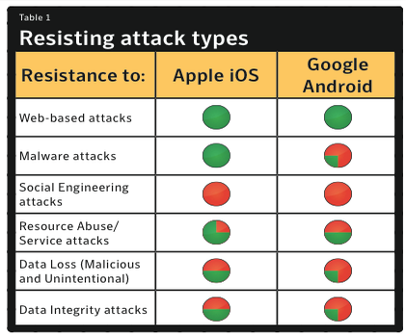
ANDRIOD VS IOS:

Slide 20
CONCLUSION
There are many threats and attacks against mobile devices, e.g., loss/theft, sensitive information leakage, and location privacy compromise
Mobile access control, information leakage protection, and location privacy protection, etc.
With the simple tips given in presentation , we can keep our data safe and secure
Our mobile devices contains important and delicate data which needs to be kept safe and secure .

