Slide 1

M.i.t.m .

Slide 2
ONLINE BUS TICKET RESERVATION SYSTEM (OBTRS)
Submitted by-
Ashwin Sharma
Nikhil Vyas
Nilesh Soni
Submitted to-
Prof.Nidhi.M.Chorey

Slide 3
TABLE OF CONTENTS
Introduction
Requirement Analysis
Design
Conclusion
References

Slide 4
INTRODUCTION
Online Bus Ticket Reservation System is Windows based application that works within centralized network. The software program “Online Bus Reservation System” provides bus transportation system, a facility to reserved seats, cancellation of seats and different types of enquiry which need an instant and quick reservation. OBTRS is built for manage and computerize the traditional database, ticket booking and tracking bus and travel made easy. It maintains all data’s of users , bus details, reservation details, booking details, customer details.
Default username is admin and password is root.

Slide 5
ANALYSIS
Requirement analysis is a software engineering task that bridges the gap between the system level software allocation and software design.
It enables the system engineer to specify software function and performance, indicate software interface with other system elements, and establish design constraints that the software must meet.
It provides the software designer with a representation of information and function that can be translated to data, architectural and procedural design.
Notes:
Aim of this phase: understand the exact requirements of the customer, document them properly.Consists of two distinct activities: requirements gathering and analysis requirements specification.

Slide 6
Introduction :
Udankhatola is a domestic privatized transportation company that runs the Buses all over the country. This is an web application which provides Booking of tickets all over the world.
Problem statement :
System that are using by the staff at the counter currently is an internal system and just used to sell the bus ticket at the counter. Customer has to go to the counter to buy bus ticket or ask for bus schedule. Furthermore, customers need to pay cash when they buy the bus ticket and sometimes needs to queue up long time to get the bus ticket. Besides that, customer also not allowed to buy bus ticket through telephone and the bus company's telephone always-busy line .
Notes:
Aim of this phase: understand the exact requirements of the customer, document them properly.Consists of two distinct activities: requirements gathering and analysis requirements specification.

Slide 7
solution
The method to solve this problem is to create an online booking bus ticket system . Customer can buy the book ticket over the Internet, 24 hours a day, 7 days a week and the bus ticket can't be lost, stolen or left behind. In addition, the online system lets the customers check the availability of the bus ticket before they buy bus ticket. Furthermore, customers no need to pay cash to buy bus ticket because they can pay the bus ticket on the traveling time.

Slide 8
SYSTEM SPECIFICATION
Hardware Configuration:
Computer processor : Pentium4(min)
Hard Disk : 50Gb(min)
RAM :512MB(min)more
SOFTWARE SPECIFICATION:
Operating System : WINDOWS XP or above
Language used : Java, JSP, CSS
Data Base : My-SQL
Server : Apache Tomcat 6.0

Slide 9
SCOPE
The scope of the online bus ticket reservation system is:
A person should be able to
Login to the system through the first page of the application
Change the password after logging into the system
Should be able to create a new login for the accessing the reservation facility.
Query the buses for two weeks (Only two weeks advance reservation is available).

Slide 10
No reservation before two days can be done.
Able to choose the seats which are available for a certain class.
Give details about the credit card.
Improved & optimized service.
Freight Revenue enhancement

Slide 11
USE CASE DIAGRAM
“A use case is a description of a system’s behaviour as it responds to a request that originates from outside of that system (the user).”
In other words a use case describes “who” can do “what” with the system in question. The use case technique is used to capture a system’s behavioural requirements by detailing scenario-driven threads through the functional requirements. The use cases describe the system from the user’s point of view! A use case is a standard set by, among other, UML 2.0. It is a non-technical description of the behaviour of the system.

Slide 12
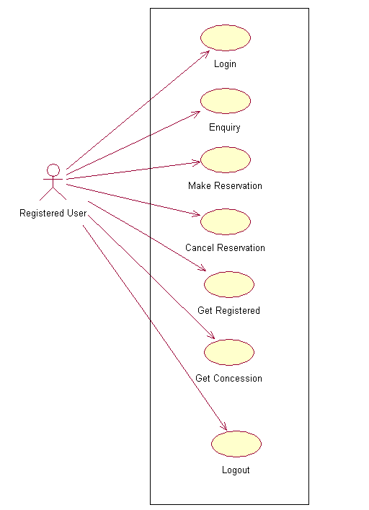
USE CASE diagram for registered user

Slide 13
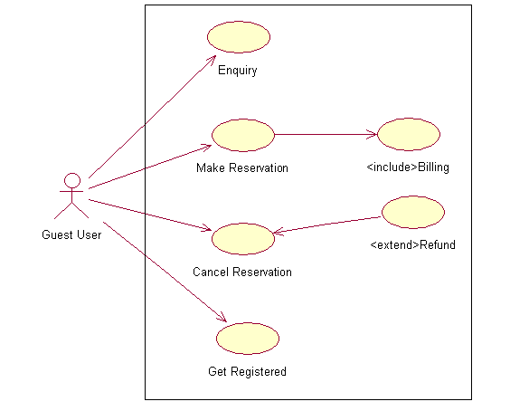
USE CASE diagram for guest user

Slide 14
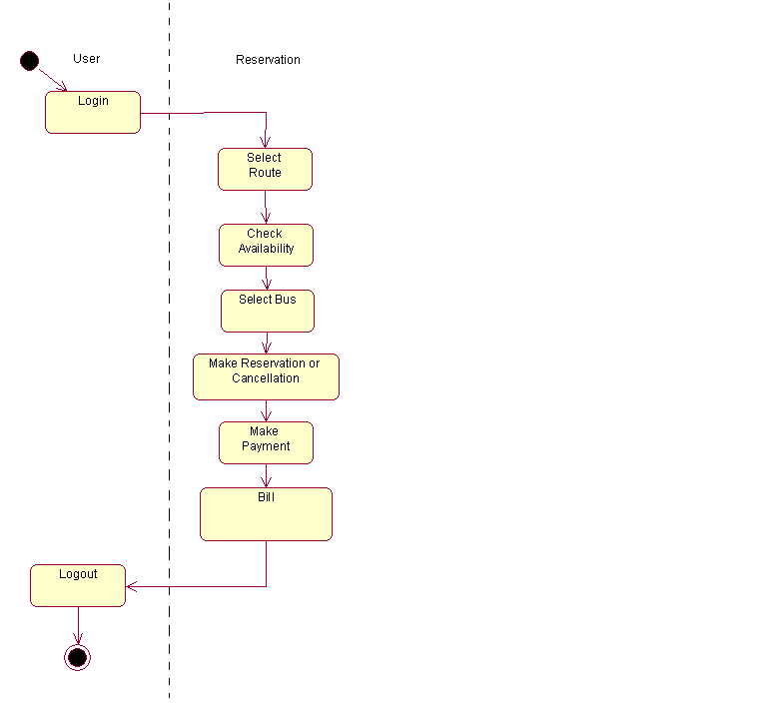
ACTIVITY DIAGRAM :

Slide 15
DESIGN
Using SRS as input, system design is done. System design included designing of software and hardware i.e. functionality of hardware and software is separated-out. After separation design of software modules is done. The design process translates requirements into representation of the software that can be assessed for quality before generation of code begins

Slide 16
MODULES IDENTIFIED -
Login Module
Route Module
Bus Info Module
Payment Module

Slide 17
DFD Diagram
A Data Flow Diagram (DFD) is a process-oriented graphical representation of an application system. A DFD "is a picture of the movement of data between external entities and the processes and data stores within a system.“
The components of a typical dataflow diagram are: the process, the flow, the data store, and the terminator.

Slide 18
DFD DIAGRAM “0 level”

Slide 19
DFD Diagram for rigistered user

Slide 20
DFD for guest user

Slide 21
SEQUENCE Diagram
A sequence diagram shows interaction among objects as a two-dimensional chart. The chart is read from the top to bottom. The objects participating in the interaction are shown at the top of the chart as boxes attached to a vertical dashed line. Inside the box the name of the object and the class are underlined. This signifies that we are referring any arbitrary instance of the class. The vertical dashed line is called the object’s lifeline

Slide 22
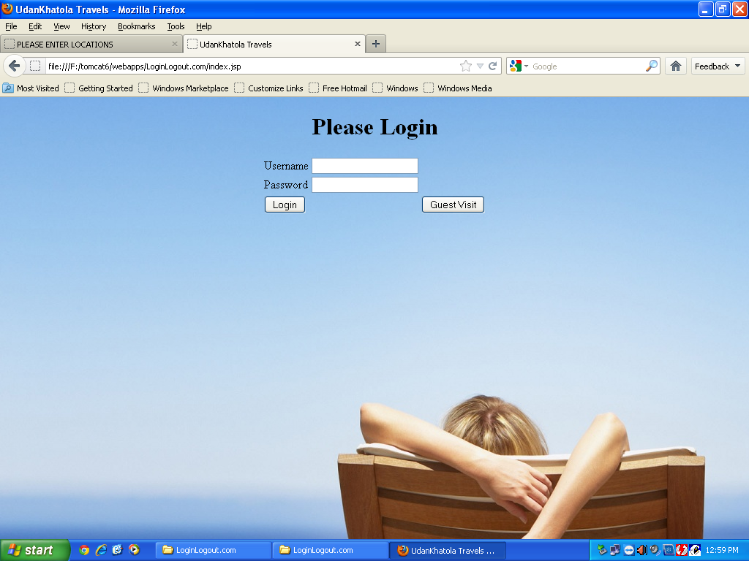

Slide 23
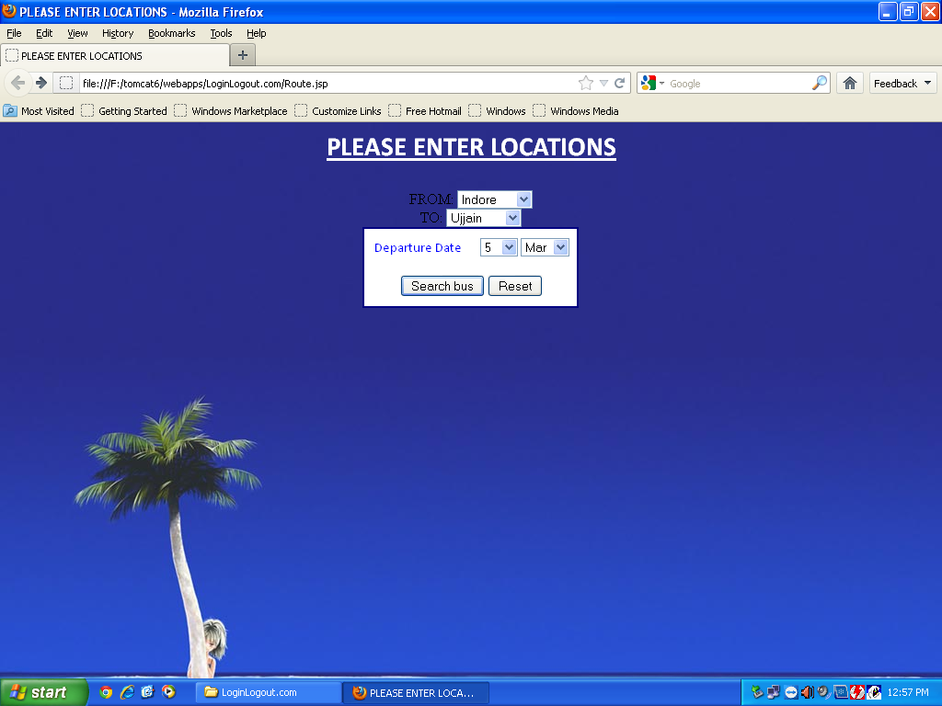

Slide 24
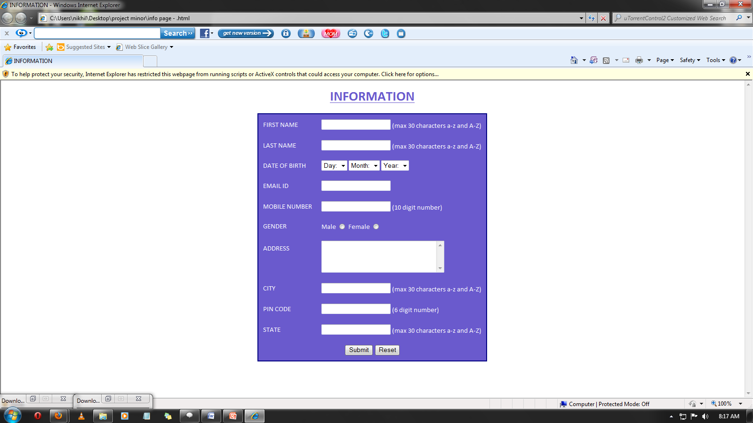
UI DESIGN

Slide 25
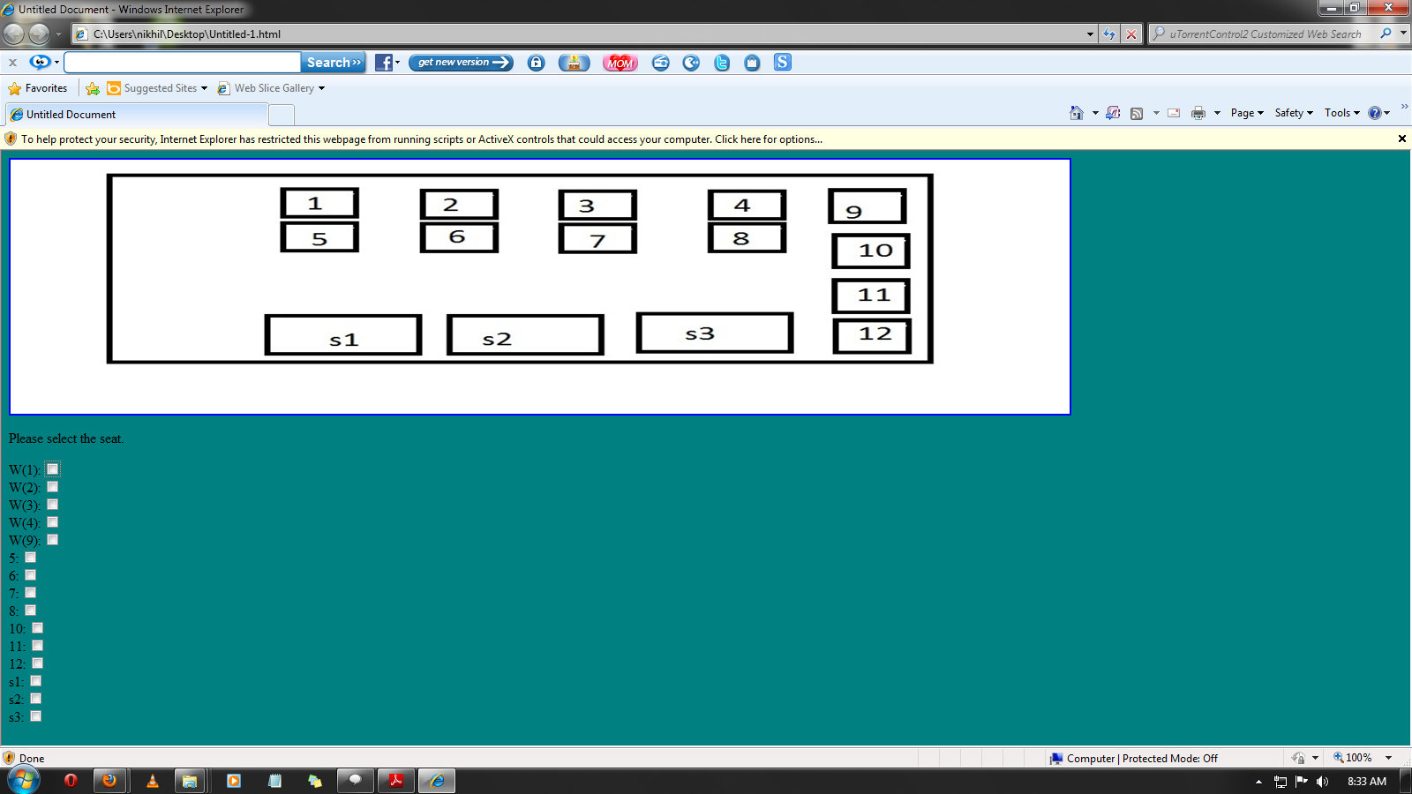

Slide 26
Conclusion
Udan Khatola travels is Online Bus reservation System which provides online reservation of bus.
This system is user friendly and accurate.
This system is available 24 hours and efficient in reservation.
It has no hidden costs in fares.

Slide 27
Important Features
It simplifies the tasks and reduces paper work.
Accuracy.
User Friendly.
Availability.
Efficiency.
Reliable.
Durable.

Slide 28
Limitations
Monthly maintenance cost required.
Cannot be operated by all types of users.

Slide 29
Refrences
http://en.wikipedia.org
http://www.google.co.in/

Slide 30
Thank you!!!!!!!!

