Slide 1

Vehicle Driver’s Drowsiness Detection
Under the Guidance of : Submitted By:
Prof. Damanpreet Singh Manshi (1930034)
CSE SLIET Raushan Raj (1930035)

Slide 2

Introduction
Driver’s drowsiness has been one of the major causes of road accidents and can lead to severe physical injuries, deaths and significant economic losses.
To avoid this, we present a system for driver drowsiness detection that is a vehicle safety technology which helps prevent accidents caused by the driver getting drowsy.

Slide 3

Motivation
NHTSA Estimates 100,000 drowsiness/fatigue related Crashes Annually.
Fatigue has been estimated to be involved in
10-40% of crashes on highways (rural Interstate).
An accident involving driver drowsiness has a high fatality rate because the perception, recognition, and vehicle control abilities reduces sharply while falling asleep.
Driver drowsiness detection technologies can reduce the risk of a catastrophic accident by warning the driver of his/her drowsiness.

Slide 4

Objective
To investigate the physical changes on the face of driver due to fatigue and drowsiness.
To develop a system that uses eyes closure to detect drowsiness and then alert by ringing an alarm.

Slide 5
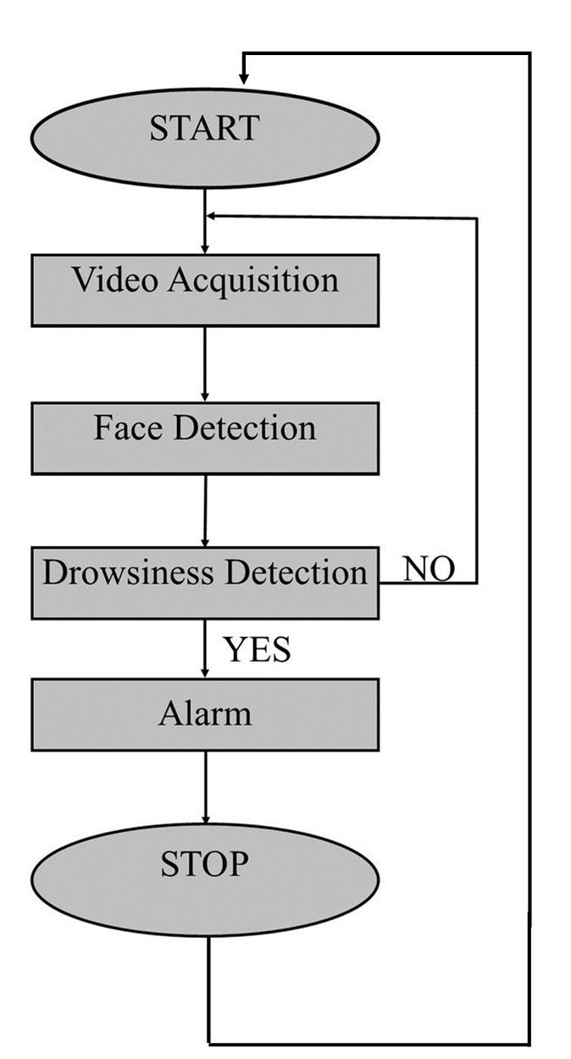

Flow Diagram

Slide 6
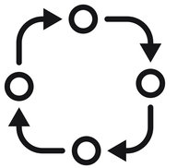
Methodology/Technology
Technology: Deep Learning
Language: Python
Framework: TensorFlow, Keras, PyGame, Tkinter
Architecture: CNN (InceptionV3 model)

Slide 7

Hardware/Software Requirements
Hardware: Google Collab, Kaggle
Software: Anaconda( Jupyter Notebook), PyCharm

Slide 8








Project Timeline
Data Gathering
Data Preparation
Model Building
Model Evaluation
Graphical User Interface
Result
Future Work

Slide 9

Data Gathering
MRL Eye Dataset has been used. It is the large-scale dataset of human eye images.
The dataset contains infrared images in low and high resolution, all captured in various lightning conditions and by different devices.

Slide 10

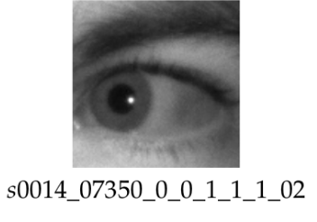
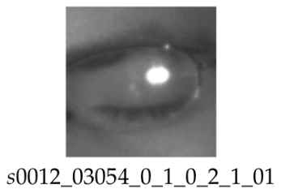
Data Preparation
The data set contains sample of 37 peoples in different conditions and some codes were assigned for them(refer figure below).
We wrote a python script which automatically classifies the entire datasets into open eyes and closed eyes under two folders: training and testing.
Image Augmentation Concept is used to create more data.

Slide 11

Model Building
Concept of Transfer Learning is used for building the model.
InceptionV3 CNN Architecture is used for training.
Model was trained with validation split of 0.2, batch size of 8 and number of epochs were 5.

Slide 12

Model Evaluation
After training the model, the performance of the model is:
Accuracy: 0.7999
Loss:0.4265
Validation Accuracy: 0.6072
Validation Loss: 2.2326

Slide 13
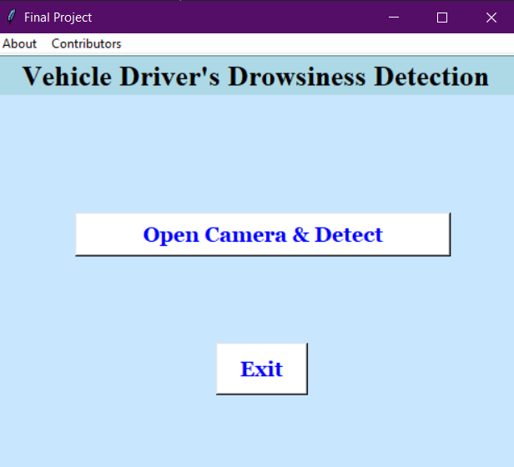
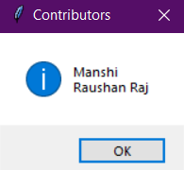

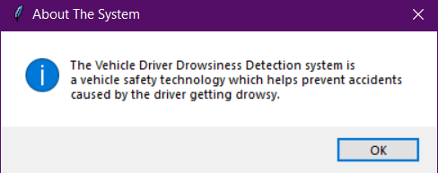
Graphical User Interface

Slide 14
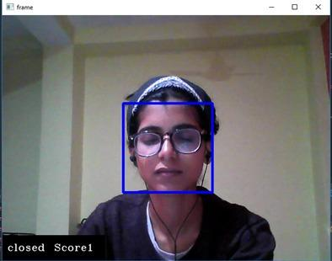

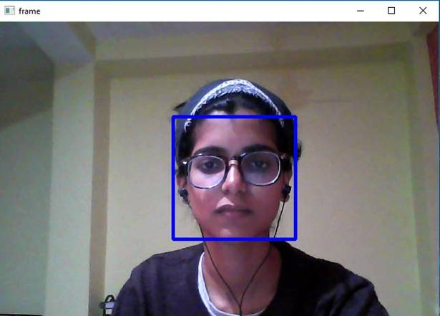

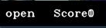

Result

Slide 15

Future Work
Increasing the performance of the model by using different transfer learning approach like VGG16, ResNet50 etc.
Deployment of the model either on IoT or cloud.

Slide 16

Thank You !!

