Slide 1

Understanding Career Aspirations of Gen-Z
Presented by Mansi Chaudhari

Slide 2
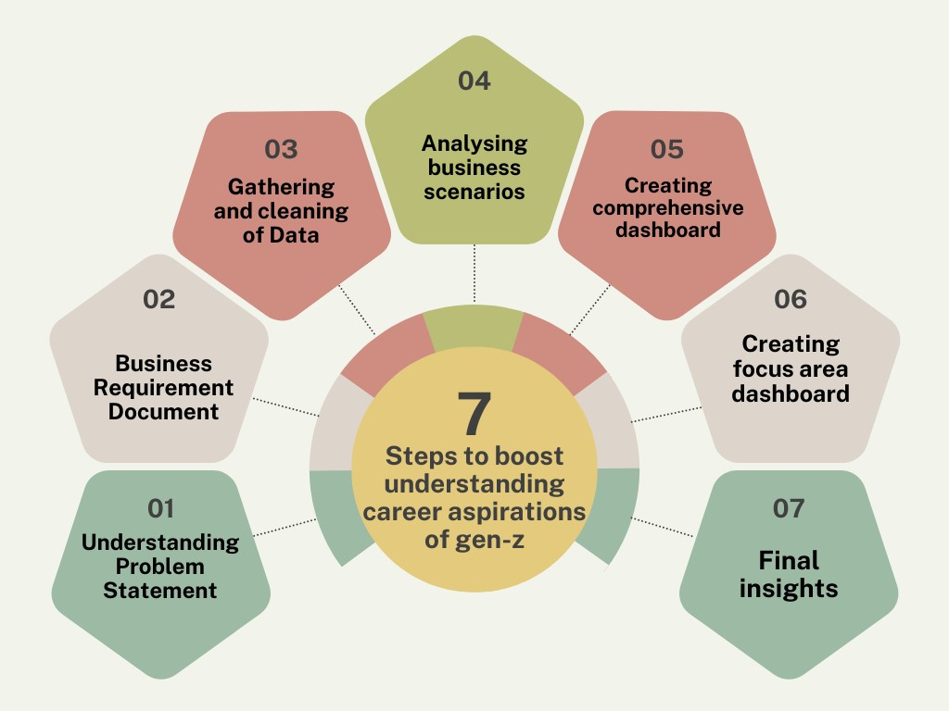
LEARNING ROADMAP

Slide 3
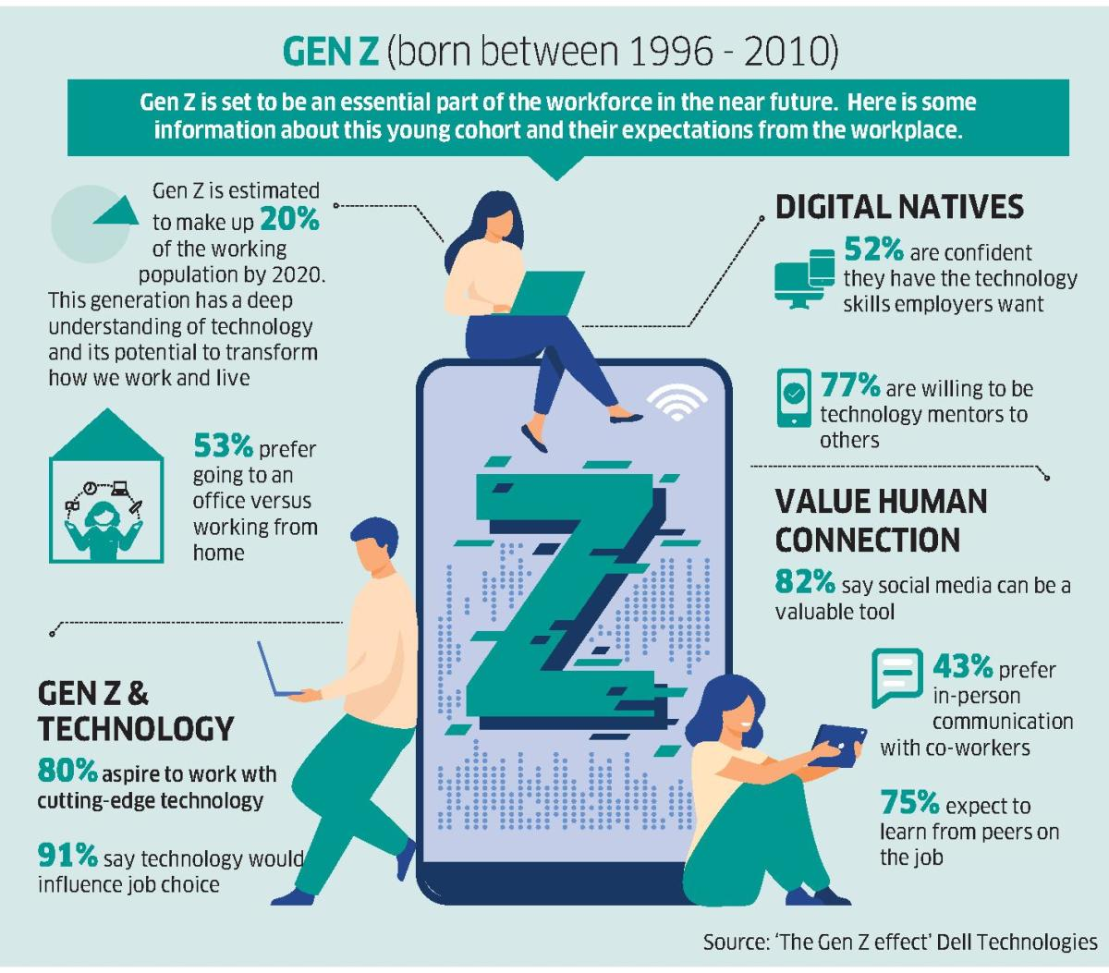
Understanding Career Aspirations of Gen-Z
G
Gen-z more often called iGen because of its fluidity in using technology.Gen zers are well versed in using it.Their unique perspective about careers and life goals makes them the best fit for the post-pandemic workforce. Called the 'change generation’.Gen-Z and the second half of millennials prioritize purpose over money.They look for values and growth, and most importantly, a corporate culture that aligns with their ethics.Gen Z can surprise you with their research and analytical skills while also being passionate about their career paths. They thrive off an organization that encourages them to excel in their areas of interest.A creative work environment, remote-work options, and time-off benefits can all bring in a change for the better. As digital natives, Gen Zers are agile enough to adapt to this new reality.

Slide 4
Problem Statement
For this problem statement, we are going to discuss and understand about the Career Aspirations of Generation-Z who are going to be the 25-27% of the total workforce of our country by 2030, their contributions will be huge in the prospect of our countries and world economic growth. In general Gen-Z are more focused towards fast growth (carrier & financial), work-life balance, flexibility and environmental responsibility.
Well, there are some new situations where Gen-Z are not understood properly as a result of which employers and employees are facing difficulties. So this analytical learning is focused on understanding the gap which might help the recruiters get the right people with right aspirations on board.
Here are some articles for better research and understanding:
https://www2.deloitte.com/us/en/pages/consumer-business/articles/understanding-generation-z-in-the-workplace.htmlhttps://hr-path.com/en/blog/generation-zs-career-aspirations-beliefs-and-paradoxes/2022/07/15/?cn-reloaded=1
https://www.hibob.com/blog/gen-z-career-expectations/

Slide 5
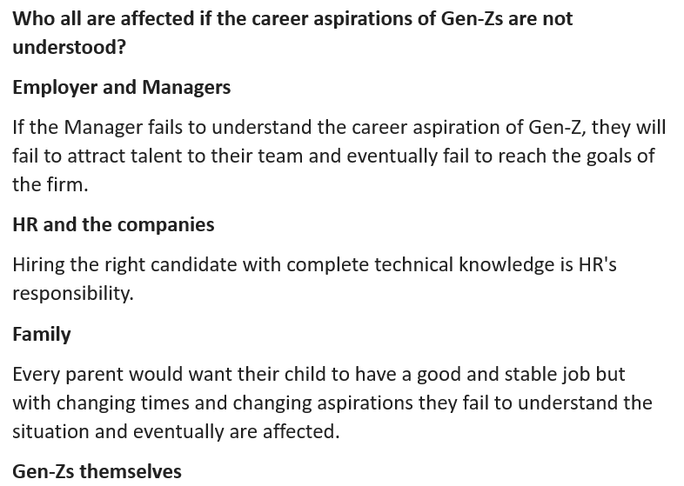
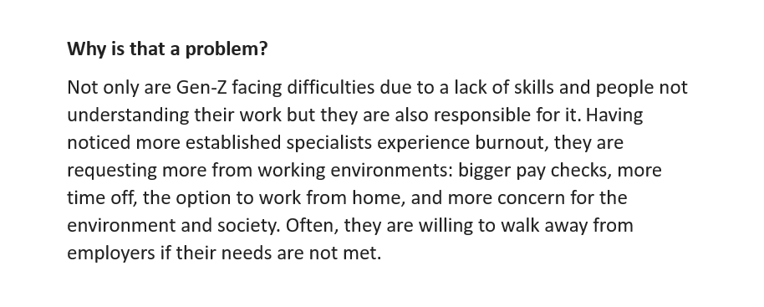
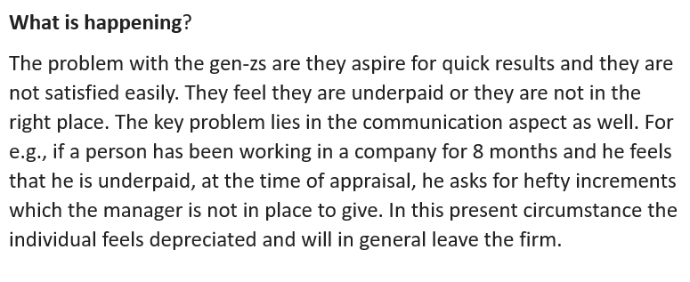
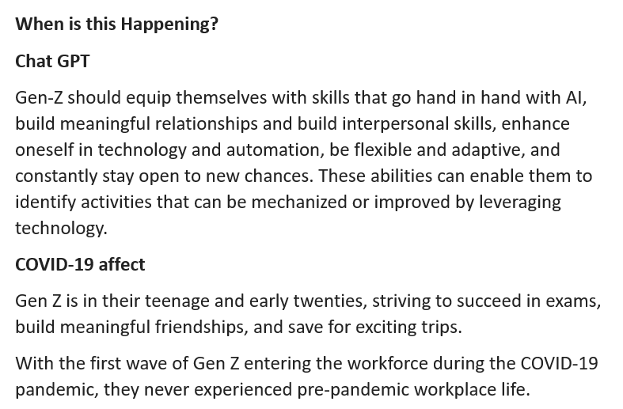
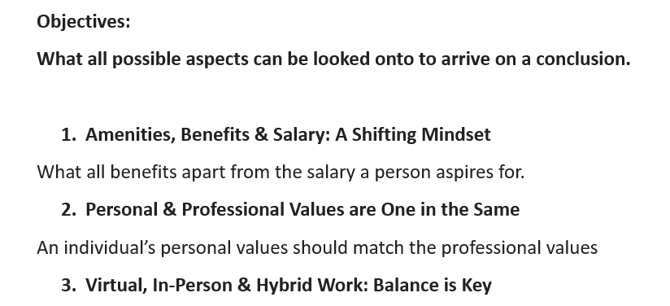
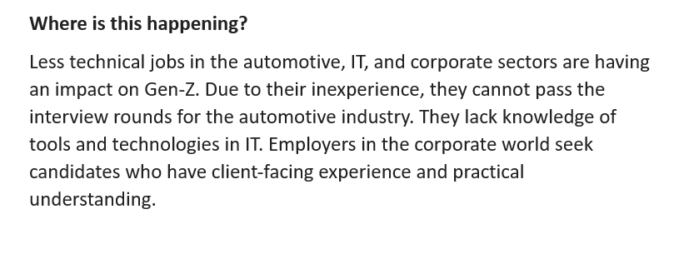
Approaching the problem statement and creating a Business Research Document.

Slide 6
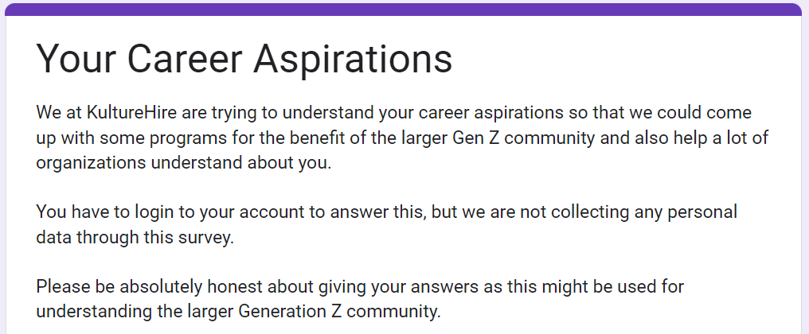
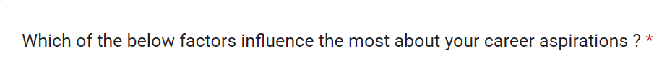
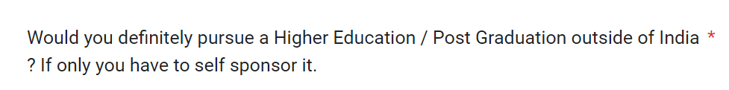
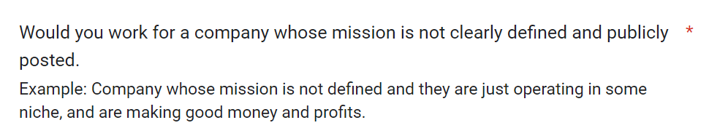
DATA COLLECTION PROCESS
Data collection improves customer experience and drives better decision-making and overall growth for businesses across the board.
For our problem statement we gathered data from the Gen-Zs through platforms like LinkedIn, Instagram, etc.
We received around 3100 complete forms and around 50,000 responses. The responses were roughly from 1800 different Postal codes across India.

Slide 7
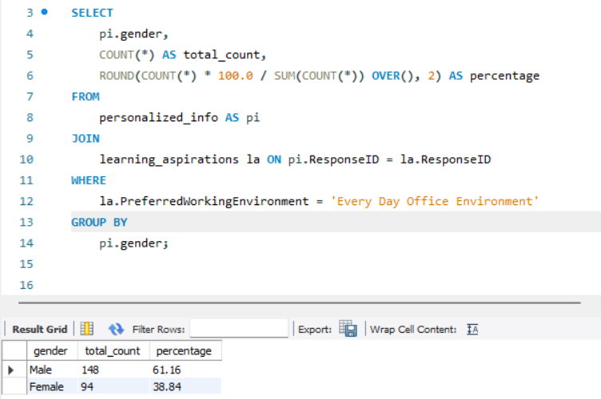
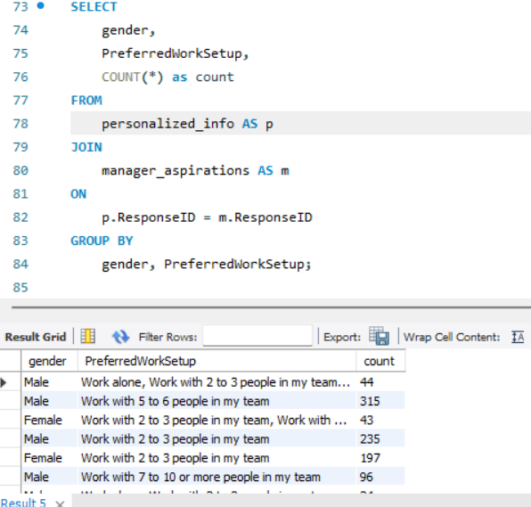
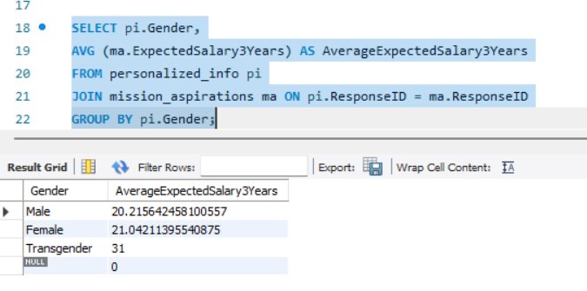
Cleaning the data and Analysis of Business questions using sql
We worked on MYSQL Server Workbench. Imported data from csv and xlsx files to the server, wrote codes to get the answers to the required for the Analysis of Business questions.
We solved 22 business questions and here we have some snippets of the codes along with the outputs:

Slide 8
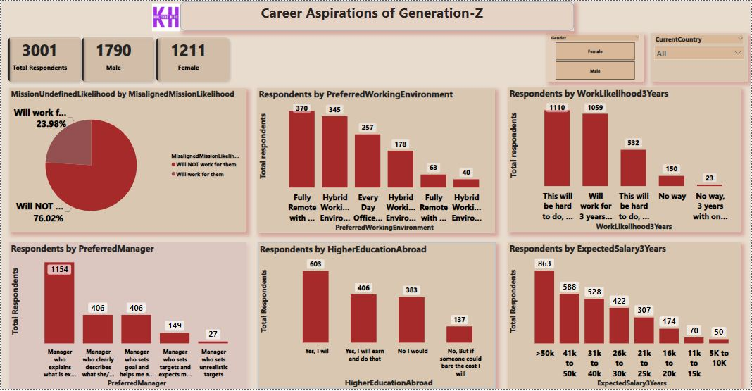
Comprehensive Dashboard

Slide 9
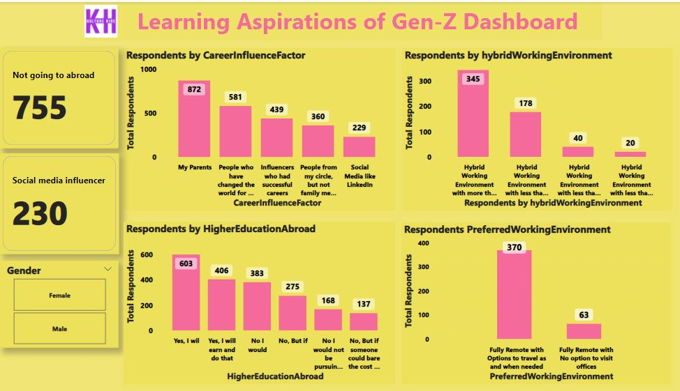
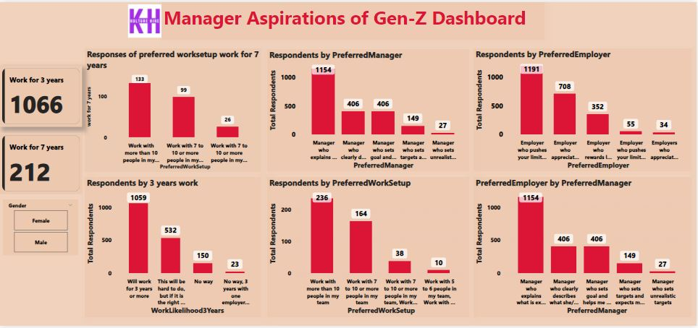
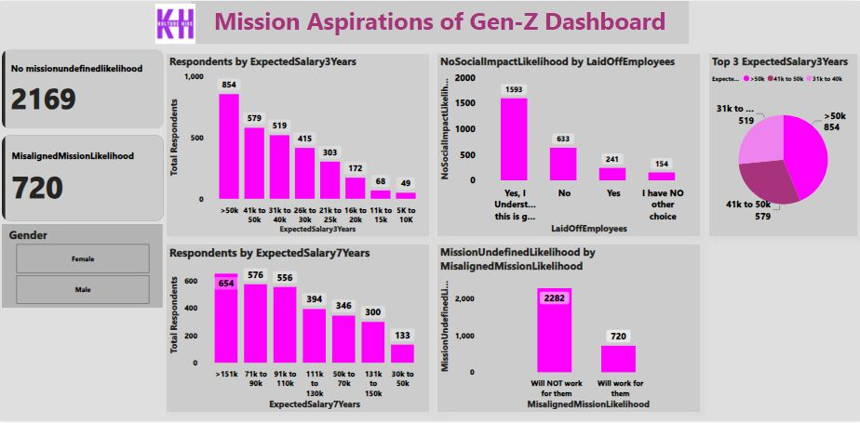
Focused Area Dashboard
We made three focused dashboards along with one comprehensive dashboard. These three dashboards were based of 3 aspects :
Learning Dashboard
Manager Dashboard
Mission Dashbaord

Slide 10




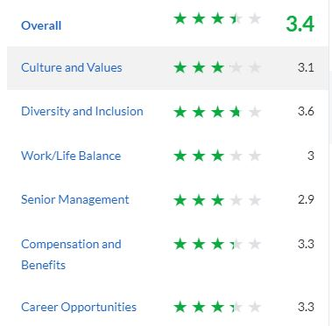
Walmart
Glassdoor
Ambitionbox
HQ - Bangalore/Bengaluru, Karnataka, India | Retail 5k-10k Employees (India)
If you’re thinking ‘scale’, think bigger and don’t stop there. Take a regular day at Walmart Global Tech India and match that with 260 million customers a week, 11,695 stores, under 59 banners in 28 countries, and eCommerce websites in 11 countries.
That’s Walmart Global Tech India for you!
Through our products and engineering services across all Walmart properties (stores, app, and online) we help customers live better by saving them time and money.
Our teams are engaged in cutting edge engineering and product development to support Walmart’s strategy of offering customers an anywhere, anytime shopping experience.
Ratings
55% of Walmart employees would recommend working there to a friend based on Glassdoor reviews. Employees also rated Walmart 3.0 out of 5 for work life balance, 3.1 for culture and values and 3.3 for career opportunities.

Slide 11

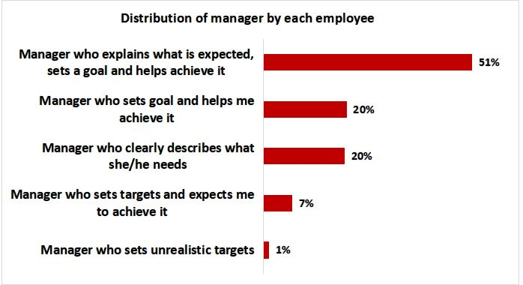
Distribution of Manager by Employees
Problem : From overall ratings ,management has less ratings i.e 2.9 on glassdoor.
Reason: Manger didnot give as such attention to employees ,sometimes managers can be rude, they put all pressures on employees and ultimately converted into overtime.It may distracts worklife balance of employees.
Recommendation :Manager can define work towards employees in clear and concise way and can have one & one discussion with them on regural basis .It will beneficial for employees what they have to achieve

Slide 12
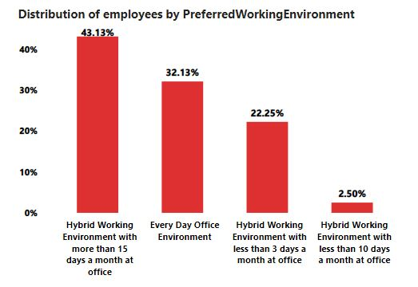
Distribution of Employees by WorkingEnvironment
Problem : From overall ratings ,work/life balance has less ratings i.e 3 on glassdoor.
Reason: Due to high volume of work employees have to extend their regular shift-timing/working hrs, which leads to distraction in terms of work and personal life.Most of time, employees have to work as an overtime which distrubs their mental as well as physical health.
Recommendation Manager can set proper vision that does not change frequently, it could help employees to work within shift timing.management have to be focused on employees instead of just focusing on customers.

Slide 13

Thank you

