Slide 1

Project Title – Seasonal Agricultural Performance Analysis
[Student Name-Mansi
College Name-Manipal University ]
AICTE STU ID :STU6a6c2e9a09a651785474714

Slide 2

PROBLEM STATEMENT
(Agricultural activities are influenced by seasonal variations in environmental conditions, farming practices, resource availability and market conditions. As a result, agricultural performance may differ from one season to another.
However, raw agricultural data does not clearly explain how agricultural performance changes across seasons or what patterns can be observed in different seasonal conditions.
The problem is to analyze the given agricultural dataset and investigate seasonal differences in agricultural performance by identifying meaningful patterns, trends, relationships and variations within the available data.

Slide 3
Project Description .
Seasonal Agriculture Performance Analysis is a data analytics project focused on understanding how agricultural performance varies across the Kharif, Rabi, and Zaid seasons. The project uses agricultural data covering factors such as crop type, geographical location, rainfall, temperature, soil conditions, fertilizer and pesticide usage, irrigation methods, crop yield, production, water usage, and economic performance.
The project involves data exploration, data cleaning, statistical analysis, and data visualization to identify meaningful seasonal patterns, trends, relationships, and variations. The analysis compares agricultural yield, production, profitability, and water-use efficiency across seasons and examines the relationship between environmental factors and crop performance.
The findings are used to generate evidence-based insights and recommendations that can support better understanding of seasonal agricultural performance and contribute to more informed agricultural planning.

Slide 4

WHO ARE THE END USERS?
Farmers: To understand seasonal crop performance, yield patterns,
resource usage, and profitability.
Agricultural Planners: To support evidence-based seasonal planning and
resource allocation.
Agricultural Researchers: To identify seasonal trends, environmental relationships,
and areas requiring further investigation.
Government & Agricultural Organizations: To support data-driven agricultural
policies and planning.
Agribusinesses: To understand seasonal production and economic performance
for better decision-making.

Slide 5

Technology Used
Python – Primary programming language used for data analysis.
Google Colab – Used as the development and execution environment.
Pandas – Used for data loading, cleaning, manipulation, and analysis.
NumPy – Used for numerical calculations and data operations.
Matplotlib – Used to create visualizations and present analytical findings.
CSV Dataset – Used as the source data for the analysis.

Slide 6
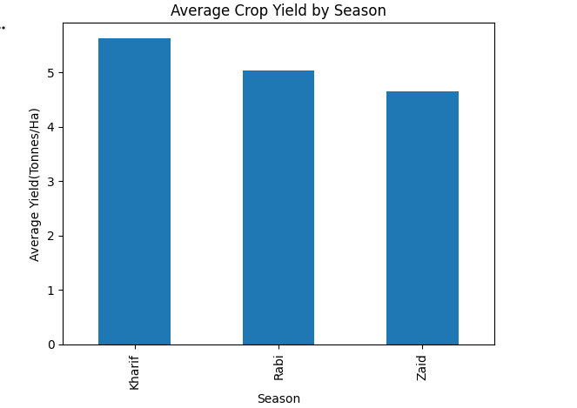
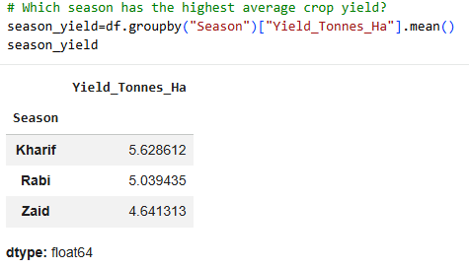
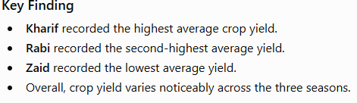
RESULTS
[Add screen shots of your code ]

Slide 7
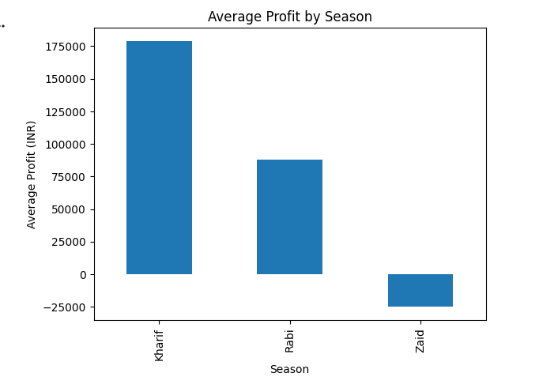
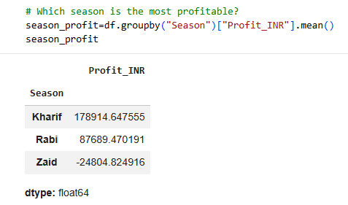
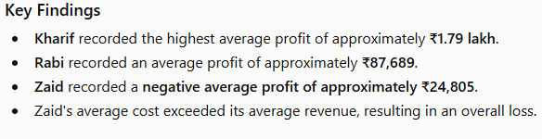
RESULTS

Slide 8
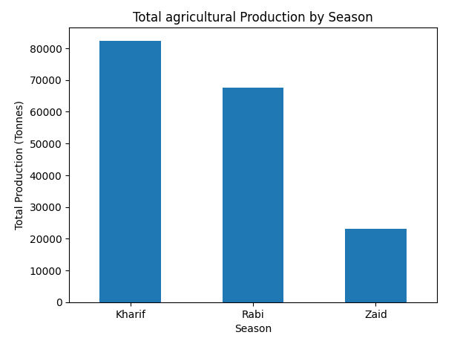
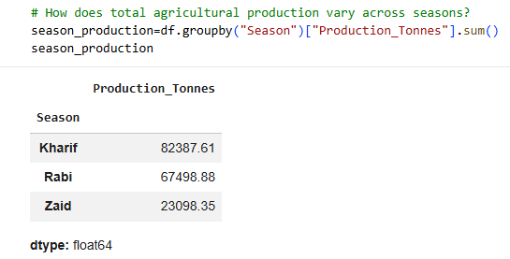
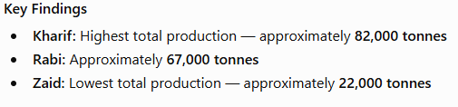
RESULTS

Slide 9
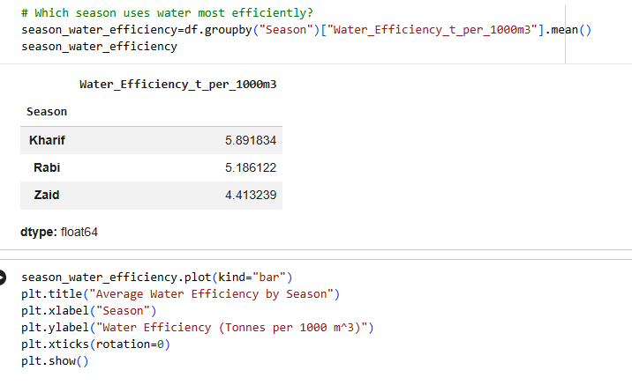
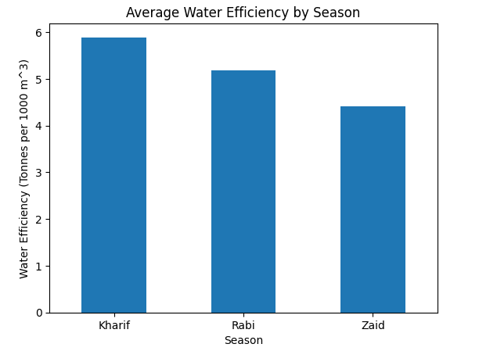
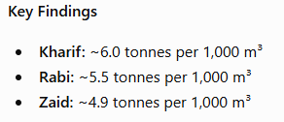
RESULTS

Slide 10
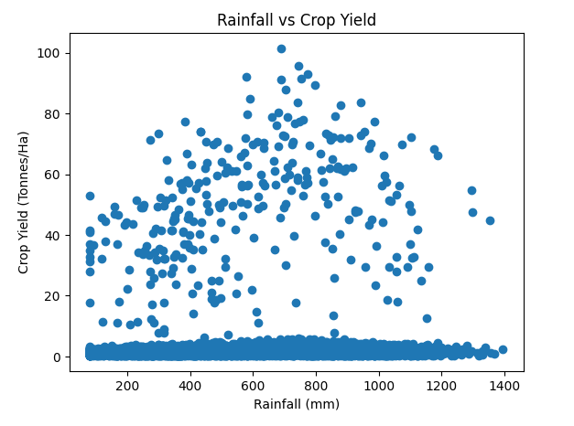
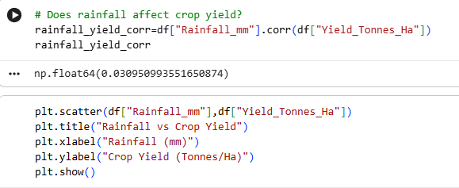
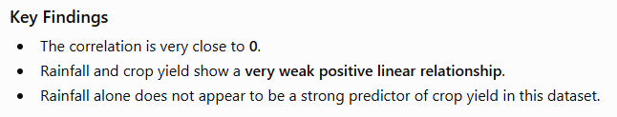
RESULTS
[Add screen shots of your code ]

Slide 11
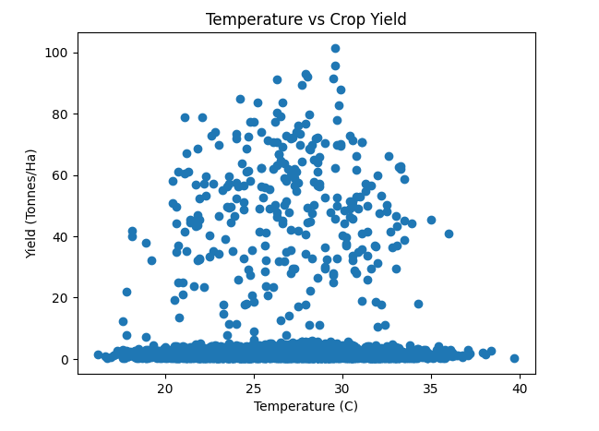
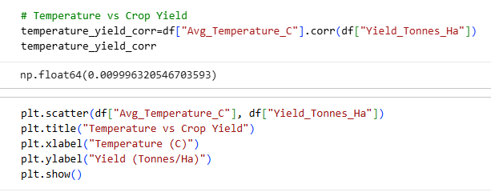
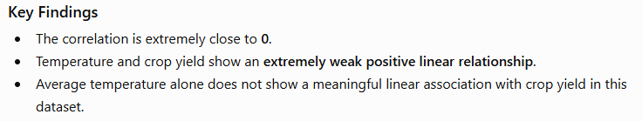
RESULTS
[Add screen shots of your code ]

Slide 12
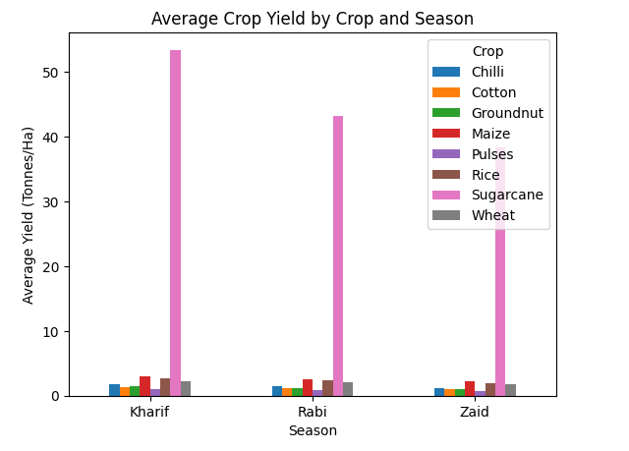

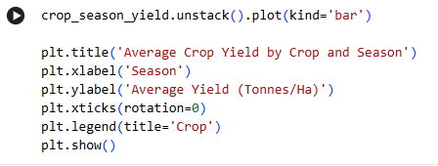
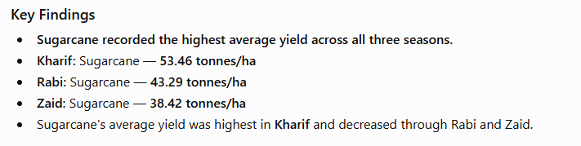
RESULTS
[Add screen shots of your code ]

Slide 13
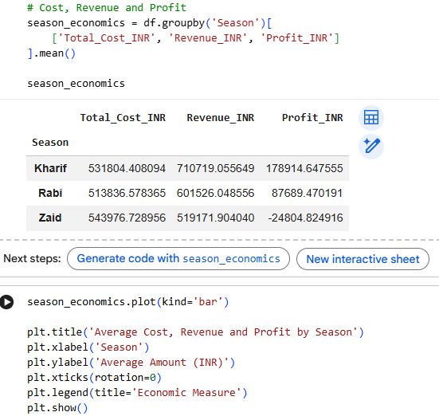
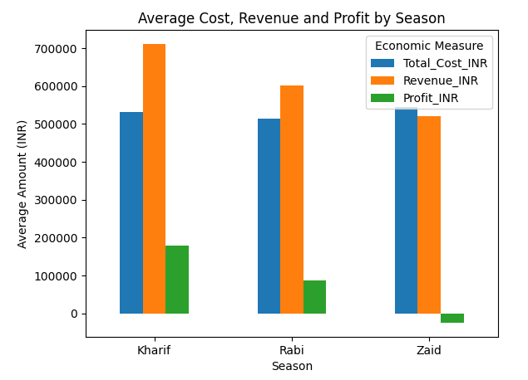
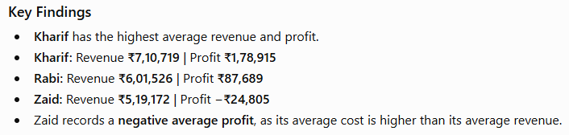
RESULTS
[Add screen shots of your code ]

Slide 14
Project Checklist ✓ Dataset loaded successfully ✓ Top 5 rows analyzed ✓ Dataset shape and structure examined ✓ Data types examined ✓ Missing values identified and handled ✓ Duplicate records identified and handled ✓ Descriptive/statistical analysis performed ✓ Outliers investigated ✓ Univariate analysis completed ✓ Bivariate analysis completed ✓ Multivariate analysis completed ✓ Correlation analysis completed ✓ Seasonal comparisons performed ✓ At least 3 student-designed analyses completed ✓ Evidence-based recommendations provided

Slide 15
Future scope
Predictive Analytics: Develop models to predict crop yield and profitability for different
seasons.
Weather Integration: Incorporate real-time weather data to improve agricultural
performance analysis.
Crop Recommendation: Build a system to recommend suitable crops based on seasonal and
environmental conditions.
Resource Optimization: Identify strategies for efficient use of water, fertilizer, and other
agricultural resources.
Regional Analysis: Expand the analysis to more regions and datasets to identify broader
agricultural patterns.
Interactive Dashboard: Develop an interactive dashboard to help farmers and agricultural
stakeholders explore insights easily.

Slide 16
GitHub Link
Project: Seasonal Agriculture Performance Analysis
Repository: https://github.com/mansi-analytics/seasonal-agriculture-performance-analysis

Slide 17
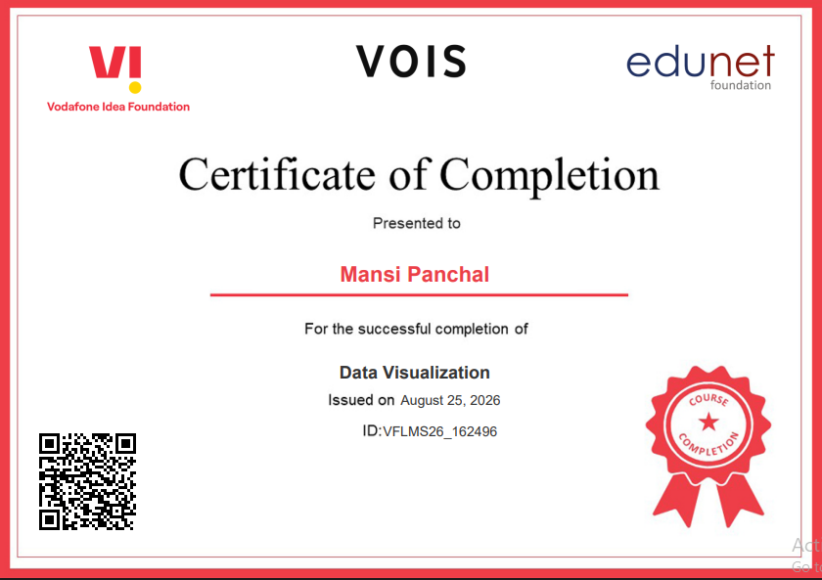
VOIS Course completion certificate - Course name- Data Visualization

Slide 18




