Slide 1
Phishing Site Detection Using ML Name- Mansi Bhanushali Roll no:- 2021009

Slide 2
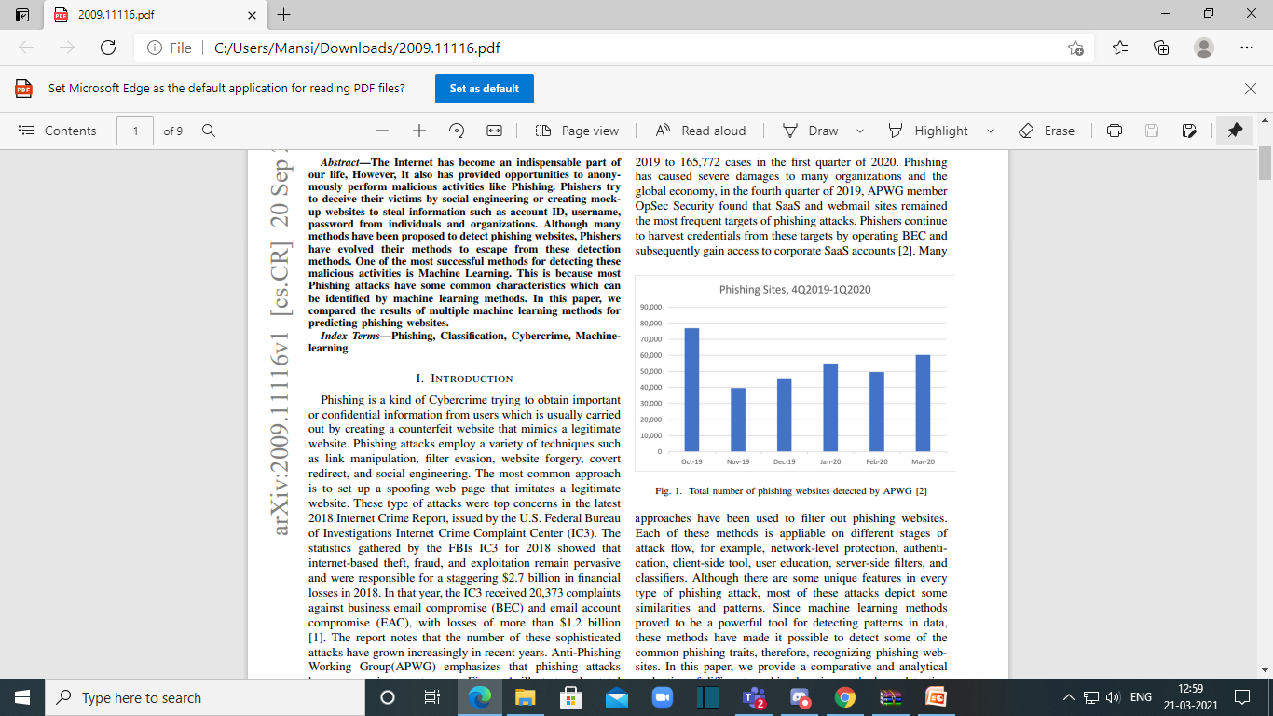
Introduction
Phishing attack is cybercrime trying to obtain sensitive, confidential information such as usernames, passwords, credit card information and more by creating a counterfeit website that mimics a legitimate website.

Slide 3
Phishing Techniques
Link manipulation
Filter evasion
Website forgery
Covert redirect
Social engineering

Slide 4
Phishing Detection Approach
1) List Based Approach -
The lists based technique incorporates two sort of lists:
Blacklist and Whitelist
Blacklist- list of malicious websites.
Whitelist- list of valid websites.
2) Visual Similarity Based Approach –
Phishing website appearance is exactly similar to the targeted legitimate website.

Slide 5
Phishing Detection Approach
3) Machine learning based Approach:
Machine learning methods are used to classify malicious activities or phishing website.

Slide 6
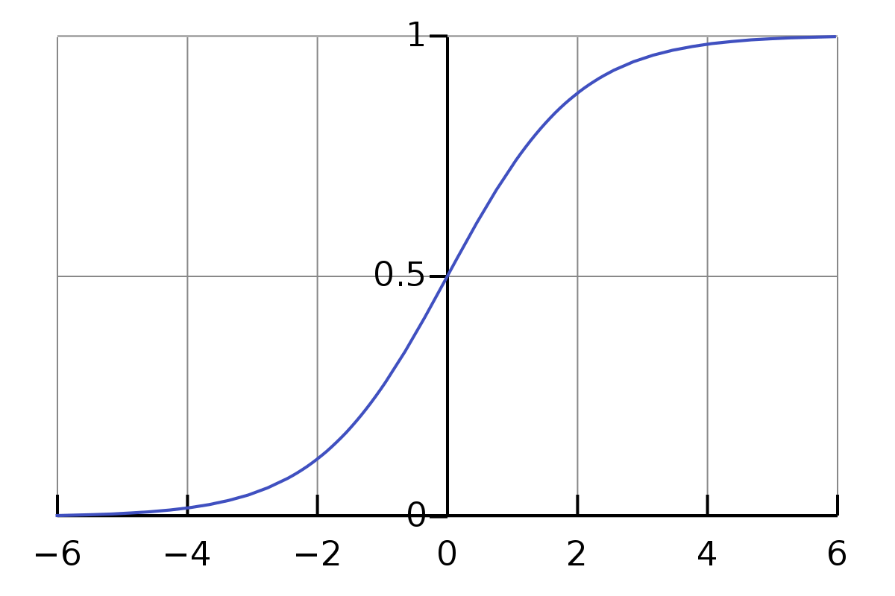
Machine learning Approach
Logistic Regression
Logistic Regression is a Machine Learning algorithm which is used for the classification problems, it is a predictive analysis algorithm and based on the concept of probability.
To map predicted values to probabilities, we use the Sigmoid function.

Slide 7
Machine Learning Approach
K Nearest Neighbour
K-NN algorithm assumes the similarity between the new case/data and available cases and put the new case into the category that is most similar to the available categories.
K-NN algorithm stores all the available data and classifies a new data point based on the similarity. This means when new data appears then it can be easily classified into a well suite category by using K- NN algorithm.

Slide 8
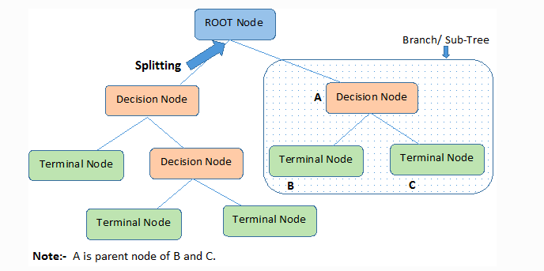
Machine Learning Approach
Decision tree
A decision tree is a flowchart-like tree structure where an internal node represents a feature or attribute, the branch represents a decision rule, and each leaf node represents the outcome.
The topmost node in a decision tree is known as the root node. It learns to partition based on the attribute value. It partitions the tree in a recursive manner called recursive partitioning.

Slide 9
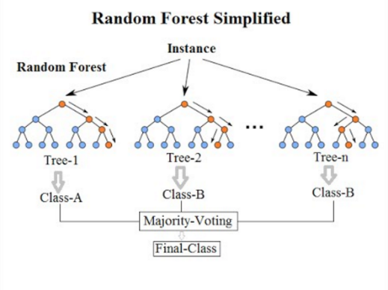
Machine Learning Approach
Random forest
Random Forest is a classifier that contains a number of decision trees on various subsets of the given dataset and takes the average to improve the predictive accuracy of that dataset.
Instead of relying on one decision tree, the random forest takes the prediction from each tree and based on the majority votes of predictions.

Slide 10
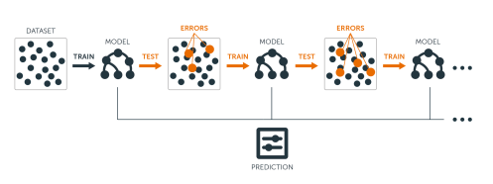
Machine Learning Approach
Gradient Boosting
Gradient boosting is a machine learning technique for regression and classification problems, which produces a prediction model in the form of an ensemble of weak prediction models, typically decision trees. The objective of it is to define a loss function and minimize it.

Slide 11
Machine Learning Approach
AdaBoost
AdaBoost algorithm, short for Adaptive Boosting, is a Boosting technique that is used as an Ensemble Method in Machine Learning. It is called Adaptive Boosting as the weights are re-assigned to each instance, with higher weights to incorrectly classified instances.
It works on the principle where learners are grown sequentially. Except for the first, each subsequent learner is grown from previously grown learners.
XGBoost
XGBoost stands for “Extreme Gradient Boosting”. XGBoost is an ensemble learning method. his powerful algorithm lies in its scalability, which drives fast learning through parallel and distributed computing and offers efficient memory usage.

Slide 12
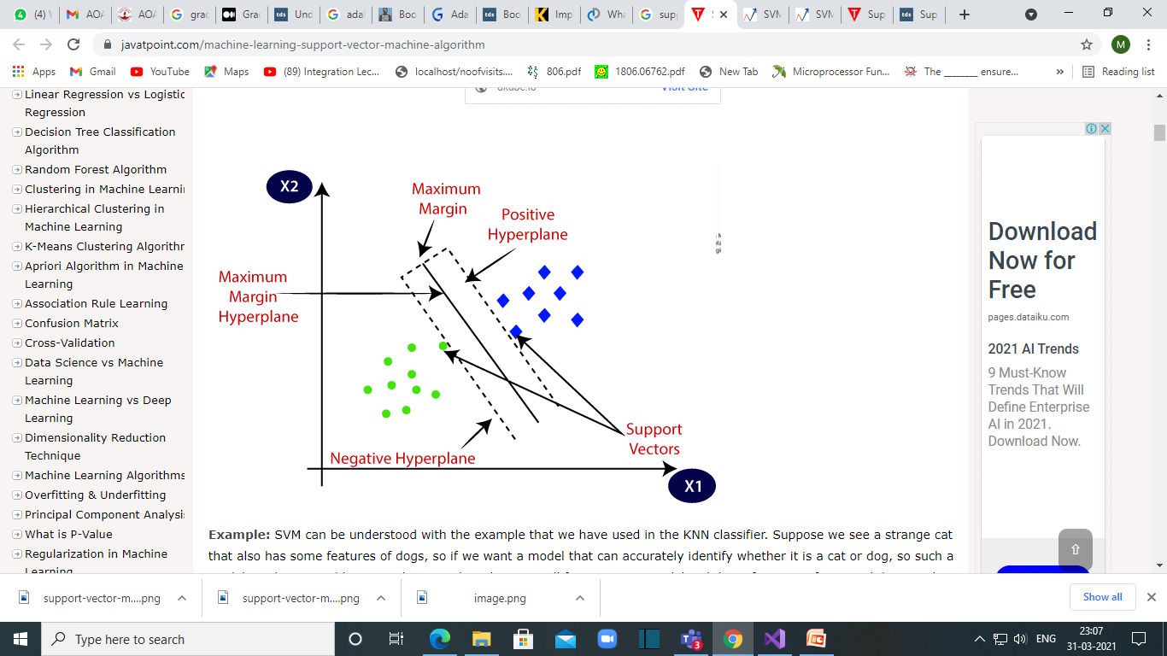
Machine Learning Approach
Support Vector Machine:
The goal of the SVM algorithm is to create the best line or decision boundary that can segregate n-dimensional space into classes.This best decision boundary is called a hyperplane.
SVM chooses the extreme points/vectors that help in creating the hyperplane. These extreme cases are called as support vectors.

Slide 13
Data Set Features
Some of the data set features used for identifying a phishing Website:-
Having IP Address
URL Length
Shortening Service
Having @ Symbol
Double Slash Redirection
Prefix Suffix
Having Sub Domain

Slide 14
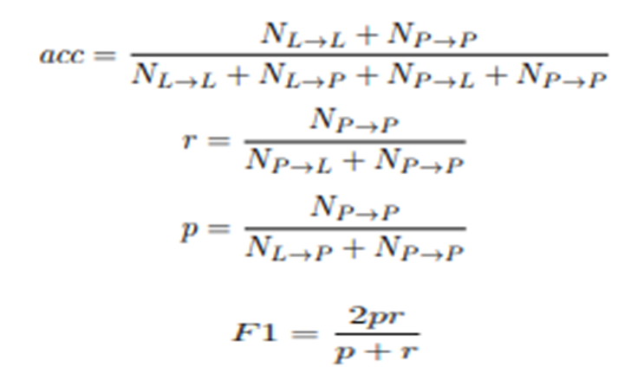
Evaluation Matrix
NL→L : Number of legitimate websites classified as legitimate
NP→P : Number of phishing websites classified as phishing
NL→P: Number of legitimate websites misclassified as phishing
NP→L : Number of phishing websites misclassified as legitimate

Slide 15
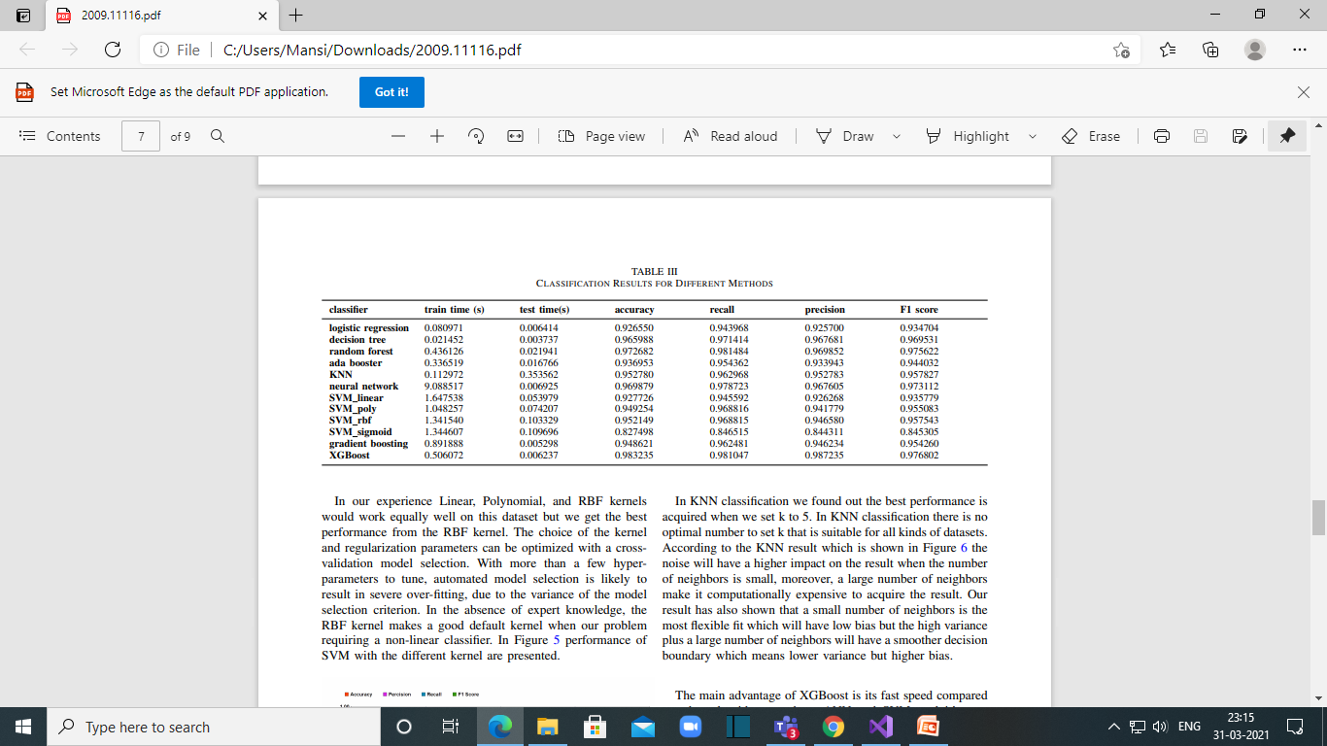
Result

Slide 16
Conclusion
By evaluating various machine learning models on phishing website dataset it was observed that ensembling classifiers namely Random Forest, XGBoost both provided better accuracy compared to other models. This is the reason ensemble based learning is used in most classifications .

Slide 17
Implementation Strategy
Train the dataset using explained dataset features.
Implement Decision Tree and Random forest to calculate accuracy, recall,precision and F1 score.

Slide 18
References
https://en.wikipedia.org/wiki/Phishing
https://www.javatpoint.com/machine-learning-decision-tree
https://www.mygreatlearning.com/blog/adaboost-algorithm/
https://www.javatpoint.com/machine-learning-support-vector-machine
Algorithm
https://www.javatpoint.com/machine-learning-random-forest-algorithm
https://medium.com/mlreview/gradient-boosting-from-scratch
https://machinelearningmastery.com/boosting-and-adaboost-for
machine-learning/
https://www.tutorialspoint.com/machine_learning_with_python/machine
_learning_with_python_classification_algorithms_logistic_regression
https://www.javatpoint.com/k-nearest-neighbor-algorithm-for-machine-
Learning

