Slide 1

Project Title – Healthcare analytics for doctor visit.
[Student Name ] : Mansi Breja

Slide 2

PROBLEM STATEMENT
Healthcare organizations generate large amounts of data related to patient visits, demographics, medical conditions, and healthcare services. However, analyzing this data effectively can be challenging. The project aims to analyze doctor visit data to identify patterns in patient visits, understand demographic and medical trends, and uncover factors influencing healthcare utilization. The analysis can help healthcare providers make data-driven decisions, improve resource allocation, and enhance patient care.

Slide 3
Project Description
[write detail description about your project ]
The Healthcare Analytics – Doctor Visit Analysis project focuses on analyzing patient and doctor visit data using data analytics techniques. The dataset is explored to understand patterns such as the number of doctor visits, patient demographics, medical conditions, age groups, and other relevant factors.

Slide 4

WHO ARE THE END USERS?
Hospital Organisations
Health care firms

Slide 5

Technology Used
  Python
  Visual Code Studio
  Numpy ,Pandas
  Matplotlib,Seaborn

Slide 6
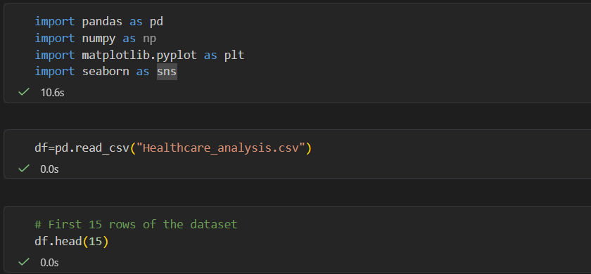
RESULTS
Demo Link

Slide 7
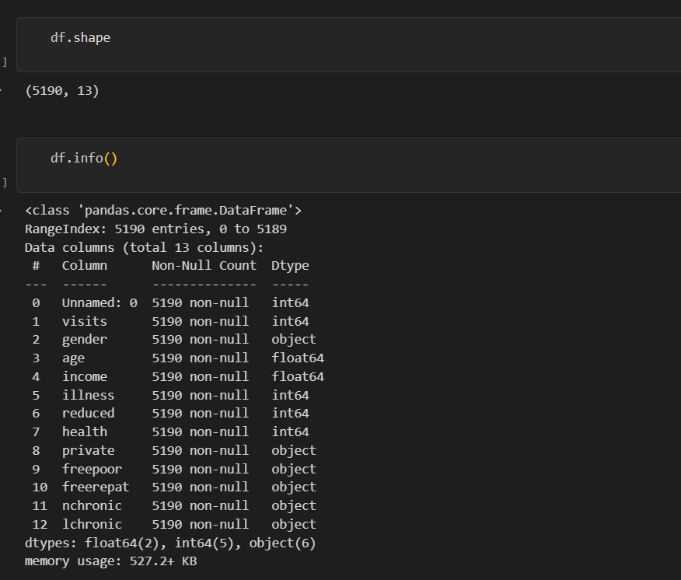
RESULTS
Demo Link

Slide 8
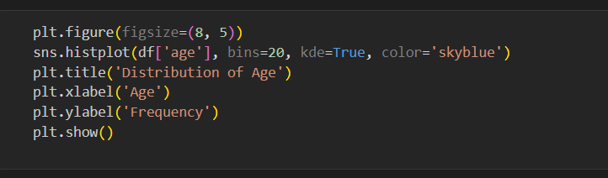
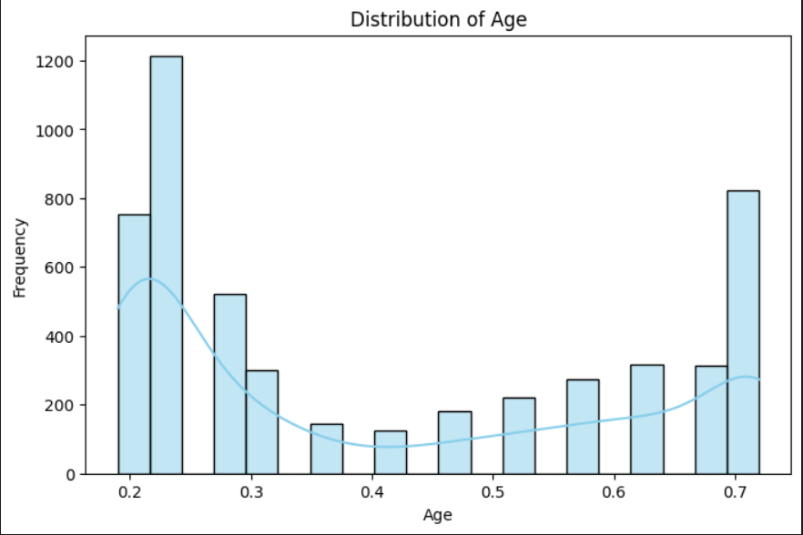
RESULTS
Demo Link

Slide 9
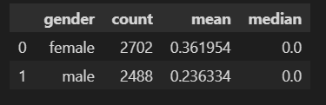
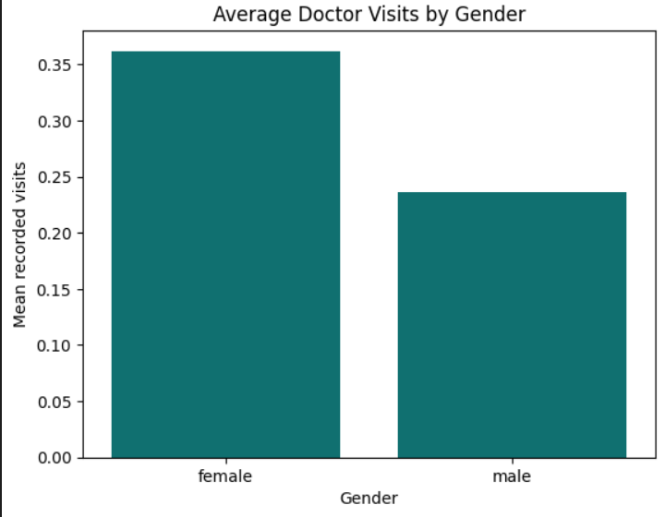
RESULTS

Slide 10
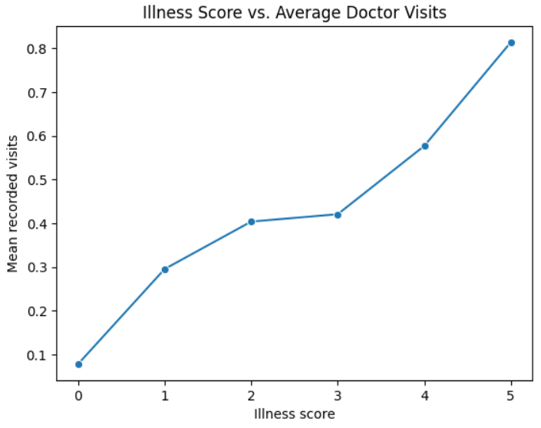
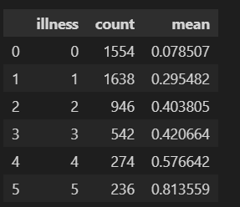
RESULTS

Slide 11
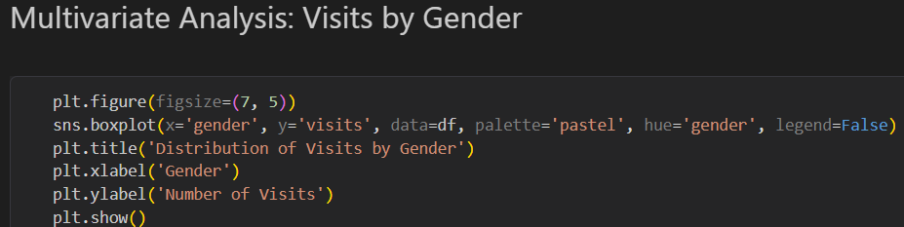
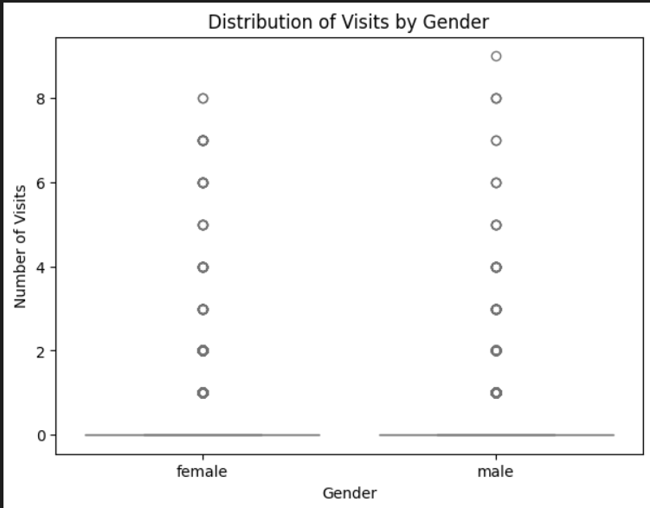
RESULTS
Demo Link

Slide 12
Thank you
.
.

