Slide 1
Exploratory Data Analysis (EDA) for Real Estate Pricing
Unveiling the Dynamics of House Valuation in a Dynamic Market

Slide 2
Introduction
Analysis of 1,460 properties with 81 features
Objective: Identify factors influencing house prices
Enable informed decision-making for pricing strategy
Uncover patterns and trends in the real estate market
Provide actionable insights for business opportunities

Slide 3
Methodology
Data Cleaning: Handled missing values and outliers
Feature Engineering: Created new metrics (e.g., price per sq ft)
Univariate Analysis: Distribution of individual variables
Multivariate Analysis: Relationships between variables
Statistical Modeling: Correlation analysis and clustering
Visualization: Charts and graphs for pattern identification

Slide 4
Key Findings

Slide 5
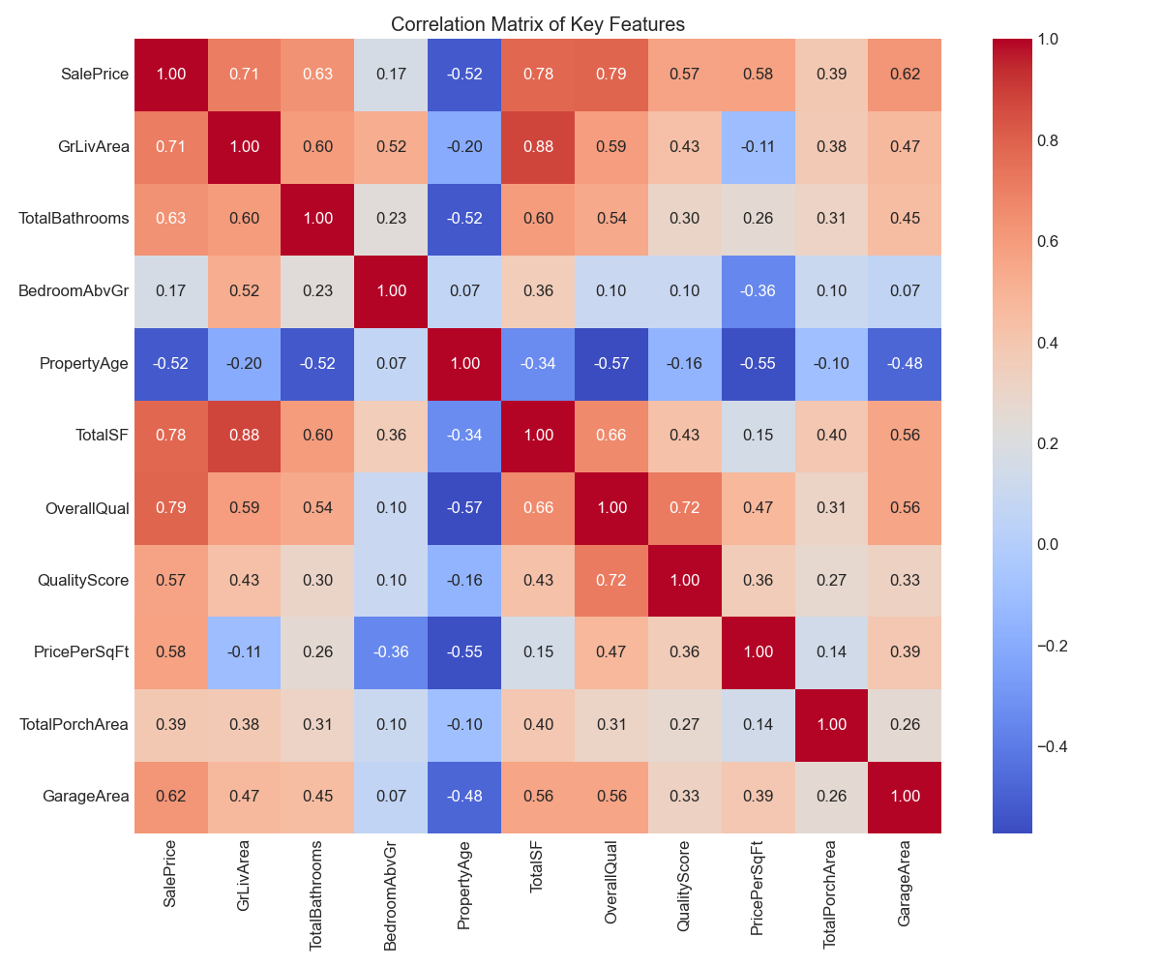
Primary Price Determinants
Correlation matrix showing the strongest factors influencing house prices

Slide 6
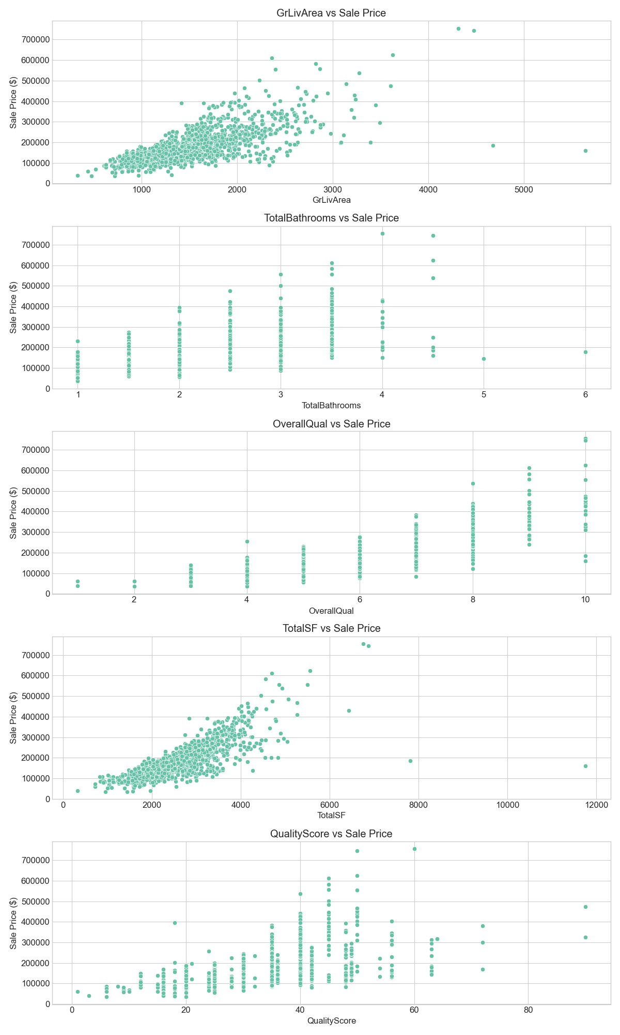
Size Impact Analysis
Strong positive correlation between living area and price (0.71)
Each additional bathroom adds significant value
Bedrooms show positive but weaker correlation (0.17)
Total square footage is the second strongest predictor (0.78)

Slide 7
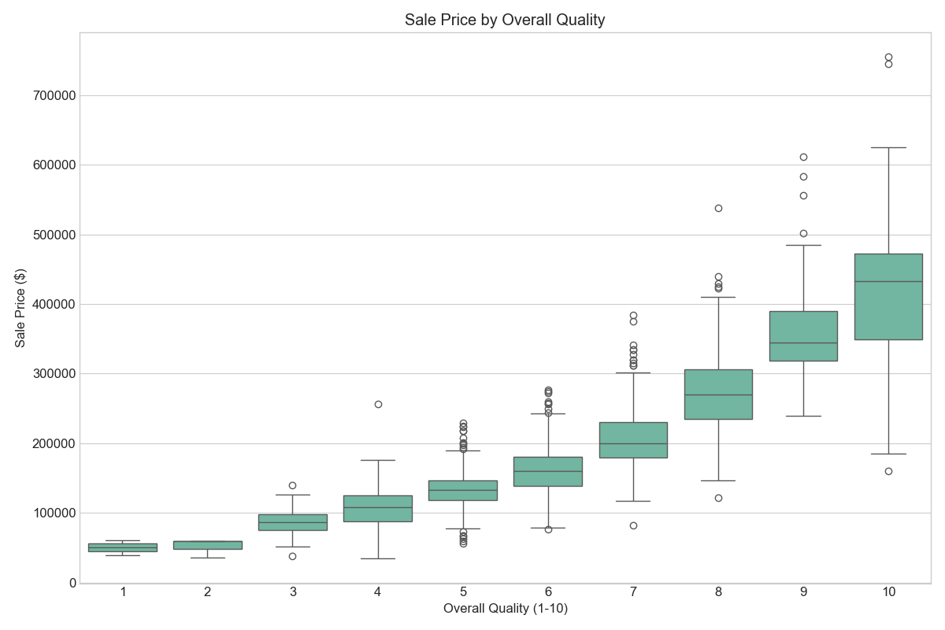
Quality and Condition Impact
Overall quality is the strongest single predictor of price (0.79 correlation)

Slide 8
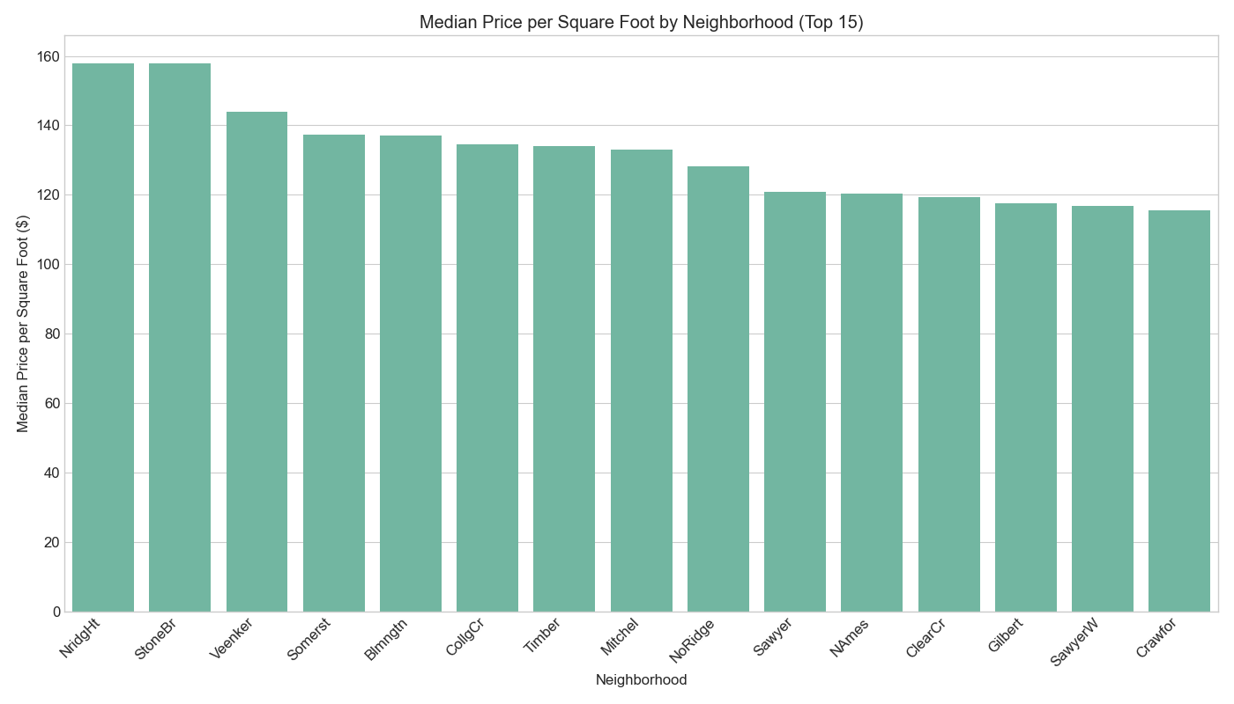
Location Analysis
Price per square foot varies significantly by neighborhood

Slide 9
Property Age and Renovations
Property age has a negative correlation with price (-0.52)
Remodeled homes sell for higher prices than similar non-remodeled homes
Newer homes with modern features command premium prices
Renovation can significantly offset the negative impact of age

Slide 10
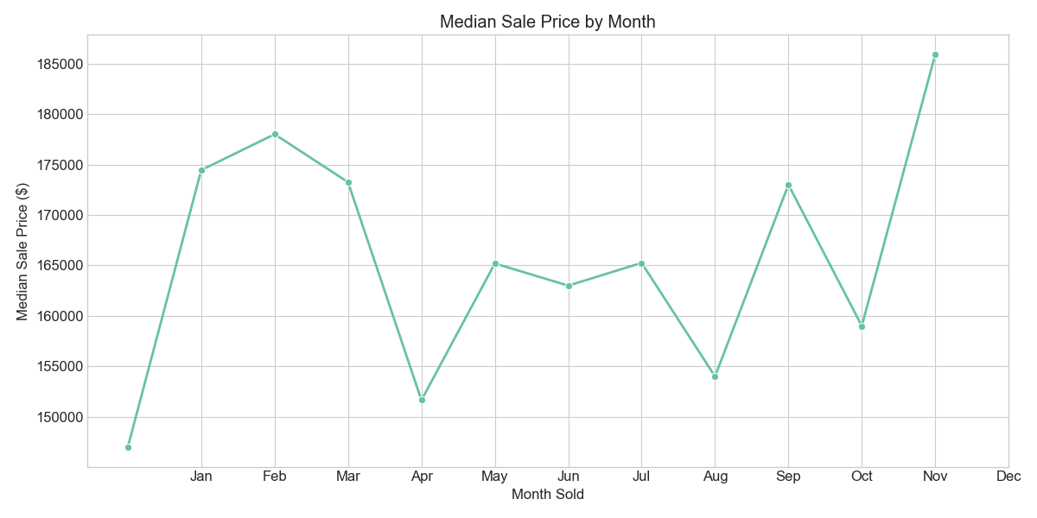
Market Trends
Sale prices show patterns based on month of sale
Certain months show consistently higher prices
Normal sales vs. abnormal conditions show distinct pricing patterns
Understanding seasonal variations can optimize listing timing

Slide 11
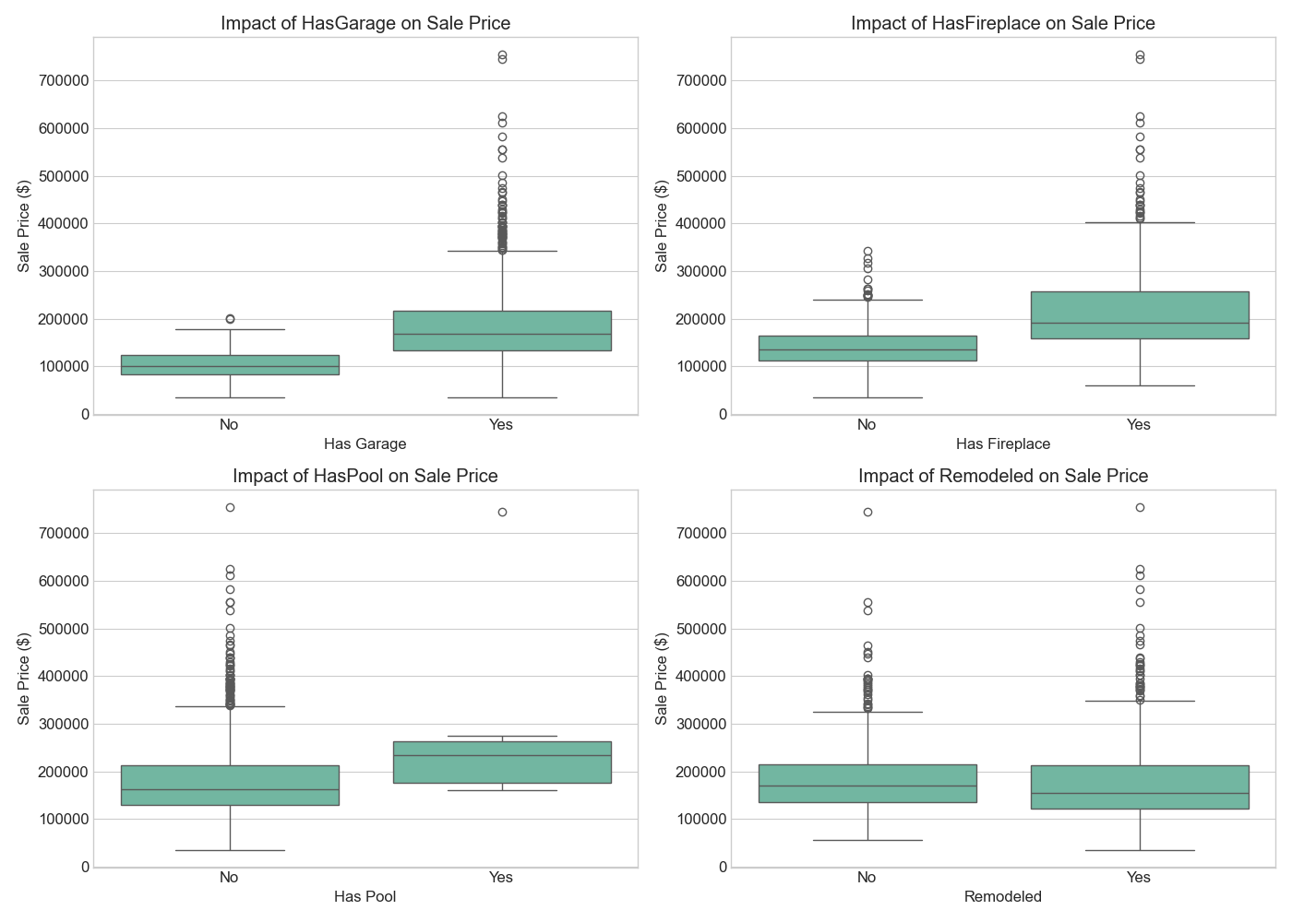
Impact of Amenities
Presence of garage, fireplace, and other amenities adds significant value

Slide 12
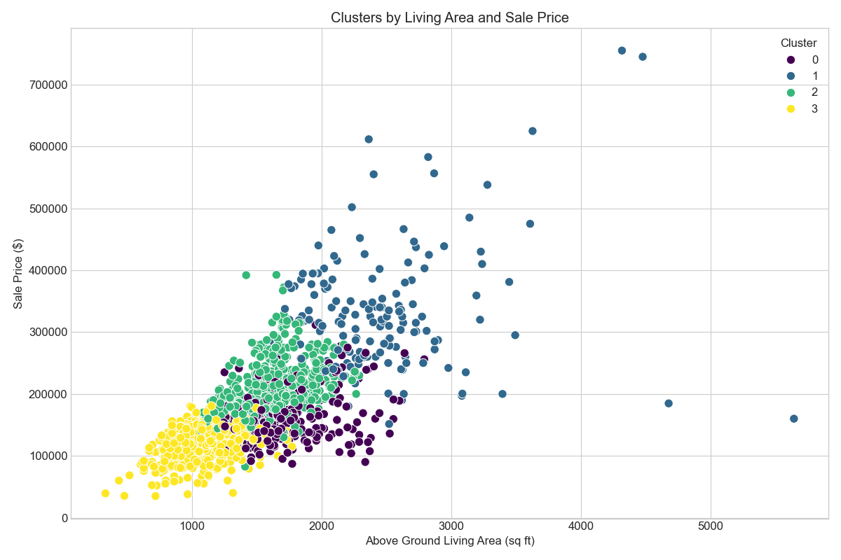
Market Segmentation
Cluster analysis identified four distinct property segments in the market

Slide 13
Market Segments Identified
Luxury Segment: $331,635 avg. price, newer homes (34 yrs), high quality (8.1/10)
Mid-Range Modern: $207,966 avg. price, newer homes (28 yrs), good quality (6.9/10)
Mid-Range Older: $160,782 avg. price, older homes (83 yrs), average quality (5.7/10)
Economy Segment: $121,201 avg. price, older homes (69 yrs), basic quality (5.0/10)

Slide 14
Recommendations

Slide 15
Strategic Recommendations
Develop a multi-factor pricing model weighing quality, size, location, and age
Target properties in growing neighborhoods with renovation potential
Prioritize bathroom additions and quality improvements for maximum ROI
Consider seasonal trends when listing properties
Tailor marketing approaches based on the four identified property clusters
Use price per square foot by neighborhood as benchmark for competitive pricing

Slide 16
Conclusion
Overall quality and size are the strongest price determinants
Location significantly impacts property valuation
Property age negatively affects price but can be offset by renovations
Market segmentation reveals distinct pricing strategies for different property types
Data-driven approach enables optimized pricing and investment decisions
Continued analysis can further refine pricing strategies and market positioning

Slide 17
Thank You
Questions & Discussion

