Slide 1

Rungta College of Engineering and Technology, Bhilai , Chhattisgarh
Department of Computer Science and Engineering
(Data Science)
Education Performance Dashboard
Team members
Mansi Gupta
Richa Patel
Muskan Bharti
Rani Kumari
Sakshi Tiwari
Varsha singh

Slide 2
Abstract
Designed by a data analyst to monitor education performance
Shows important data like student results, attendance, and enrollment
Uses charts and graphs for easy understanding
Helps teachers and administrators track student progress
Identifies strengths and weak areas in academic performance
Supports data-based decisions to improve education quality
Saves time by presenting all information in one dashboard

Slide 3
Introduction
Education systems generate large amounts of student and academic data
An Education Performance Dashboard organizes this data in one place
It is developed by a data analyst using data analysis and visualization tools
The dashboard shows key metrics like attendance, marks, and overall performance
It helps teachers, administrators, and management understand trends easily
Supports quick and accurate decision-making
Aims to improve student outcomes and educational quality

Slide 4
Problem statement
Educational data is often scattered across multiple sources
Manual analysis of student performance is time-consuming and error-prone
Lack of clear visualization makes it difficult to understand trends
Teachers and administrators struggle to identify weak and strong areas
Decision-making is often based on assumptions rather than data
There is a need for a centralized dashboard to monitor education performance effectively

Slide 5
Literature Survey
Many researchers highlight the importance of data visualization in education for quick understanding of performance.
Studies show dashboards help teachers and administrators track student outcomes more efficiently than traditional reports.
Previous work emphasizes using indicators like attendance, grades, and student behavior to improve learning support.
Research suggests that interactive dashboards increase engagement and help in timely decision-making.
Literature also points out challenges like data quality, integration from different sources, and ensuring real-time updates.
Most studies conclude that performance dashboards improve transparency and support better educational planning.

Slide 6
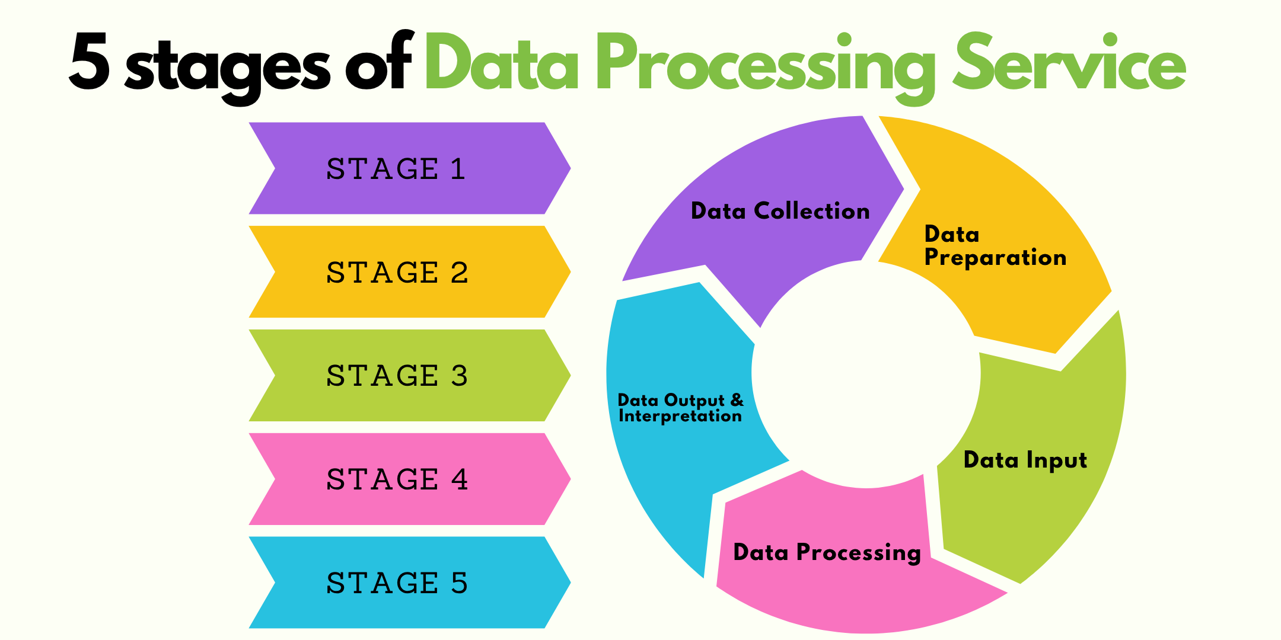
Proposed Methodology
Data Collection
Data Cleaning & Preprocessing
Data Analysis
Data Visualization
Dashboard Development
Performance Monitoring & Decision Support

Slide 7





Reference
Python
R
Excel
SQL
Power BI
Tableau

Slide 8
Result
The dashboard provides a clear and visual view of student performance data
Helps identify high-performing and low-performing students easily
Shows trends in attendance, marks, and overall results
Reduces manual effort and time in analyzing educational data
Improves accuracy and consistency in performance reporting
Enables quick comparison across classes, subjects, or academic years

Slide 9
Conclusion
The Education Performance Dashboard is an effective tool for performance monitoring
It supports data-driven decision-making in the education sector
Helps teachers and administrators take timely corrective actions
Enhances transparency and understanding of academic outcomes
Overall, it contributes to improving the quality of education and student success

