Slide 1
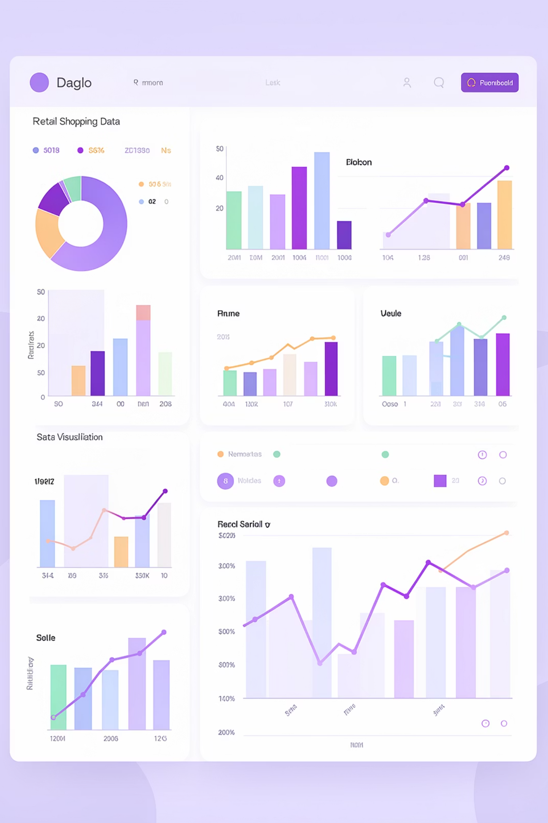
Customer Shopping Behavior Analysis
Uncovering insights from 3,900 purchases to guide strategic business decisions

Slide 2
Dataset Overview
3,900
18
37
Purchase Records
Data Fields
Missing Values
Transactional data analyzed
Customer and purchase details
Review ratings imputed
Customer Data
Purchase Details
Age, Gender, Location
Subscription Status
Previous Purchases
Item, Category, Amount
Season, Size, Color
Discount Applied

Slide 3
Python Data Preparation
01
02
03
Data Loading
Exploration
Cleaning
Imported dataset using pandas
Checked structure and summary statistics
Handled missing values, standardized columns
04
05
Feature Engineering
Database Integration
Created age groups and purchase frequency metrics
Loaded cleaned data into PostgreSQL

Slide 4
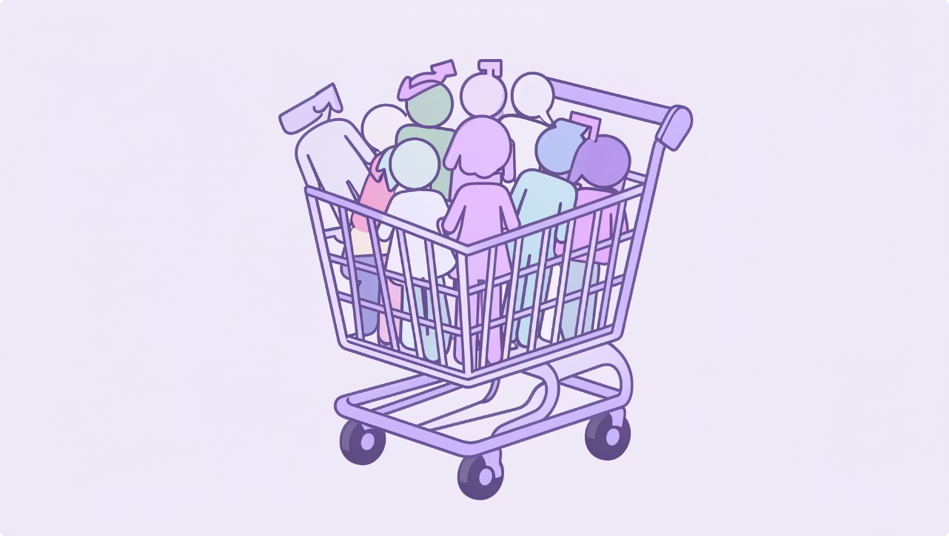
SQL Analysis: Revenue Insights
Gender Revenue Comparison
Male customers generated $157,890 vs. Female customers at $75,191
Shipping Impact
Express shipping: $60.48 average
Standard shipping: $58.46 average

Slide 5
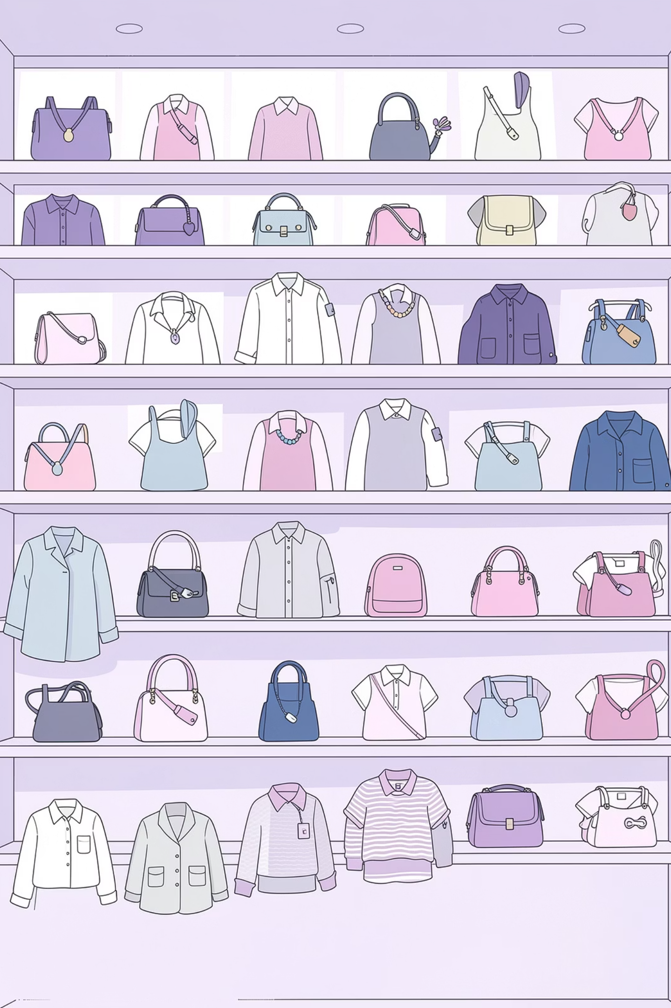



Product Performance
Top Rated
Most Discounted
Gloves (3.86), Sandals (3.84), Boots (3.82)
Hat (50%), Sneakers (49.66%), Coat (49.07%)
Best Sellers
Jewelry, Blouse, Pants, Sandals, Jacket

Slide 6

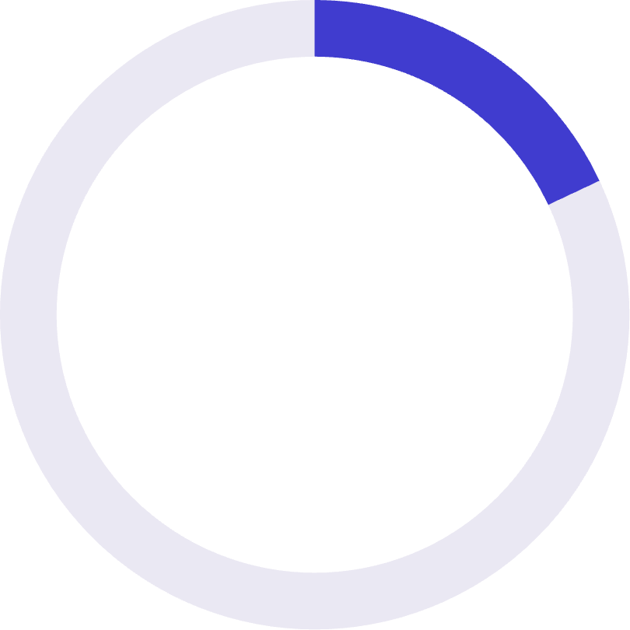

Customer Segmentation
79%
18%
2%
Loyal Customers
Returning
New
3,116 repeat buyers
701 customers
83 first-time buyers
Subscription Status
Purchase Frequency
27% subscribed (1,053 customers)
839 customers used discounts above average spend
73% non-subscribed (2,847 customers)
958 repeat buyers (>5 purchases)

Slide 7
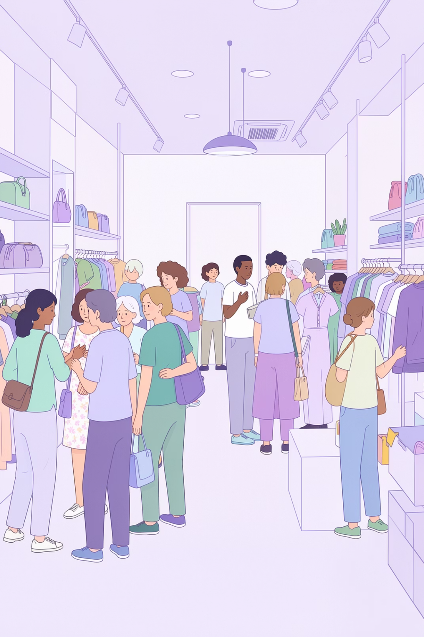
Age Group Analysis
Young Adult
$62,143 revenue
18-30 years
Middle-aged
$59,197 revenue
31-45 years
Adult
$55,978 revenue
46-59 years
Senior
$55,763 revenue
60-70 years

Slide 8
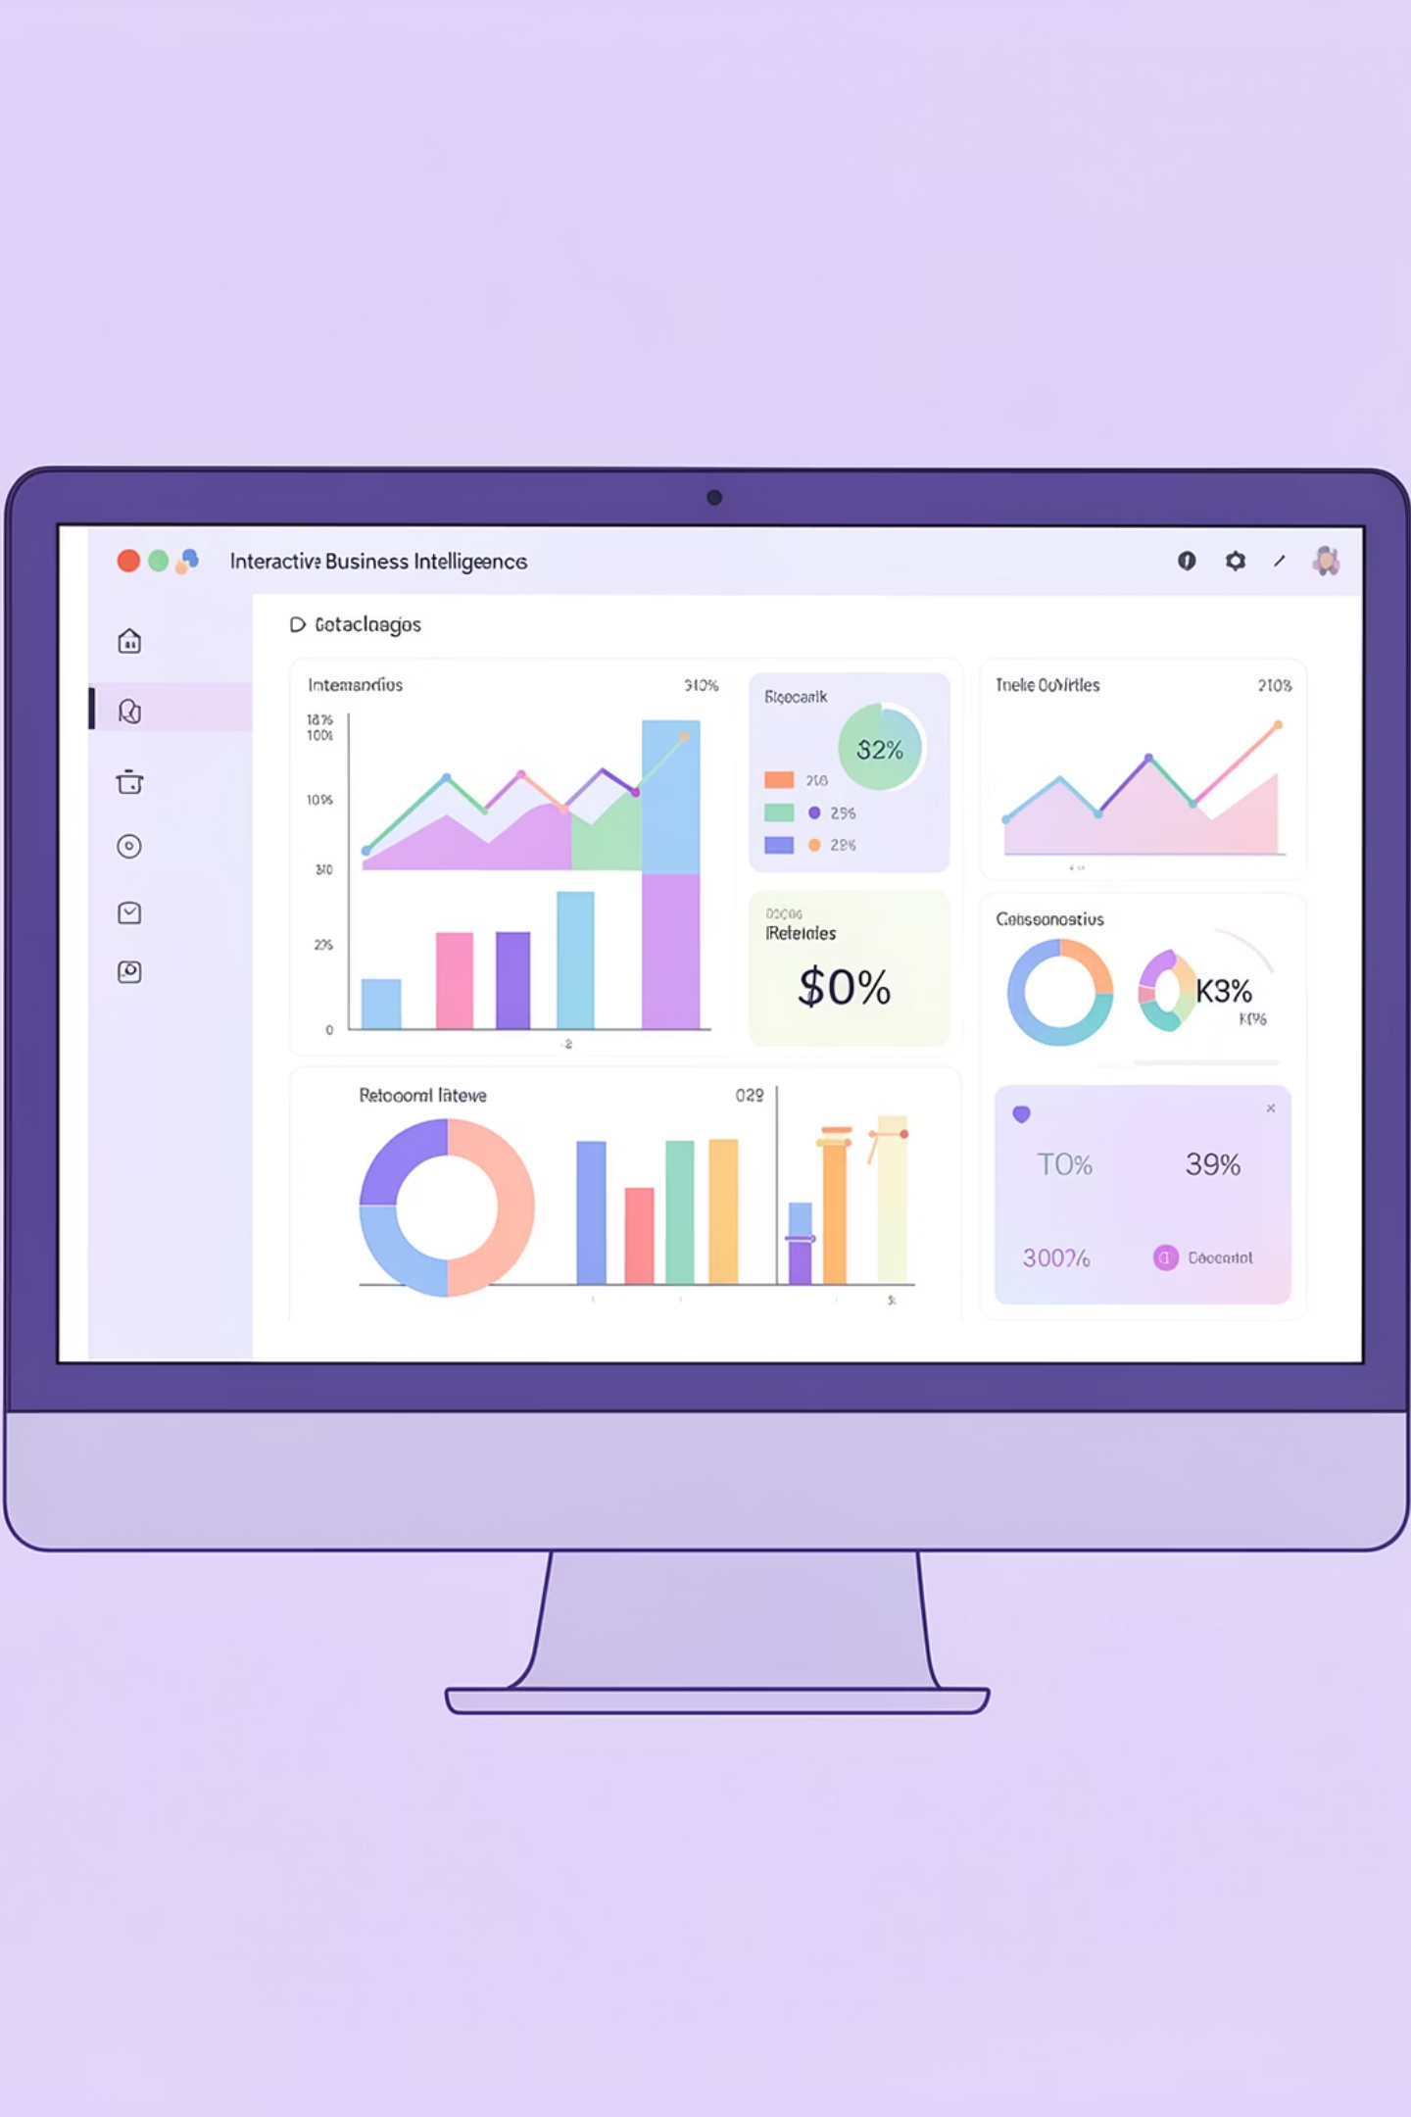
Power BI Dashboard
Key Metrics
3,900 customers, $59.76 average purchase, 3.75 average rating
Interactive Filters
Subscription status, gender, category, shipping type
Visualizations
Revenue by category and age group, customer segmentation

Slide 9




Key Findings
Revenue Gap
Male customers spend 2.1x more than female customers
Loyalty Program
79% of customers are loyal repeat buyers
Discount Strategy
High-discount products drive sales but impact margins

Slide 10





Strategic Recommendations
Boost Subscriptions
Loyalty Programs
Review Discount Policy
Promote exclusive benefits for subscribers
Reward repeat buyers to move into loyal segment
Balance sales boosts with margin control
Product Positioning
Targeted Marketing
Highlight top-rated and best-selling products
Focus on high-revenue age groups and express-shipping users

Slide 11


