Slide 1

Super Market Store
Project(22030501020)
MCA SEMESTER-4
Mansi R. Gami
Internal Guide : Nidhi K. Chitroda
Darshan University

Slide 2
Outline
Abstract
Problems of Existing System
Scope & Advantage
System Requirement
Module List
Module Detailing
Diagram
Database Schema
Implementation Screenshots
Limitations
Conclusion
Reference

Slide 3
Abstract
This supermarket management system has realized the transmission and control of large goods, to facilitate the management and decision of sales, and reduce a big burden for supermarkets and supermarket managers. It also can help to improve the work efficiency of supermarkets. the supermarket management system is very convenient for managing, inputting, outputting, and finding the data to make the messy supermarket data specific, visualizations, rationalization. In the aspect of the software, the supermarket management system uses PHP language and MySQL as the background database. In the aspect of software, various configurations in a computer including input and output capacity, internal memory and external memory capacity can meet the requirements of users.

Slide 4
Problems of Existing System
Problem: Too many products, difficult to manage.
Solution: Every supermarket stocks hundreds of different items. As a result, it is difficult for business owners to recall all of the accessible products. However, you can control all elements of your business using a barcode scanner and receipt printer that syncs with the software. Many consumers no longer have to rely on supermarket sales books for income and loss information because of advances in technology.
2. Problem: Goods are available or out of stock, easy to lose
Solution: Failure to manage inventory not only reduces revenue due to loss of customers, but besides that, many items in the grocery store are very small. You also cannot control things that damage or steal your product. Don’t worry, once you have a POS, you will have complete inventory of each item in the palm of your hand.

Slide 5
Scope & Advantage
The Scope of a Supermarket Management System encompasses inventory management, point of sale operations, employee management, customer relationship management and security features, its primary aim is to optimize supermarket operations, enhance customer experience, and maximize efficiency and profitability.
Display a wide range of products with images and prices. Organize products into categories and subcategories for easy navigation. Enable users to add products to a virtual shopping cart selections .

Slide 6
System Requirement
Hardware Requirement
RAM: 8GB or more
Processor: Intel Core i5
Display: 1920 x 1080 resolution or higher
Storage: At least 1GB
Input Devices: Keyboard and mouse or other pointing devices
Software Requirement
Operating System: Windows and Android
Coding Language: PHP
Database: MySQL

Slide 7
Module List
Admin
Login/Logout
Manage Product
View Record
User
Registration
Login/Logout
Purchase Product
Send feedback
View Product

Slide 8
Module Detailing
Admin
Login: Login and manage the system.
Add Product: Add a new product to the store.
Update Product: Update product price and quantity.
Delete Product: Delete an expired product.
User
Registration: New user registration on the website.
Login: Log in and purchase the product.
Add to Cart: The customers add to carts the purchased goods.
Payment: Pay money and clear bill.
Send feedback: Send the product feedback.

Slide 9
Diagram
Use Case : Admin
Login & Logout
Add Product
Edit Product
Delete Product
Display Record

Slide 10
Diagram
Use Case : User
Login & Logout
View Product
Add to Cart
Check Product Price
Display Record

Slide 11
Diagram
Activity : Login
Login Screen
Enter Username and Password
Correct ?
False
Alert : Id or Password Wrong
True
Open Home Page

Slide 12
Diagram
ER Diagram
Variety
has
Sub-catalogue
has
Cart
c_id
c_img
s_id
s_img
cart_id
p_qnt
c_nm
c_id
s_nm
p_id
p_img
u_id
p_price
p_nm
c_nm
qty
b_id
c_add
chout_id
p_price
Bill
has
Checkout
has
p_nm
c_id
grand_total
c_city
p_id
u_id
c_email
c_phone

Slide 13
Diagram
DFD Level 0
Super Market Management System
Login
Login
Customer
Admin
Confirmation
Confirmation

Slide 14
Diagram
DFD Level 1
Customer Registration
Customer report
Customer info
Customer Detail
Product & Order
Add Product stock info
Add to Cart
Bill Detail
Customer
Admin

Slide 15
Database Schema
User Table:
Column Name | Data Type | Null | Key & Constraint | Length
u_id | Int | NotNull | PK(Auto Increment) | 50
u_nm | Varchar | NotNull |  | 50
password | Varchar | NotNull |  | 50
address | Varchar | NotNull |  | 50
city | Varchar | NotNull |  | 50
state | Varchar | NotNull |  | 50
phoneno | Varchar | NotNull |  | 50
email_id | Varchar | NotNull |  | 50

Slide 16
Database Schema
Admin Table:
Catalogue Table:
Column Name | Data Type | Null | Key & Constraint | Length
a_id | Int | NotNull | PK(Auto Increment) | 11
a_nm | Varchar | NotNull |  | 50
a_password | Varchar | NotNull |  | 50
Column Name | Data Type | Null | Key & Constraint | Length
c_id | Int | NotNull | PK(Auto Increment) | 50
c_nm | Varchar | NotNull |  | 50
c_image | Varchar | NotNull |  | 100

Slide 17
Database Schema
Sub-Catalogue Table:
Column Name | Data Type | Null | Key & Constraint | Length
s_id | Int | NotNull | PK(Auto Increment) | 50
c_id | Int | NotNull | FK | 11
s_img | Varchar | NotNull |  | 50
s_nm | Varchar | NotNull |  | 50

Slide 18
Database Schema
Product Table:
Column Name | Data Type | Null | Key & Constraint | Length
p_id | Int | NotNull | PK(Auto Increment) | 50
s_id | Int | NotNull | FK | 50
p_nm | Varchar | NotNull |  | 50
p_price | Decimal | NotNull |  | 50,0
p_image | Varchar | NotNull |  | 50
p_qnt | Int | NotNull |  | 50
tot_qty | Int | NotNull |  | 100

Slide 19
Database Schema
Cart Table:
Column Name | Data Type | Null | Key & Constraint | Length
cart_id | Int | NotNull | PK(Auto Increment) | 50
p_id | Int | NotNull | FK | 50
p_image | Varchar | NotNull |  | 50
p_nm | Varchar | NotNull |  | 50
p_price | Decimal | NotNull |  | 50,0
p_qnt | Int | NotNull |  | 50
u_id | Int | NotNull | FK | 100

Slide 20
Database Schema
Check-Out Table:
Column Name | Data Type | Null | Key & Constraint | Length
chout_id | Int | NotNull | PK(Auto Increment) | 50
c_nm | Varchar | NotNull |  | 50
c_add | Varchar | NotNull |  | 100
c_city | Varchar | NotNull |  | 50
c_phone | Varchar | NotNull |  | 50
c_email | Varchar | NotNull |  | 50
grand_total | Int | NotNull |  | 50

Slide 21
Database Schema
Bill Table:
Column Name | Data Type | Null | Key & Constraint | Length
b_id | Int | NotNull | PK(Auto Increment) | 50
u_id | Int | NotNull | FK | 50
p_id | Int | NotNull | FK | 50
p_nm | Varchar | NotNull |  | 50
p_price | Varchar | NotNull |  | 50
qty | Int | NotNull |  | 50

Slide 22
Database Schema
Feedback Table:
Column Name | Data Type | Null | Key & Constraint | Length
f_id | Int | NotNull | PK(Auto Increment) | 100
f_nm | Varchar | NotNull |  | 100
city | Varchar | NotNull |  | 100
email | Varchar | NotNull |  | 100
product | Varchar | NotNull |  | 100
message | Int | NotNull |  | 1000

Slide 23
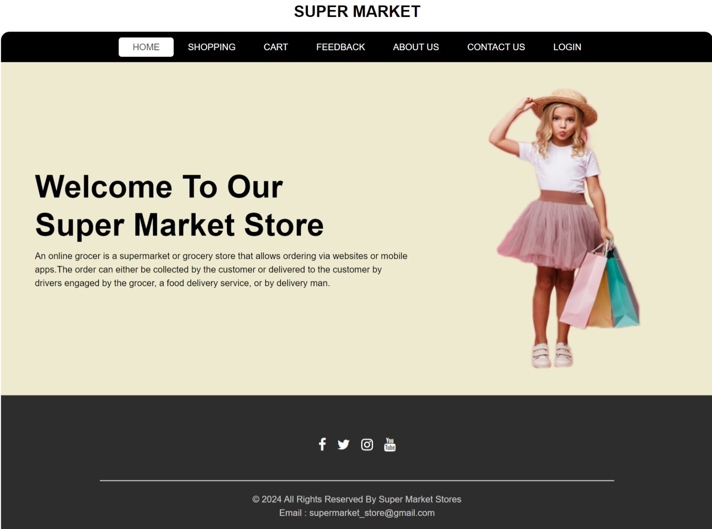
Screen Design: User Side
Home Page
First Page of the website. Home page redirects Different Pages.

Slide 24
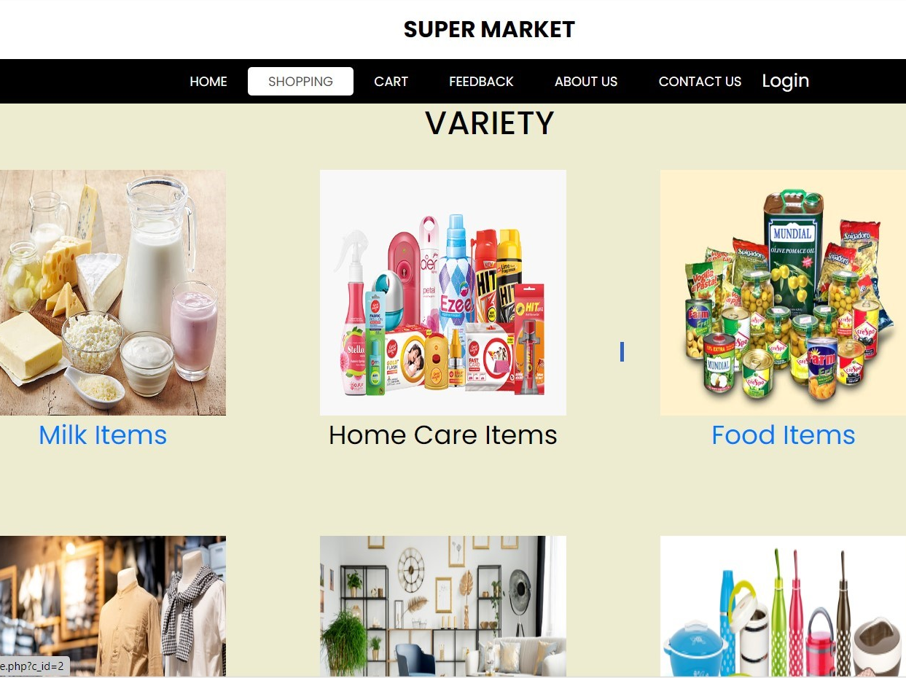
Variety Page
This page Display Different types of Category.

Slide 25
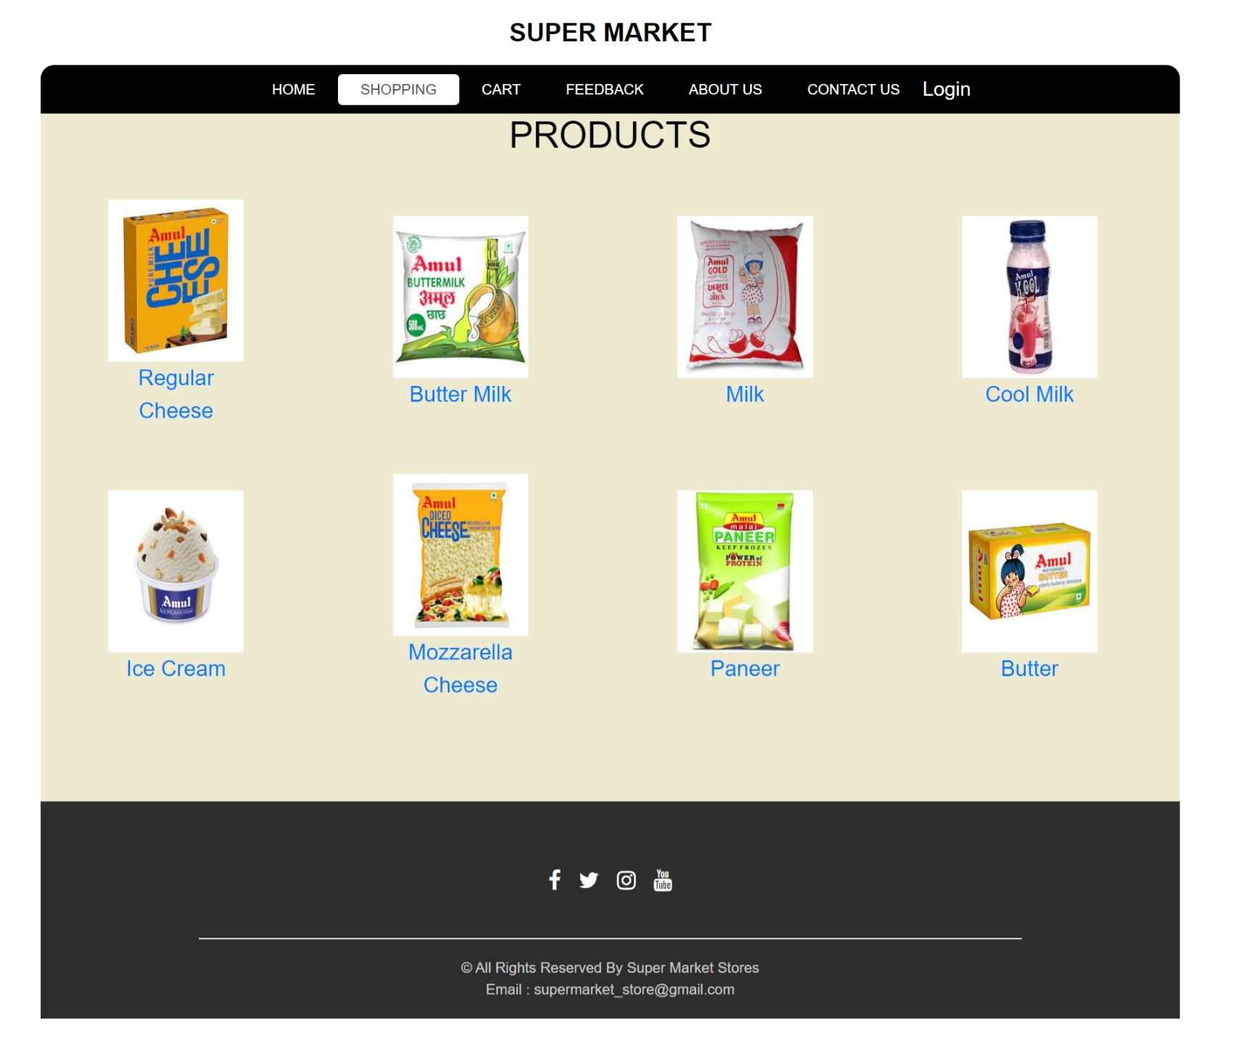
Sub-Catalogue Page
This page Display Category wise items.

Slide 26
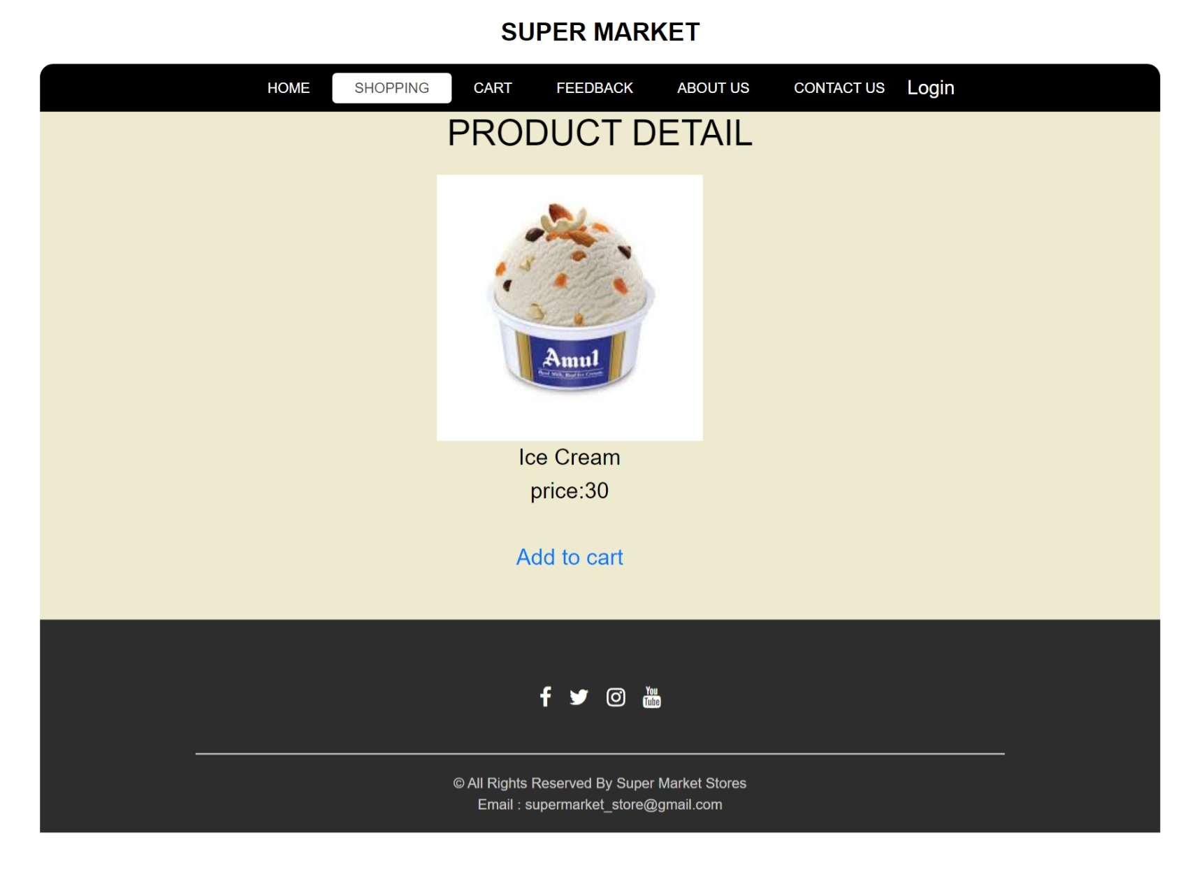
Product Detail Page
This page Display Product Detail.

Slide 27
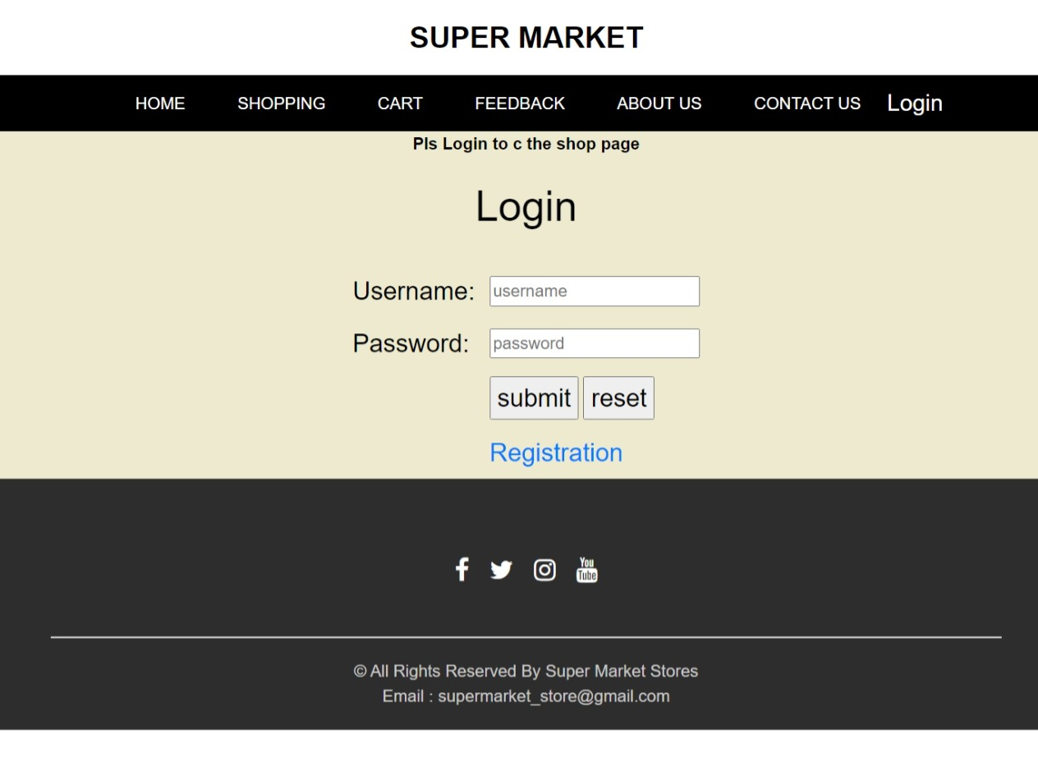
Login Page
User can login the website and after the shopping.

Slide 28
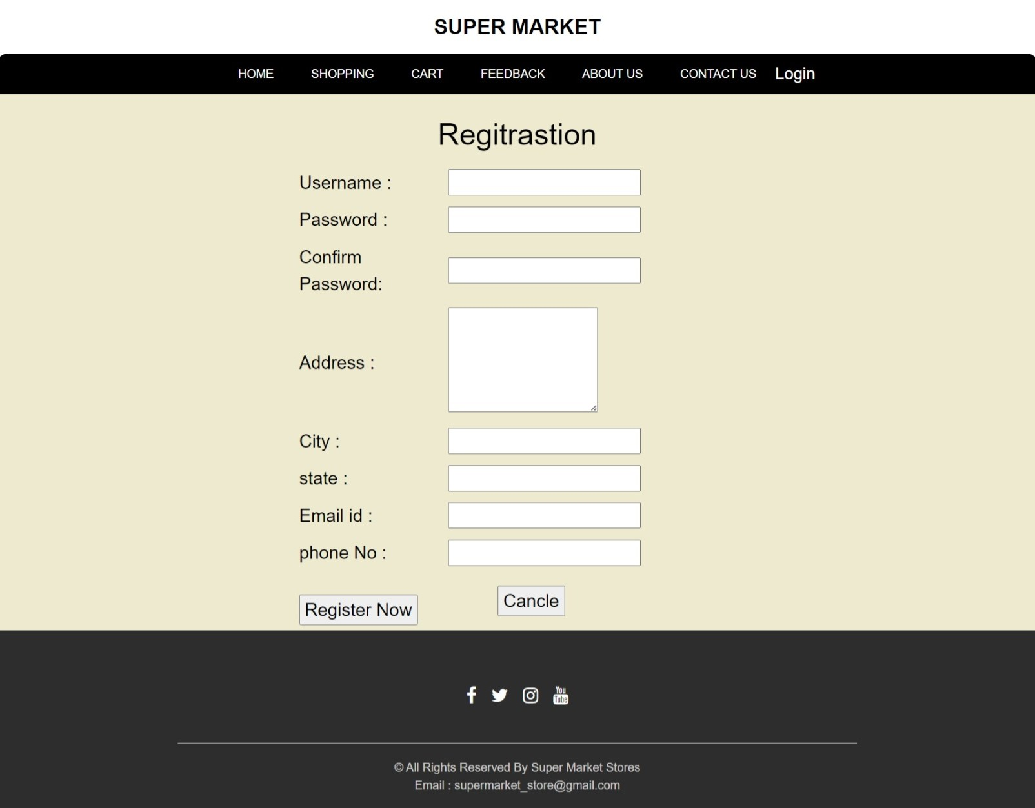
Registration Page
This form will allow the target end-users to register in the system. To register, the following information will be encoded in the system.

Slide 29
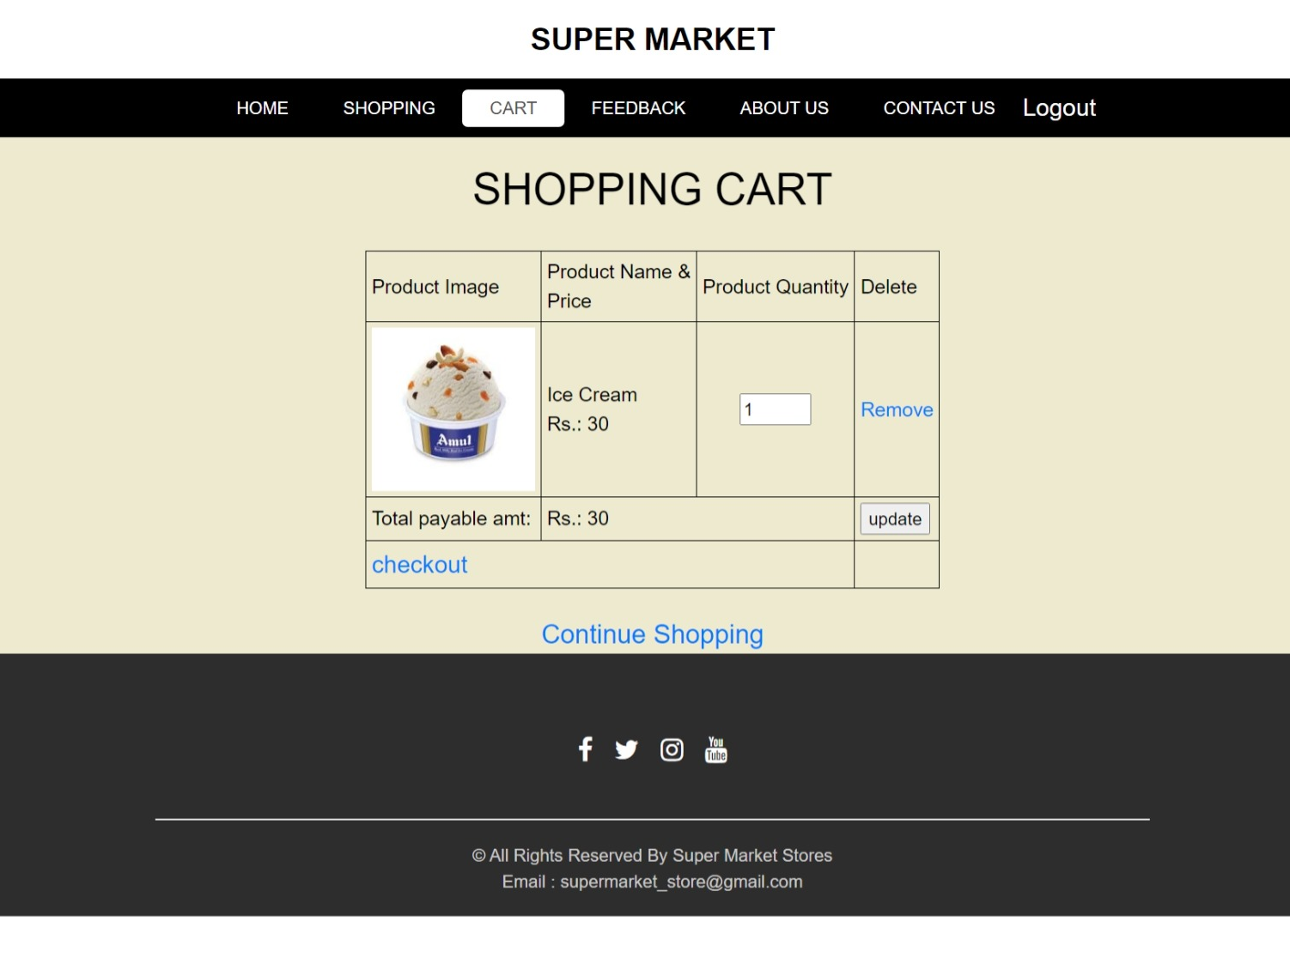
Cart Page
This page display purchase product all detail.it is display product name, Product image, product price, product quantity, total payable amount and update button for provide work update purchase product and provide create bill link.

Slide 30
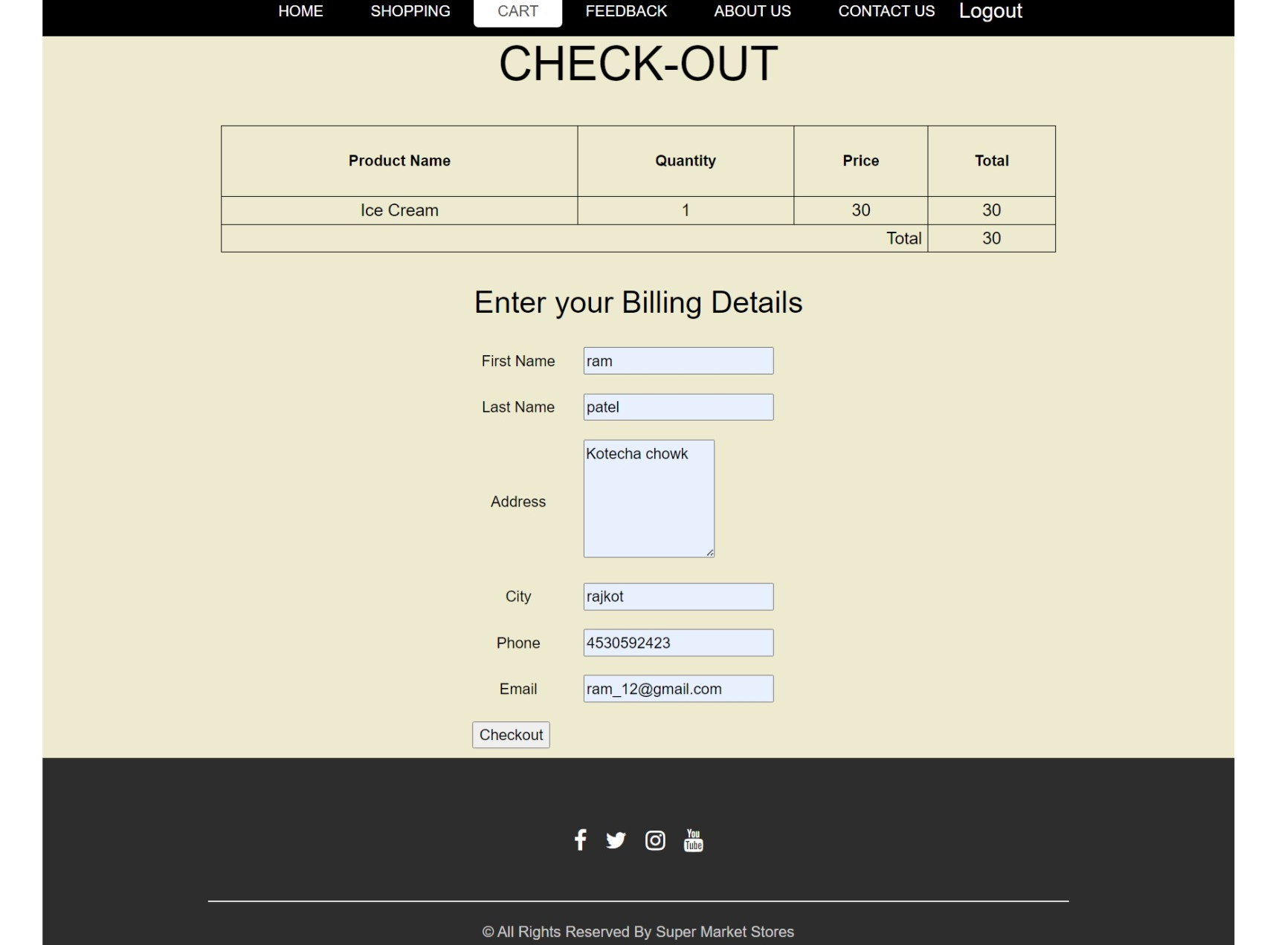
Check Out Page
This page display to fill the bill form and check-out the all details.

Slide 31
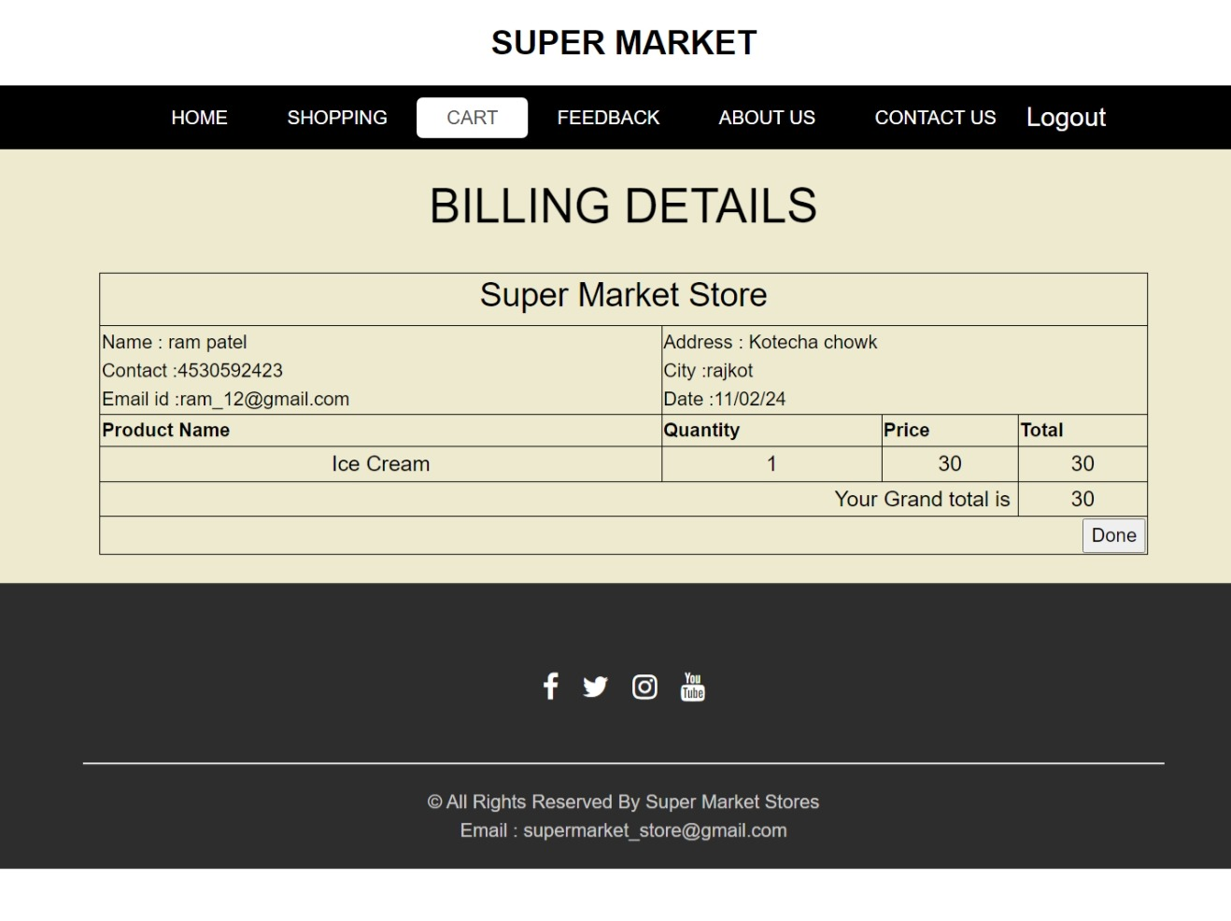
Bill Page
This page display Billing details.

Slide 32
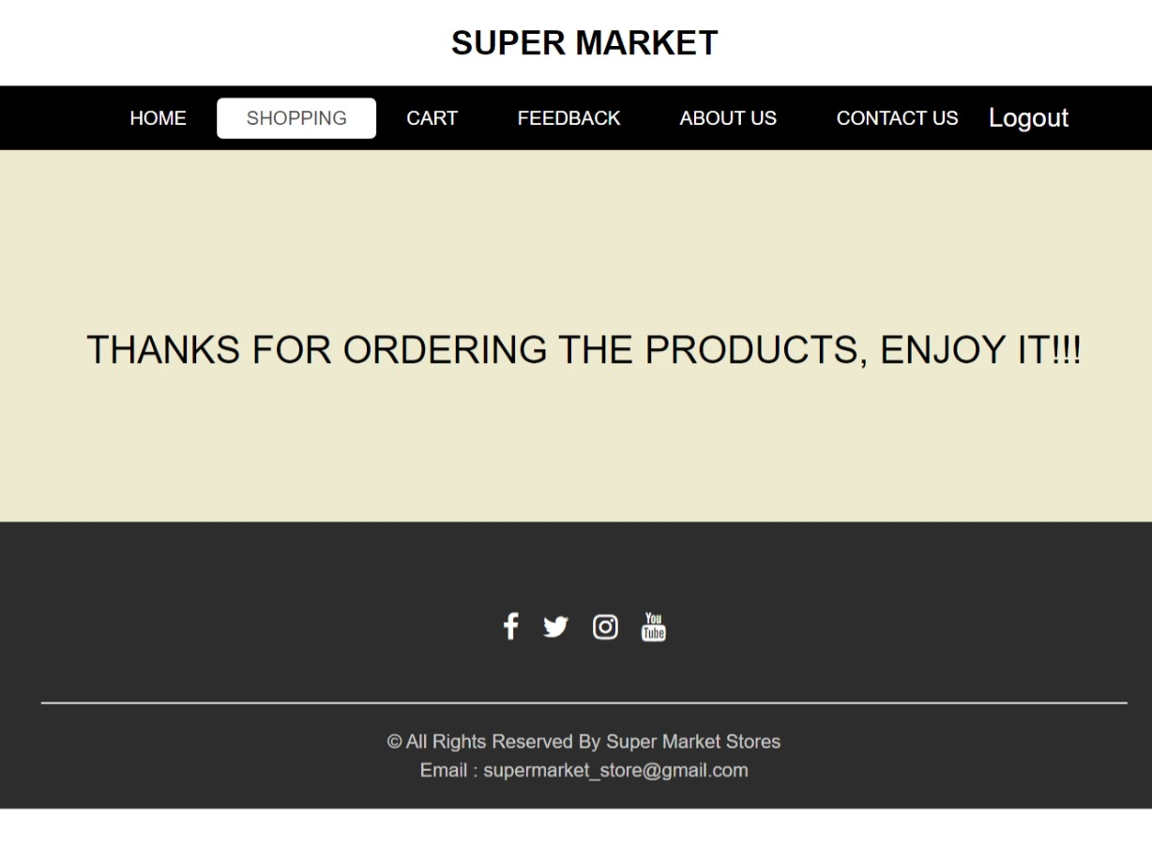
Done Page
This page is display thank you message for purchase the products.

Slide 33
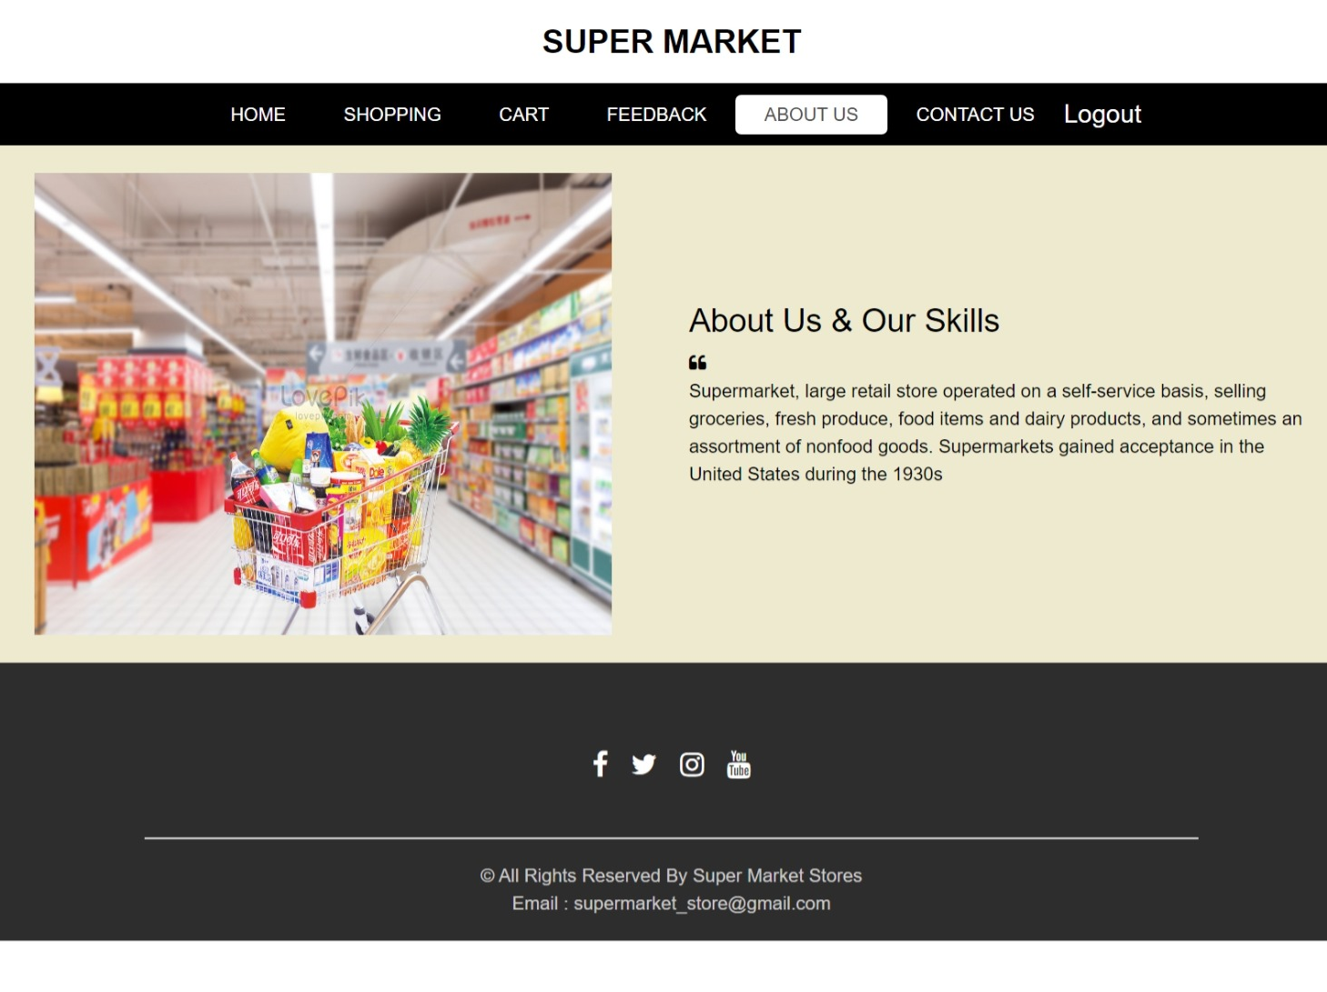
About Us Page
This page display about the super market store.

Slide 34
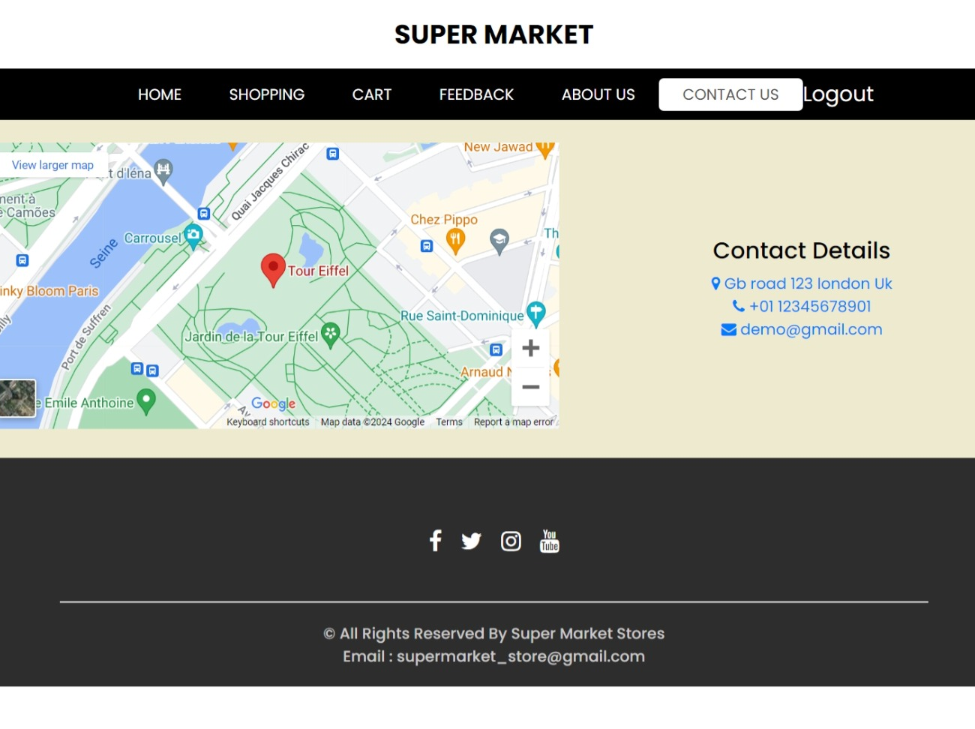
Contact Us Page
This page display contact details.

Slide 35
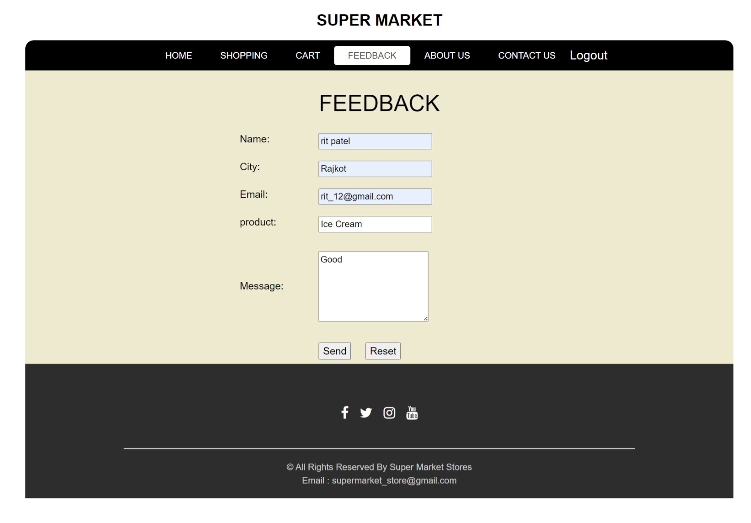
Feedback Page
This form display Users gives feedback.

Slide 36
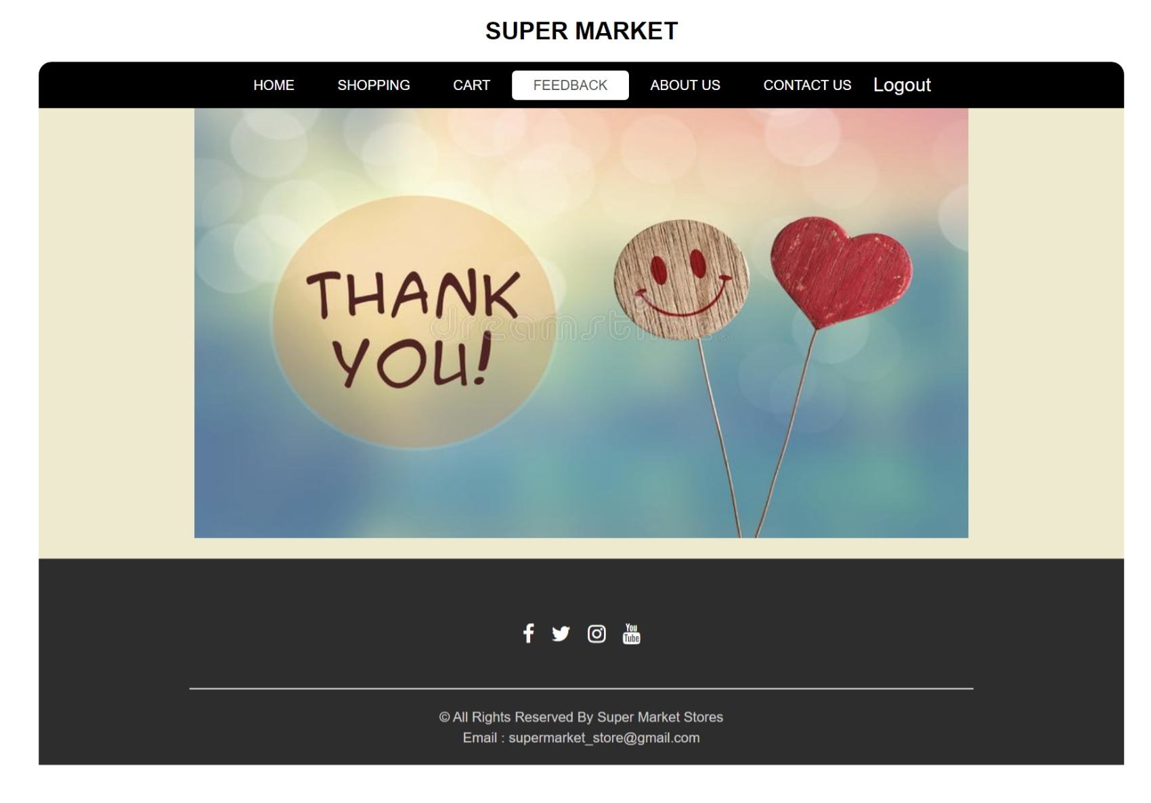
Thank You Page
This page is display thank you message for send the feedback.

Slide 37
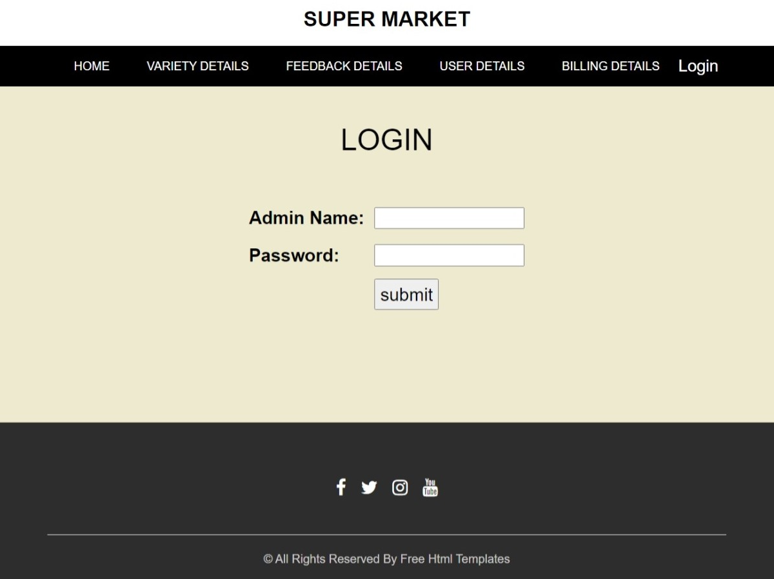
Screen Design: Admin Side
Login Page
Admin can login the website and after the changes in website.

Slide 38
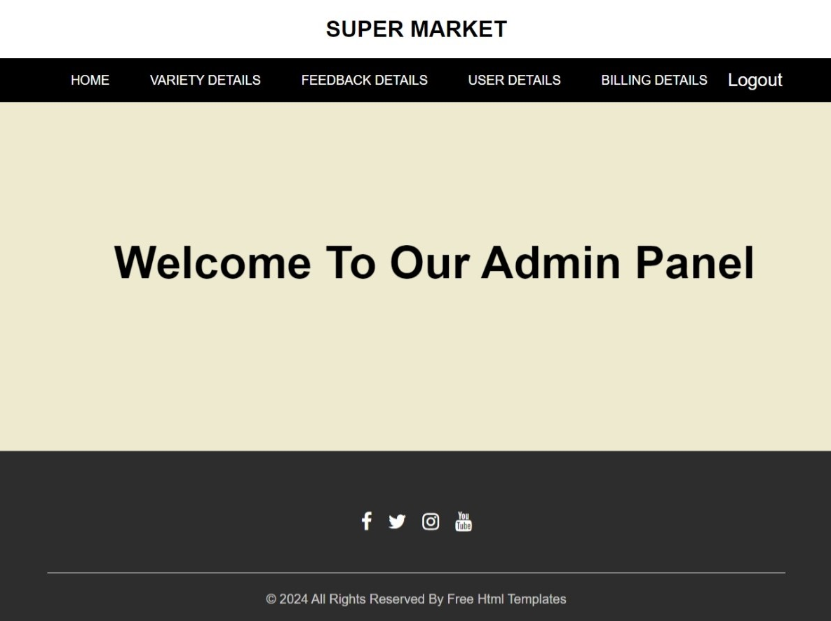
Welcome Page
This page display welcome message. .

Slide 39
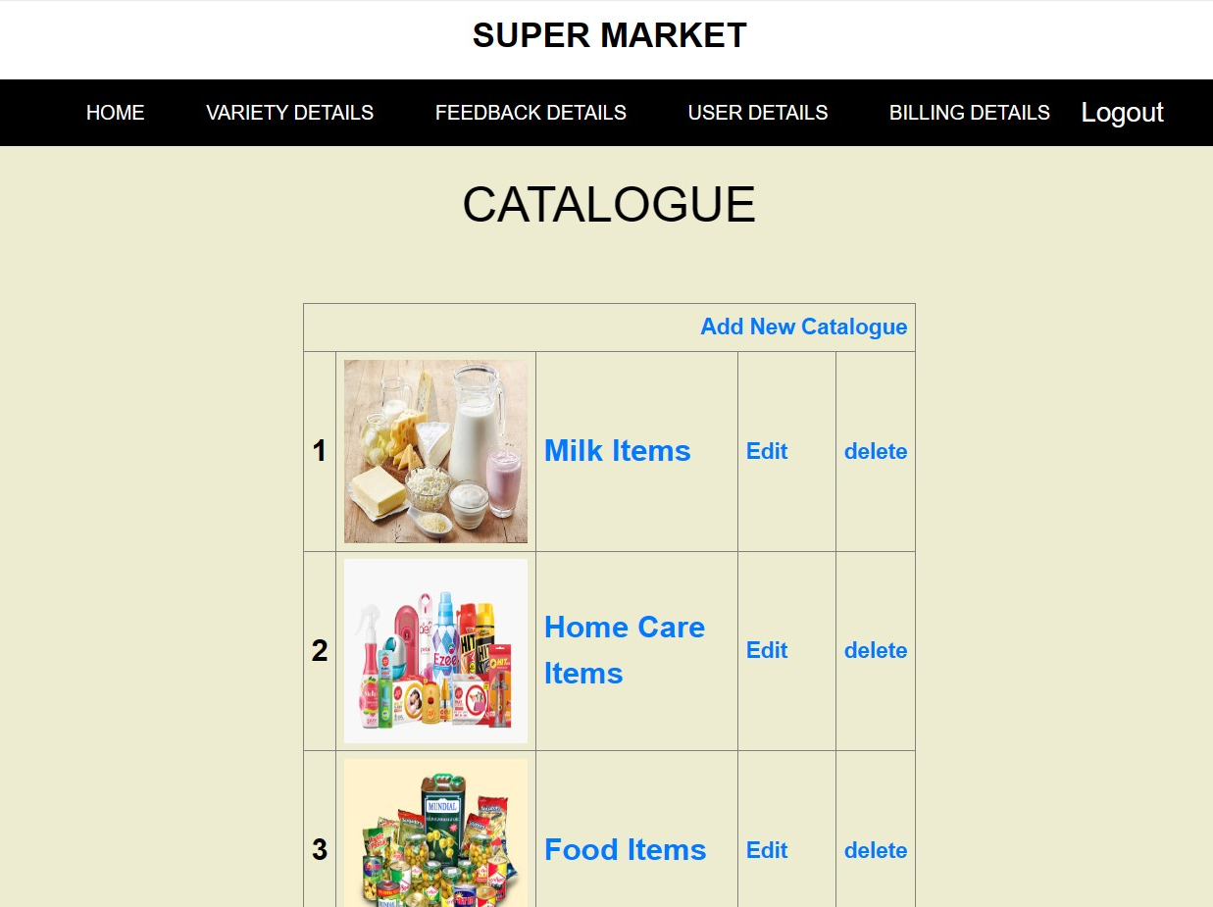
Catalogue Page
This page display different category Add, Edit and Delete option.

Slide 40
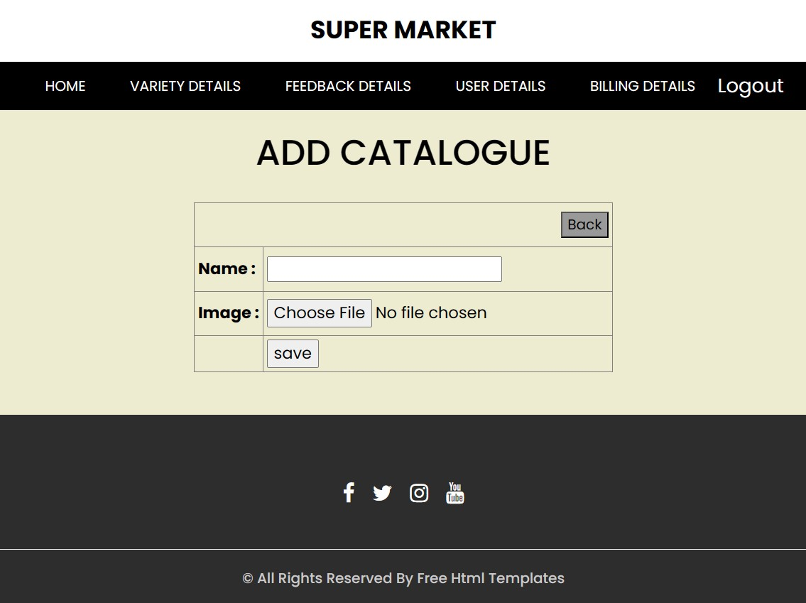
Add Catalogue Page
This page provide add new catalogue.

Slide 41
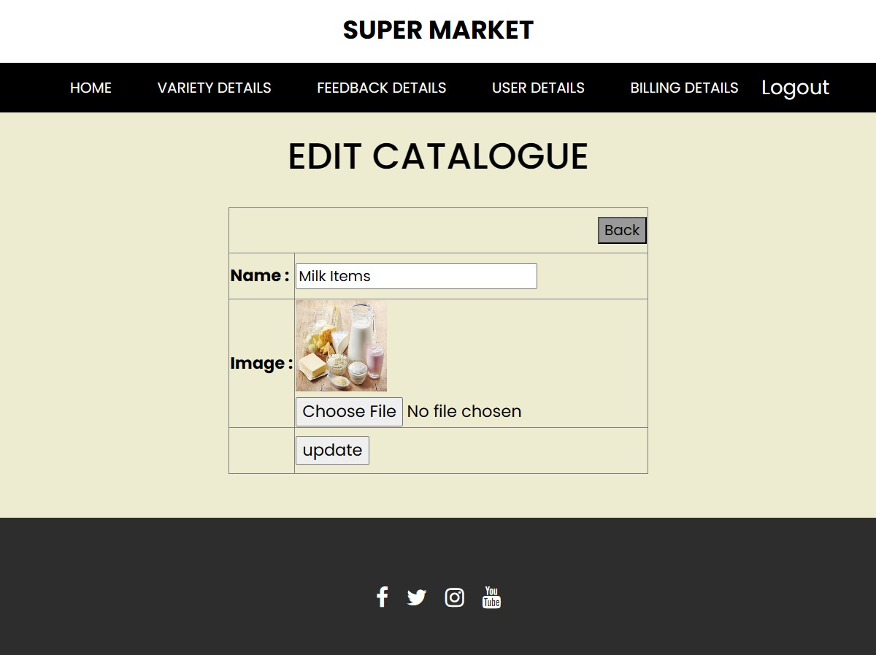
Edit Catalogue Page
This page provide edit the catalogue.

Slide 42
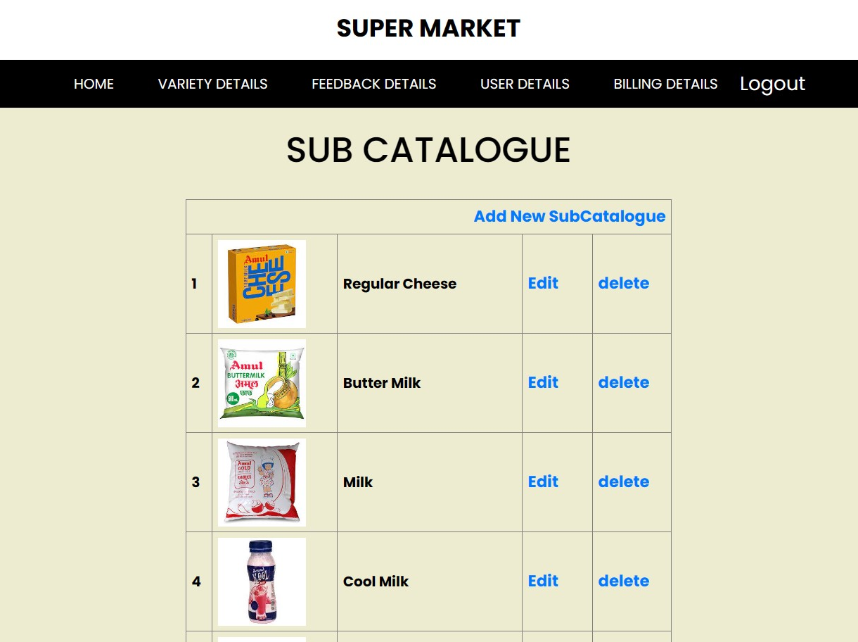
Sub-Catalogue Page
This page display different Sub-Catalogue Add, Edit and Delete option.

Slide 43
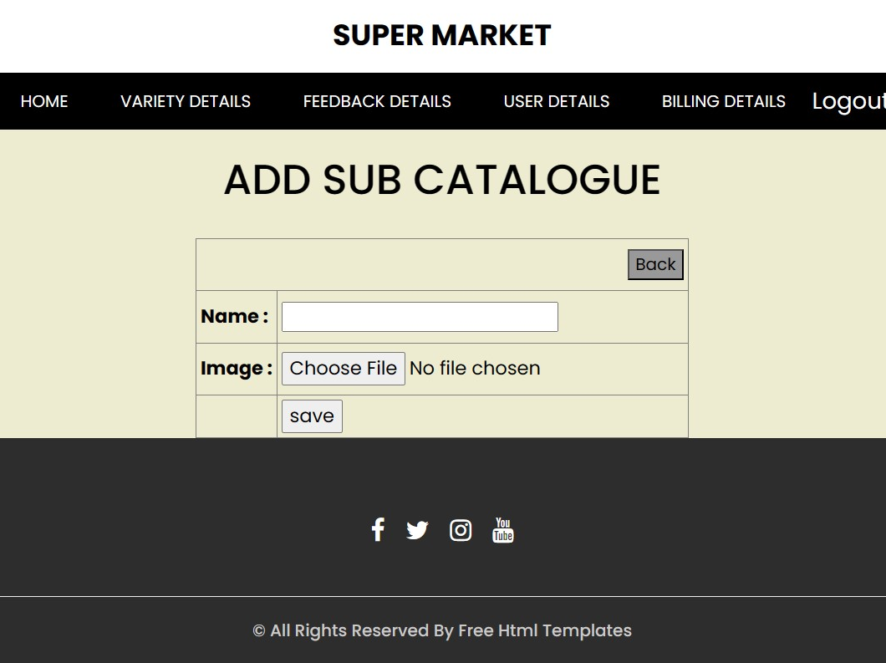
Add Sub-Catalogue Page
This page provide add new sub-catalogue.

Slide 44
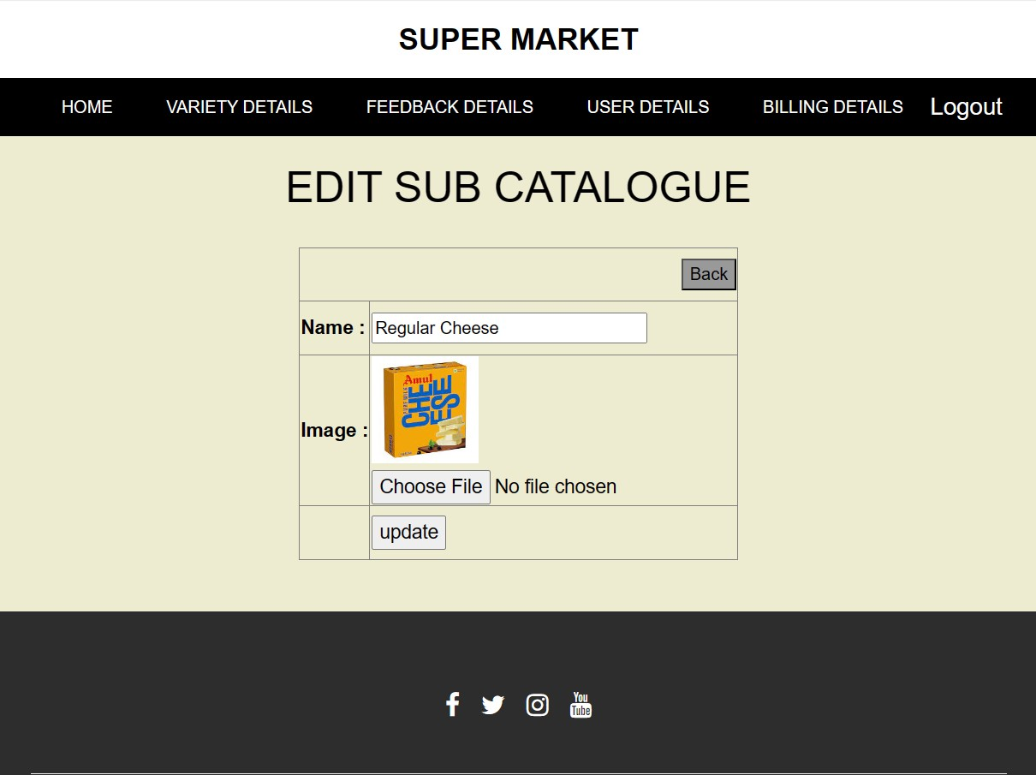
Edit Sub-Catalogue Page
This page provide edit the sub-catalogue.

Slide 45
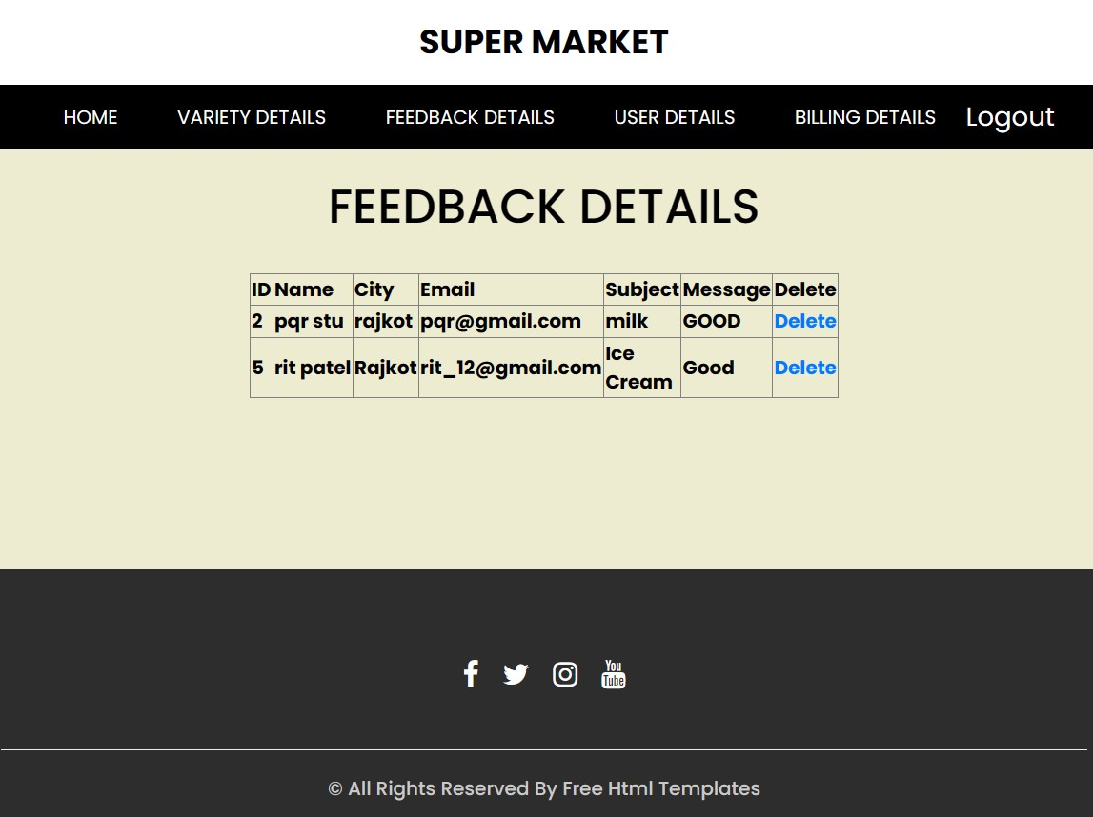
Feedback Detail Page
This page display Feedback details.

Slide 46
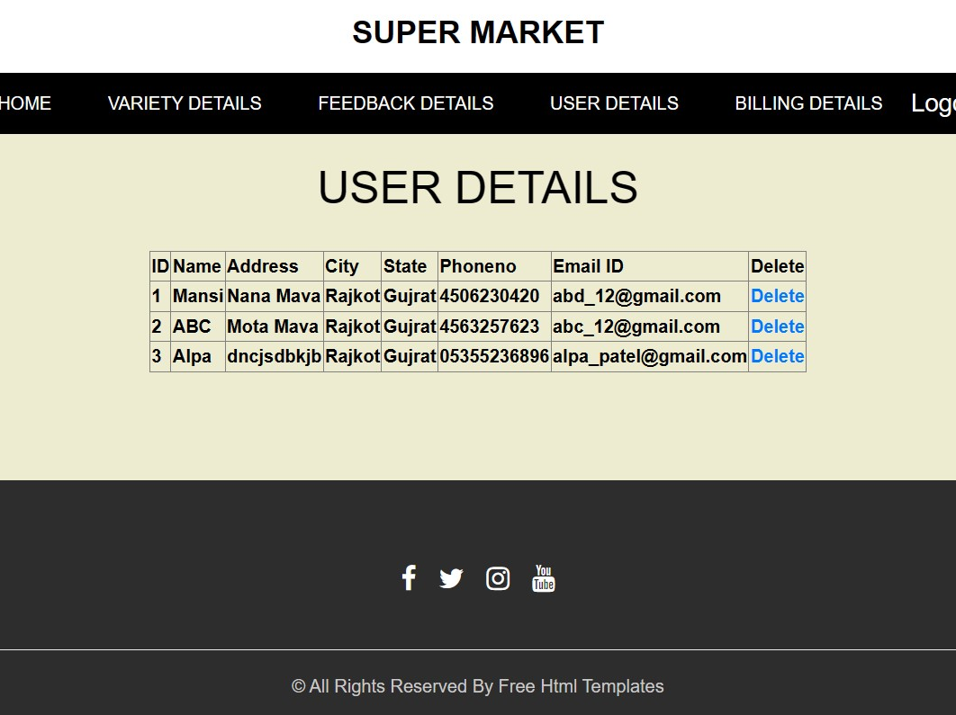
User Detail Page
This page display User details.

Slide 47
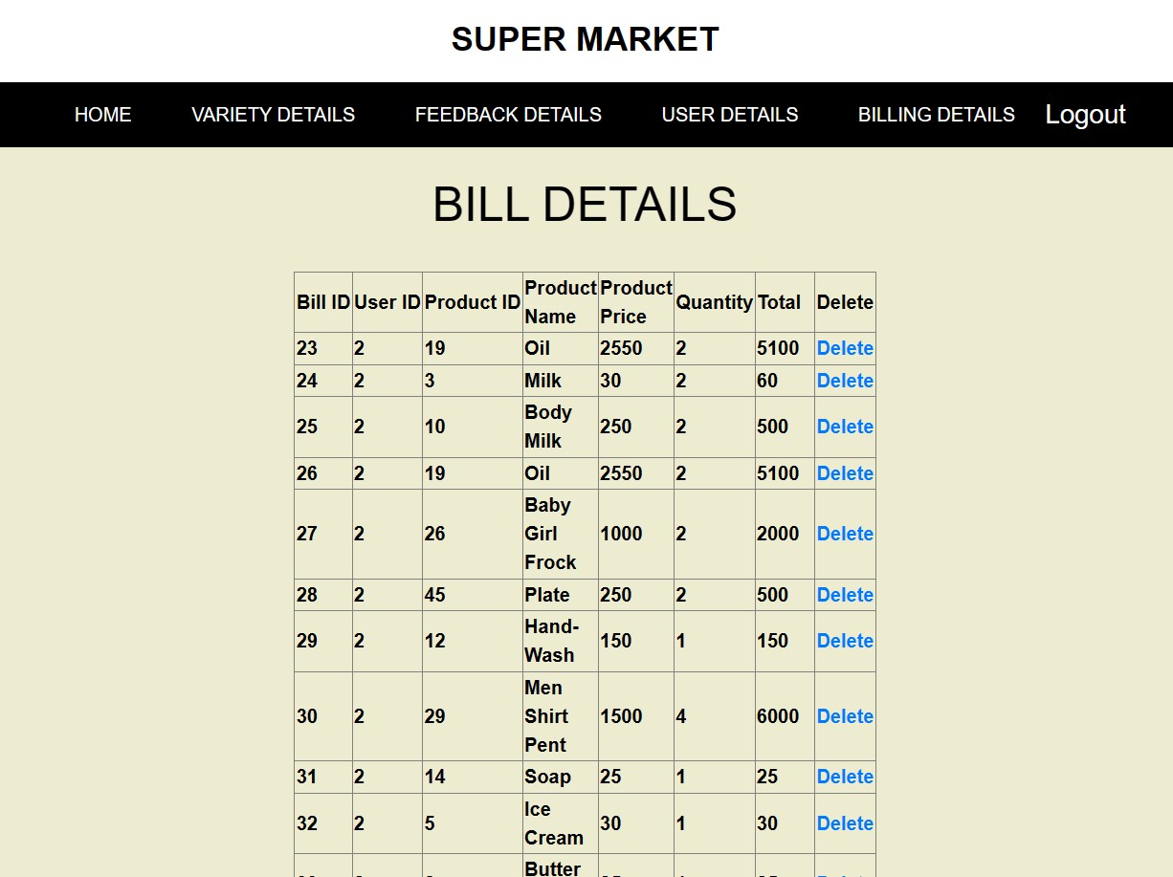
Bill Detail Page
This page display Billing details.

Slide 48
Limitations
The small and medium-sized supermarket management system uses MySQL database and PHP language to develop and realize. This Project is not available online. This Project is for knowledge only.

Slide 49
Conclusion
In conclusion, our project aimed to purchase the best product and easy to shop. our main aims to provide various features like a discount, high quantity etc. Super Market Store involves operating and monitoring all aspects of a retail or wholesale store. This means working with employees, suppliers and customers. Effectively managing a store can boost sales and improve the customer experience. This role involves many retail elements, including inventory, sales and marketing.

Slide 50
Reference
https://www.w3schools.com/php/
https://www.geeksforgeeks.org/php-tutorial/

Slide 51
Thank You

