Slide 1
Deep Frank-Wolfe For Neural Network Optimization
Team –13
Spanddhana Sara (2020702021)
Ritam Basu (2020701005)
Mansi Khamkar (2020201026)
P. Ankitha Reddy (2020900007)

Slide 2
Introduction
The current practice in neural network optimization
- Stochastic Gradient Descent (SGD)
- Adaptive variants.
SGD requires schedule for decay of its learning rate.
- Non-convex optimization no consistent methodology.
Adaptive variants tend to produce solutions that generalizes less well on unseen data.
Deep Frank Wolfe (DFW) yields good generalization performance while requiring only one hyperparameter.
DFW designs an optimization algorithm that leverages efficient convex solvers

Slide 3
Advantages over SGD:
Each iteration exploits more information about learning objective, while preserving the same computational cost as SGD.
Optimal step-size is computed in closed-form.
Converges significantly faster.
This paper proposes a proximal framework which preserves information from the loss function.
Designs a novel smoothing scheme for dual optimization of SVMs.

Slide 4
Related Work
Non Gradient- Based Methods
Large per-iteration cost.
Adaptive Gradient Methods
Provide subpar generalization
Learning to Learn and Meta- Learning
Learn the learning rate, optimization algorithm and improve practical performance. Can use DFW to optimize the meta-learner
Optimization and Generalization
Not fully understood, the resulting recommendations are sometimes opposing,
Proximal Methods
Higher computational cost per iteration.
Linear SVM Sub-Problems
Higher cost per iteration thus impairs speed and scalability.

Slide 5
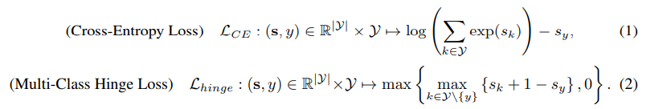

Problem Formulation
Learning Objective:
Given a dataset (x_{i} , y_{i})_{i∈[N]}, where each x_{i} ∈ R^{d} is a sample annotated with a label y_{i} from the output space y.
Given a vector of scores per label s ∈ R^{|Y|}, we denote by L(s, y_{i}) the loss function that computes the risk of the prediction scores s given the ground truth label y_{i} . For example, the loss L can be cross-entropy or the multi-class hinge loss:
Let f_{i}(w) = f(w, x_{i}) and Li(s) = L(s, y_{i}) for each i ∈ [N],l and ρ(w) is regularization. The Learning problem under empirical risk minimization form is:

Slide 6
A Proximal Approach:
The SGD Algorithm
At iteration t, the SGD selects a sample j at random and observes estimate ρ(wt)+Lj (fj (wt)), , given the learning rate nt, it performs
SGD minimizes a first-order approximation of the objective, while encouraging proximity to the current estimate wt.
Choosing which part to approximate is a crucial decision, as it yields optimization problems with widely different properties

Slide 7
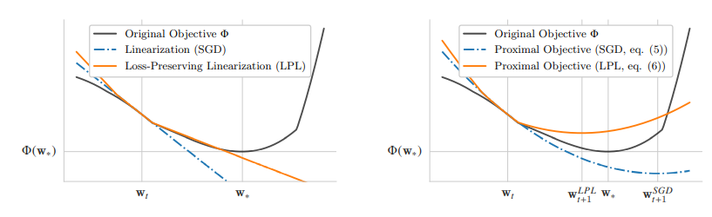
A Proximal Approach:
Loss- Preserving Linearization.
At iteration t, with selected sample j, the proximal problem that linearizes the regularization ρ and the model fj , but not the loss function L is given by:
The above figure shows the comparison of SGD and Loss-Preserving Linearization in case of a piecewise linear loss.

Slide 8
Optimal Step Size
The optimal-size can be obtained in closed form because the hinge loss is convex and piecewise linear. In fact, the approach presented here can be applied to any loss function that is convex and piecewise linear.

Slide 9



Optimal Step-size proof

Slide 10

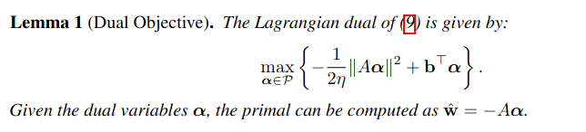
Dual of the Problem

Slide 11
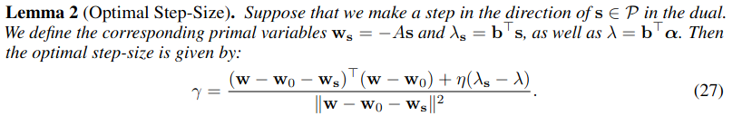
Step-size calculation

Slide 12
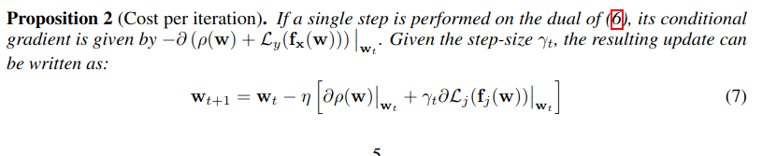
Cost Per Iteration
Since the step-size can be computed in closed-form, the main computational challenge is to obtain the update direction. The following result shows that by taking a single step per proximal problem, the dual conditional gradient can be computed at the same cost as a standard stochastic gradient.

Slide 13
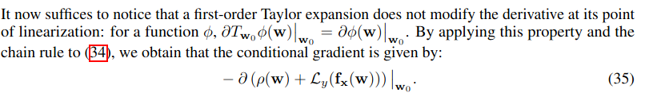
Conditional Gradient

Slide 14
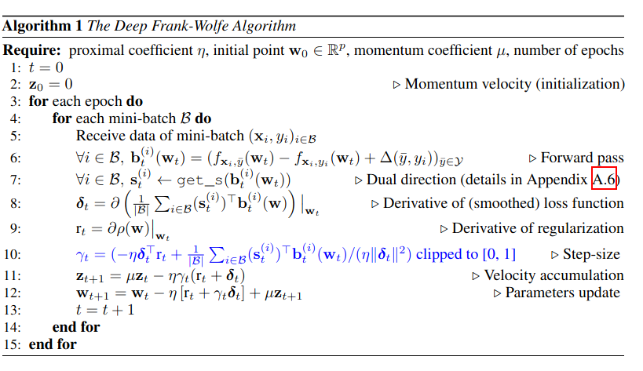
The Deep Frank-Wolfe Algorithm

Slide 15
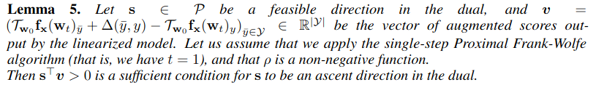
Smoothing the Loss
The SVM loss is non-smooth and has sparse derivatives.

Slide 16
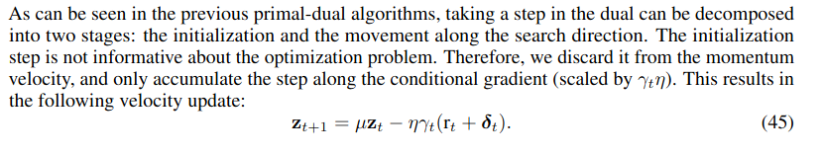
Nesterov Momentum

Slide 17
Experiments
We focused on comparing performances of DFW and SGD on the following datasets and networks :
Image classification with CNNs
Dataset : CIFAR10
Networks : DenseNet, WideResNet
Optimizers : DFW, SGD, ADAM
Natural language inference with RNNs
Dataset : The Stanford Natural Language Inference (SNLI)
Networks : Bidirectional-LSTM
Optimizers : DFW, SGD, ADAM

Slide 18
Experiments
Implemented DFW optimizer, trainer and other utility functions
Experiments were performed using Google Colaboratory.
The settings and hyperparameters used for the experiments are as described in the paper.
In each experiment we trained the networks using DFW, SGD and ADAM for same number of epochs.
SGD has a unique hand-designed schedule for each experiment, as described ahead.
Each experiment required 9 to 10 hours for training.
From the results of our experiments, we observe that the performances of DFW and SGD are comparable, as concluded in the paper.

Slide 19
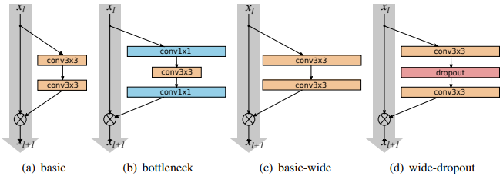
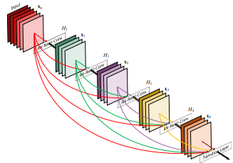
Image classification with CNNs
Dataset : CIFAR10
Contain 60,000 RGB natural images of size 32 x 32
Splits: train set (50K), test set (10K)
No augmentation used
Classes 10
DenseNet :
Depth 40, growth factor 40, 1.9M parameters
Hyperparameters : batch-size (64), epochs (100)
WideResNet :
Depth 40, width factor 4, 8.9M parameters
Hyperparameters : batch-size (128), epochs (100)
DFW :
Loss : SVM (smoothed), momentum : 0.9, LR (initial) : 1.0 for WRN & 0.1 for DN, L2 regularization : 1e-4
SGD :
Loss : CE, momentum : 0.9, LR (initial) : 0.1, L2 regularization : 5e-4 for WRN & 1e-4 for DN, LR decay : at epoch 60 for WRN
ADAM :
Loss: CE, LR (initial) : 1e-3, L2 regularization : 1e-4
WideResNet
DenseNet

Slide 20
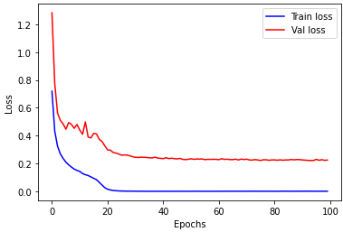
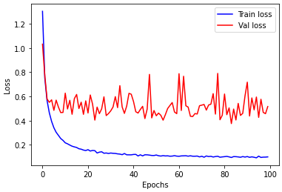
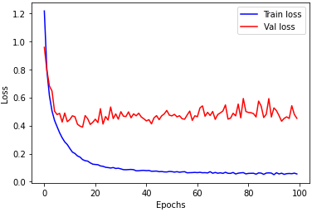
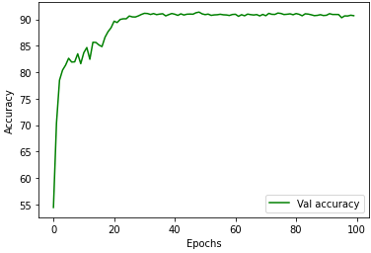
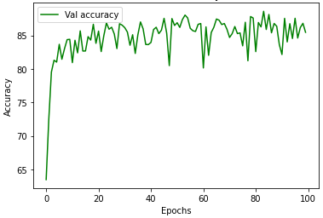
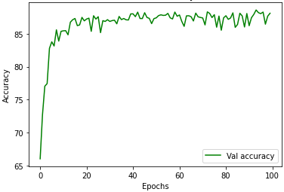
Results : DenseNet trained on Cifar10
Train vs Val loss
Train vs Val loss
Train vs Val loss
Validation accuracy
Validation accuracy
Validation accuracy
DFW : Test Accuracy: 91.0 %
SGD : Test Accuracy: 88.6 %
ADAM : Test Accuracy: 87.3 %

Slide 21
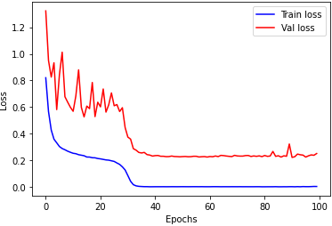
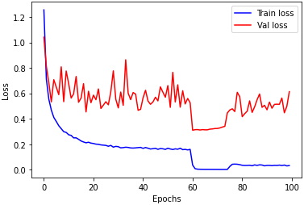
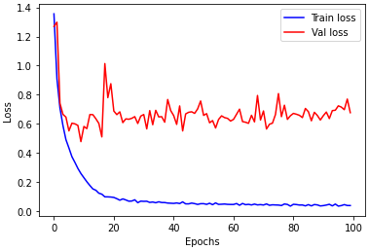
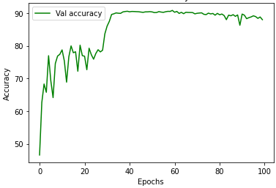
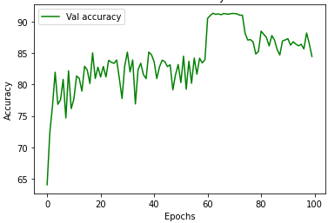
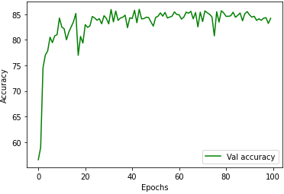
Results : WideResNet trained on Cifar10
Train vs Val loss
Train vs Val loss
Train vs Val loss
Validation accuracy
Validation accuracy
Validation accuracy
DFW : Test Accuracy: 89.7 %
SGD : Test Accuracy: 90.5 %
ADAM : Test Accuracy: 84.3 %

Slide 22
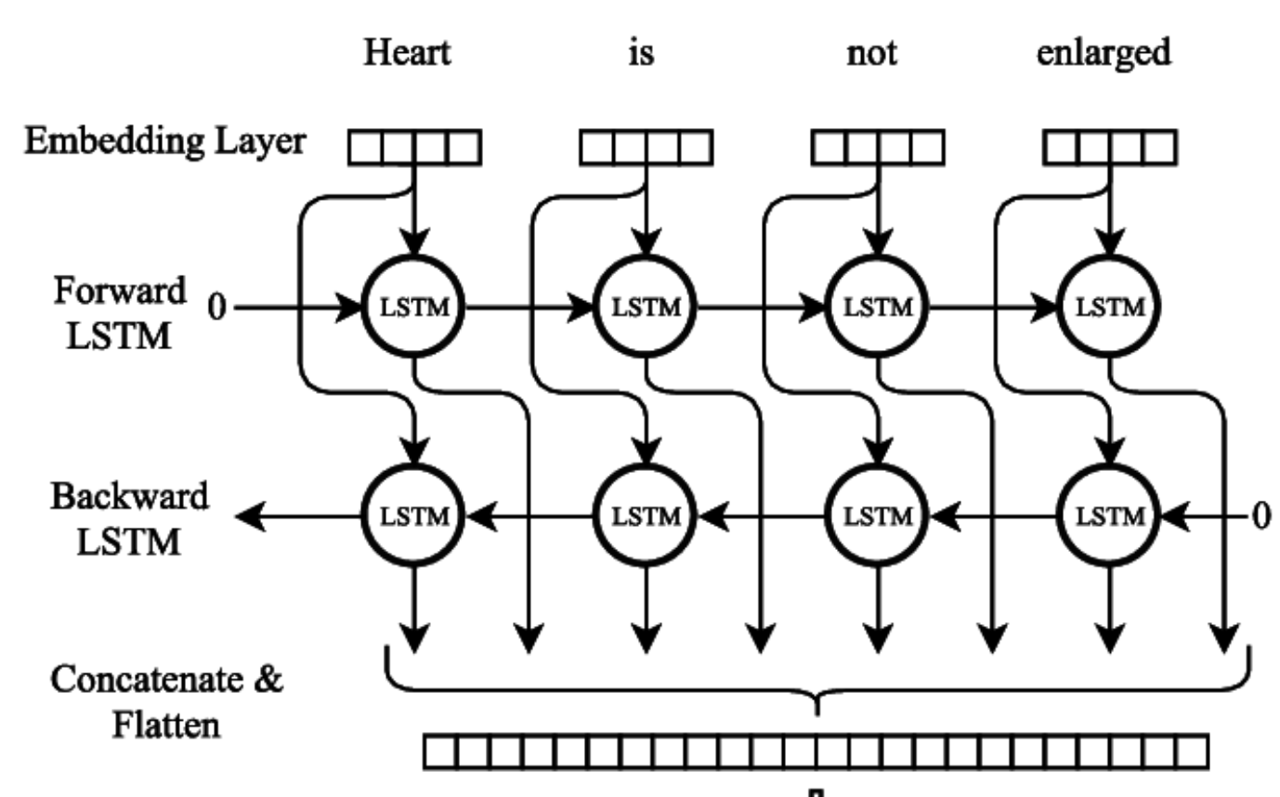
Natural language inference with RNNs
Dataset : SNLI
Contains 570K pairs of sentences
Splits: train set (549367 pairs), val set (9842 pairs), test set (9824 pairs)
Picked random 10% of the train and val sets per epoch due to large training time
3 classes : entailment, neutral & contradiction
Glove embeddings used : 840B.300d
Bidirectional-LSTM :
47M parameters, input dim (2048), encoder layers (1)
Hyperparameters : batch-size (64), epochs (40), momentum and regularization are deactivated
DFW :
Loss : SVM (not smoothed), Lr (0.1)
SGD :
Loss : SVM
Learning rate decay :
LR decayed by a power of 10 per epoch
If the validation accuracy does not improve, the learning rate is divided by a factor of 5
ADAM :
Loss : SVM (not smoothed), Lr (1e-4)
Bidirectional LSTM

Slide 23
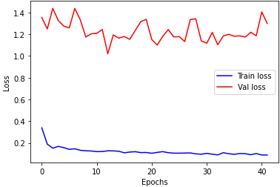
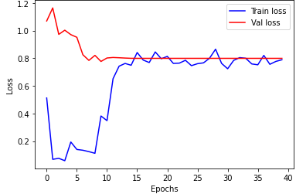
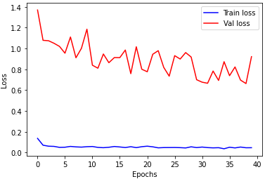
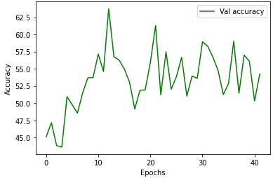
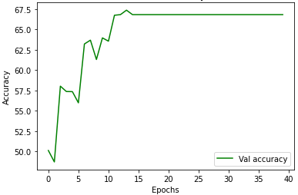
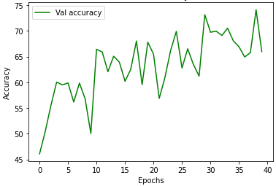
Results : BiLSTM trained on SNLI
Train vs Val loss
Train vs Val loss
Train vs Val loss
Validation accuracy
Validation accuracy
Validation accuracy
DFW : Test Accuracy: 58.2 %
SGD : Test Accuracy: 61.1 %
ADAM : Test Accuracy: 66.7 %

Slide 24
THE IMPORTANCE OF THE STEP-SIZE
IMPACT ON GENERALIZATION :
• Take the protocol to train the DN network on CIFAR-10 with SGD, and simply change the initial learning rate to be ten times smaller, and the budget of epochs to be ten times larger. As a result, the final training objective significantly decreases from 0.33 to 0.069.
• Yet at the same time, the best validation accuracy decreases from 70.94% to 68.7%.
• We have observed DFW to accurately optimize the learning objective.
• The good generalization performance of SGD may be due to its schedule with a large number of steps at a high learning rate.

Slide 25
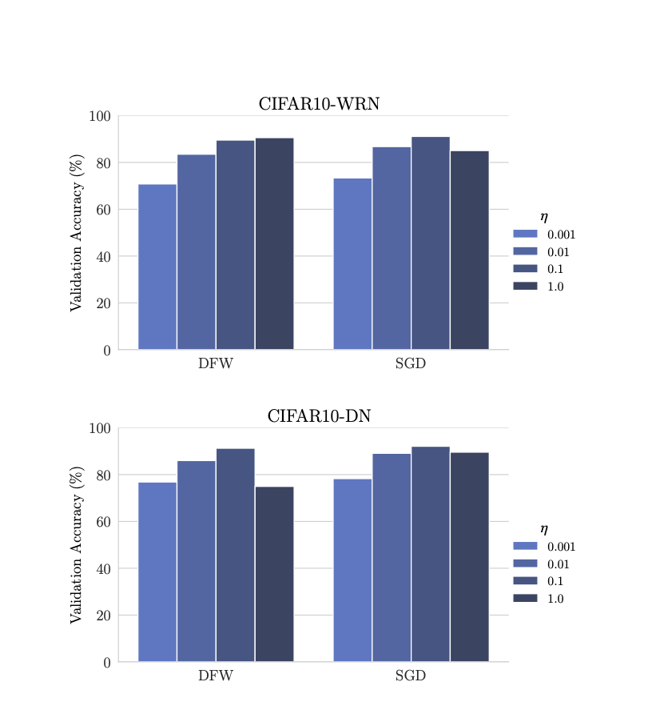
SENSITIVITY ANALYSIS :
We analyze the impact of the initial learning rate η on both the training accuracy (quality of optimization) and the validation accuracy (quality of generalization).
Compare results of the DFW and SGD algorithms on the CIFAR data sets when varying the value of η as a power of 10.
The results on the validation set are summarized in figure.

Slide 26
In some cases where η is high, SGD obtains a better performance than DFW.
By using a batch- size of 64 and η = 1, DFW obtains a test accuracy of 91.0% on CIFAR-10 with the DN architecture and SGD obtains 88.6%.
Observations:
Choice of high learning rate provides a consistent improvement for convolutional neural networks:
Accurate minimization of the training objective with large initial steps usually leads to good generalization.
Sometimes it is beneficial to even increase the batch-size in order to train the model using large initial steps.

Slide 27
CONCLUSION
We have seen that DFW is an efficient algorithm to train deep neural networks.
We emphasize the generality of our framework in problem formulation, which enables the training of deep neural networks to benefit from any advance on optimization algorithms for linear SVMs.
This framework could also be applied to other loss functions that yield efficiently solvable proximal problems.
We also know the intricate relationship between optimization and generalization in deep learning.
This illustrates a major difficulty in the design of effective optimization algorithms for deep neural networks:
The learning objective does not include all the regularization needed for good generalization.
In order to further advance optimization for deep neural networks, it is essential to alleviate this problem and expose a clear objective function to optimize.

Slide 28
Thank you!

