Slide 1
Sparse Matrix Operations in Social Networks Group - 9

Slide 2
CONTENT
Introduction
Band Matrices
Physical Significance
Sparse matrix operations
Eigen Centrality
Random Walk

Slide 3
INTRODUCTION
A network is a set of items (nodes or vertices) connected by edges or links. A social network can be described as set of people or groups of people with some pattern of contacts or interactions between them which means graph of individuals who connected to each other..
The essential characteristics of a social network are:
1. There is a collection of entities that participate in the network.
2. There is at least one relationship between entities of the network.

Slide 4


SPARSE MATRICES
We represent a network by a graph (N,g), which consists of a set of nodes N={1, ..., n} and an n×n matrix (referred to as an adjacency matrix), where
.
Most of the social networks are typically large and sparse. Network can be extremely expensive in terms of both computations and storage.
To improve the efficiency, sparse matrices are used to represent such networks. It can both save a significant amount of memory and speed up the processing of that data.

Slide 5
REPRESENTATION
Adjacency matrices
Coordinate format
CSR (Compressed Sparse Row)
CSC (Compressed Sparse Column)

Slide 6
APPLICATIONS
Social networking link prediction
Identifying the core topics in the documents
Summarizing the large paragraphs
Analyzing the product review in e-commerce site
Sentiment analysis of tweets on social media

Slide 7
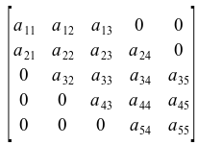
BAND MATRIX
A band matrix is basically just a representation of sparse matrix whose non-zero entries are restricted to the diagonal band, comprising the main diagonal and zero on both the other sides.
Upper Band Matrix
Lower Band Matrix

Slide 8
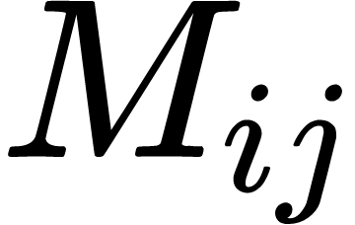
BANDWIDTH OF A BAND MATRIX
Formally, Consider a (N×N) matrix A = ( ). If all the elements of the matrix are zero outside a diagonally bordered band whose range is determined by constants k1 (for upper) and k2 (for lower) :
M(i,j) = 0 if p < q - k1 or p > q + k2;
Where k1, k2 >= 0
These variables k1 and k2 are known as the lower bandwidth and upper bandwidth respectively of the band matrix. The bandwidth of the matrix is the maximum of k1 and k2; in other words, it is the number k such that
Mi,j = 0 if | i – j | > k

Slide 9
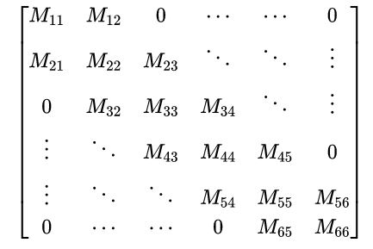
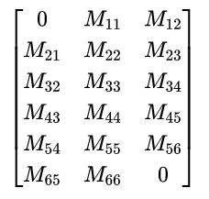
BAND STORAGE
Band matrices are generally stored by storing the diagonals in the band; the rest of the elements are implicitly zero. For example, a has bandwidth 1. The 6-by-6 matrix is stored as the 6-by-3 matrix.

Slide 10
APPLICATION OF BAND MATRIX
In numerical analysis, matrices from finite element or finite difference problems are often banded. Such matrices can be viewed as descriptions of the coupling between the problem variables; the banded property corresponds to the fact that variables are not coupled over arbitrarily large distances. Such matrices can be further divided – for instance, banded matrices exist where every element in the band is nonzero. These often arise when discretizing one-dimensional problem

Slide 11
PHYSICAL SIGNIFICANCE
They are used in computationally heavy fields like machine learning, natural language processing to map the data sets.
Recommender systems like Facebook and YouTube can be an example of using sparse matrices because they are typically in wraps with only 1000 number off Facebook friends or YouTube videos While the dataset stored in them is of billions of users.
From a mathematical standpoint, if we have a 100,000 x 100,000 matrix of sparsity>99% , this will require us to have 100,000 x 100,000 x 8 = 80 GB worth of memory to store this matrix (since each double uses 8 bytes)! But the same representation with sparse matrices can be done in 80MB !!

Slide 12
ADVANTAGES AND APPLICATIONS
CSR ( most widely used form) is used for write-once-read-many tasks .
Advantages:
Efficient item access and slicing
Fast arithmetic
Fast vector products
Sparse matrices come up a lot in practice, beyond just adjacency matrices in graphs. For example,
Word counts we might represent a document by which words are in it, but only a small fraction of all words would appear in a given document
Ratings: we might represent an Amazon item by the user ratings, but only a small fraction of all users have rated the given item

Slide 13
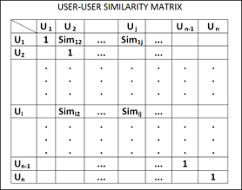
SPARSE MATRICES IN RECOMMENDER SYSTEMS
A recommender system is an information filtering system that seeks to predicts the rating given by a user to an item, primarily in commercial applications.
Once, we have a USER-USER similarity matrix now we have to find the similar users. Let say from USER-USER similarity matrix, three most similar users to user U10 →U1, U7, U15.Thus now we can recommend items to the user like for U10 as per the likings of U1,U7,U15.

Slide 14
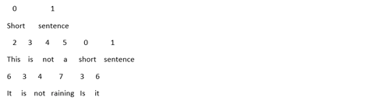
SPARSE MATRICES IN TEXT SUMMARISATION
Accordingly a CSR matrix is obtained and as its sparse the 0s in the matrix are omitted .
A few examples of such text analysis use cases are: Text Summarization ,Social media analysis ,Sentiment analysis.
From this data we can create news digests, report generation, news summarization, and headline generation.
Step2 : We vector represent each document
Document 1: <0 1, 1 1>
Document 2: <0 1, 1 1, 2 1, 3 1, 4 1, 5 1>
Document 3: < 3 2, 4 1, 6 2, 7 1>

Slide 15


SPARSE MATRIX-MATRIX MULTIPLICATION
Multiplication of two Matrices A, B is computed as , which is defined only when number of columns in both A and B is same i.e. and then .
Many Sparse matrix algorithms have memory access outpace floating-point operations as the computational bottleneck, this demands diligence when choosing a storage format to minimize memory traffic.
One approach to compute would be to compute from B and store it as a CSR matrix but this reorganization requires a significant amount of memory traffic. Also computing the inner product of sparse vectors is inefficient operation because of the low ratio of flops to cache misses.
But when a sparse- dense inner product would significantly increase the ratio of flops.

Slide 16



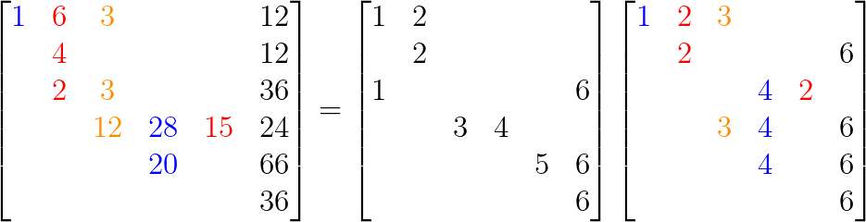


SPARSE MATRIX-MATRIX MULTIPLICATION
Thus to compute , first we reconstruct sparse matrix into a dense
matrix which is done using matrix coloring and then compute.
such that nonzero entries in are also nonzero entries
needed to form C. Finally, must be reorganized into C, which is done by
using process similar to compression of .

Slide 17
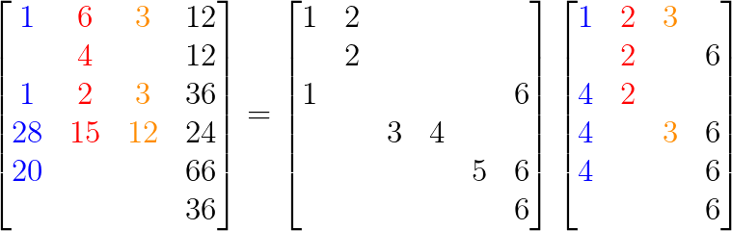
Sparse matrix-matrix multiplication
The structure of admits the coloring,

Slide 18
MATRIX VECTOR MULTIPLICATION
Sparse Matrix-vector Multiplication is an important operation in sparse matrix in linear algebra. This equation is used to define the operation over the matrix
y<-Ax +y
The main aim of SpMV is to reduce the non uniform behaviour of matrix structure.We know that SpMV kernel should be memory-bound therefore the fraction of peak bandwidth which the kernel can achieve is the measure of success.This problem can be resolved by choosing a right matrix format and also implement the parallel kernel for each specific formats such it provides high efficiency.we need to analyse a particular matrix and select a suitable format which best suits to its sparse pattern.The well known formats are DIA,ELL,CSR .

Slide 19


DIA FORMAT
Matrix A: Offset = [ -2 0 1]

Slide 20
DIA FORMAT
Data [* * 5 6 1 2 3 4 7 8 9 * ]
Iteration 0 [ 2 3 ]
Iteration 1 [ 0 1 2 3 ]
Iteration2 [ 0 1 2 ]

Slide 21


ELL FORMAT

Slide 22
ELL FORMAT
Data [ 1 2 5 6 7 8 3 4 * * 9 0]
Indices [0 1 0 1 1 2 2 3 * * 3 *]
Iteration 0[0 1 2 3 ]
Iteration 1[ 0 1 2 3 ]
Iteration 2[ 0 1 2 3 ]

Slide 23
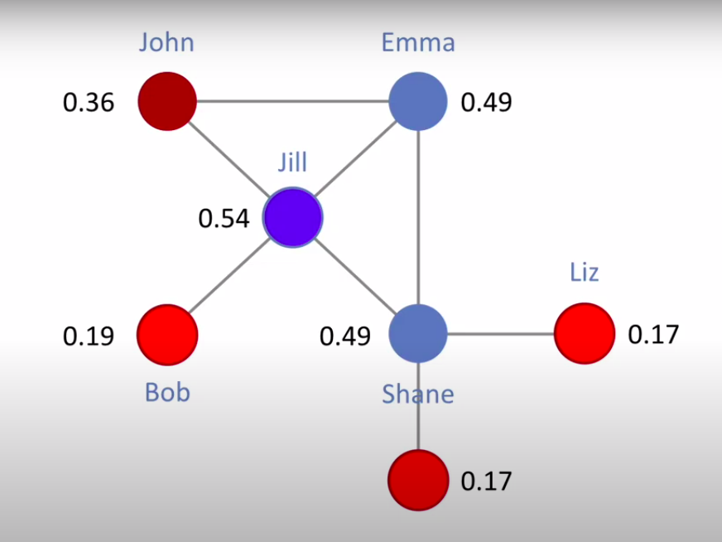
EIGEN CENTRALITY
In social Networks, eigenvector centrality (also called eigen centrality or prestige score) is a measure of the influence of a node in a network.
It assigns relative scoring where higher score mean more influential node

Slide 24
APPLICATIONS
Twitter uses this principle of Eigen Centrality to show users suggestions of whom to follow.
Google uses this concept to calculate the page rank of documents in their search engine and we get the most significant document as per our searched keyword.
Facebook uses this principle to guide us the friends that we can make based on the network.

Slide 25
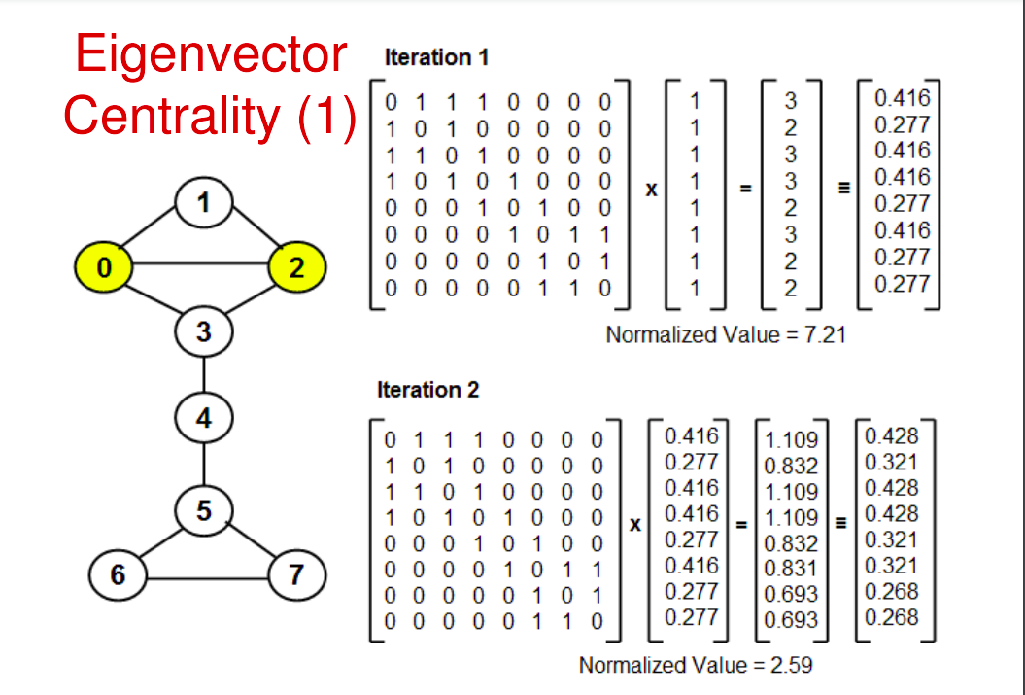
POWER ITERATION METHOD

Slide 26
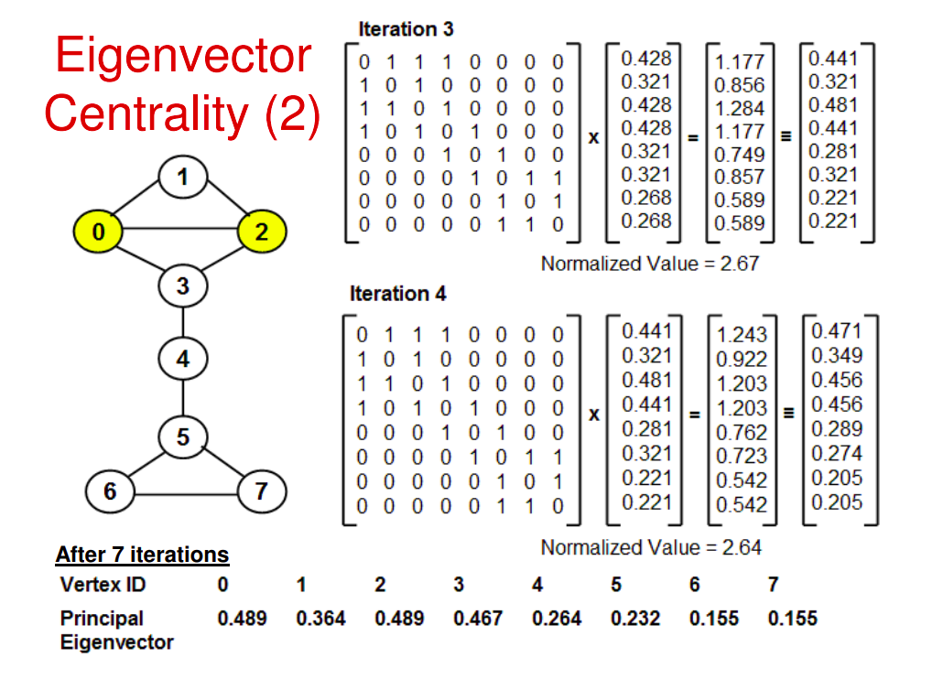

Slide 27


RANDOM WALK ON SOCIAL NETWORK
It is a stochastic process
Used to model diffusion, interactions, opinions among humans
Important when only local connectivity is known at each node
Various proximity measures like node similarity rank used to capture graph structure
Elements used in Random Walk:
Graph adjacency matrix (A)
Diagnonal degree matrix (D)
Probability transition matrix (P) :
(for unweighted graph)
Definition of random walk:
The walker at node 'I' and time 't' selects one of its connected neighbors with some probability to which it hops at time 't+1'

Slide 28

STATIONARY DISTRIBUTION IN RANDOM WALK
Random walk converges to a stationary distribution if the graph is well-behaved
This stationary distribution vector is the eigenvector of the probability transition matrix with largest eigenvalue 1
The 2nd largest eigenvalue determines the rate of convergence

Slide 29
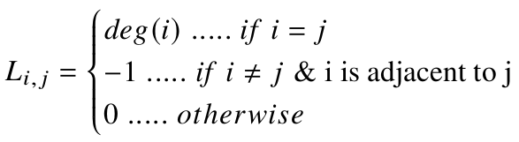
LAPLACIAN MATRIX
Used to find properties of graphs
Used in operations like -diffusion, partitioning, random walk, clustering
Eigenvalues and eigenvectors tell a lot about the structure of the graph
Defined as : L = D – A

Slide 30
WORK DISTRIBUTION
Vaishali Singh(2020201070)
- Introduction & representations of Sparse matrix
B. Sindhu(2020201048) & Mahak Modani(2020201068)
- Matrix Multiplication
Abhishek Sharma(2020201055)
- Band Matrix

Slide 31
WORK DISTRIBUTION
Mansi Khamkar (2020201026)
- Random Walks on social network and Laplacian Matrix
Tushar Bhatt (2020201081)
- Physical Significance of sparse matrices
Shubham Swetank(2020201025)
- Eigen Centrality

