Slide 1
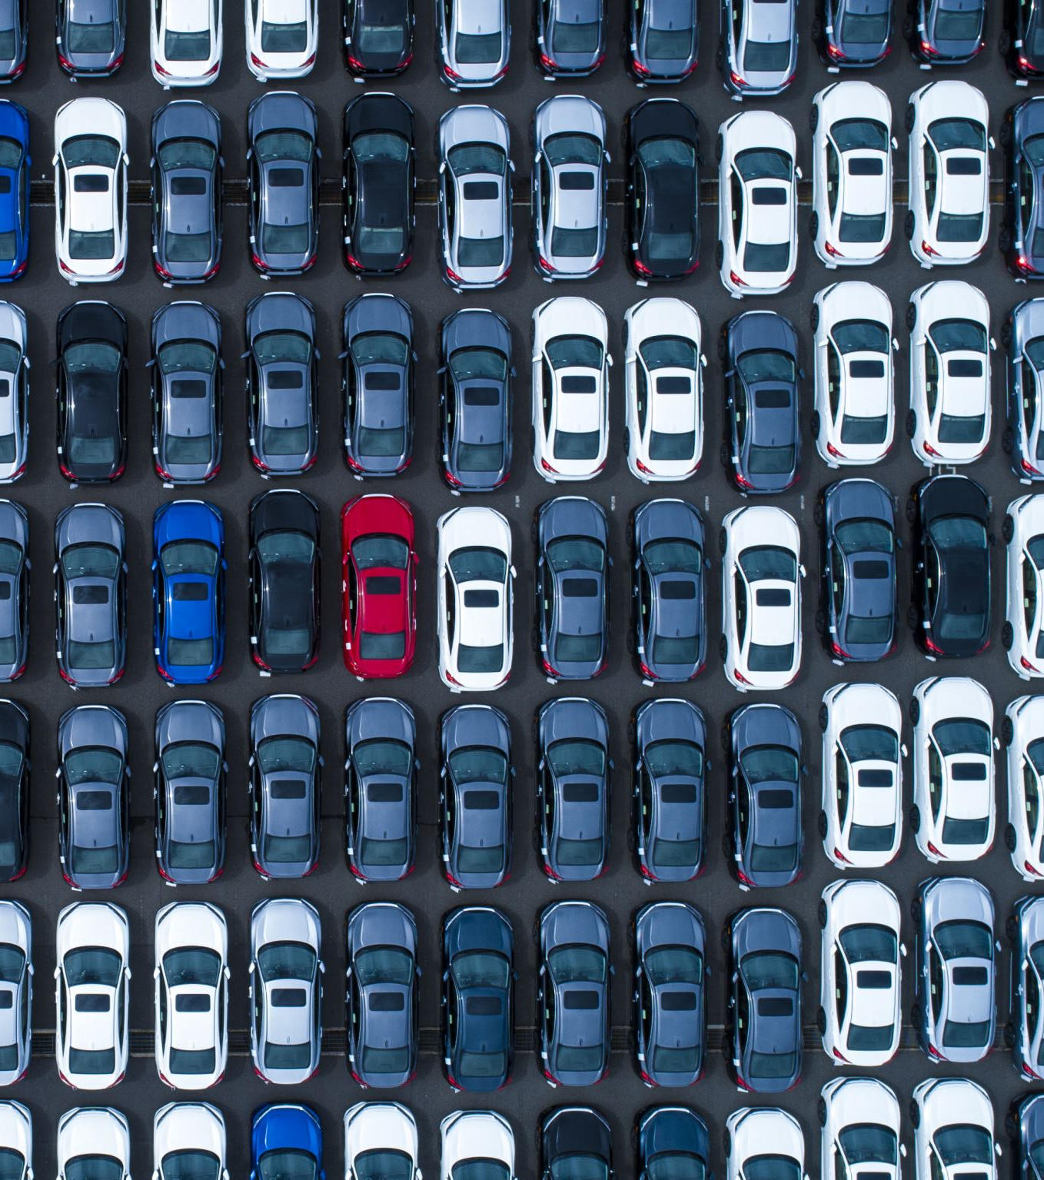
Used Car Market Analysis in the UAE
DBD800 – Big Data
Presented by: Group 5
Mansi (185408234)
Shruti (111559233)

Slide 2
Roadmap
Introduction
Problem Statement
Methodology
Hive Analysis (5 insights)
Zeppelin & Spark Analysis (5 insights)
Conclusion
Q&A

Slide 3

Introduction
This project analyzes over 10,000 used car listings from across the UAE.
Dataset sourced from Kaggle’s “UAE Used Cars Analysis – Full Project v1.0”.
Includes make, model, year, price, mileage, fuel type, transmission, location, and color.
Covers listings from Dubai, Abu Dhabi, Sharjah, and other emirates.
Uploaded and processed in HDFS, analyzed via Hive, Zeppelin, and Spark.
Goal: Provide data-driven insights for buyers, dealerships, and analysts on pricing, demand, and car trends.

Slide 4
The dataset includes information on used cars listed in the UAE. Major attributes include:
Column Name | Description | Data Type
Make | Manufacturer of the vehicle (e.g., Toyota, Mercedes-Benz) | String
Model | Specific model name | String
Year | Manufacturing year | Integer
Price | Listing price in AED | Integer
Mileage | Distance traveled in kilometers | Integer
Body Type | Vehicle category (Sedan, SUV, etc.) | String
Cylinders | Engine configuration | Integer
Transmission | Type of transmission | String
Fuel Type | Fuel used (Gasoline, Diesel, etc.) | String
Color | Exterior color | String
Location | Emirate where listed (Dubai, Abu Dhabi, etc.) | String
Description | Additional features and condition notes | String

Slide 5
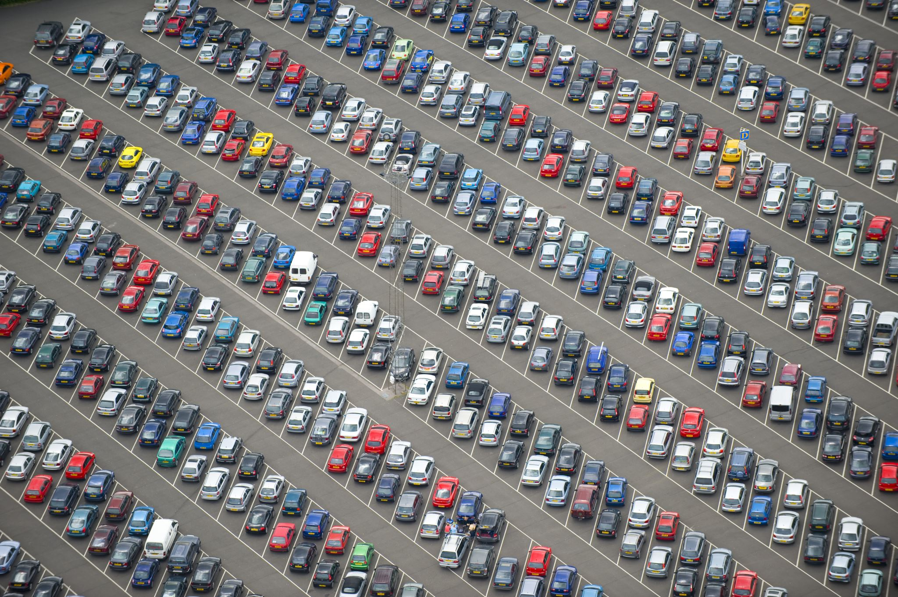
Problem Statement
UAE’s used car market is growing rapidly with thousands of online listings.
It is difficult for users to manually compare listings with diverse attributes (make, price, mileage, etc.).
Stakeholders lack visibility into trends, outliers, and resale behaviors.
Example questions:
  What brands have the most listings?
  How does price change with manufacturing year or mileage?
  Which cities and fuel types dominate the market?
Need for scalable Big Data tools to uncover reliable, insightful patterns from this complex dataset.

Slide 6
Methodology
1. HDFS (Hadoop Distributed File System)
Uploaded the full 10,000-row CSV dataset using terminal commands.
Ensured proper directory setup in HDFS for accessibility.
2. Hive
Created a structured external Hive table to query data.
Executed HiveQL queries for aggregation, filtering, and grouping (e.g., color, brand, year).
3. Zeppelin
Used Apache Zeppelin notebooks to write and execute queries.
Connected Zeppelin to Hadoop and Spark for interactive data exploration and visuals.
4. Spark (via Zeppelin)
Loaded data as a Spark DataFrame using schema inference.
Used Spark SQL for advanced queries like filtering top expensive listings or average prices by year.
Visualized results with pie charts, bar graphs, and line plots inside Zeppelin.
5. Integration & Insight Generation
Generated 10 total insights—5 from Hive, 5 from Zeppelin/Spark.
Analyzed and interpreted results using both raw queries and visual dashboards.

Slide 7
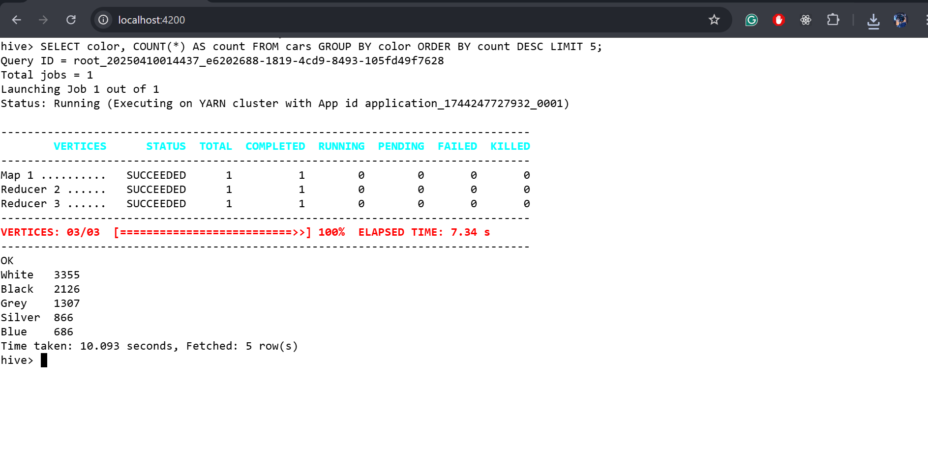
Hive Analysis 1: Most Common Car Colors
A query was executed to group listings by color and count their frequency.
Results shows white > black > grey.
White is preferred in UAE due to its heat-reflective properties.

Slide 8
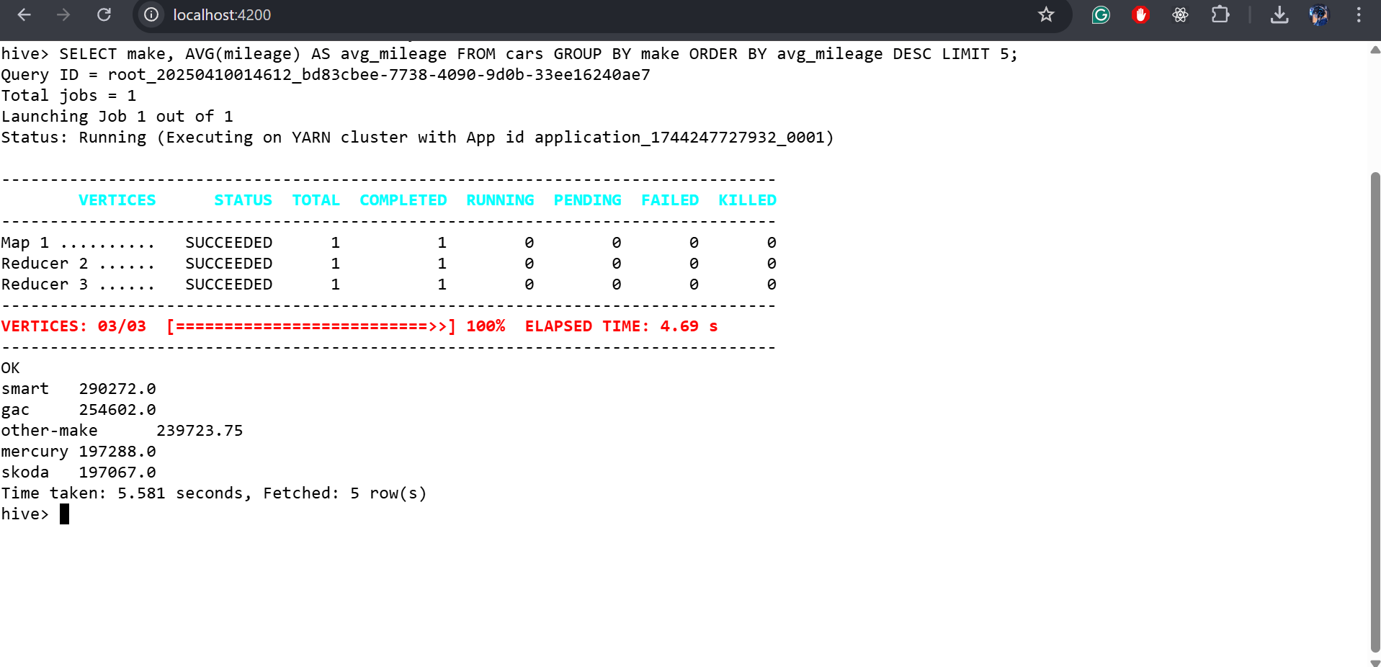
Hive Analysis 2: Average Mileage by Brand
A query was executed to calculate average mileage by brand.
Results show the top 5 brands with the highest mileage.
These brands are considered more reliable and frequently used.

Slide 9
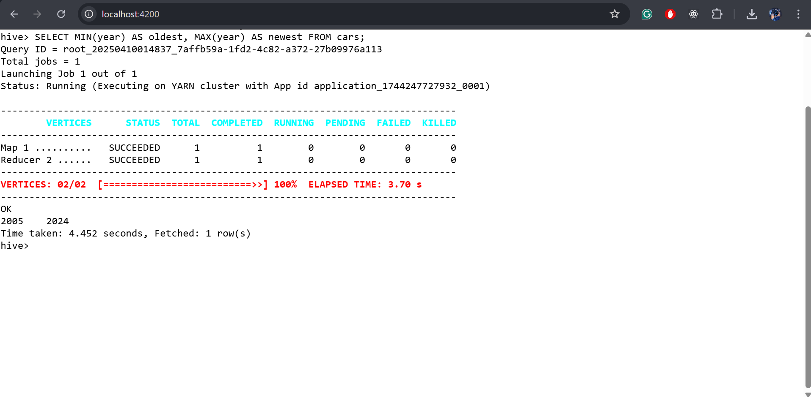
Hive Analysis 3: Newest vs. Oldest Listings
A query was executed to find the minimum and maximum manufacturing year.
Results show listings from 2005 to 2024.
This reflects an active resale market across decades.

Slide 10
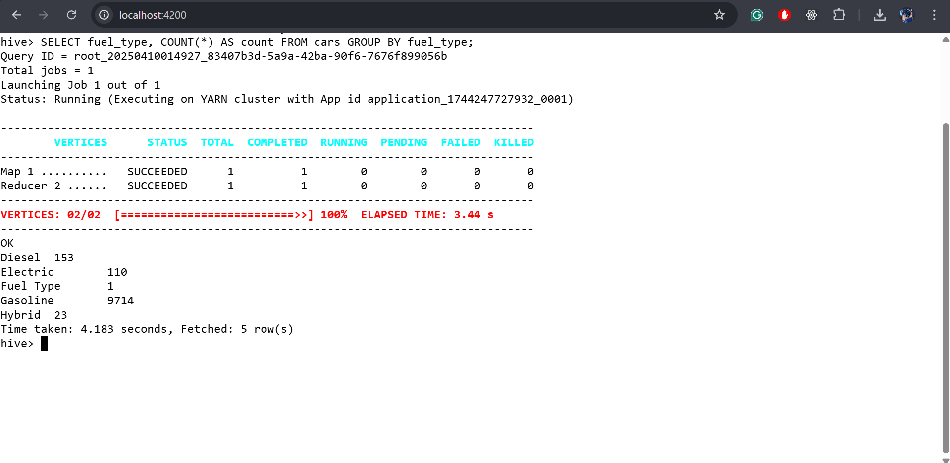
Hive Analysis 4: Fuel Type Distribution
A query was executed to count the number of listings by fuel type.
Results show diesel is dominant, followed by electric.
Indicates a slow but growing shift toward green vehicles.

Slide 11
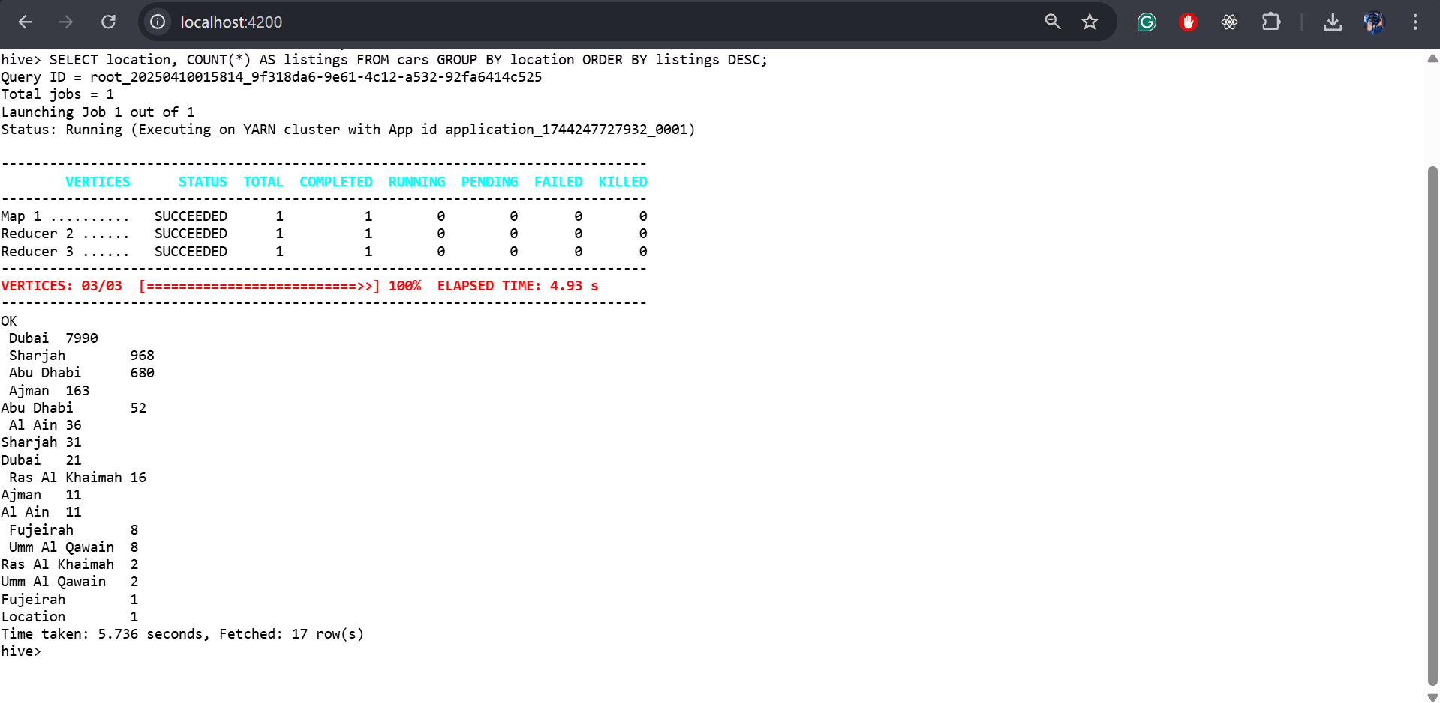
Hive Analysis 5: Listings by Location
A query was executed to count listings by city.
Results show Dubai > Sharjah > Abu Dhabi.
These cities have the highest market activity for used car

Slide 12
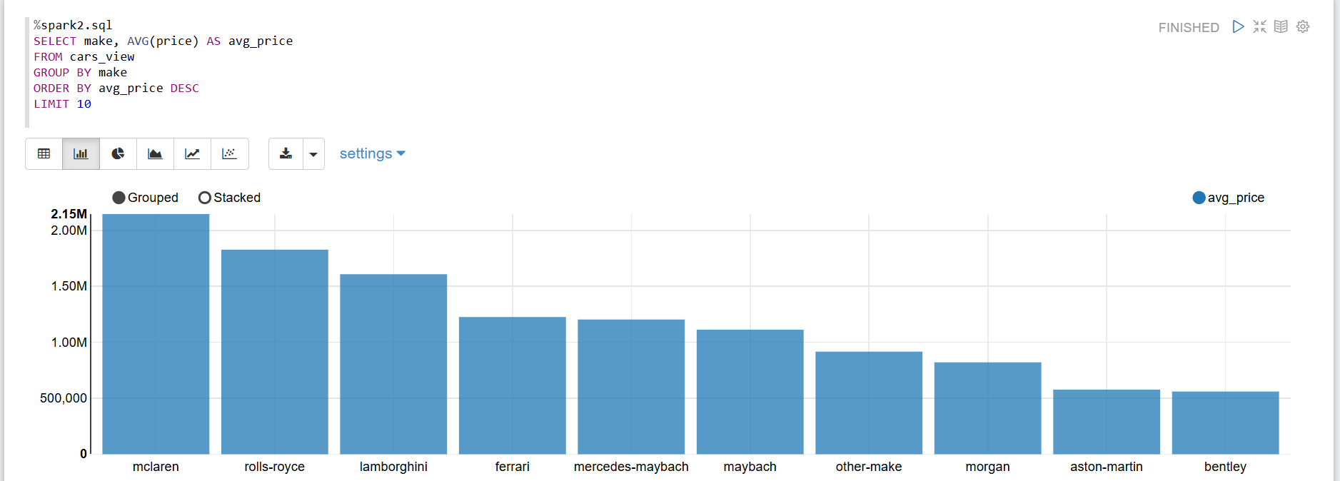
Zeppelin/Spark Analysis 1: Price Distribution by Brand
A Spark data frame was used to analyze price distribution across brands.
Results show McLaren and Rolls-Royce lead in high prices.
Reflects a strong luxury market presence in the UAE.

Slide 13
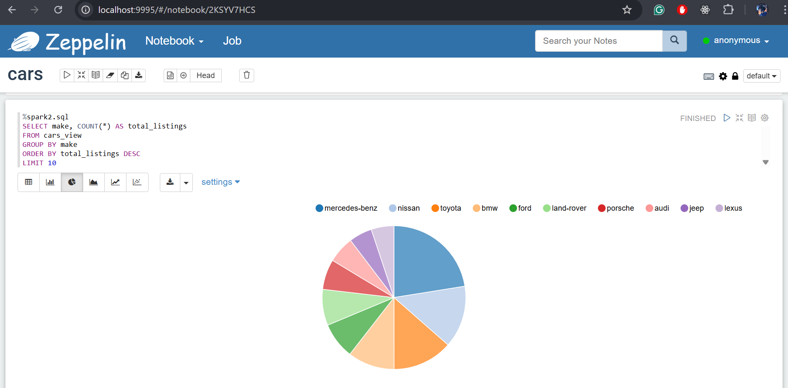
Zeppelin/Spark Analysis 2: Most Frequently Listed Brands
A query was executed to count the number of listings by brand.
Results show Mercedes-Benz appears most often.
Indicates high brand trust and strong resale demand

Slide 14
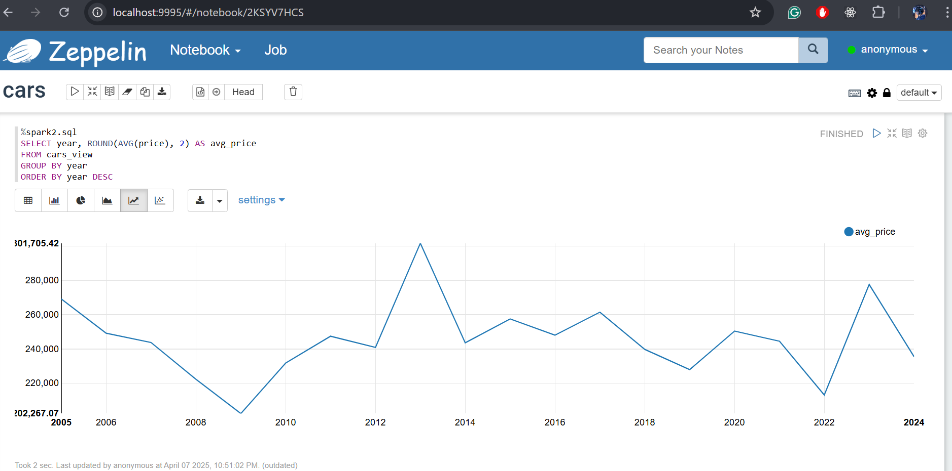
Zeppelin/Spark Analysis 3: Avg. Price by Year of Manufacture
A query was executed to calculate average price by manufacturing year.
Results show prices drop sharply after 5 years.
Highlights strong depreciation trends in the UAE market.

Slide 15
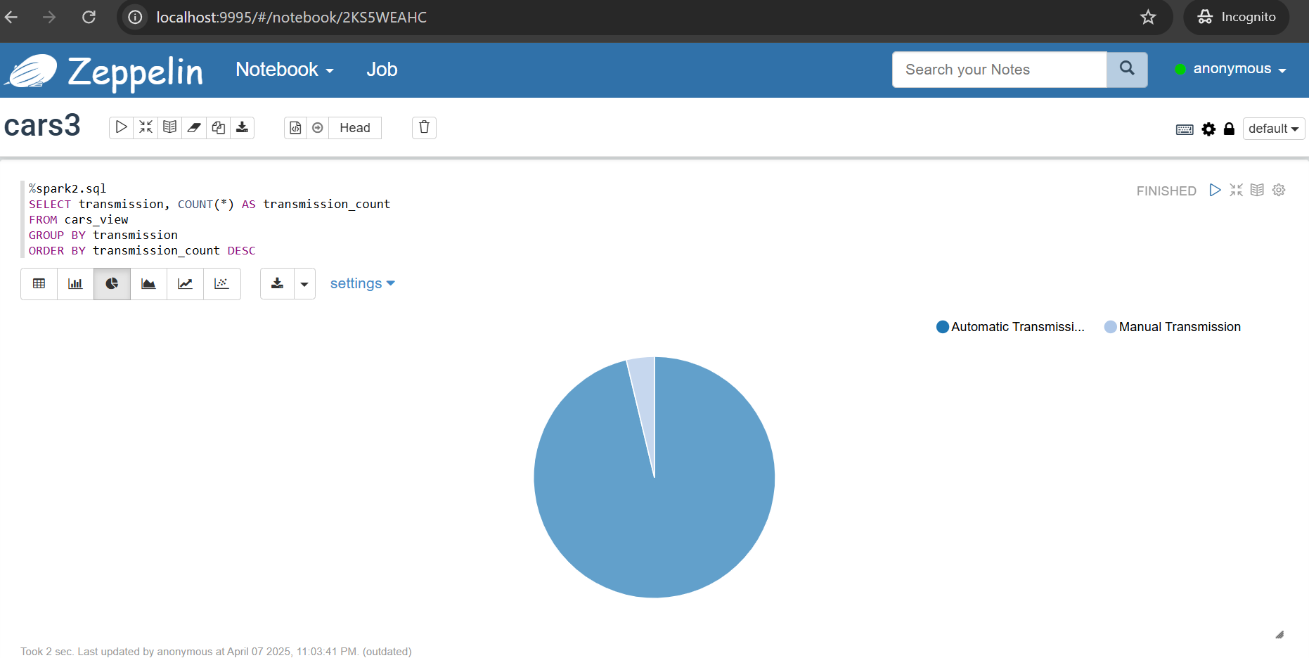
Zeppelin/Spark Analysis 4: Transmission Type
A query was executed to count listings by transmission type.
Results show automatic transmission dominates the market.
Preferred for its convenience in urban driving.

Slide 16
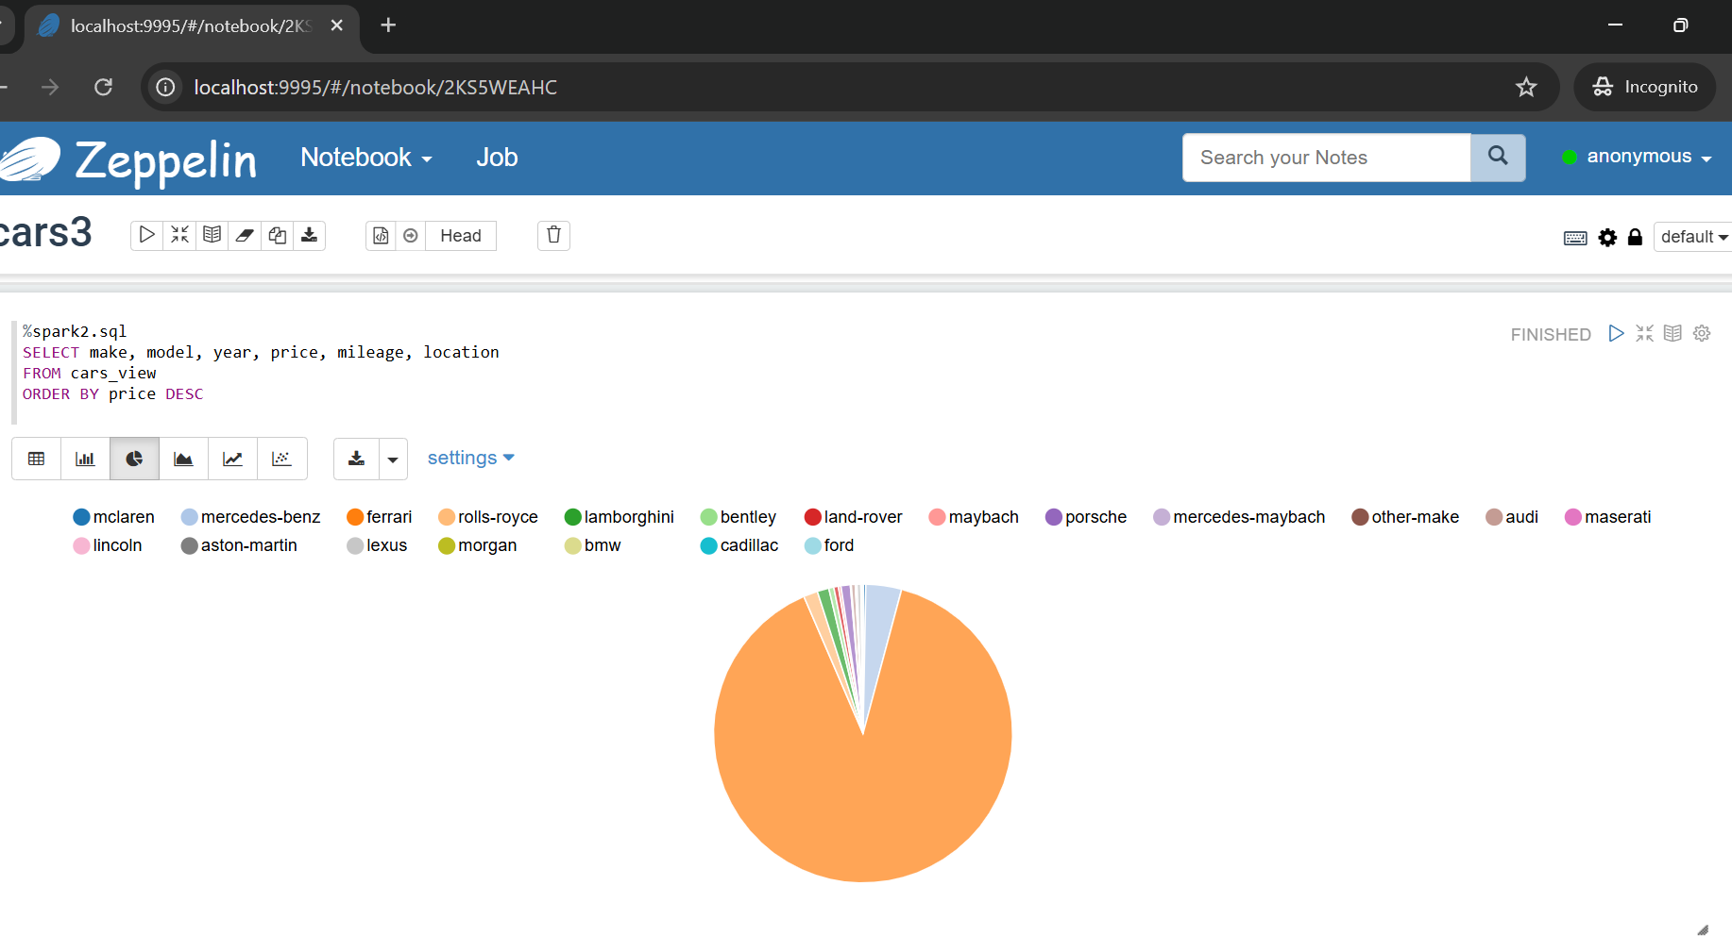
Zeppelin/Spark Analysis 5: Top Expensive Listings
A query was executed to sort and filter the most expensive listings.
Results show Ferrari and Rolls-Royce top the list.
Some cars are listed for millions of AED, showing luxury resale strength.

Slide 17
Conclusion
The UAE used car market is diverse, with strong demand for white, automatic, and diesel vehicles.
Luxury brands like Rolls-Royce and Ferrari dominate the high-end resale segment, highlighting premium buyer interest.
Car value depreciates sharply after 5 years, offering crucial timing insights for buyers and sellers.
Big Data tools (Hive, Spark, Zeppelin, HDFS) enabled scalable querying, analytics, and visual storytelling.
The findings provide actionable insights for car buyers, dealerships, and analysts navigating the resale market.

Slide 18

Thank You!
Any Questions?
We’re happy to answer your queries.

