Slide 1
Scheduling
- Mansi Patel (121028)
- Nishant Patel (121031)

Slide 2
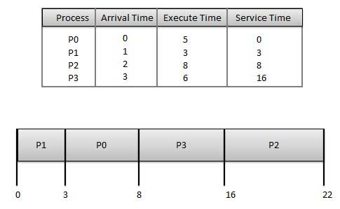
Shortest Job First
Main issue is that the execution of any process should be calculated first
There are high chances of starvation

Slide 3
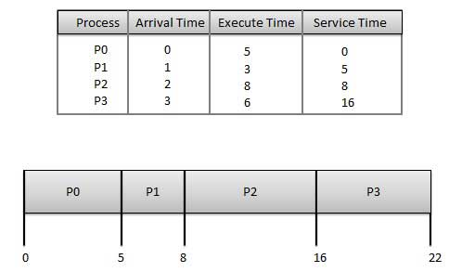
FIFO(also known as FCFS)
Better for long processes than short ones.
It favors processor bound processes over I/O bound processes.

Slide 4
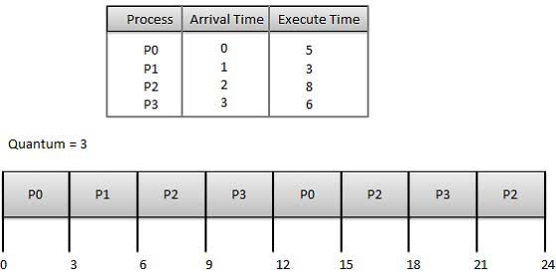
Round Robin
Uses preemption based on clock
Also known as time-slicing.

Slide 5
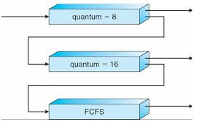
Multiple Feedback
Effective when the relative length of various jobs is not known.
It is similar to Round robin for individual queues.

Slide 6
Comparing various scheduling algorithms
 | FIFO | Round Robin | Shortest Job First | Multiple feedback
Decision mode | Non- Preemptive | Preemptive | Non-Preemptive | Preemptive
Throughput | Not emphasized | Low if quantum is small | High | Not emphasized
Response time | High (for large variance in execution time ) | Good for short processes | Good for short processes | Not emphasized
Overhead | Minimum | Minimum | Can be high | Can be high
Effect on processes | Penalizes short and I/O bound processes | Fair | Penalizes long processes | Favor I/O bound processes
Starvation | No | No | Possible | Possible

Slide 7



Schedules used by various OS
Traditional UNIX- Round Robin
Linux- Round Robin and FIFO
Windows- Multilevel Feedback
MacOS- Round Robin
NACHOS- Round Robin
PintOS- Multilevel Feedback

