Slide 1

Visualizing Tech Workforce Dynamics (2020–2025)
Layoffs, Salaries & Global Trends in Major companies
Course: BSDS 6301: Data Visualization
Presenter: Mansi Thakrar

Slide 2
Why Study Tech Workforce Dynamics?
Post-covid tech boom led to over-hiring, followed by corrections.
Analyze resilience of salaries despite market volatility.
Essential for career strategy and understanding global disparities.
Visualization reveals hidden structures in economic data.

Slide 3
Datasets Overview
Dataset 1: Tech Layoffs (Kaggle)
Timeline: 2020 - 2025
Fields: Company, Industry, Count, Country
Dataset 2: Data Jobs (Kaggle)
Timeline: 2020 - 2023
Fields: Title, Salary, Experience, Work Setting

Slide 4
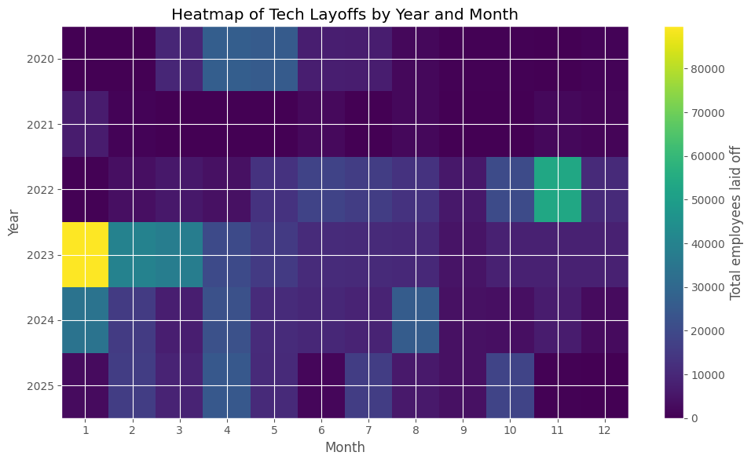
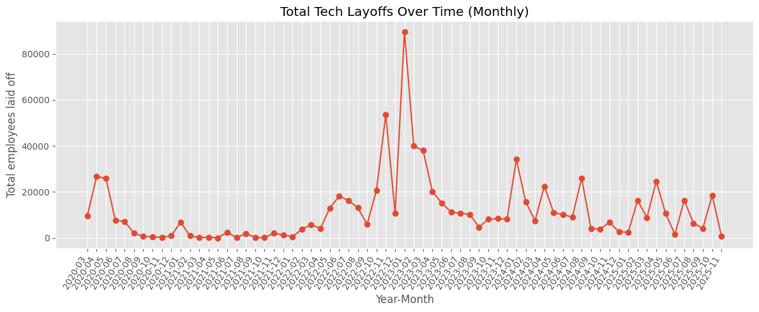
Tech Layoffs Over Time
Clear peak in layoffs observed during 2022–2023.
Market stabilization visible post-2024.
Correlates with post-pandemic economic corrections.

Slide 5
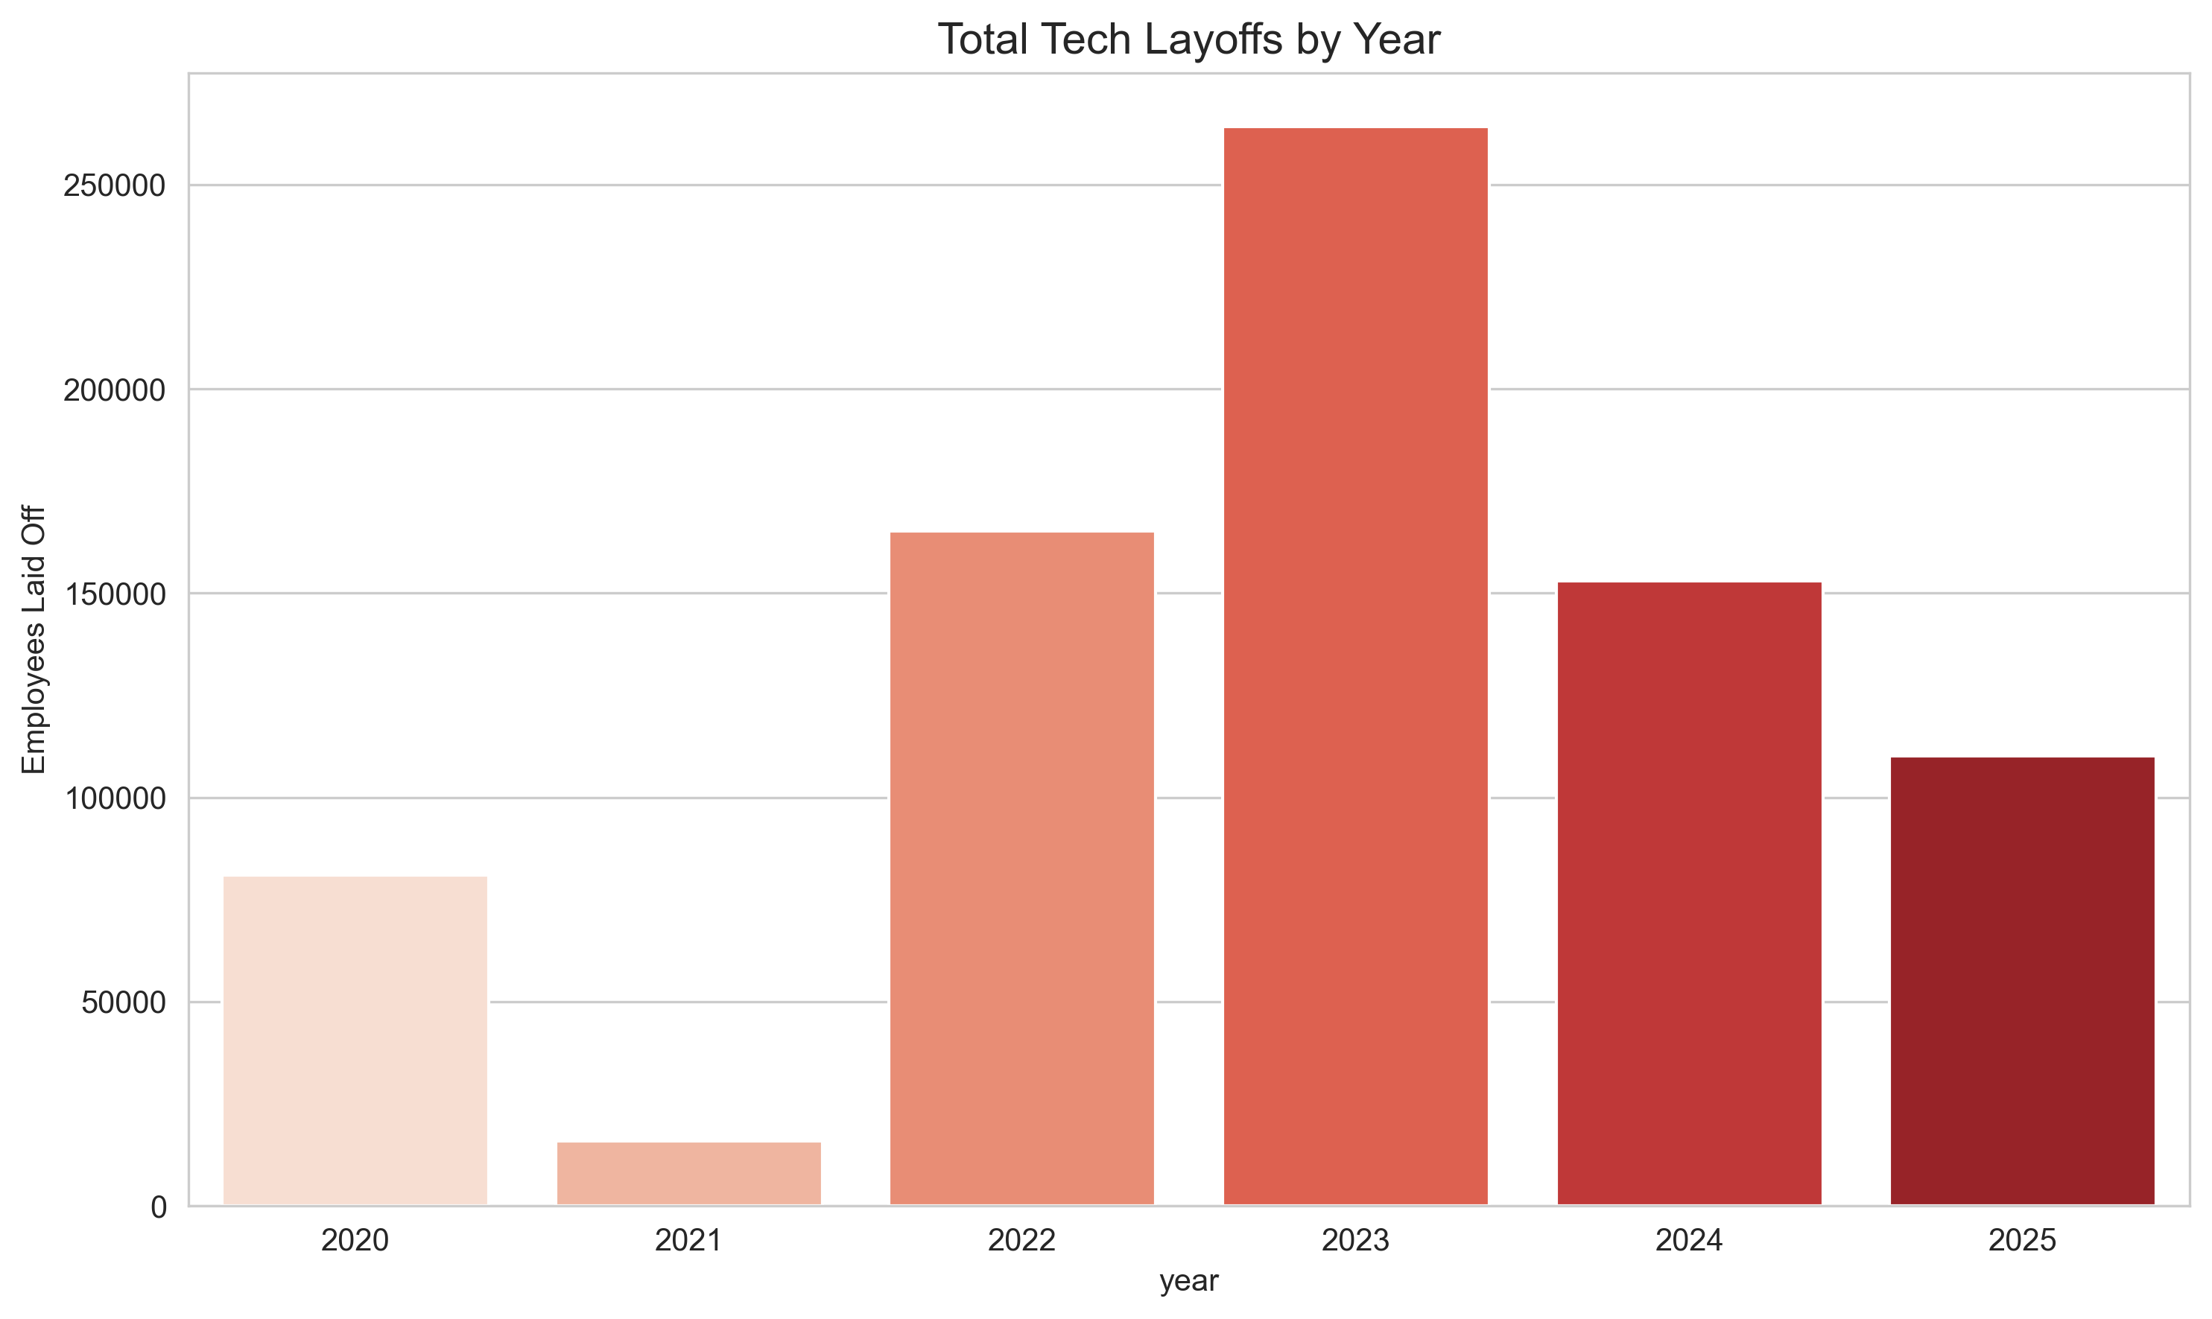
Layoffs by Year
Sharp rise in 2022 compared to 2021.
2023 remained high, marking the most volatile period.
2024 shows signs of recovery.
2025 even though has high numbers, has recovered comparatively

Slide 6
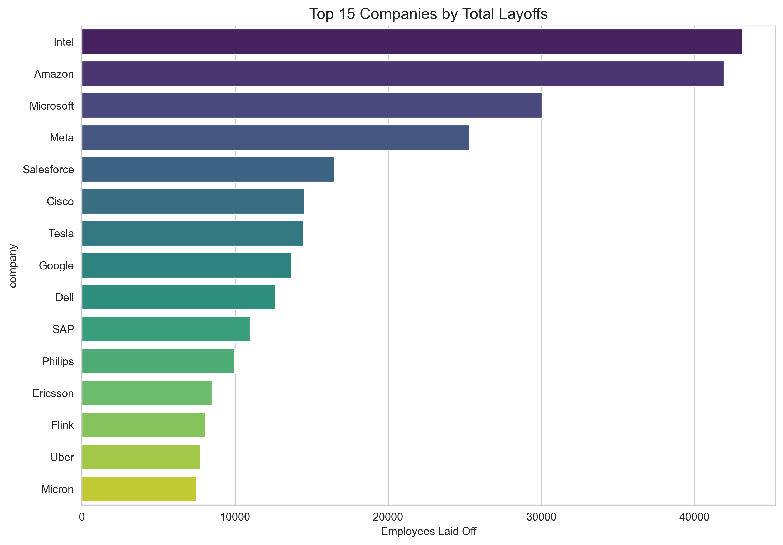
Top 15 Companies by Layoffs
Major tech giants (Intel, Amazon, Meta, Google) dominate the totals.
Reflects workforce resizing after massive growth phases.
Company-level view highlights systemic industry shifts.

Slide 7
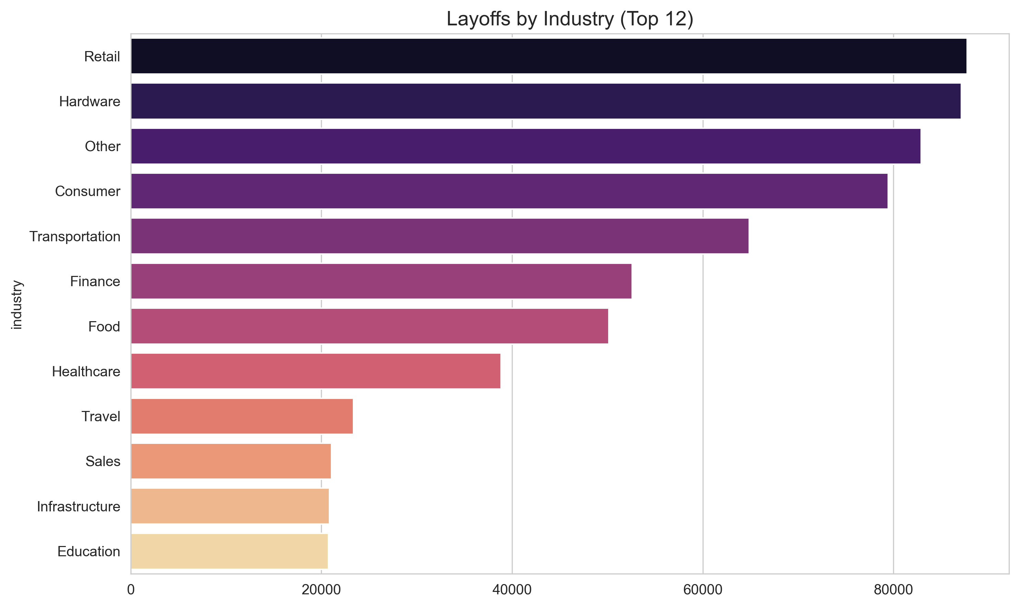
Layoffs by Industry
Retail, Hardware, Consumer hit hardest.
Transportation, Finance, Food and Healthcare also show significant numbers.
Useful for identifying sector-specific risks.

Slide 8
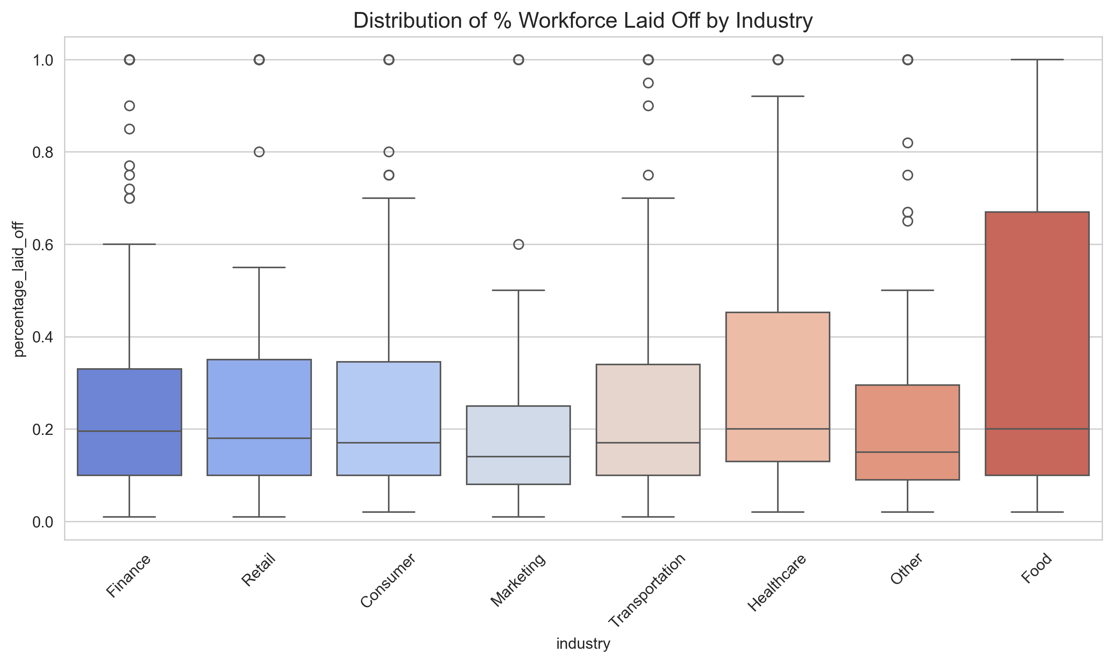
Percentage Laid Off Distribution
High variance within industries.
Boxplots reveal that while totals are high, many companies laid off smaller % of workforce.
Outliers indicate total shutdowns or massive pivots.

Slide 9
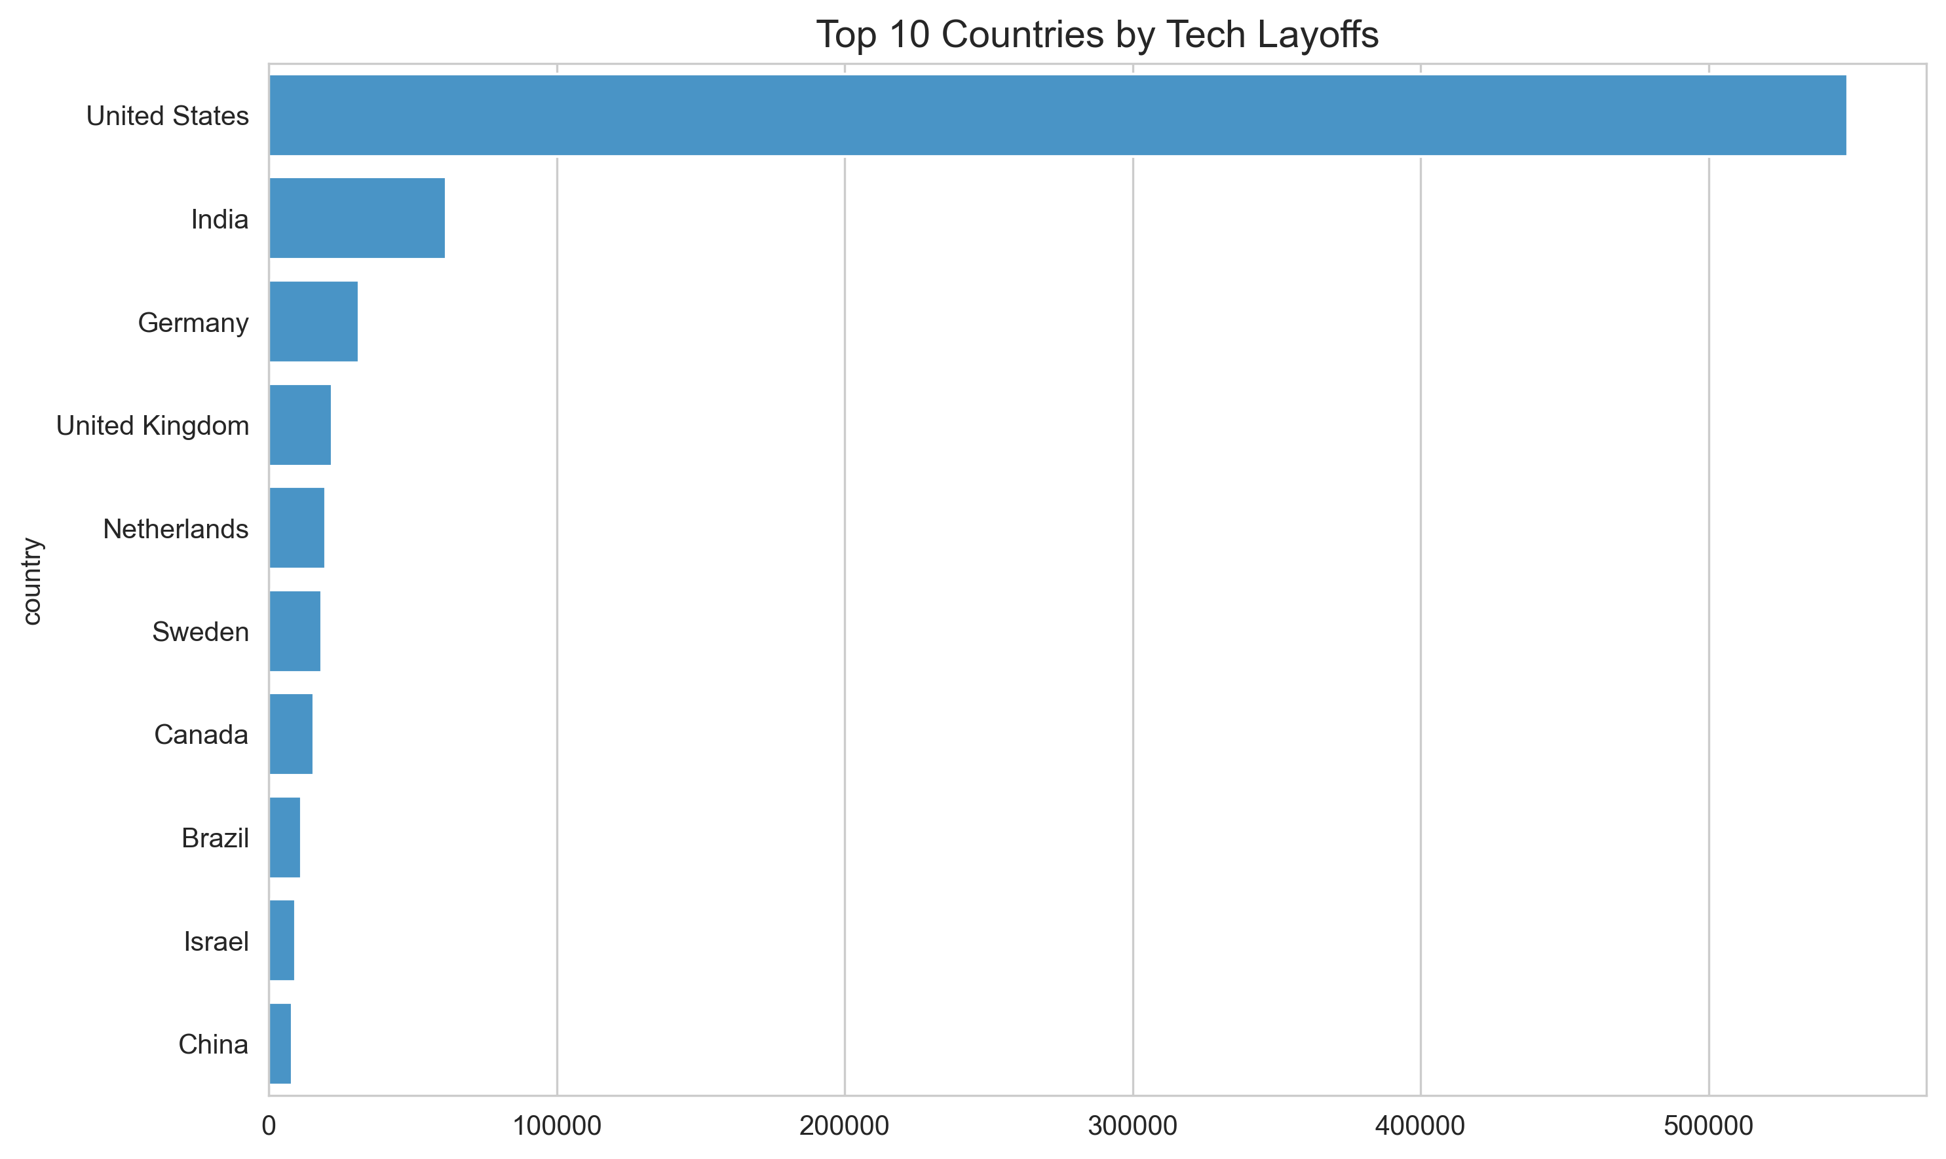
Global Layoff Distribution
United States dominates the dataset.
India, Germany, and UK follow.
Reflects the concentration of tech HQs in the US.

Slide 10
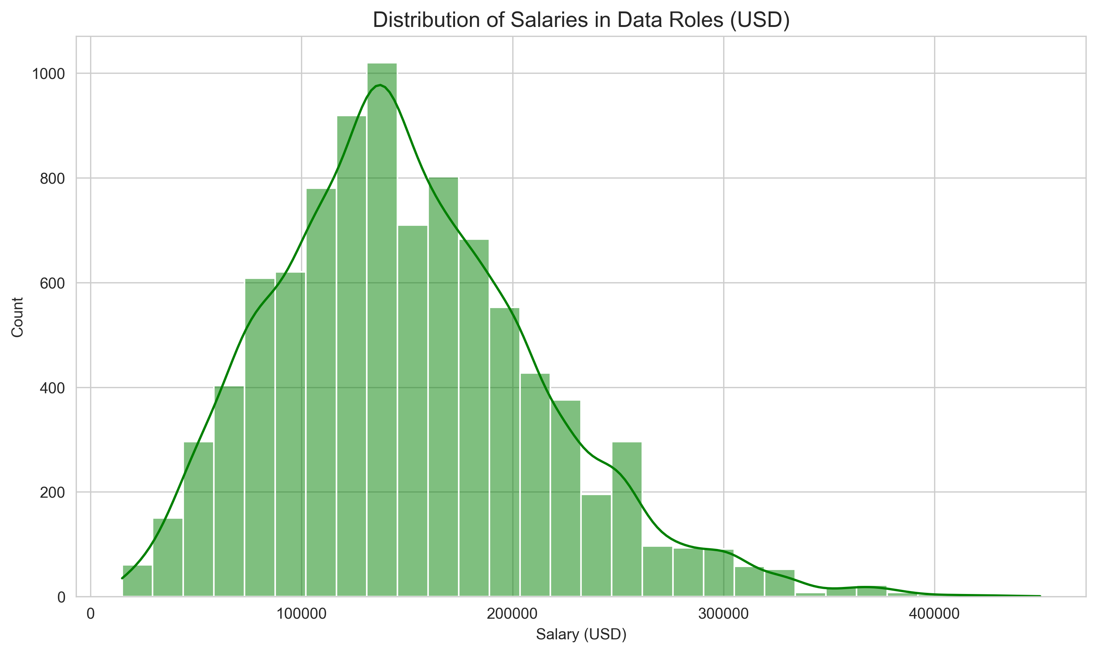
Salary Distribution (Data Roles)
Right-skewed distribution.
Most roles cluster between $100k - $150k.
Long tail extends to $400k+, showing high ceiling for specialized roles.

Slide 11
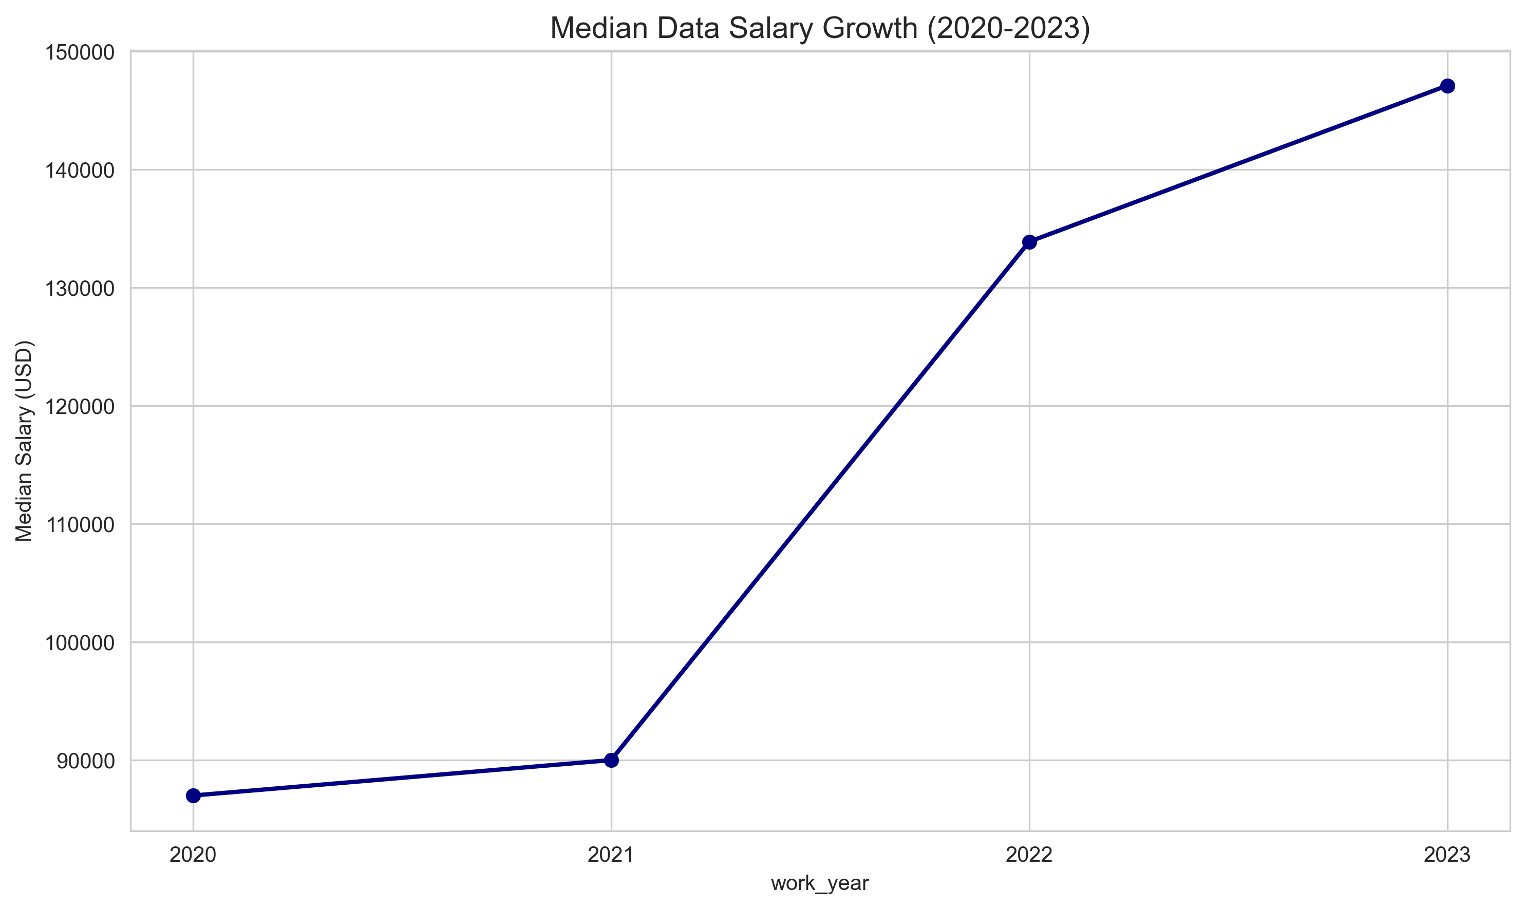
Median Salary Growth
Steady upward trend from 2020 to 2023.
Indicates strong demand for data skills despite broader layoffs.
Resilience of the specific Data/AI sector.

Slide 12
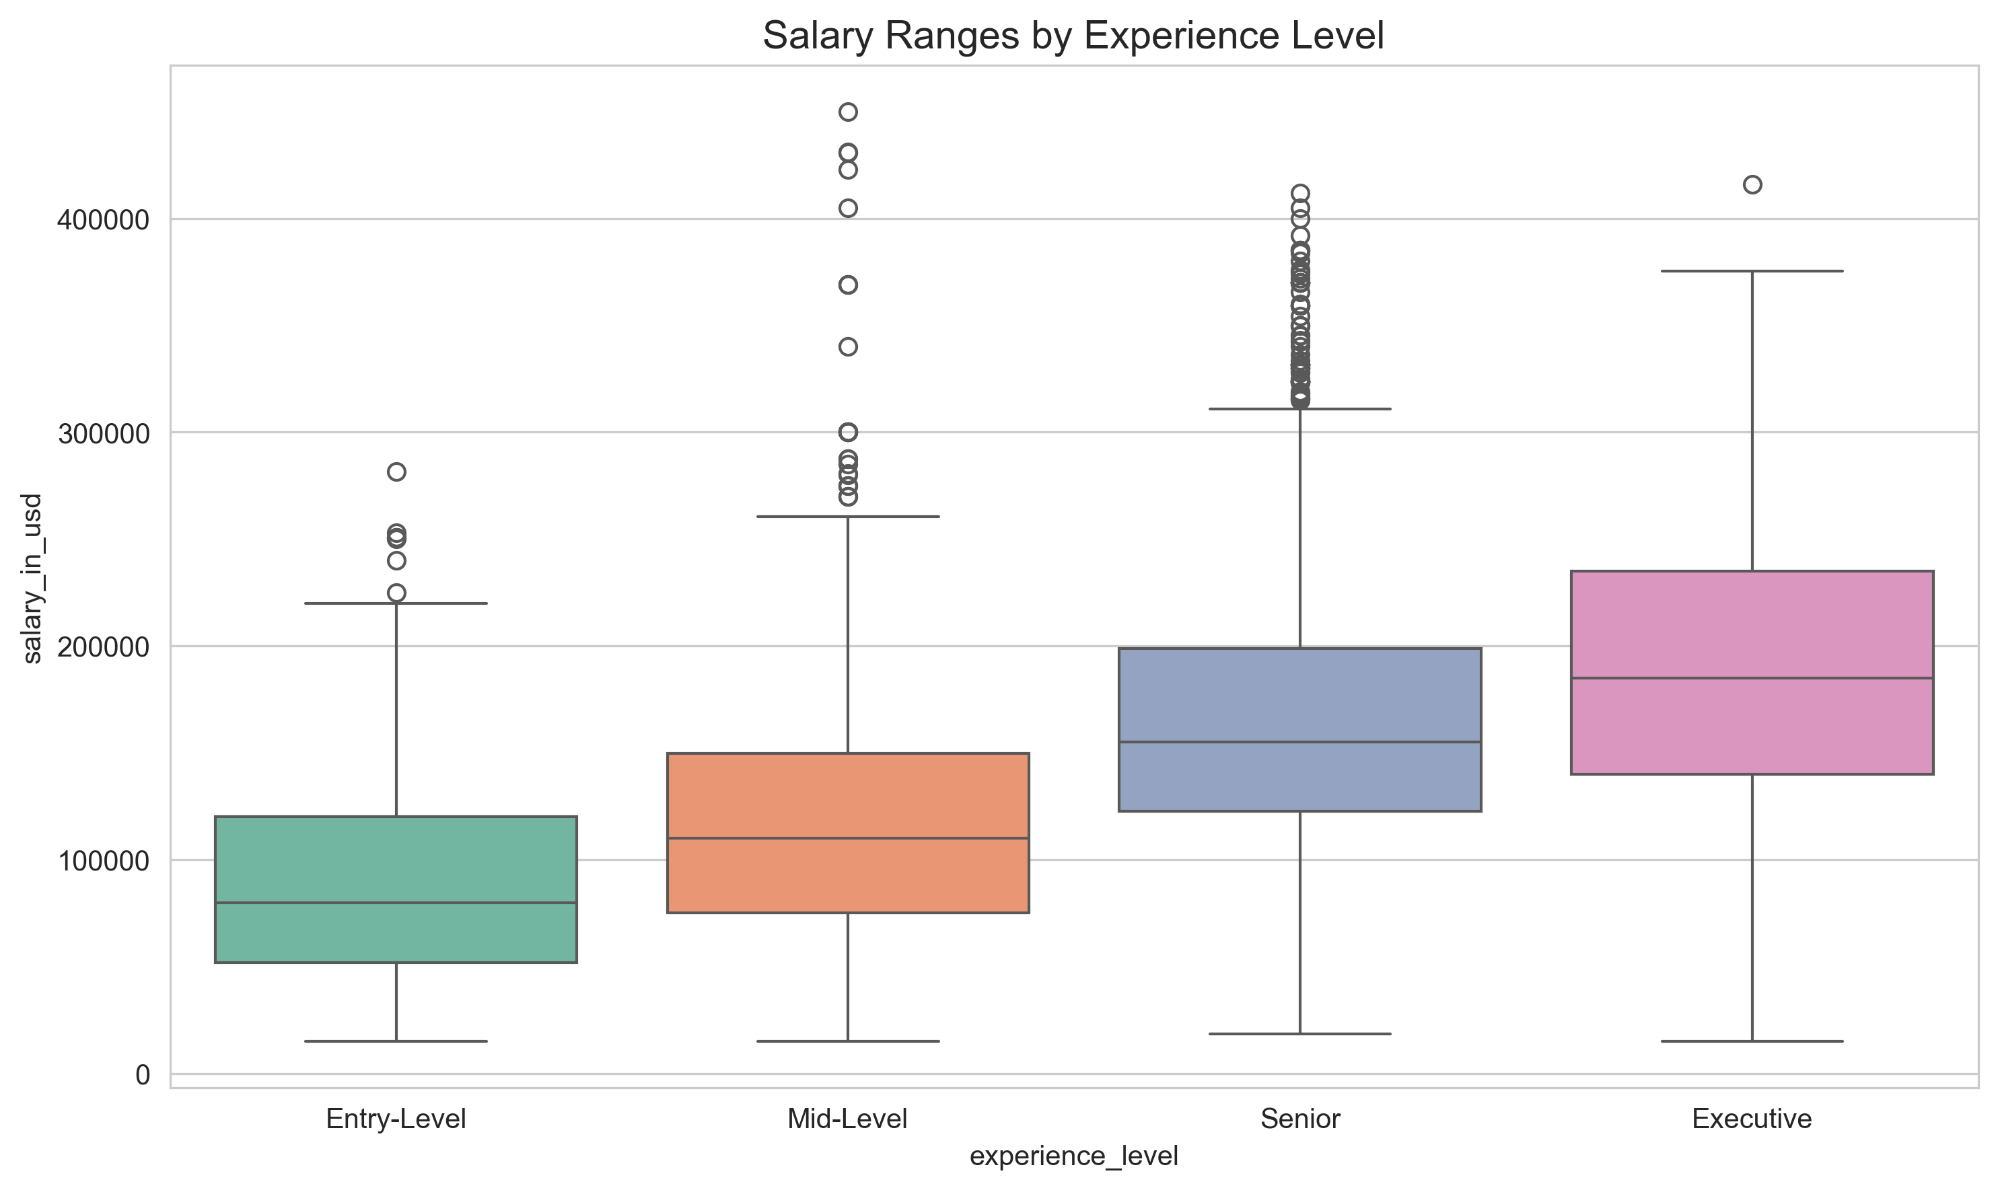
Salary by Experience Level
Clear stratification: Entry < Mid < Senior < Executive.
Executive roles show highest variance.
Senior roles provide stable, high median compensation.

Slide 13
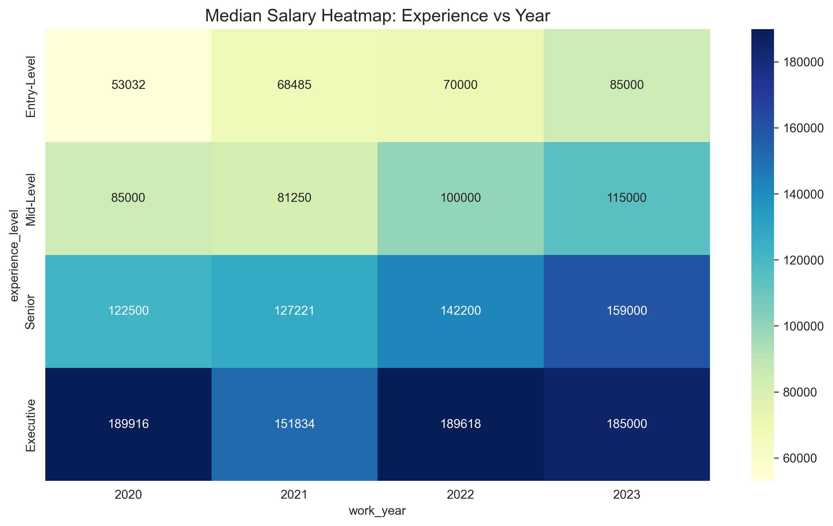
Salary Heatmap (Exp x Year)
Matrix view of compensation.
Executive salaries in 2020 & 2022 show the 'hottest' zones.
Consistent growth across all levels year-over-year.

Slide 14
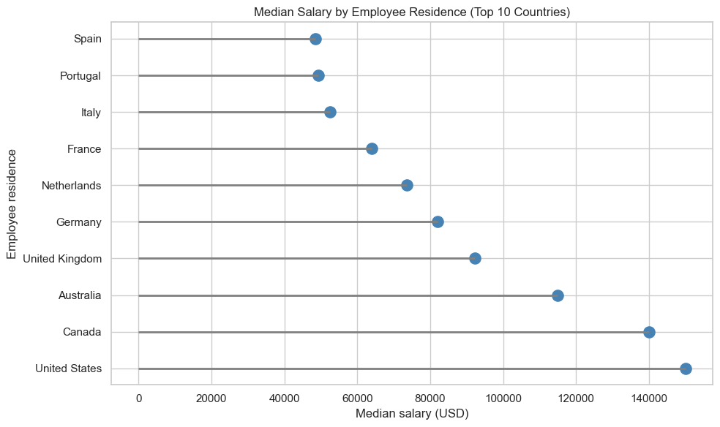
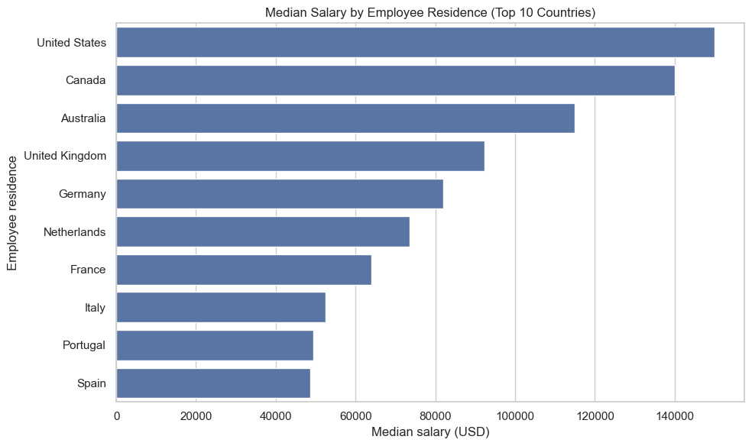
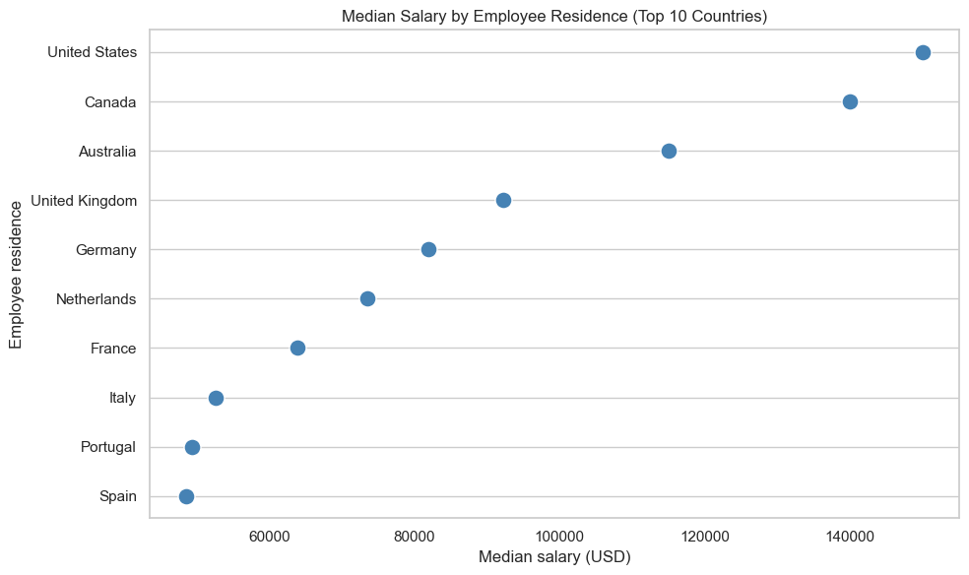
Global Salary Disparities
US offers highest median salaries.
Significant gap between US (max) and other countries on the lower end (min).
Important factor for remote work strategies.

Slide 15
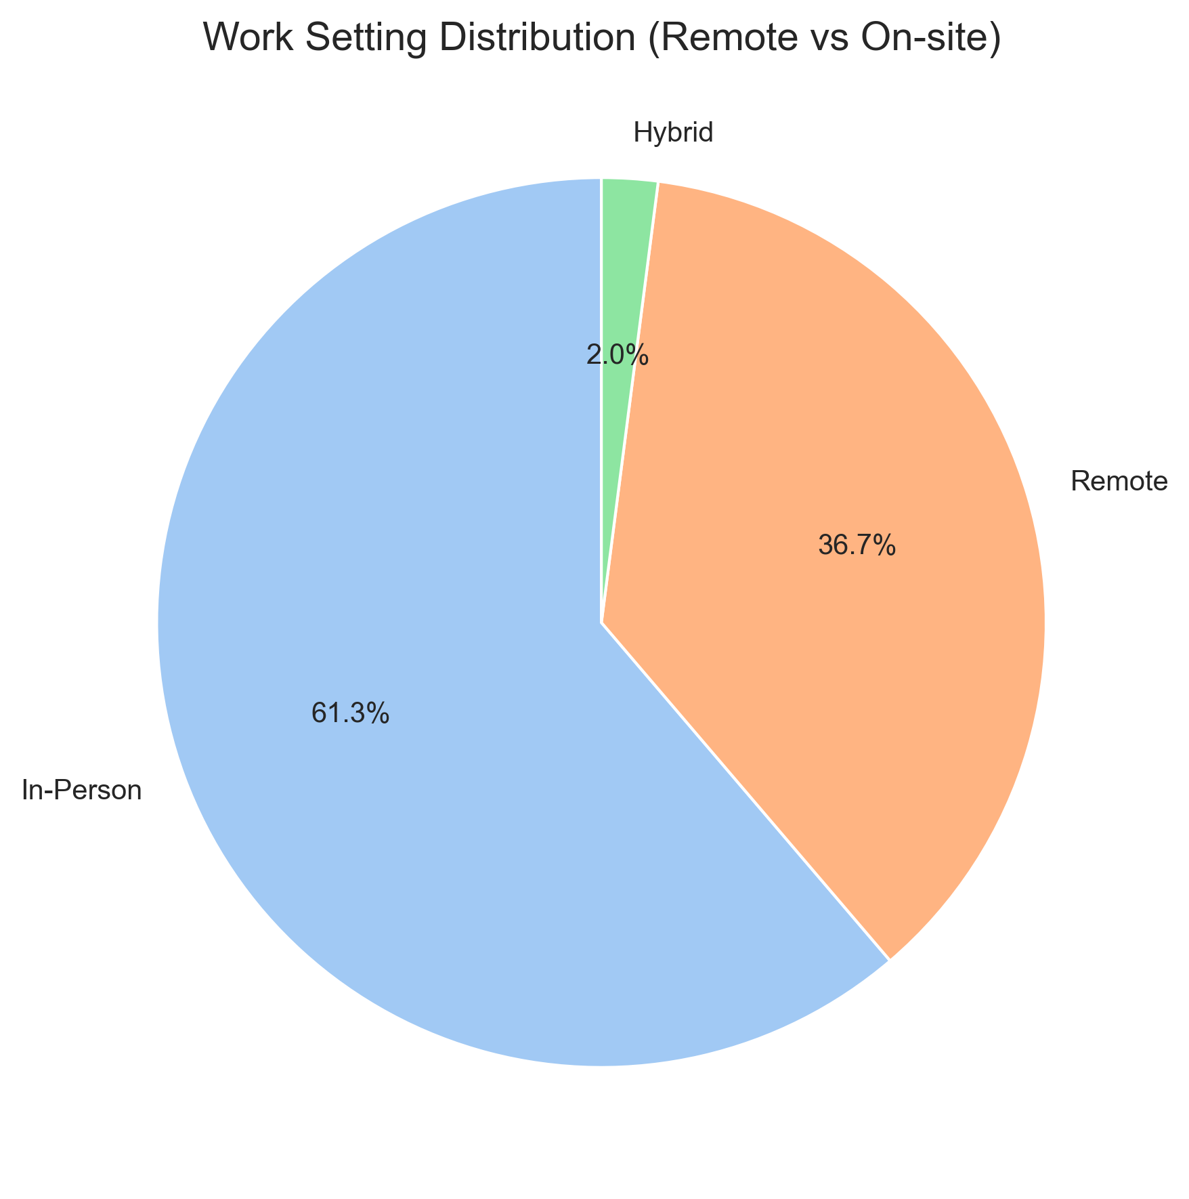
Work Setting Distribution
In-person and Remote were historically dominant.
Recent trends show shifts in how work is structured.
Visual shows the aggregate composition of the dataset.

Slide 16
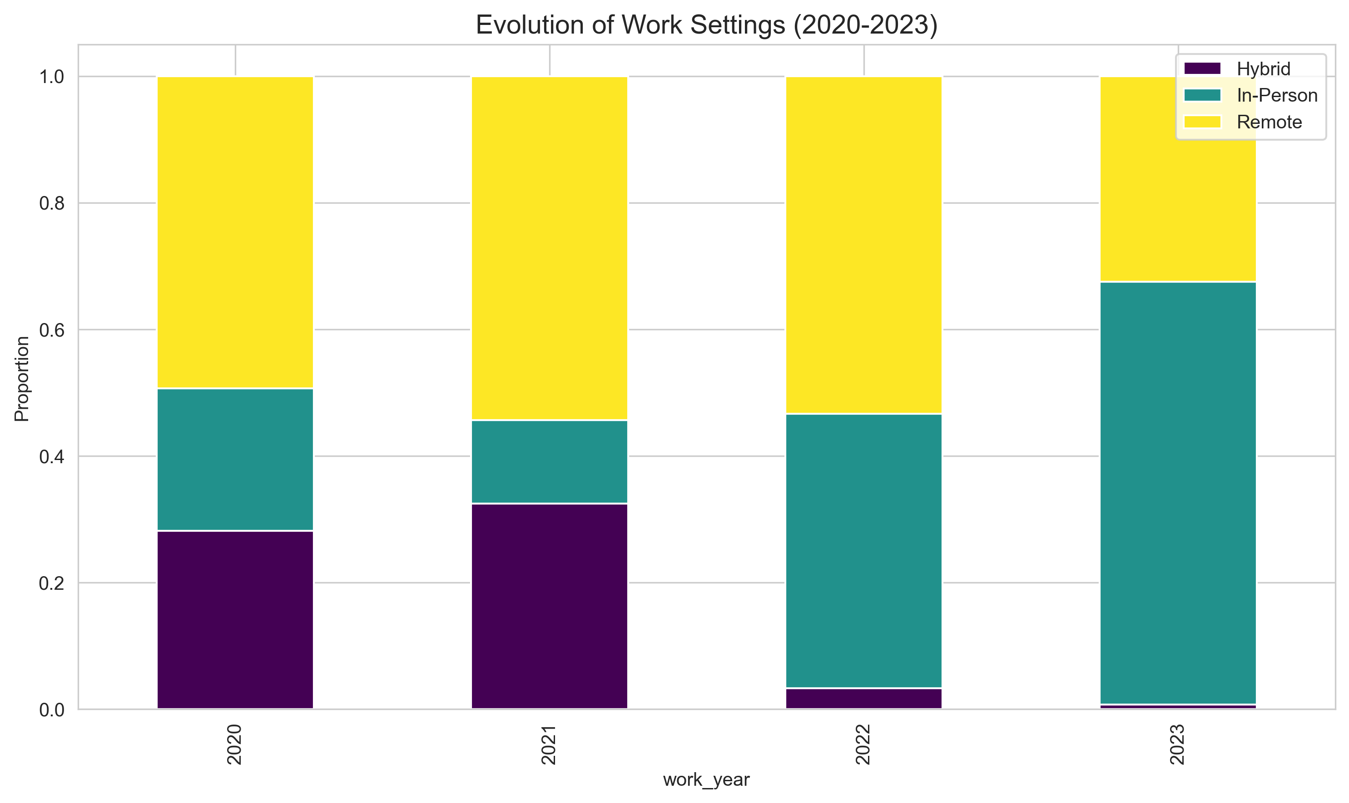
Work Setting Evolution
Drastic shift during 2020-2021 towards Remote - COVID.
2023 shows return to In-person/Hybrid models.
Reflects the 'Return to Office' mandates.

Slide 17
Key Insights
Layoffs peaked in 2022-23 but salaries in Data roles kept growing.
US market drives both layoffs and highest compensation.
Experience level is the strongest predictor of salary.
Hybrid/In-person work is recovering share from fully remote.

Slide 18
Conclusion
Tech workforce is stabilizing after a volatile correction.
Data Visualization clarifies complex temporal and categorical trends.
Future analysis: Add 2024 salary data and predictive modeling.
Possible projects: Predictions of salary/layoff in the next 5 years.

Slide 19


