Slide 1

Artificial Intelligence
Artificial intelligence (AI) is intelligence demonstrated by machines, unlike the natural intelligence displayed by humans and animals, which involves consciousness and emotionality.

Slide 2
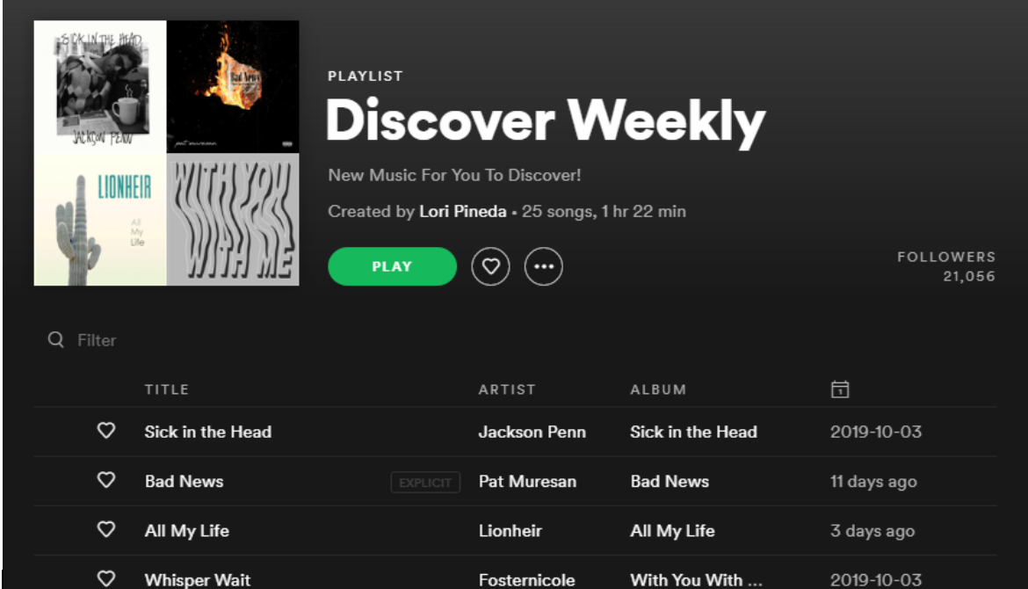
Artificial Intelligence (cont.)
Spotify is known to use AI and machine learning algorithm to know your music preferences, streaming history or even how many times you have heard a particular song. It uses this information to give you an updated playlist. It even monitors whether you are listening to the whole song or just skipping through it. It also dissects the music by beats per minute, style and the type of voices to create a personalized listening experience for its listeners.

Slide 3
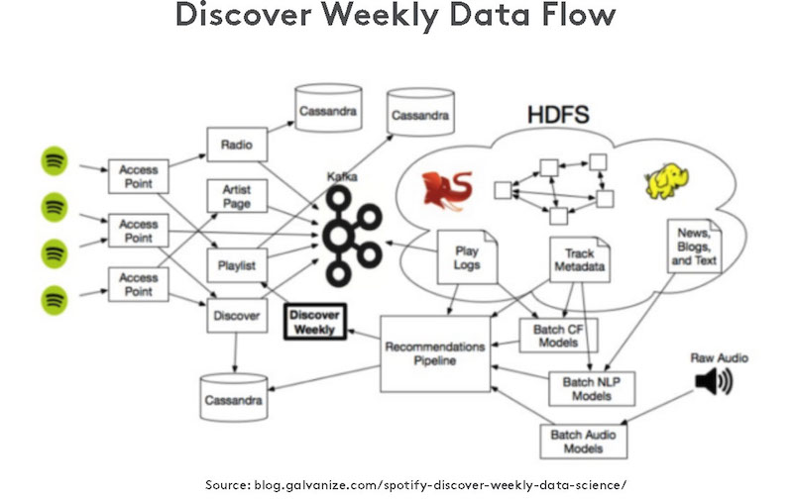
Artificial Intelligence (cont.)
Data drives decisions across every department at Spotify. This information is used to train algorithms which extrapolate relevant insights both from content on the platform and from online conversations about music and artists, as well as from customer data, and use this to enhance the user experience.

Slide 4

Spotify in India
Spotify launched in India on February 28. Within the first week of its launch, Spotify said it secured 1 million users on the platform.
It grows to 320 million monthly active users, sees success with registrations in India.

Slide 5
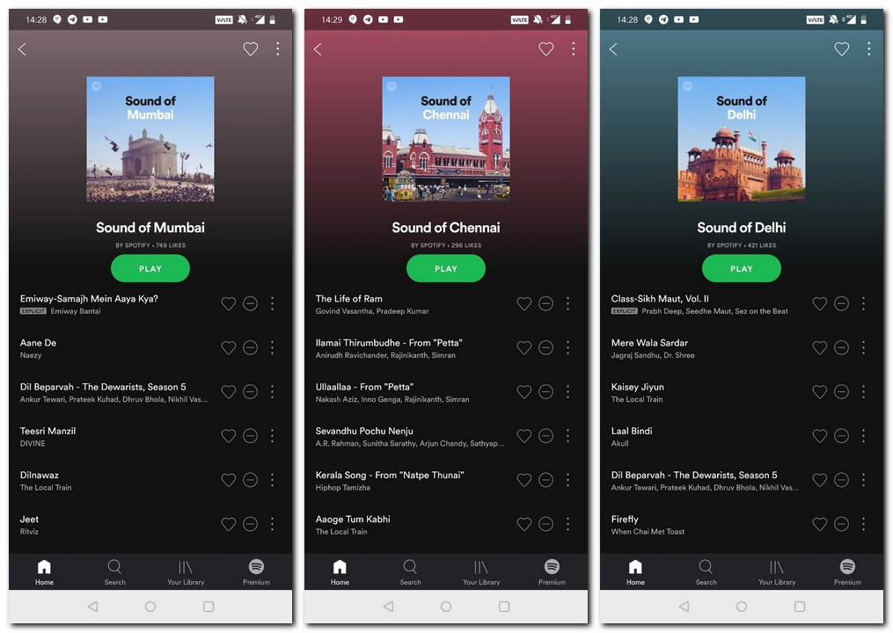
Spotify in India (cont.)
Spotify has struck a deal with Indian record label Saregama that enables the Swedish music streaming company to add more songs to its catalogue in India.
The deal enables Spotify subscribers to listen to over 100,000 tracks from across genres such as Indian classical, devotional and Carnatic among others. In addition to this, subscribers also get access to the songs by artists such as Lata Mangeshkar, Mohammed Rafi, Kishore Kumar, Asha Bhosle and RD Burman among others.

Slide 6
Conclusion
Spotify is a widely used music streaming app which not only uses cloud facilities to host its application, but also uses AI to curate the application in accordance with each and every user’s unique taste and preference.
It has expanded its services to many countries, by having a well thought Service Level Agreement with each and every country so that all of it’s users can experience music at its best.

Slide 7
Thank you

