Slide 1

Hypnosis
BY: Mansi Tripathi

Slide 2


Slide 3


Slide 4
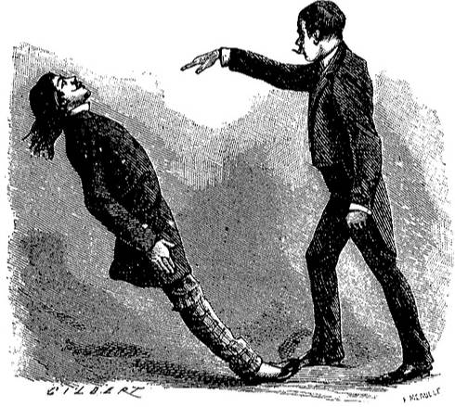

Slide 5
Has anyone of you ever been hypnotized?
An average person experiences hypnosis at least twice a day

Slide 6
How many of you think that they cannot be hypnotized?
Nearly everyone in this room can be hypnotized.
Researchers estimate that 10 to 15 percent of adults are highly hypnotizable, 20 percent are completely resistant to hypnosis, and the rest of the population falls somewhere in the middle.

Slide 7
Let’s have a small demonstration!

Slide 8
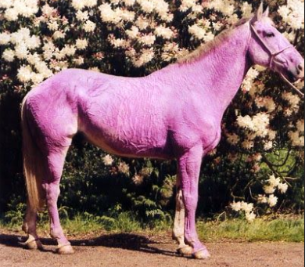

Slide 9
Fun Facts about Hypnosis
The more imaginative you are, the easier it is for you to get hypnotized
You would not be hypnotized if you don’t want to
In a state of hypnosis, you wouldn’t do anything you don’t want and would be fully aware of your surroundings

Slide 10
For those of you who are willing to get hypnotized,
Lets have another demonstration!

Slide 11
How many of you who smoke cigarette or drink alcohol wanted to quit but have failed?
Anybody wanting to lose weight and have failed invariably?

Slide 12
Did you know?
Hypnosis is 30 times more effective in helping people quit smoking or drinking
90.6% Success rate when using hypnosis to stop smoking
Results showed that the group who received the hypnosis lost more weight. Each participant on average losing 17lbs over the course of the study, compared to women in the control group losing only 0.5lbs

Slide 13


Slide 14


