Slide 1
SFG integration sync

Slide 2
Kickoff
Purpose
Technical meeting for SFG towards integrations and productization​
Content
Sync different teams on the current status​
Rise expectations, mismatches, etc…​
Reviews when required (e.g. test plan reviews)​
Integration schedule and information sharing regarding expected timeline.​
Timeline - TBD
Kickoff​ 13/11/2023
Feature freeze​ 3/01/2024
Code freeze ​ 8/01/2024
Release​ 15/01/2024

Slide 3
WW48.1

Slide 4
Agenda
The scenario we investigate
Expectation vs Reality
Variance between runs
Host overhead
Ordering issues and how to guarantee

Slide 5
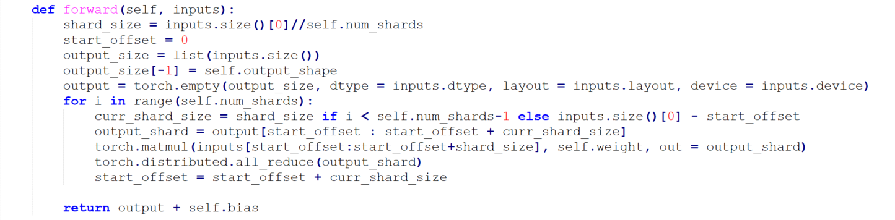
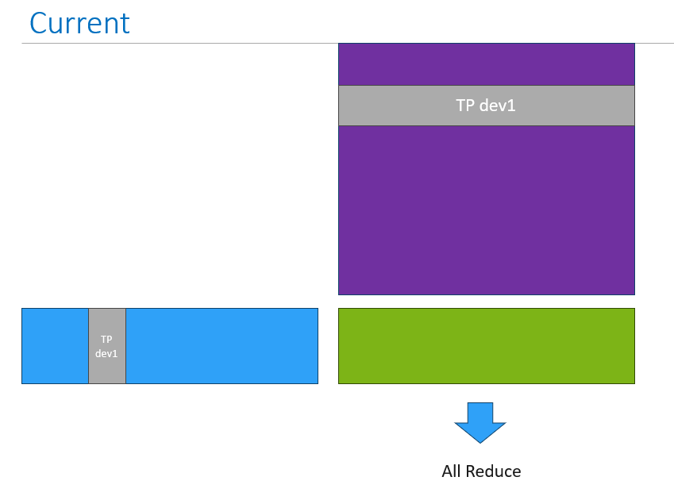
Slicing on Batch
x2
Hidden=14336
CD=14336 / 8TP = 1792
BS=14K
C= A*B
All reduce(C)

Slide 6
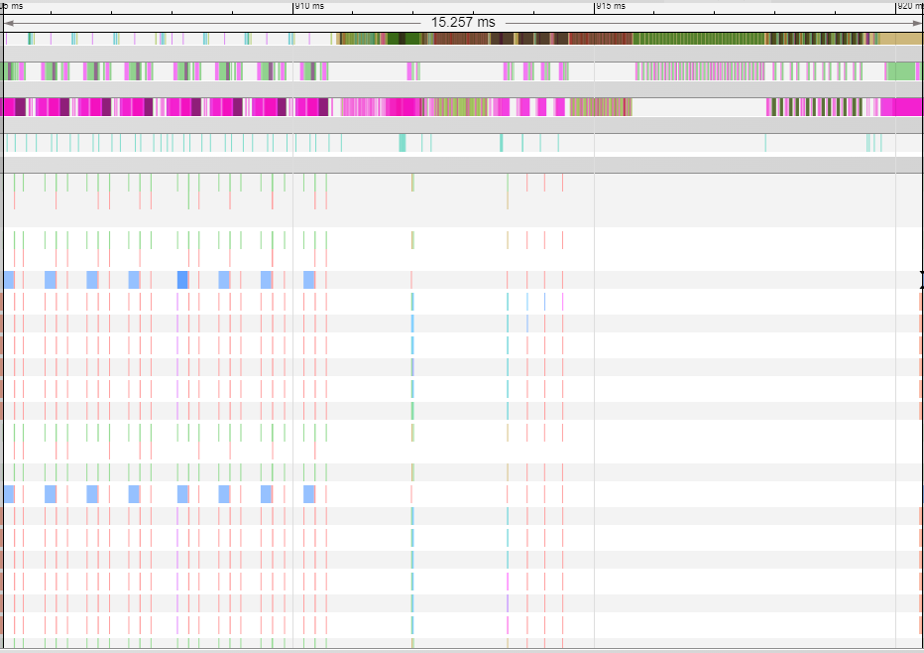
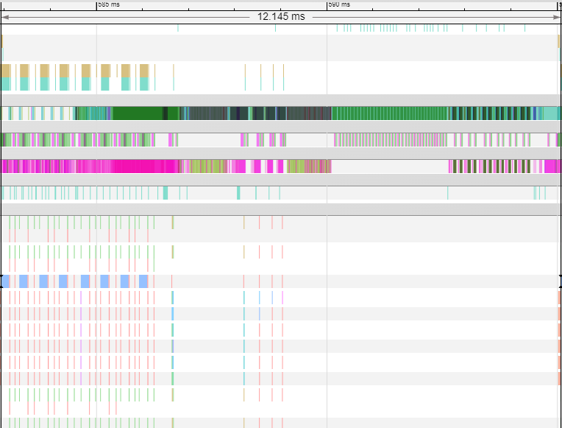
MME to MME
With SFG & Without Patch
With SFG & With Patch
15.257ms
12.145ms
mme2mme - 5.1ms
mme2mme - 3.2ms
0.4ms
0.7ms
Why each MME is different graph ? Expecting to have them as 1 graph

Slide 7
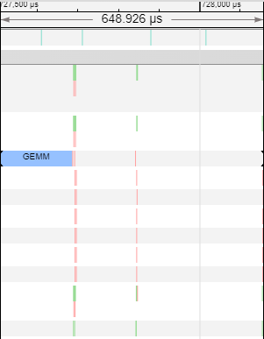
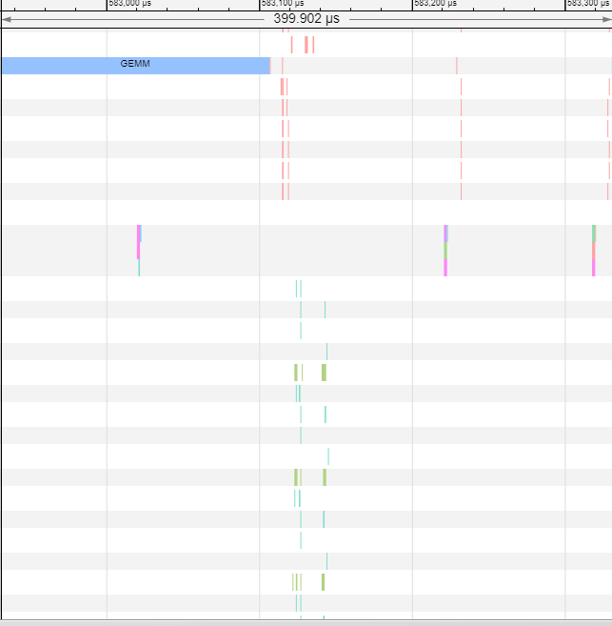
MME to NIC – no overlap
With SFG & Without Patch
With SFG & With Patch
Mme=182u
Mme=176u
NIC = (1024*14)*(14*1024/8/4)*2/246000000000*1000000

Slide 8
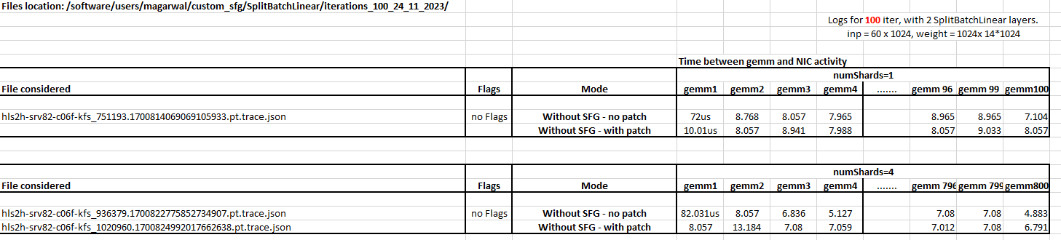
Variance between runs
We have seen that first execution have large duration between mme and nic
Seems the fix increase the overhead for 4shards by 40-50% - Siju
1shard
4shards

Slide 9
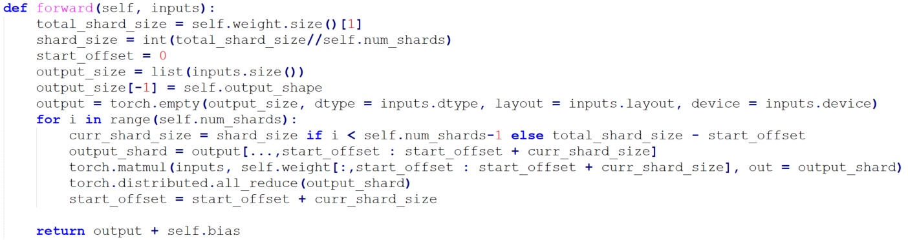
Slicing on Weight
Strided insert
x2
Hidden=14336
CD=14336 / 8TP = 1792
BS=14K
C= A*B
All reduce(C)

Slide 10
Ordering of event & host overhead
https://jira.habana-labs.com/browse/SW-165974
First launch is different than the other
Ordering is guaranteed by single thread

Slide 11
Next step
Since ordering is ok need to investigate why no parallel – Moshe Roden
Additional delay of 23u in the host – Siju
Why view generated additional graph break ? – Siju
Why first launch is different than the others ? – Siju
Slicing on weight – on hold
MME1, MME2, MME3
NIC1 , NIC2

Slide 12
Suggestion to next steps
Generate DFA log for HCL, even without device stuck ( using env. Var ) – Liav
Correctness concern that GC backend no signaling in the correct place, since they are not uniformly aligned ( view instead of physical buffer ) – Moshe Levy
Ask a json from Siju – Moshe Levy
Misalignment between the time GC backend signal ( begin of the graph, gemm 12,13,14,43) and actual we see ( at the end of the graph 61,62,63) – Moshe Levy and Moshe Roden

Slide 13
WW48.2

Slide 14
Agenda
Ordering
Latency between different graphs
Review action items from previous meeting

Slide 15
Ordering OK – Why no parallel ? 1/2
Moshe Roden / Moshe Levy / Siju Samuel
Problem 1: Correctness issues with GC when working with view
Pre graph contains 4 gemm
Post graph contains 43 gemms
Expectation: GC backend to signal evenly
Reality: GC signaling after gemm 12,13,14,43
How to proceed ?
Bridge to allocate the shards as contiguous and supply to GC as tensors and not view – Siva
Investigate signaling when tensor view - Moshe Levy

Slide 16
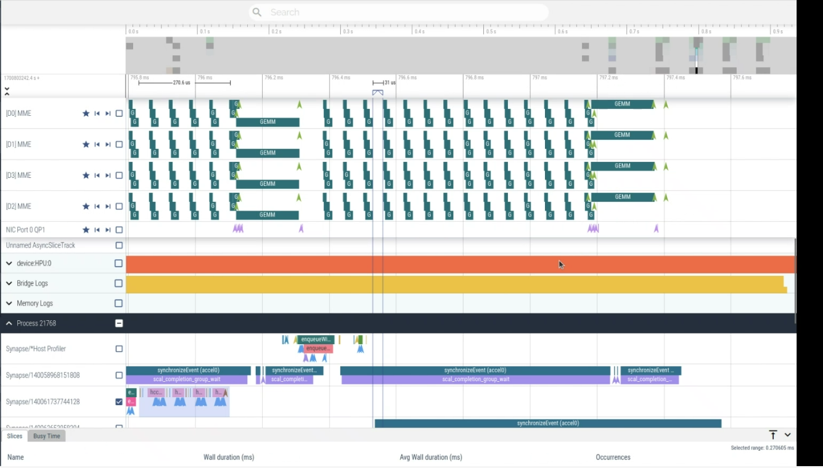
Ordering OK – Why no parallel ? 2/2
Moshe Roden / Moshe Levy / Siju Samuel
Problem 2:
GC backend signal ( begin of the graph, gemm 12,13,14,43)
Expectation: NIC to work after 12,13,14,43
Reality: NIC to work after 61,62,63
How to proceed ?
Investigate if there is additional delay between GC and Engine ARC – Moshe Levy with Rakesh
Investigate delay between HCL download to stream – Liav, Generate DFA log for HCL even without device stuck

Slide 17
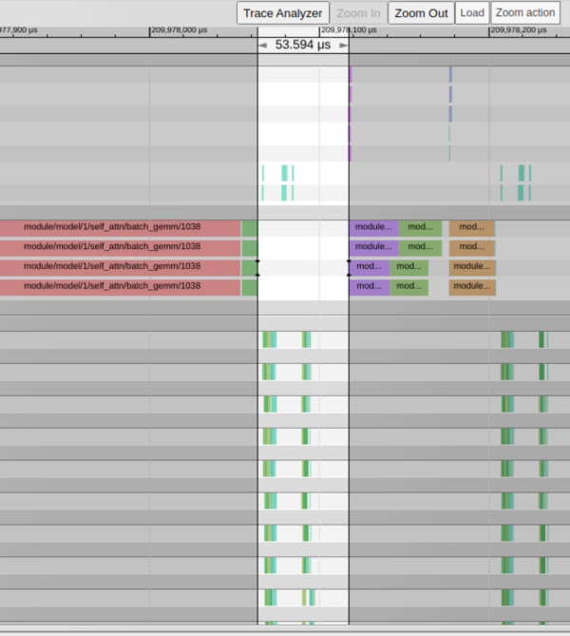
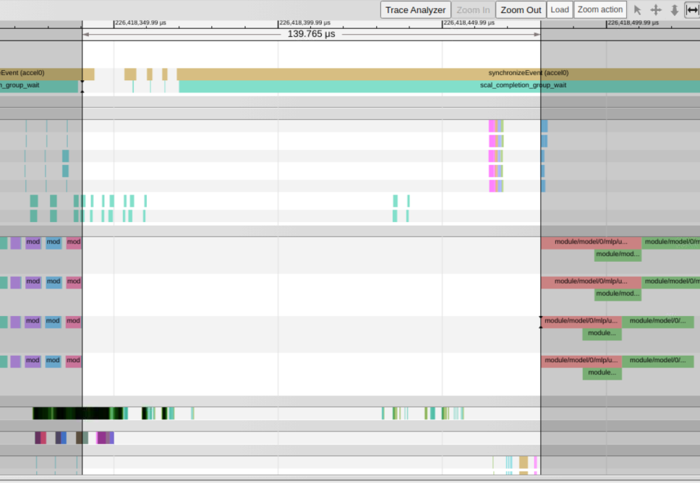
Slicing on weight - Kaylan
x8 card, LZY_Collective
Llama_v2_70B
Increase latency between 42us → 140us
Concern: host synchronization happening
Siva to sync with Liav Viner and Kalyan to continue investigate
Latency OH

Slide 18
Review action items from previous meeting
Since ordering is ok need to investigate why no parallel – Moshe Roden
Why view generated additional graph break ? – Siju, Done.
Need to recheck on the model to sync with Deepak and Kalyan – Siju
Why first launch is different than the others ? – Siju,
Init HCL happen in the first launch that increase latency 23u
Additional delay of 23u in the host
Slicing on weight – on hold

Slide 19
WW49

Slide 20
Root Cause of interleaved scheduling
The reason for the interleaved scheduling is that all 4 gemm slices are sharing the same (un-sliced ) operand.
Hence, graph compiler is performing BW mitigation (share the input that's already in SRAM).
Method proposed by Aviv is to create "copy" on the (un-sliced ) operand as well (same offset in the same section)
This will prevent graph compiler to share the operand and will allow running each gemm to completion.

Slide 21
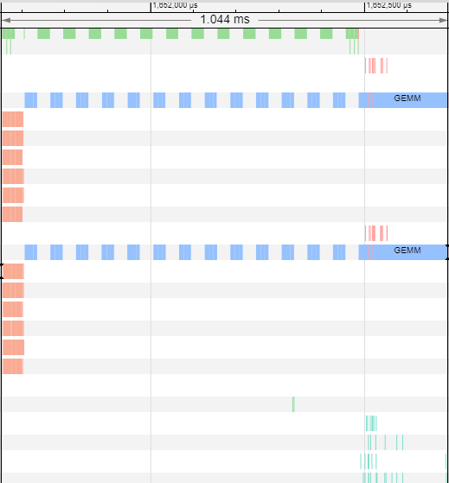
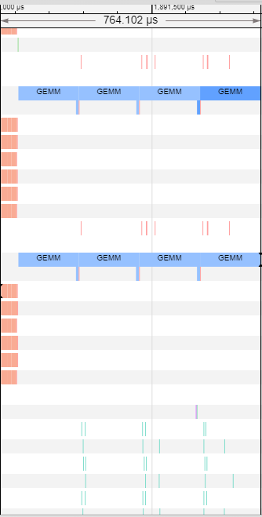
Results 1/3
Without duplicated copy
With duplicated copy
1044u→ 764u ( 36% improvement!!!)

Slide 22
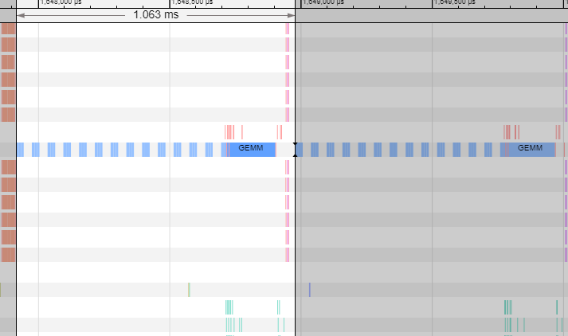
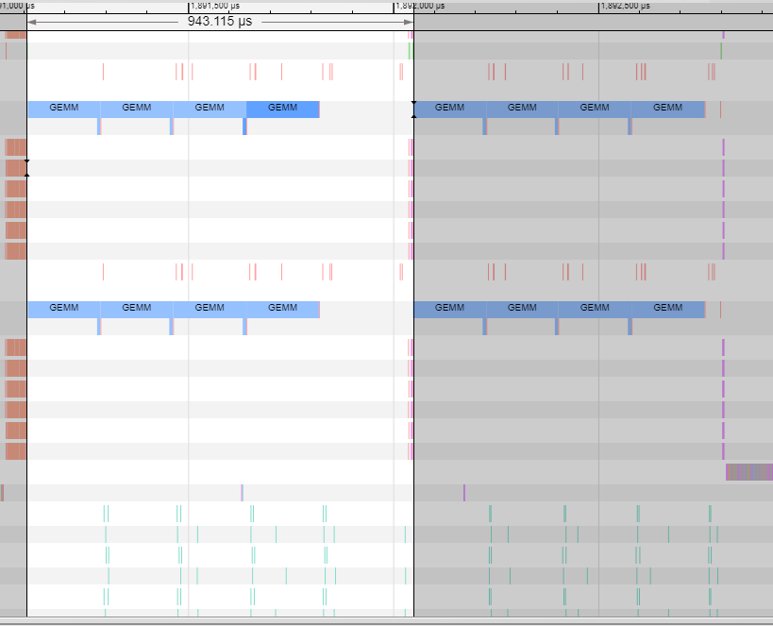
Results 2/3 - launch to launch
Without duplicated copy
With duplicated copy
1063u→ 943u ( 12% improvement)

Slide 23
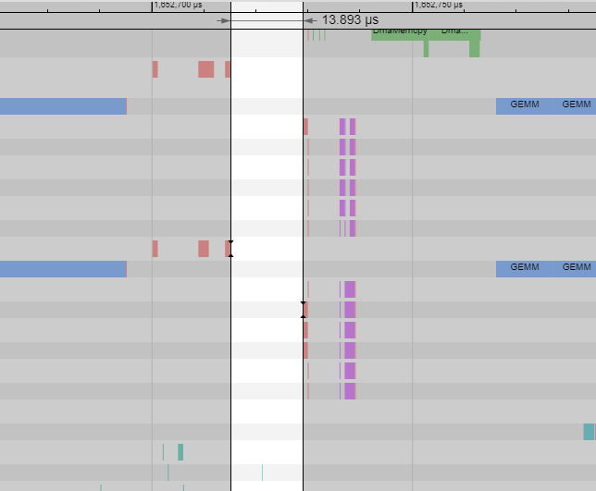
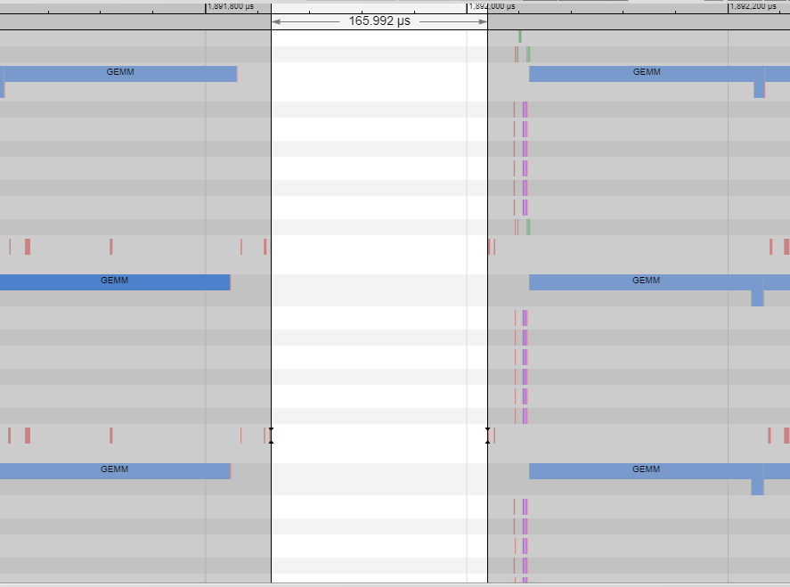
Results 3/3 – compute to compute between launchs
Without duplicated copy
With duplicated copy

Slide 24
Different methods to achieve the overlap
The solution with duplication of memory is temporary with the cost of additional memory
How to solve the additional memory ?
Alternatives:
when introducing "view" ( same section - same offset) - graph compiler will need to waste HBM to SRAM BW every time
Aligned to the current handling, as we already introduced shards partitioning
when introducing control dependency - it means we prevent graph compiler to reuse BW and again waste HBM to SRAM BW every time
Either by graph compiler running to completion when get external event, or
By bridge adding when signaling the events

Slide 25
Next step
Investigate increased host overhead between launches – Siju
Discuss with deepSpeed of integration using LinearAllreduce – Eyal
Propose bridge api to allow same section-same offset for the non sharded operand – Amit
Modify the POC script to use same section-same offset on non-sharded operand – Siva and Siju
Check the benefit on llamav2 ( concern of OOM ) – Kalyan

Slide 26
Comparing with shards to without shard
Gemm is taking more time when sharding
Need to check mme utilization ( geometry ) → slicing on weight
Memory placement → the same

Slide 27
Network
NIC
Capacity: 14336[hidden]x60[batch]x2[dtype] x2[AR=RS+AG] =3.28MB
BW: 12.5[GBs]x24[port]x7/8[devices]=262GBs
Time = 12us
In llamav2 we see gap between projection 8us and reality 42us
Might suggest that our projected number is also not correct

Slide 28
Problem Statement
In order to allow parallel compute and network involves
Partitioning LinearAllReduce to shards of mme-allreduce-mme-allreduce
Slicing on weight non-common dim
Adding same section-same offset on activation tensor ( to avoid HBM BW optimization)
Signaling between compute compute-network on shard granularity
Question we ask is how to expose this on the user script as a product?

Slide 29
Proposal
Naïve way is to connect via an Op aligned to the LinearAllReduce
patching the LinearAllReduce to use User op instead of deepSpeed op
Op part of the bridge, as contains both network and compute
We will need also op for megatron - ColumnParallelLinear/RowParallelLinear
What does it involve to have it as an op ?

Slide 30
WW50

Slide 31
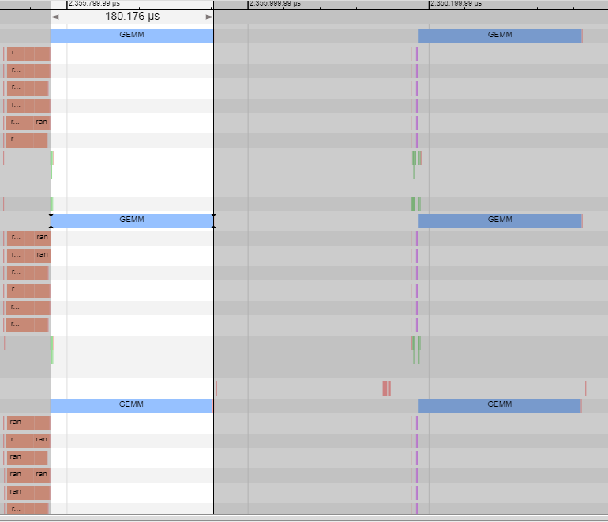
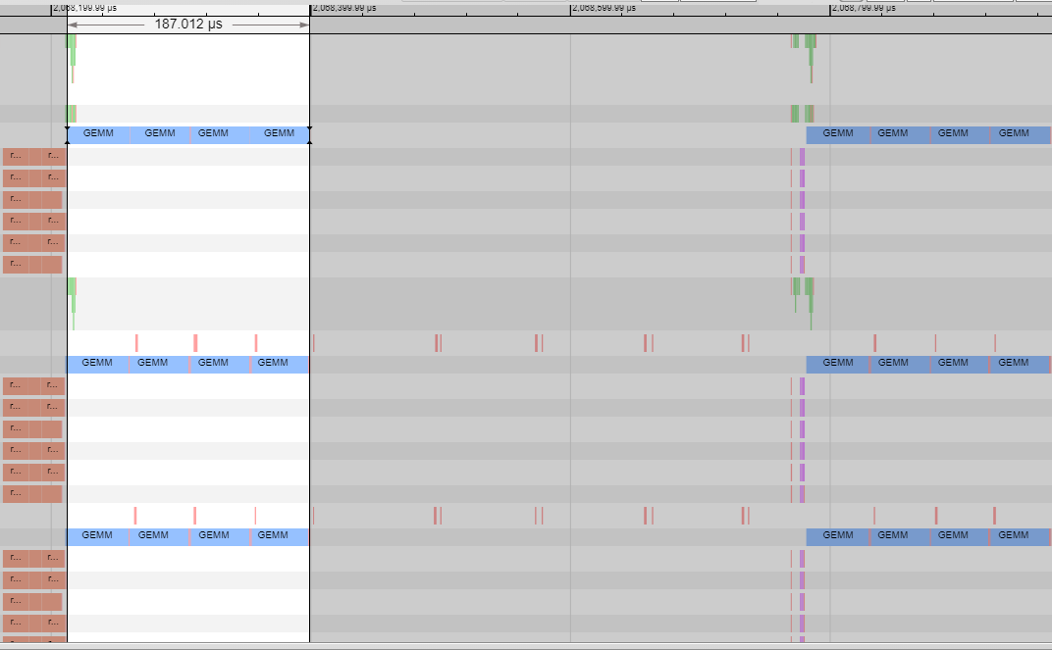
Slicing on weight
1shard
4shard,
MME additional 7us
407u
567u
227u
380u

Slide 32
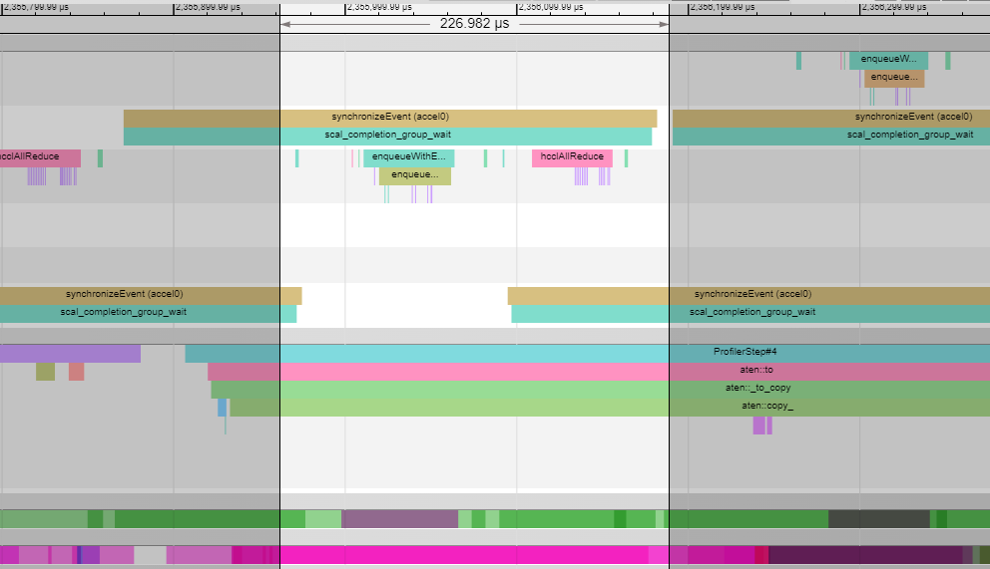
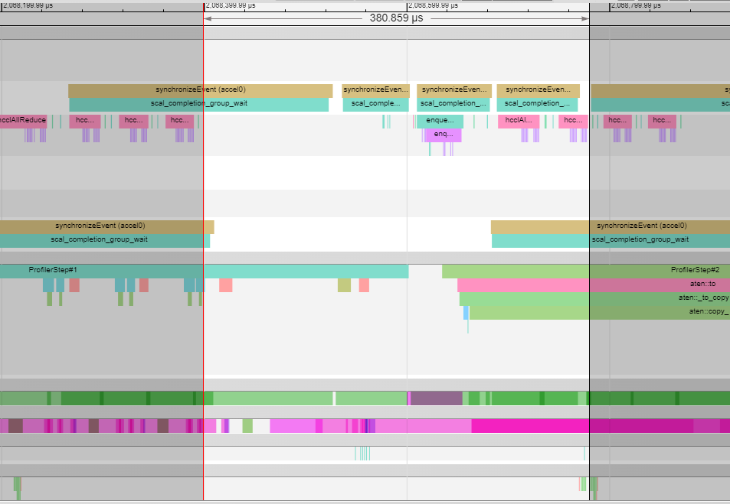
Slicing on weight
1shard
4shard,
MME additional 4.5%
48u
125u
211u
125u
46u
51u
Increased time
On host before enqueue

Slide 33
Plan
1shard: 180u[gemm] + 227u[host]
4shard: 187u[gemm] + (227-48)[host, pipeline latency to enqueue]
➔ desired: 41/407 = 10%
Preliminaries:
multithread ( handle data dependency between the threads )
procedure call for the all reduce ( probably recomputing the same hccl )
pipeline 48u ( time until enqueue ) with the gemm shards

Slide 34
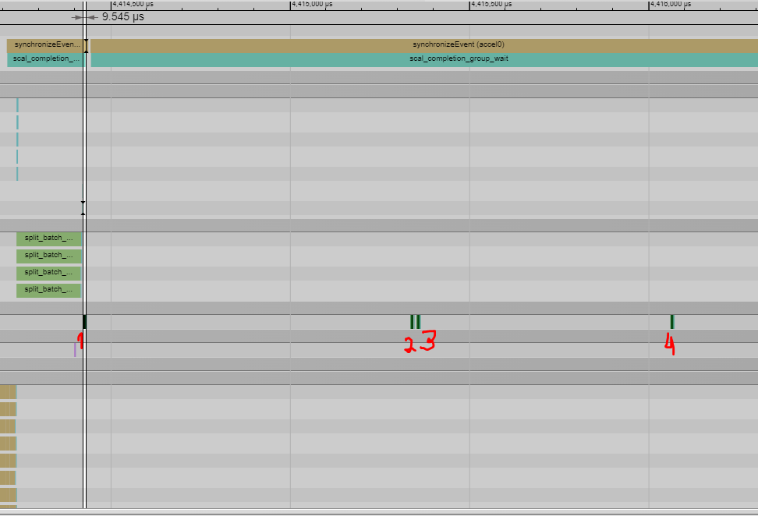
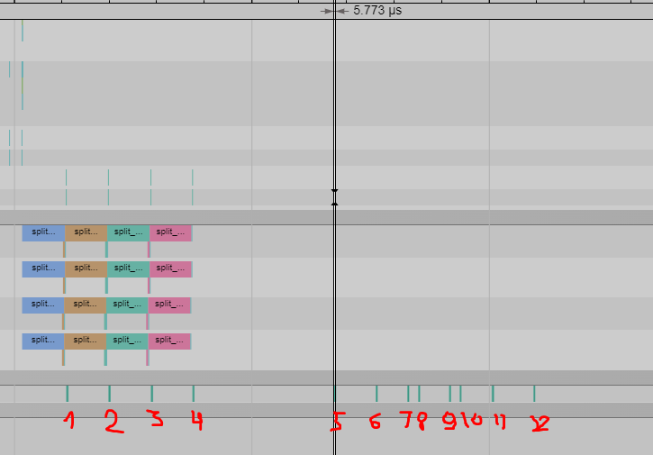
Slicing on Weight
1shard
Liav with Tal analyzing the gaps
4shard

Slide 35
Enforcing GC MME to run to competition
Issue is not seen – GC runs each mme to completion
Reason is that operand A (SRAM) operand B (HBM )
When slicing op B (HBM) optimization doesn’t happen – under discussion

Slide 36
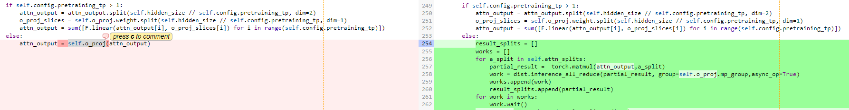
Productization
Modeling llama
https://gerrit.habana-labs.com/#/c/371332/5/optimum/habana/transformers/models/llama/modeling_llama.py
override self.o_proj with HabanaLinearAllReduce and then elimiate from the user script ...
Notes:
https://gerrit.habana-labs.com/#/c/371332/5/optimum/habana/transformers/models/llama/modeling_llama.py

Slide 37
Next steps
hccl call optimization – today takes 40u, pending the multi-thread handling

Slide 38
Items to discuss
PT Thread work

Slide 39
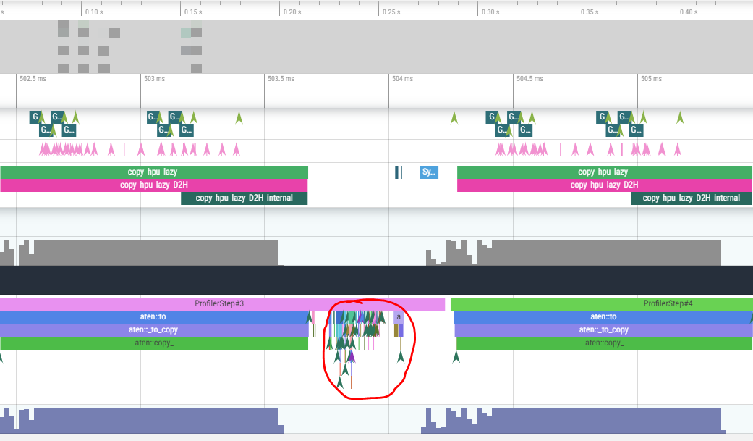
PT Thread work
no seen on latest – only between launch

Slide 40
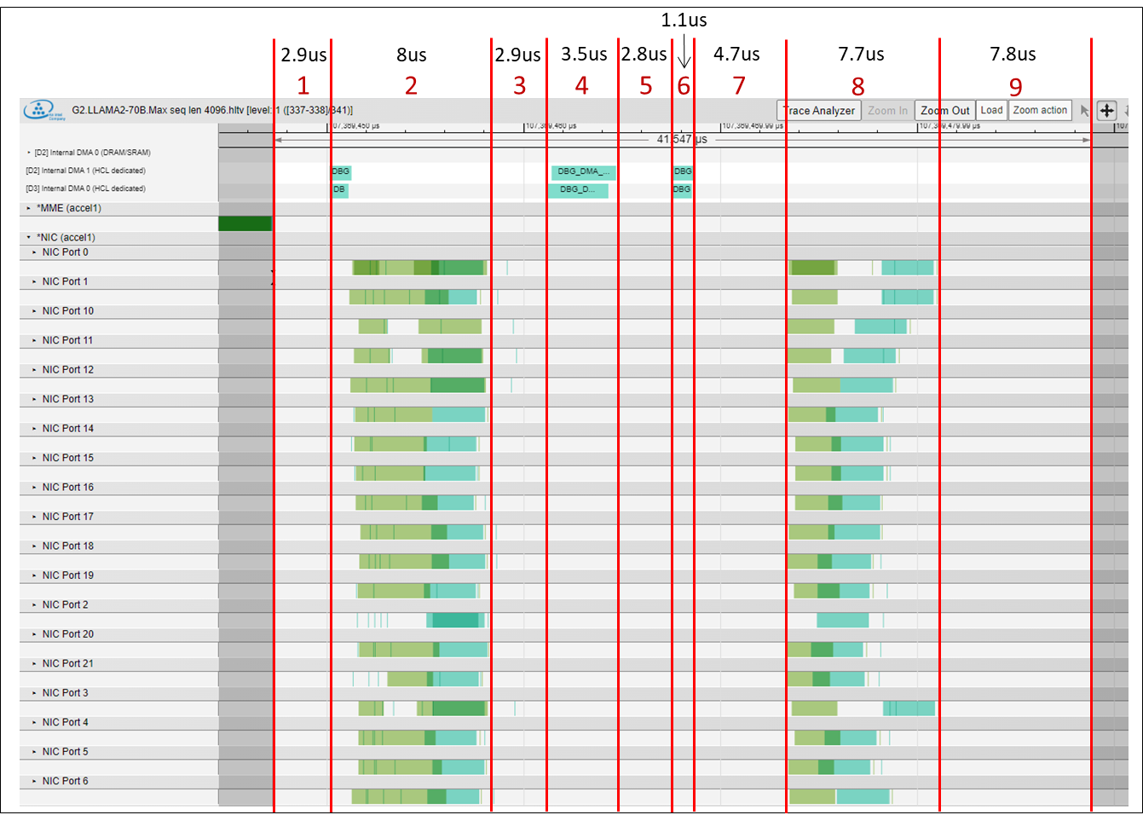
All-Reduce Latencies – Roman
Stages Elaboration:
Stage 1: Compute finished
SO signaling by the MME: 1usec worst-case
Monitor expires:
Increments a long-SO in the device → Indicates that compute finished
Increment a completion group counter at the host (irrelevant for our case)
Scheduler ARC: A monitor waits for a value of long-SO, then writes a message to the DCCM queue which indicates an expiry of the fenced monitor.
ARC reads the message from the DCCM queue, then executes unfenced instructions that are in the ping-pong buffer.
Scheduler ARC sends instructions via the DUP engine to the engine ARCs.
Engine ARC generates the instructions that the engines should execute: Sending the descriptors to the lower CP.
First EDMAs then NICs
Q: Can we send NIC’s instructions before the EDMA?

Slide 41
All-Reduce Latencies – Roman
Stages Elaboration:
Stage 2: Reduce Scatter time
Stage 3: Similar roundtrip as stage1, only that all syncs occur within the same stream
Stage 4: Reduction: BF16 += BF16 / FP32 += BF16
Stage 5: Should be eliminated with the SRAM flow
Stage 6: Duplication
Stage 7: Similar sync to stage 3. NICs add latency on top of EDMA, possibly due to engine ARC additional latency.
Stage 8: All-gather comms
Stage 9: Similar to stage 1, but w/ longer latency
DUP sends commands to all compute engines.
Engine ARC receives a pointer to ECB list, copies to DCCM. Each ECB command is a pointer to a descriptor, which the engine ARC should fetch to the DCCM, the send to the commands to the lower CP.
In total: 2 HBM accesses of the engine ARC per ECB list + ECB.

Slide 42
WW51

Slide 43
Agenda
NIC device time
hcl host call optimization

Slide 44
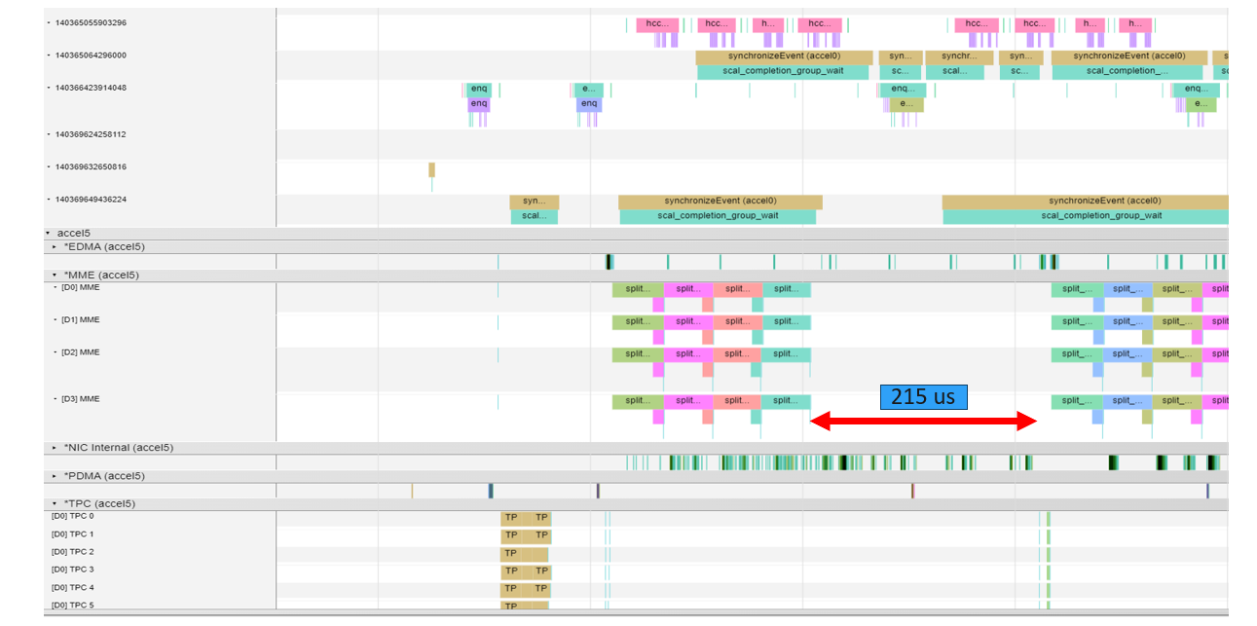
NIC device time – start early and end late
MME 187us = 46u per MME shard
Expected 3.28MB/260Gb=12u
even though the NIC seems to have started its work after the first matmul, it takes long to finish in the device, and from one matmul to the next graph (starts on TPC), the device takes 215 us

Slide 45
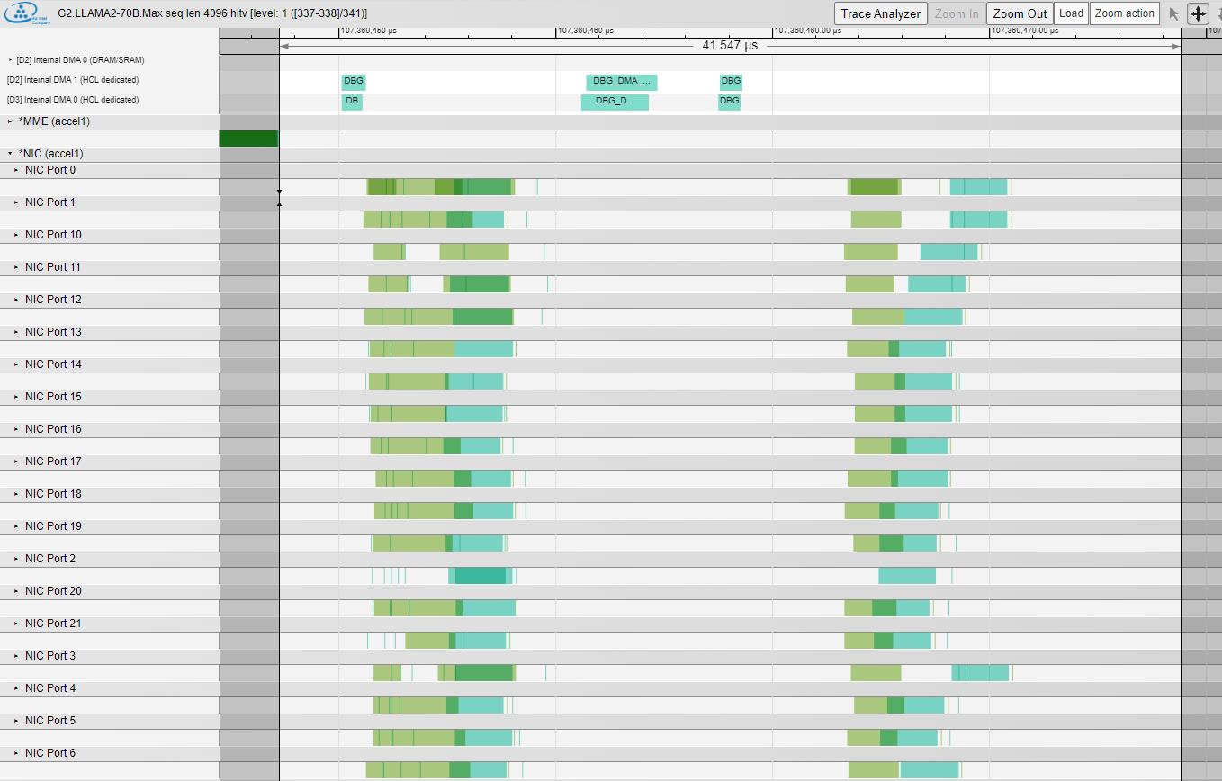
All-Reduce Latencies – [60,8192]x2[BF16] = 0.9MB @ 3.5u
1.1us
Runtimes
2.9 usec
8 usec
2.9 usec
3.5 usec
2.8 usec
1.1 usec
4.7 usec
7.7 usec
7.8 usec
➔ Total of 41.4us
Depending on size:
2 = 3.5u ➔ 8u # reduce_scat
8 = 3.5u ➔ 8u # all_gather
4 = 3.5u # dma RMW
6 = 1.1u # dma duplication
29.4u overhead
3.5x3+1.1 work
2.9us
8us
2.9us
3.5us
2.8us
4.7us
7.7us
7.8us
1
2
3
4
5
6
7
8
9
next_shard

Slide 46
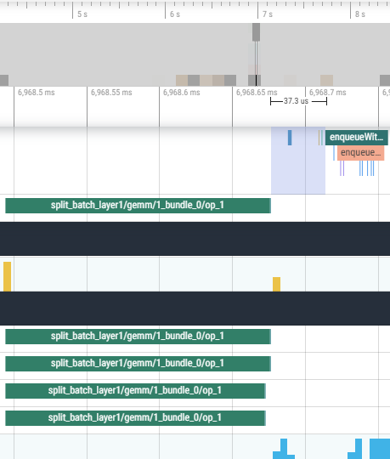
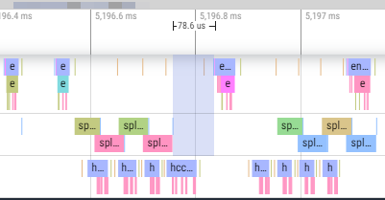
All Reduce in our case 1/2
 | NIC | Work= 3.33NIC | Const OH Overhead | Sum= Work+OH | Granularity | Total | Exposed
3.28MB | 12u | 40u | 30u | 70u | 1 | 70u | 70u
1.64MB | 6u | 20u | 30u | 50u | 2 | 100u | 50u
0.82MB | 3u | 10u | 30u | 40u | 4 | 160u | 40u
Assuming each NIC shard takes 40u
Assuming each MME shard takes 40u
We should benefit although the latency overhead on the device.
To see it we need to pull the host backwards
Can we generate long device operation before the Linear to see what happen when host is not slow ?
1shard
37u
Why having less
overhead ?
4shard
78u

Slide 47
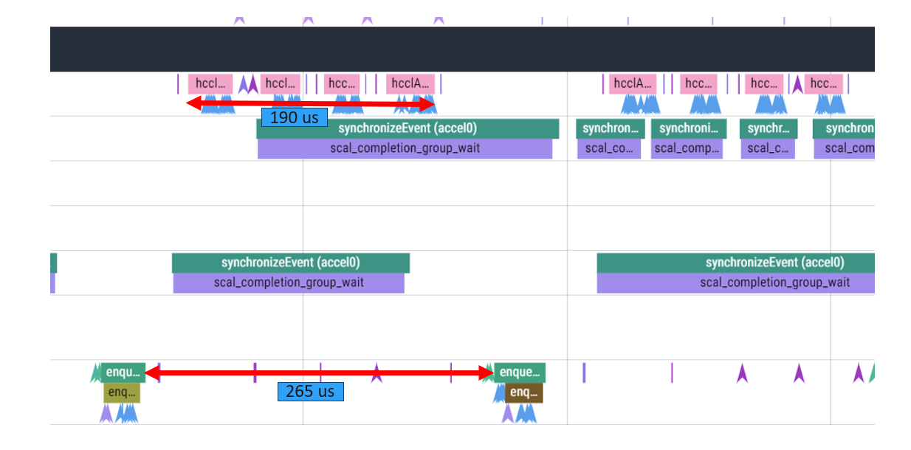
UT hcl call optimization
today takes 40u, pending the multi-thread handling

Slide 48
llama v2 hcl call optimization
Kalyan, Deepak to see if hccl host is an issue an issue in real topology or only of test
Assuming yes –
We need to optimize hcl host time when few hcl calls are mostly the same

Slide 49
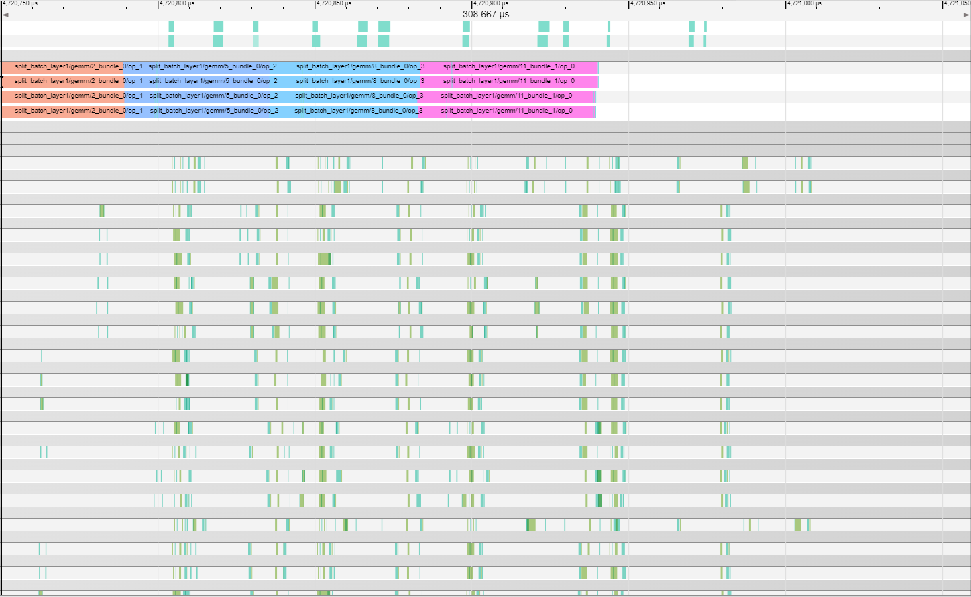
All reduce latencies
Why latencies not overlap?
Why not getting according to model ?

Slide 50
All reduce latencies
6
9
5
1
8
1
2
3
4
7
7
2
3
5
6
8
4
9
Why latencies not overlap?
Why not getting according to model ?

Slide 51
WW1’24

Slide 52
Agenda
Host in Llama usage
NIC & HCL latencies

Slide 53
Host in Llama usage
1shard takes 40u, 4 shards takes 190u
Question
Is it a UT issue or real-life issue ?

Slide 54
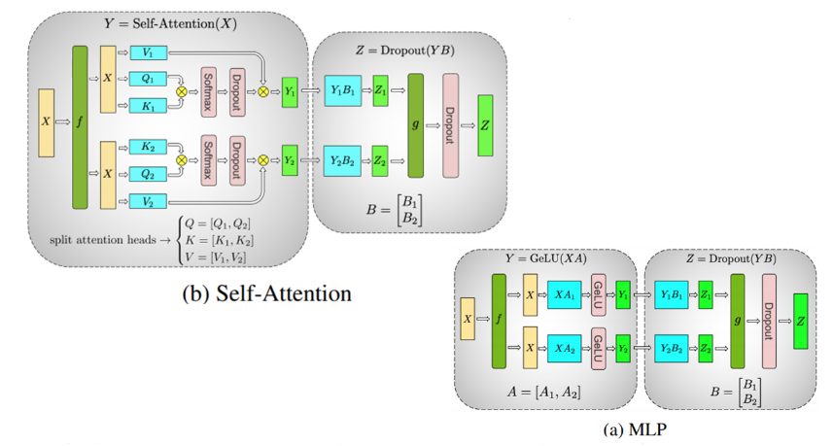
llama sizes model
Base: [8192x60]D = [1024, 60]D, [1024, 8192]D
MME 9u
8[8x1 tetris] x 1K[CD] / 1650[frq]=5u
17MB @ 2[TB/sec]= 8u
NIC 51u
0.93MB @ 262GB/sec = 3.5u
Shard: [2048x60]D = [1024, 60]D, [1024, 2048]D
MME 1.5u
2[2x1 tetris] x 1024K[CD] / 1650[frq]=1.25u
4.35MB @ 2[TB/sec]=2u
NIC 165.7u
0.23MB @ 262GB/sec = 0.87u

Slide 55
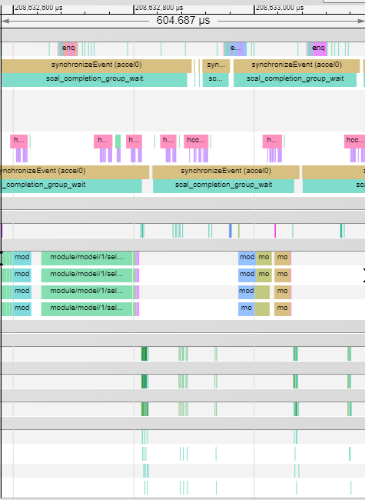
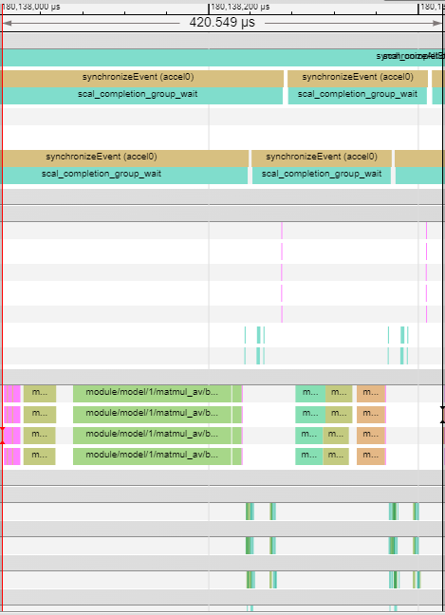
Llama_v2 – case1 – delay
4shard
1shard
16u
9.5u
165.7u
124u
16u
9u
51u
54u
160u
Notes:
Inspect real geometries from llamav2
/software/users/kkumar/llama/device/1.14.0-389_base/
/software/users/kkumar/llama/device/1.14.0-389_Scoped_revert/

Slide 56
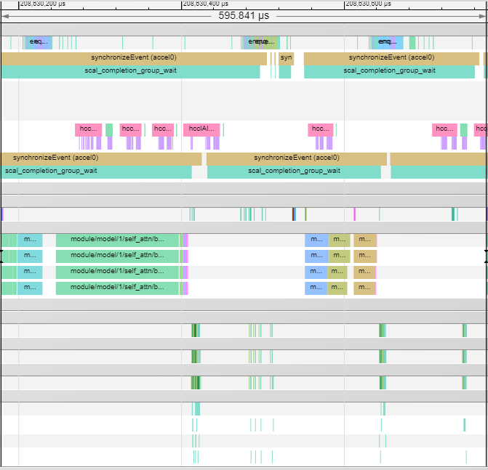
Llama_v2 – case2 – pipelined
4shard
4shard
16u
165.7u
124u
16u
143u
144u
Notes:
Inspect real geometries from llamav2
/software/users/kkumar/llama/device/1.14.0-389_base/
/software/users/kkumar/llama/device/1.14.0-389_Scoped_revert/

Slide 57
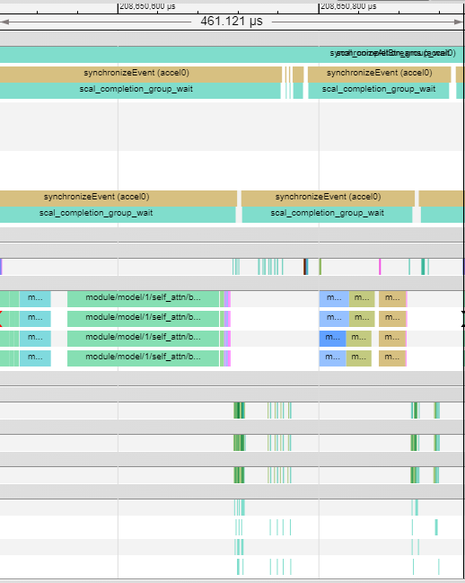
Llama_v2 – case3 no hccl seen
4shard
16u
89.5u
56.8u
16u
9u
51u
26u
54u
160u
NIC latencies
Notes:
Inspect real geometries from llamav2
/software/users/kkumar/llama/device/1.14.0-389_base/
/software/users/kkumar/llama/device/1.14.0-389_Scoped_revert/

Slide 58
Next steps
Kalyan – analyze the reason we are having these different cases ?
HCL – reduce the HCL host time when most of the configurations are the same
Each HCL shard call 28 SCAL submit calls
28 submit calls is the minimal amount ( up to 4MB)

Slide 59
All-Reduce Latencies – [60,8192]x2[BF16] = 0.9MB @ 3.5u
1.1us
Runtimes
2.9 usec
8 usec
2.9 usec
3.5 usec
2.8 usec
1.1 usec
4.7 usec
7.7 usec
7.8 usec
➔ Total of 41.4us
Depending on size:
2 = 3.5u ➔ 8u # reduce_scat
8 = 3.5u ➔ 8u # all_gather
4 = 3.5u # dma RMW
6 = 1.1u # dma duplication
29.4u overhead
3.5u x 3.33 work
2.9us
8us
2.9us
3.5us
2.8us
4.7us
7.7us
7.8us
1
2
3
4
5
6
7
8
9

Slide 60
How can we gain using SFG in llama2 inference ?
1shard have 50u overhead,
4 shard have 90u overhead
30u assuming we will have only last shard overhead , 20u/420=5% save
0u assuming overhead removed completely, 50u/420=12% save
At <4MB sizes we cannot reach full utilization on NIC time so we cannot reach 262GB/sec
Reproducible reduction doesn’t increase the overhead once SRAM reduction is applied – Adam and Eyal to take it offline
 | NIC | Work= 3.33NIC | Const OH Overhead | Sum= Work+OH | Granularity | Total | Exposed
0.93MB | 3.5u | 11.6u | 30u | 41.6u | 1 | 41.6u | 41.6u
0.23MB | 0.87u | 2.9uu | 30u | 32.9u | 4 | 132u | 32.9u

Slide 61
SFG and NIC latencies

Slide 62
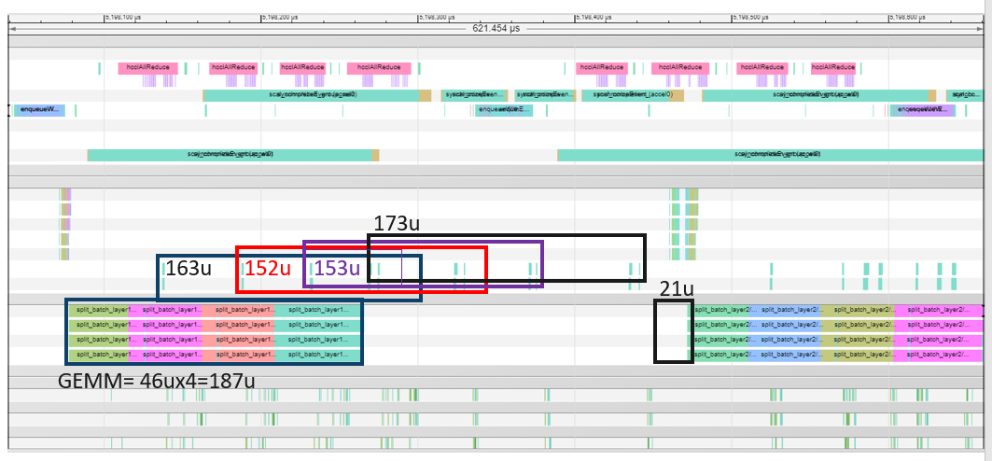
SFG and NIC latencies investigation in HCL - SW-170166
The main evidence we see here is that HCL doesn't perform "atomic" submission of the all_reduce - reason is that we see the reduce_scatter and all_gather interleaved - reduce scatter of shard2 is happening before all_gather of shard 1.
This may suggest an issue with submission and record event inside the hcl

Slide 63
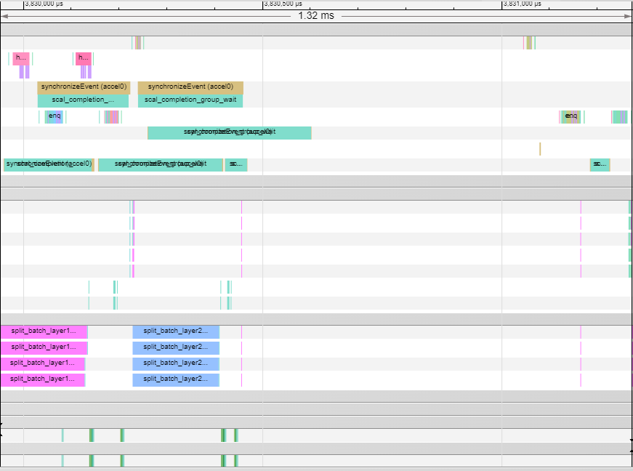
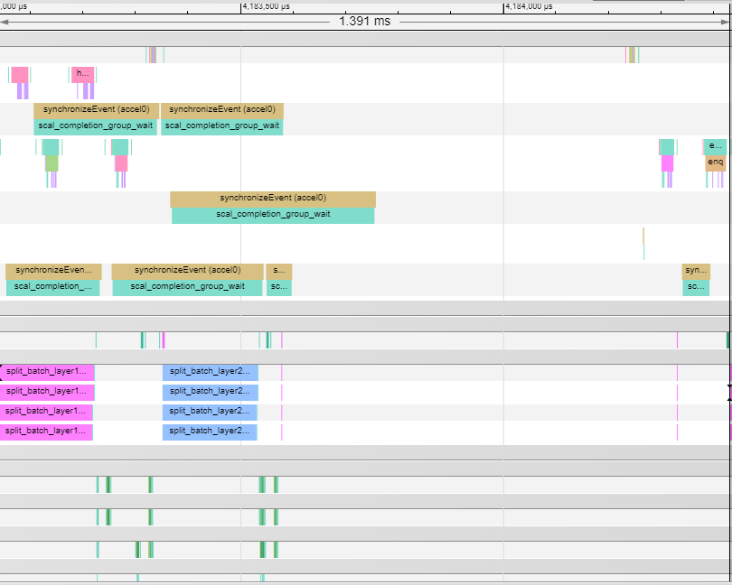
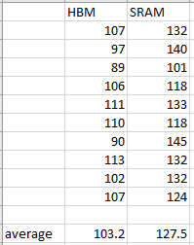
1shard - SW-170255
EDMA reduction HBM
EDMA reduction SRAM
181u
95u
180u
181u
140u
181u

Slide 64
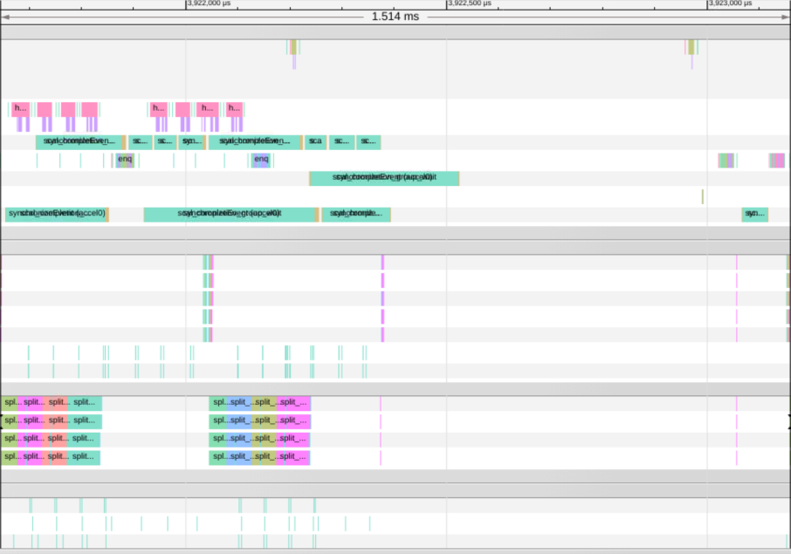
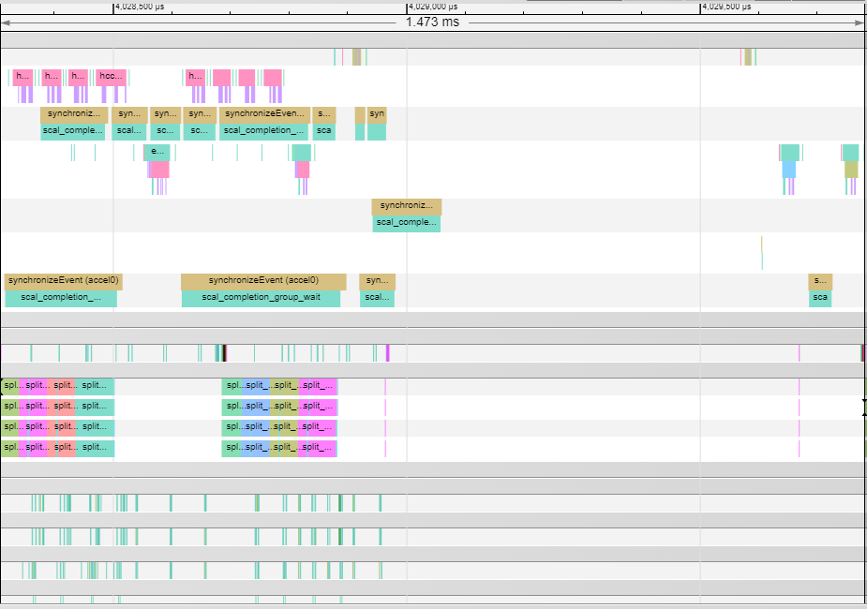
4shard
EDMA reduction HBM
EDMA reduction SRAM
194u
183u
194u
194u
206u
194u
We see here 12.5% improvement, so better to proceed investigation with this change

Slide 65
WW2’24

Slide 66
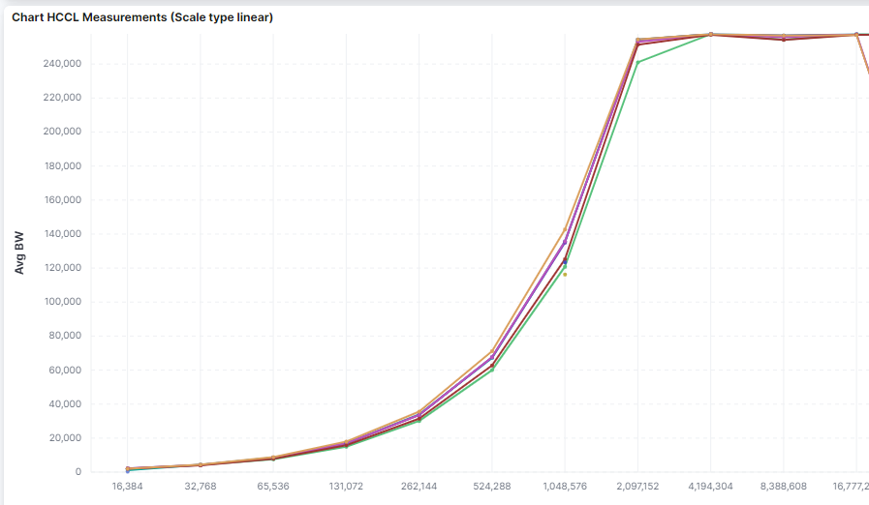
SFG for inference
In llama BS=60, Output=8192, dtype=bf16 = 0.93MB even without sharding, so adding sharding on top means we work with 0.23MB tensors.
In order to reach 4MB - it means we need to increase the BSx16 ==> not realistic.
1shard out of 4shards : 0.25MB @ 40GB/sec = 5.6u, mme takes 2u
single shard: 0.93MB @ 140GB/sec = 6.5u, mme takes 8u
optimally it means that we will have:
4shard: (5.6-2)*3+5.6=16.4u
single shard: 6.5u+8u = 14.3u
➔ Discontinue on inference, switch to training

Slide 67
WW3’24

Slide 68
SFG for inference

Slide 69
SFG for inference
Decode/Token generation
We will not have good enough utilization.
Not enough meat - it doesn't make sense to shard
1shard out of 4shards : 0.25MB @ 40GB/sec = 5.6u, mme takes 2u
single shard: 0.93MB @ 140GB/sec = 6.5u, mme takes 8u
Prompt generation
Potential for script level SFG
When large BS ( relevant for customers, not mlperf)
1 inference = 1 prompt + 2K generations

Slide 70
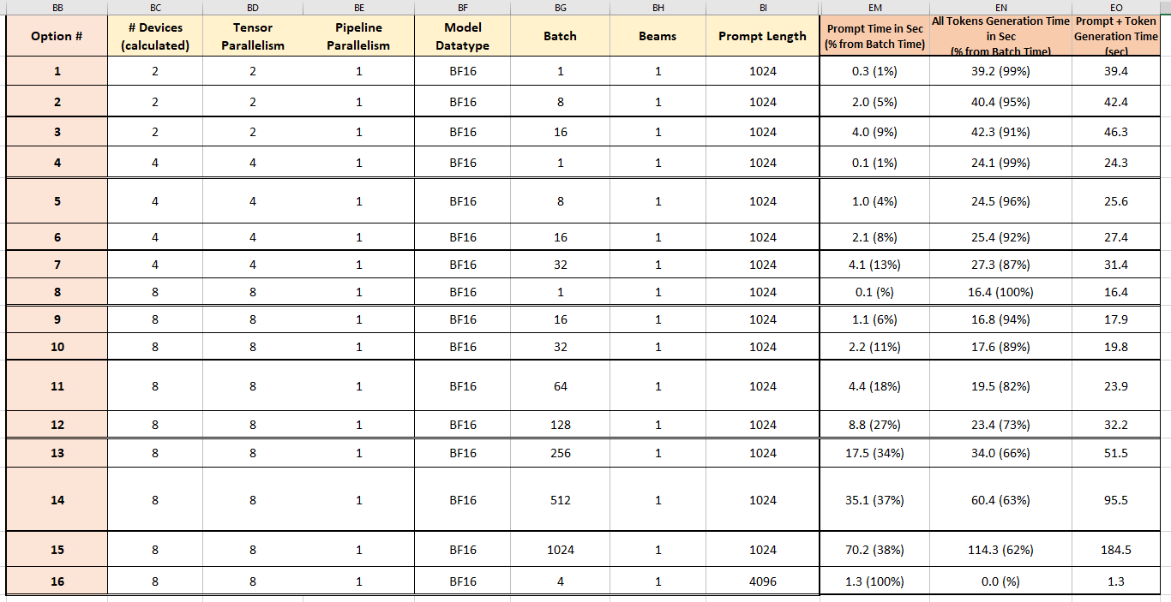
SFG for llama2 inference prompt
For BS>128, Prompt is 30% out of Batch time
Mlperf uses BS=60➔ relevant only for customers
80 layers

Slide 71
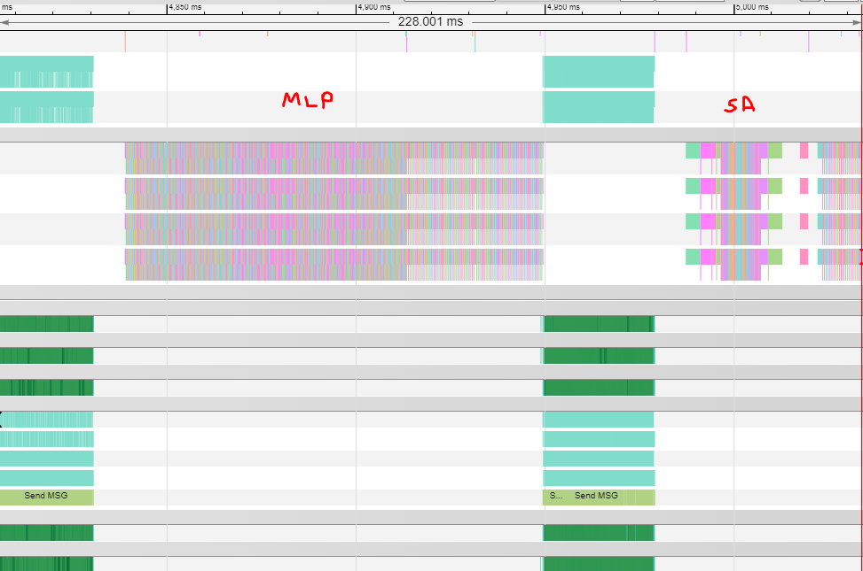
Llama2 70B BS=256, prompt generation
Prompt takes 228ms@1layer which is 34% of Batch time
All reduce MLP 30ms = 13% of prompt, 4.4% of total BS
Device MLP only
MME duration 17.9ms, 43 slices
[8192, 1024, 3]@bf16=48MB
48MB @ 262GB/s = 179u
NIC: 196ux3.33+40u[OH]=692u
MME: 192[tetris]x3584[CD]/1650[frq]=417u
275u[diff]*42+692[last] = [10.5ms-12.2ms]
670.5ms➔652.7ms ➔ [2.9%-2.6%] save for BatchTime
228ms ➔ 210.2ms ➔ [8.5%-7.8%] save for prompt KPI
Host
45u[shard] x 43[slices] = 1.9ms
Requires HPU graphs
17.8ms
5ms
24ms
30ms

Slide 72
General Purpose script level SFG
Problem statement
Number of slices [=43] is taken from GC brain
Hence, this is not GP feature for customers
Proposal
Instead, we can use some heuristics of [B*T,H] as a multiply of 2K
Constraint1: large enough shard for GraphCompiler
B[64]*T[2048]*H[8192]=1G elements
Good GC MME utilization = [2K,2K]*256= [2K,2K,3]*42+[2K,2K,2]
MME time = host time = 45u*1750[cycles/u]/H[3584]=22=nofTetris = [256,512]*24=[1.5K,2K]
Constraint2: large enough shard for NIC
B[64]*T[2048]*H[8192]*Byte[2]=2GB
Good NIC utilization[8MB], 256 shards
NIC time = host time, 45u@262GB/s [ 12MB], 86 shards of 2B

Slide 73
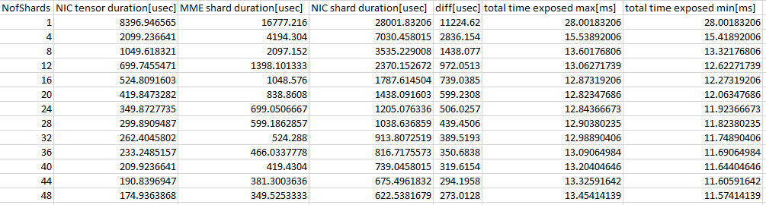
Performance implication on sharding
Even when sharding to non-aligned to GC geometry it is ok
e.g. sharding to 4 may be good enough

Slide 74
SFG for GPT3 training

Slide 75
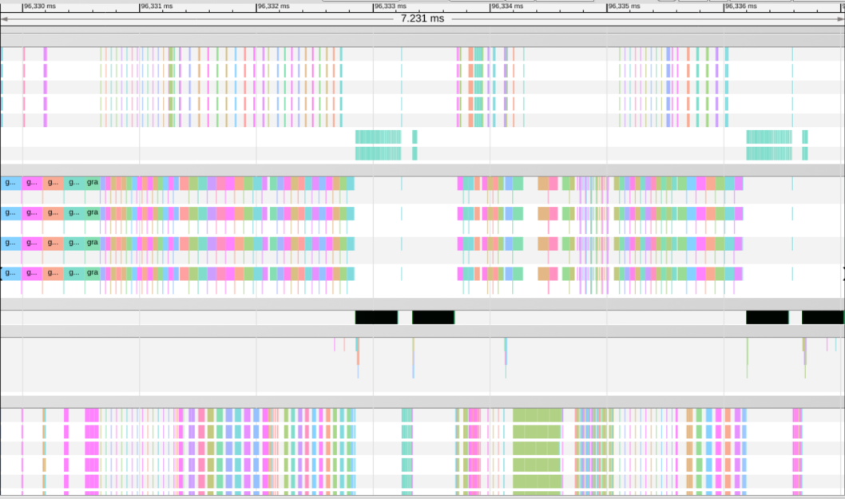
GPT3 BWD MLP
Proposal is to pipeline DEDW with AG
BxTxHx2B
B[2=micro-BS] x T[2048] x H[12288] x 2B = 0.09375G
0.09375G @ 262GB/s = 357u
trace all_gather = 360u
➔ Seems easier to integrate as no fine grain SFG needed, signaling on the tensor level
675u
552.8u
537.8u
553.8u
360u
360u

Slide 76
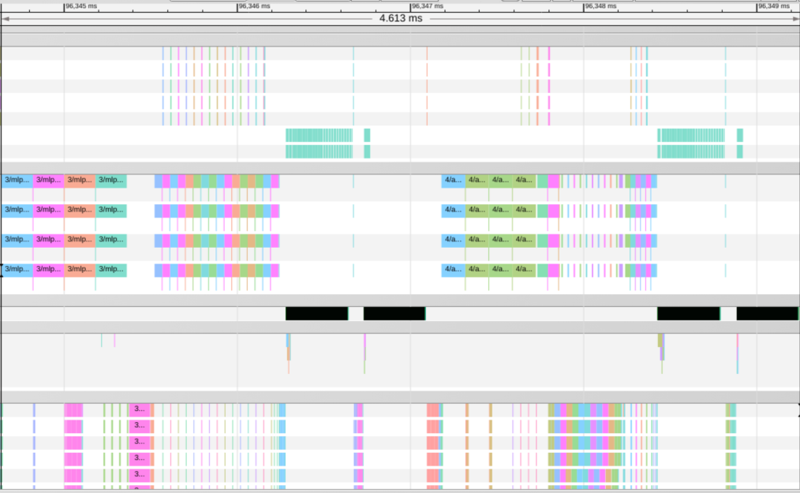
GPT3 MLP FWD
NIC
model BxTxHx2B =
B[2=micro-BS] x T[2048] x H[12288] x 2B = 0.09375G
0.09375G @ 262GB/s = 357u
reality (GPT3) =
[768,4096]x16 slices x2B = 0.09375G
trace all_reduce = 360u x 2 [reduce_scatter, all_gather]
MME
trace mlp 716.6u
24[3x8 tetris] x 6144[CD] /2[fp8]/1650[freq] = 44u
44u x 16[slices] = 714u
NIC Perf for 1shard
16 shards → 6MB @ 262GB/s=22u
714u
180u
400u
360u
360u
6u
34u

Slide 77
MLP FWD With SFG
Today 400u NIC
Pipeline MME, Slice, OH – best case
22u + 40u [OH]= 62u instead of 400u
Pipeline MME, Slice + OH – worst case
(22u+40u [OH]) x 16 [slices] – 44 x 15 [slices] = 332u

Slide 78
SA FWD
- fwd MLP out
- model BxTxHx2B = B[2=micro-BS] x T[2048] x H[12288] x 2B = 0.09375G
- reality (GPT3) = [768,4096]x16 slices x2B = 0.09375G
- trace all_reduce = 360u x 2 [reduce_scatter, all_gather]
- trace mlp 716.6u
- fwd SA out
- model BxTxHx2B = B[2=micro-BS] x T[2048] x H[12288] x 2B = 0.09375G
- reality (GPT3) = [2048,4096]x6 slices x2B = 0.09375G
- trace all_reduce = 360u x 2 [reduce_scatter, all_gather]
- trace sa 179.8u
400u
360u
6u
34u

Slide 79
SFG value for training
Plan
Start with full tensor
Then pipeline from the script level
Next step
Reproduce on a UT
 | GPT3 | LLAMA training | LLAMA2 inference
SA FWD | 3.6ms = 2.25% ( 160ms )
MLP FWD | <1% |  | 30ms = 13% of prompt
SA BWD | 4.3ms = 2.5% ( 160ms )
MLP BWD | 4.3ms = 2.5% ( 160ms )
Value | 8.25%

Slide 80
SFG for llama2 training

Slide 81
SFG for llama2 training
Waiting for trace from Deepak

Slide 82
SFG 1.15

Slide 83
SFG
Pipeline compute and network
We would like to add it as a capability to the product
Beneficial both for mlperf ( training ) customer ( inference )

Slide 84
SFG for inference
Decode/Token generation
We will not have good enough utilization.
Prompt generation
Potential for script level SFG
When large BS ( relevant for customers, not mlperf)
Example
Llama2 70B bf16, BS=256, input_seq=1K, output_seq=TBD Prompt=34% (228ms per layer) of Batch (670ms per layer)
Prompt KPI [7-8%] – 228ms → [209-212] ms,
BatchTime KPI [2.4%-2.8%] – 670ms → [651-654] ms
Pipeline on Script level – requires script change, hpu graph
https://nvidia.github.io/TensorRT-LLM/performance.html

Slide 85
SFG for training
FWD
Pipeline on Script level – requires script change, hpu graph
For example, Gaudi2 mlperf GPT3 – 2.5% save
BWD
Pipeline on Tensor level – easy integration
For example, Gaudi2 mlperf GPT3 - 5% save

Slide 86
Affected teams
Topology team ( Deepak)
Bridge ( Amit )
GC ( general support ) – Dany
Hcl ( general support ) – Adam

