Slide 1

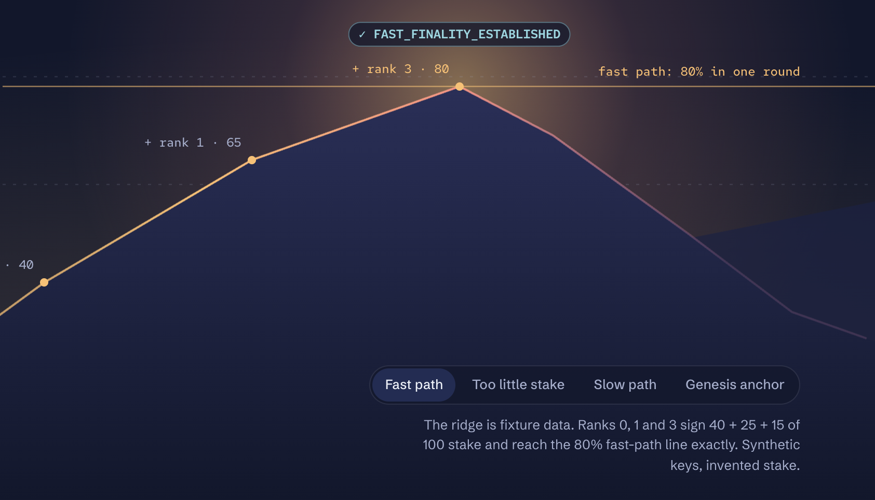
monocle
Alpenglow
is almost here.
Will you know why finality breaks?
OPEN SOURCE
RUST + WASM
RUNS IN YOUR BROWSER
Notes:
[0:00] Look at the audience, not the screen.
"Alpenglow is almost here, and it will change how Solana decides a block is final. That's exciting, but it raises a question: when finality evidence breaks, how will you know why? I'm Mansi, and I built Monocle to answer that."

Slide 2
THE PROBLEM
01
Wrong serialization
A red X
isn't an answer.
The aggregate signature is encoded incorrectly.
02
Wrong signer map
Signers don't match the stake they claim.
From the outside, every failure looks the same.
03
Wrong protocol version
Valid bytes, read under the wrong rules.
04
Incomplete evidence
A valid notarization with no finalization.
Notes:
[0:15]
"Today, when a verifier rejects a certificate, you mostly just get a failure. That could mean the signature was encoded wrongly, the signers don't match the stake they claim, the wrong protocol version was used, or a valid certificate is missing its other half. From the outside those all look the same, and on launch day you don't want to be guessing."

Slide 3
MEET MONOCLE
An open-source finality debugger
✓
×
—
VERIFIED
REJECTED
INCONCLUSIVE
Every required check ran and passed, within a stated scope.
A check failed. It does not prove the block is non-final.
Context is missing. Nothing is guessed.
It runs in your browser. No wallet. No RPC. Nothing to install.
Notes:
[0:40]
"Monocle is an open-source finality debugger that runs in your browser, with no wallet, no RPC and nothing to install. It gives one of three verdicts: verified, rejected, or inconclusive when context is missing. It never guesses, and every verdict points to the exact check behind it."

Slide 4
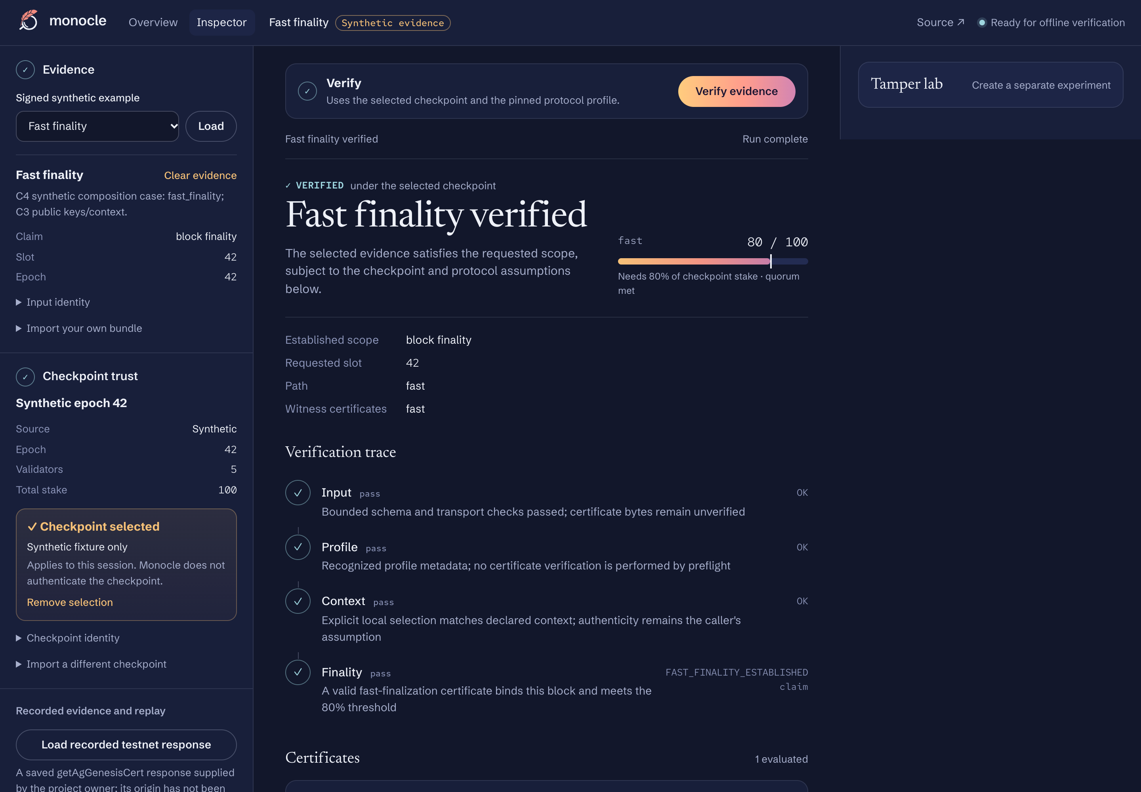
THE DEMO
1
You choose the checkpoint
Monocle never decides what to trust.
2
Verify the evidence
A signed Alpenglow certificate, checked in your browser.
3
Verified: 80 / 100
Enough stake to clear the fast-path line.
Synthetic test data: public test keys and invented stake.
Notes:
[1:00]
"A quick note before the demo: Alpenglow hasn't launched, so everything you'll see uses synthetic test data, meaning signed certificates with public test keys and invented stake. The cryptography is real, but the evidence is made for testing. Here's one of those certificates in Monocle. I choose the trusted checkpoint myself, since Monocle never decides what to trust for me, and when I verify, it comes back verified with eighty out of a hundred stake, which clears the fast-path threshold."

Slide 5
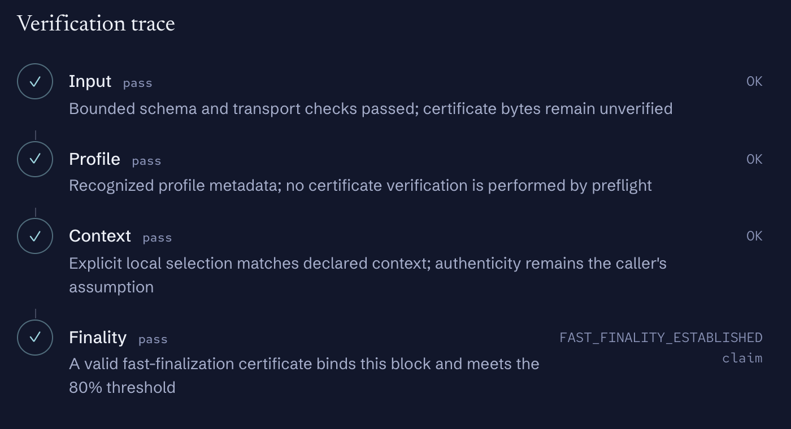
THE TRACE
Every check,
in plain sight
Each step shows its status, a readable reason and an exact diagnostic code. Nothing is hidden.
Notes:
[1:30]
"Behind that result is a full trace, where each step shows its status, a plain reason and an exact diagnostic code, so nothing about the decision is hidden."

Slide 6
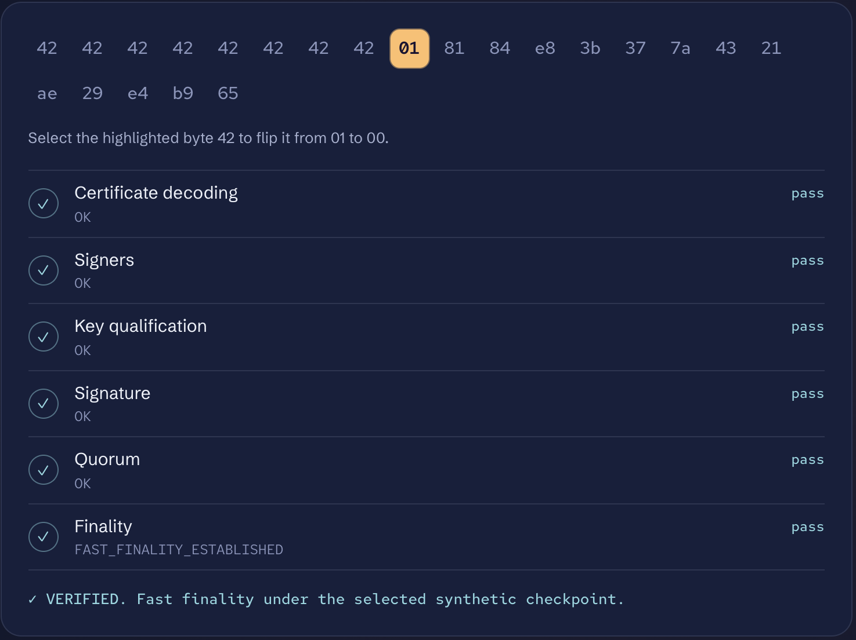
NOW, BREAK IT
One byte.
This is the certificate's raw bytes and the six checks behind it. All pass. I'm going to change a single byte.
Synthetic test data: public test keys and invented stake.
Notes:
[1:42]
"Now let's break it. This is the certificate's raw bytes, with the six checks that run against them, and all of them pass right now. I'm going to change a single byte."
(The next slide is the same view after the change. This view replays a result recorded from Monocle's real verifier, so say so if you are asked.)

Slide 7
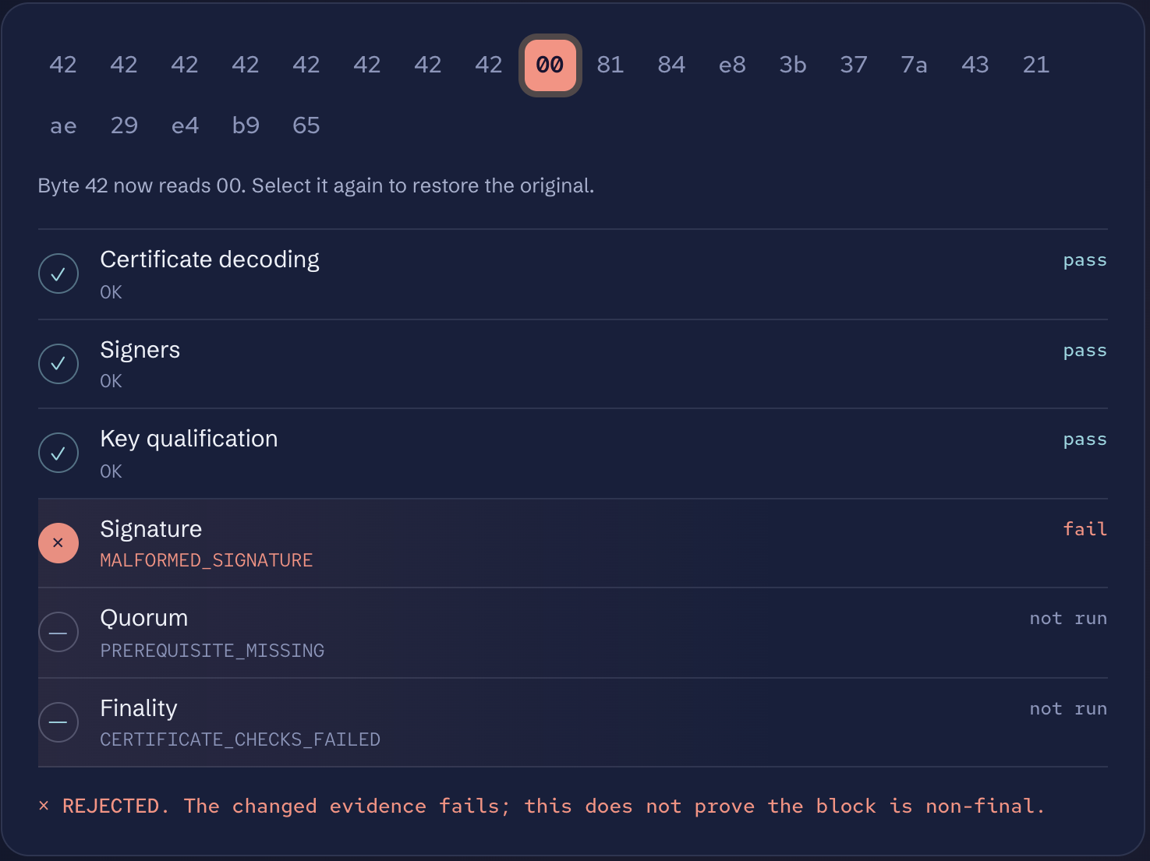
THE RESULT
Not a red X.
A diagnosis.
SIGNATURE · FAIL
QUORUM · NOT RUN
FINALITY · NOT RUN
Synthetic test data: public test keys and invented stake.
Notes:
[1:58]
"That one change makes the signature check fail. What's more useful is what didn't run: the quorum and finality checks never got a chance, because the signature broke first. So Monocle tells you not only that the evidence failed, but the order in which it gave way, and it notes that a rejection doesn't prove the block is non-final. That's the difference between a red X and a diagnosis."

Slide 8
STRAIGHT TALK
A debugger, not a light client
It does
It doesn't
Explain every check and its trust basis
Keep a missing check different from a failed one
Let you flip a byte and compare, then replay offline
Authenticate validator sets across epochs
Claim real-network verification. Not yet established
Invent context: a recorded testnet response stays inconclusive
Notes:
[2:35]
"To be clear about where this stands, Monocle is a debugger, not a light client, and since Alpenglow isn't live, nothing here has been verified against the real network yet. I also have one recorded testnet response, which Monocle keeps as inconclusive because it's missing its historical context, and it won't make that context up."

Slide 9
Try it live.
No install needed.
Alpenglow is coming. Know why it holds, or why it breaks.
monocle-omega.vercel.app
Open source on GitHub: github.com/mansi0xc/monocle
Notes:
[3:00] Look at the audience, not the slide.
"Alpenglow is coming, and when it does you'll want to know why a certificate holds or breaks. You can try Monocle right now at monocle-omega.vercel.app, and it's open source on GitHub. Thank you."

