Slide 1

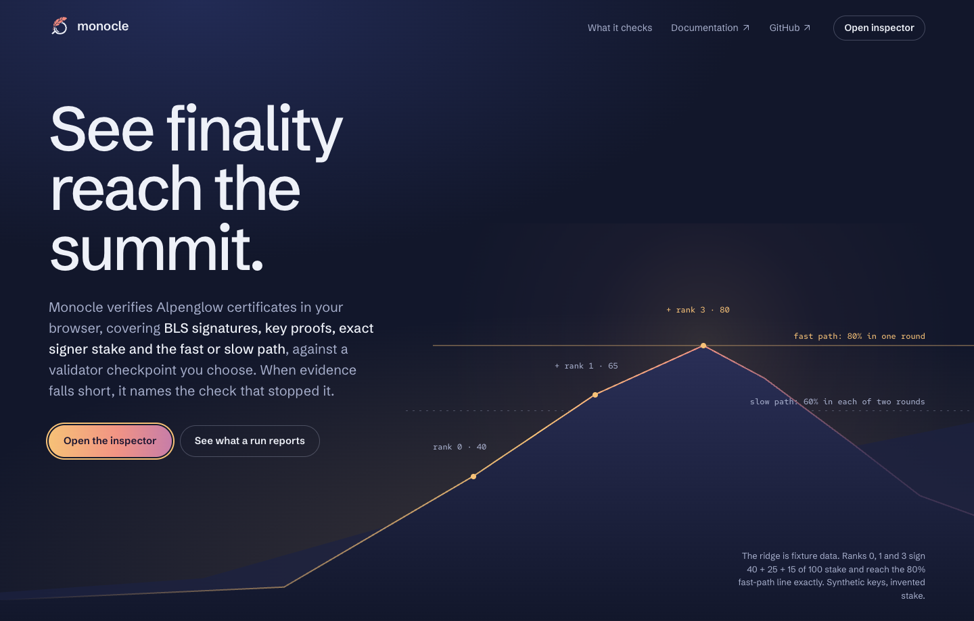
monocle
See finality
reach the summit.
A finality debugger for Solana's Alpenglow consensus. It names the check that stopped it.
OPEN SOURCE
RUST + WASM
RUNS IN YOUR BROWSER
Notes:
One-liner: Monocle explains why finality evidence verifies, fails, or stays inconclusive. The screenshot is the real landing page. Everything runs locally; no wallet and no RPC connection.

Slide 2
THE PROBLEM
A green checkmark
is not an explanation.
01
Wrong serialization
The aggregate signature is encoded incorrectly.
02
Wrong signer map
Signers don't match the stake they claim.
From the outside these failures look alike. A binary flag hides which assumption broke.
03
Wrong protocol version
Valid bytes, read under the wrong rules.
04
Incomplete evidence
A valid notarization with no finalization.
Notes:
Receiving bytes from an RPC endpoint is not verification. A useful tool exposes which check failed and keeps enough evidence to reproduce it.

Slide 3
WHAT MONOCLE DOES
Evidence to a scoped conclusion in six steps
1
Import
2
Trust
3
Check
Load a certificate bundle or a labelled synthetic fixture.
Explicitly select a validator checkpoint and profile.
Encoding, context, signers, BLS signature, stake.
4
Explain
5
Tamper
6
Replay
VERIFIED, REJECTED or INCONCLUSIVE, with every check.
Change one byte; compare freshly computed checks.
Export evidence; re-verify it offline.
Notes:
Walk the six steps. Trust selection is a deliberate user action; Monocle never authenticates the checkpoint.

Slide 4
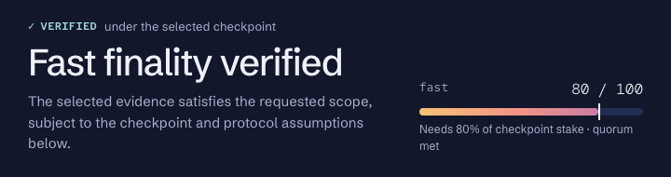
THE RESULT
Three honest verdicts
✓
VERIFIED
Every required check ran and passed, within a stated scope.
×
REJECTED
A check failed. It does not prove the block is non-final.
The real report header: verdict first, then the stake meter against its threshold.
—
INCONCLUSIVE
Context is missing. Nothing is guessed.
Status is always a word plus a symbol, never colour alone.
Notes:
Symbol plus word means the verdict survives colour blindness and greyscale projectors. This crop is the actual inspector.

Slide 5
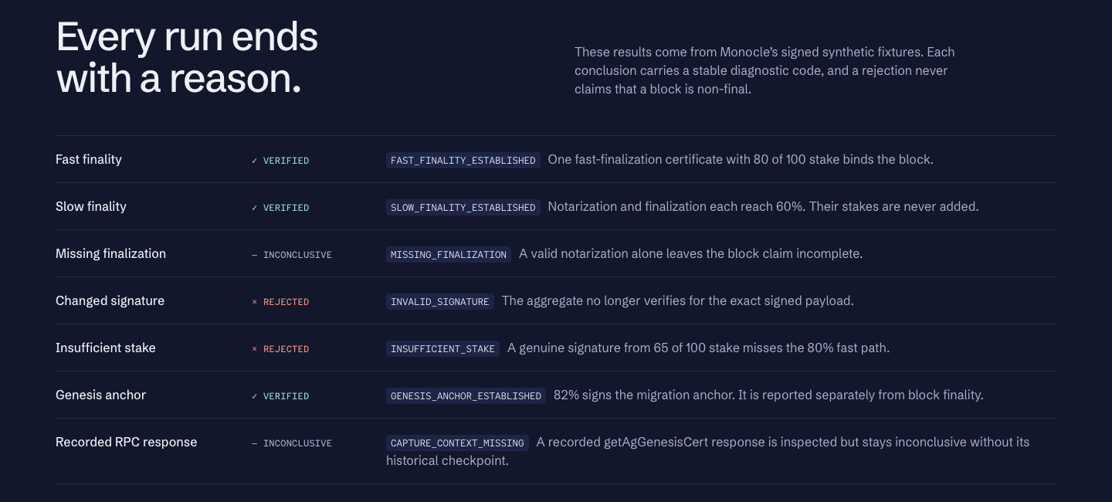
DEMO SCENARIOS
Every run ends with a reason
Signed examples use synthetic public test keys and invented stake. They make no network claim.
Notes:
Seven outcomes from signed synthetic fixtures. Each conclusion carries a stable diagnostic code. A rejection never claims that a block is non-final.

Slide 6
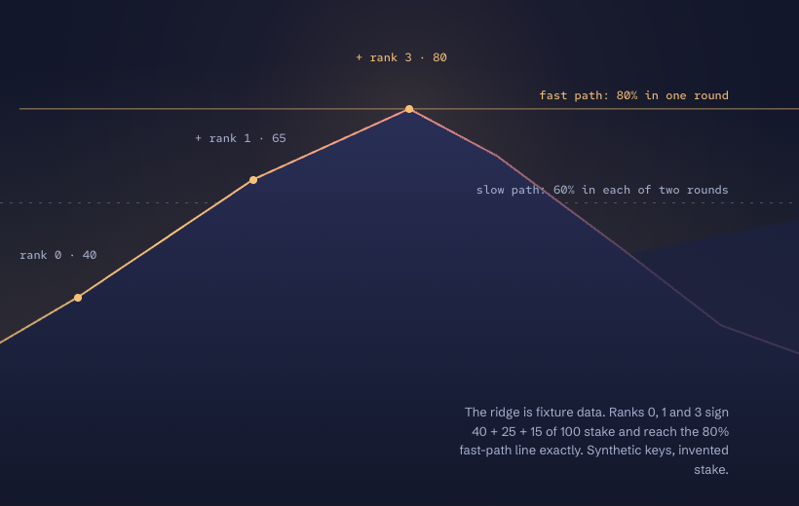
FINALITY MATH
Valid signature, not enough stake
80% fast path
80
60% slow path
65
40
Rank 0
Rank 1
Rank 3
The landing ridge is the same data: ranks 0, 1 and 3 reaching 40, 65 and 80 of 100.
Fast path: one certificate binds the block. Slow path: Notar and Finalize each reach 60%, and their stakes are never added.
Notes:
A genuine signature from 65 of 100 stake misses the 80% fast path. Monocle shows the signature check passing and the quorum check failing.

Slide 7
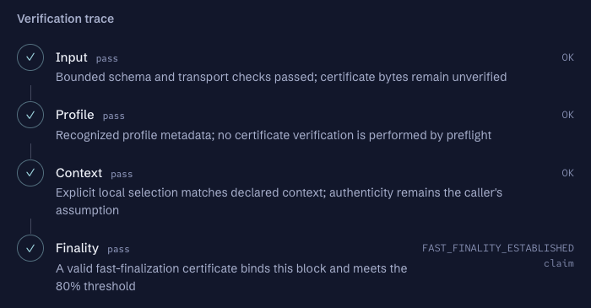
THE INSPECTOR
Every check, in plain sight
Input, profile, context, finality. Each step shows its status, a readable reason and its exact diagnostic code.
Verify in a worker
WASM, interruptible
Trust is explicit
Your checkpoint, your call
Offline ready
No network once loaded
Notes:
Real inspector crop: Input, Profile, Context and Finality all pass; the finality check carries FAST_FINALITY_ESTABLISHED.

Slide 8
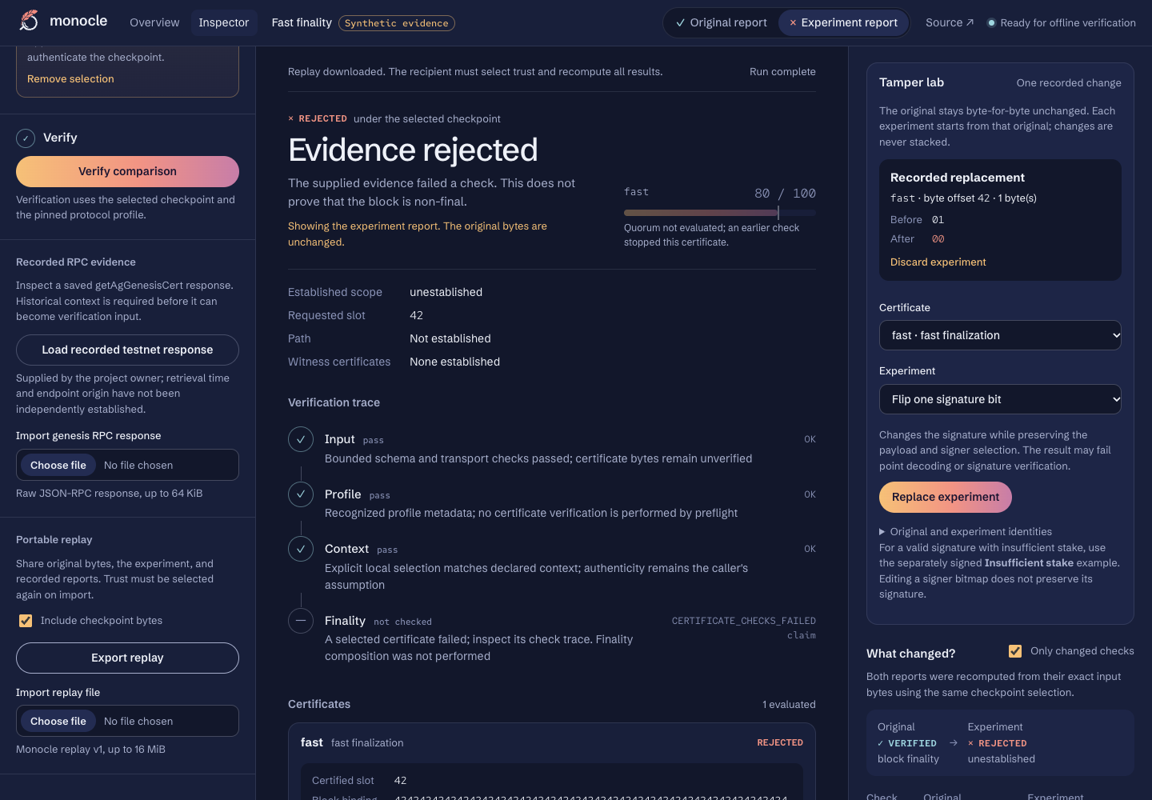
EXPERIMENT
Change one byte. Watch the checks react.
1
Original
Immutable. Never modified.
2
One byte
Equal-length replacement in a signature, field or bitmap.
3
Fresh compare
Both reports recomputed, changes side by side.
4
Replay file
Re-verified on import. Saved labels grant nothing.
Notes:
Live demo: Fast finality, select checkpoint, verify. Open Tamper lab, signature-bit experiment, verify the comparison: original VERIFIED, experiment REJECTED. Export replay, import, recompute.

Slide 9
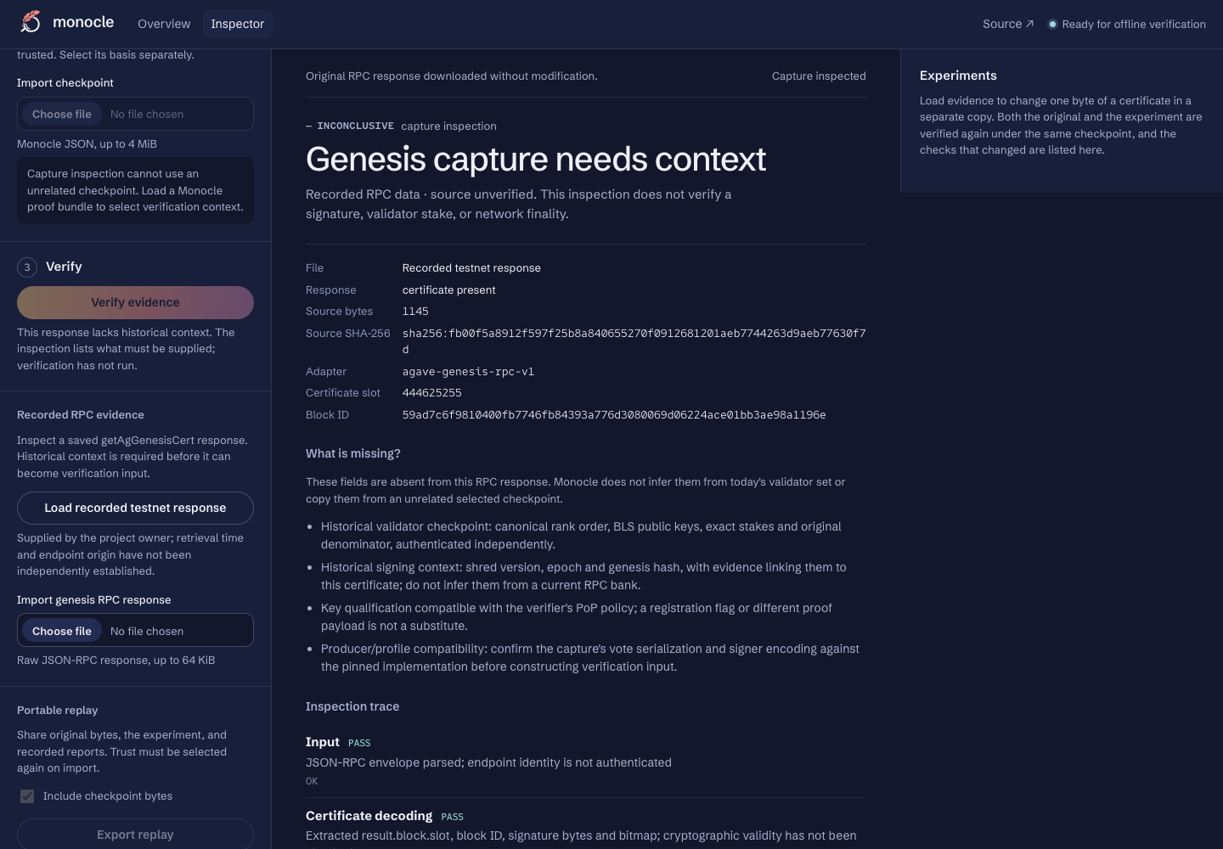
REAL NETWORK DATA
When context is missing, Monocle says so
A recorded getAgGenesisCert response is inspected, never promoted. Without its historical checkpoint the outcome stays inconclusive.
— INCONCLUSIVE
CAPTURE_CONTEXT_MISSING
Notes:
The recorded testnet response at slot 444625255 remains INCONCLUSIVE: historical checkpoint, signing context, producer compatibility and key qualification have not been established.

Slide 10
ARCHITECTURE
One Rust core, native and in the browser
monocle-core
monocle-wasm
Verifier worker
React inspector
→
→
→
Rust. Parsing, BLS checks, stake, finality, tamper, capture.
Bounded byte interface over the same core.
Interruptible. Changes invalidate old results.
Evidence, trust, report, experiments.
Rust · WebAssembly · React 19 · TypeScript · Vite · Playwright
No wallet. No RPC connection. No external font or image service at runtime.
Notes:
The native fixture generator stays separate from the verification path, so tests are not grading themselves.

Slide 11
TRUST BOUNDARIES
What Monocle refuses to claim
It does
It does not
Separate provenance, structure, trust, validity and finality
Show the trust basis next to every result
Keep a missing check different from a failed one
Render untrusted strings as text; keep big integers exact
Authenticate validator-set changes across epochs
Verify transaction execution or run a bridge
Treat a saved certificate or RPC response as verified
Claim real-network verification. It is not yet established
Notes:
The MVP uses a fixed, externally trusted checkpoint. It is a debugger, not an authenticated light client.

Slide 12
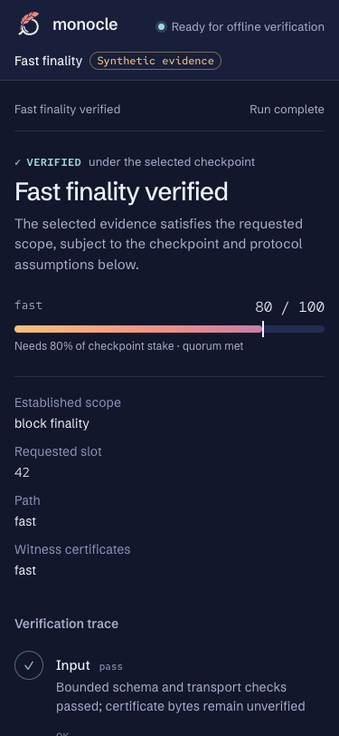
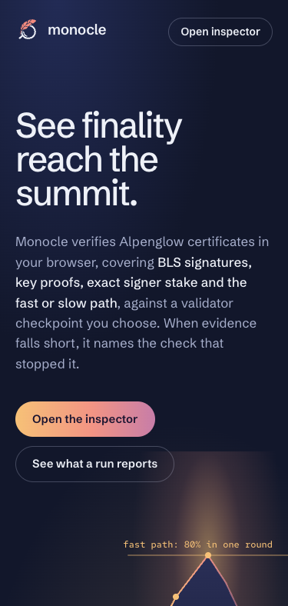
QUALITY
Built to be reproduced, not just shown
32
35
signed certificate scenarios
finality composition scenarios
33
8
Chrome browser tests
worker lifecycle tests
Responsive down to 375px
Plus WCAG A/AA scans and zero-network offline checks.
Notes:
Counts are from docs/fixture-catalog.md and docs/status.md at C8; rerun the suite before quoting them for the Dusk build. Safari, Firefox and real devices are untested.

Slide 13
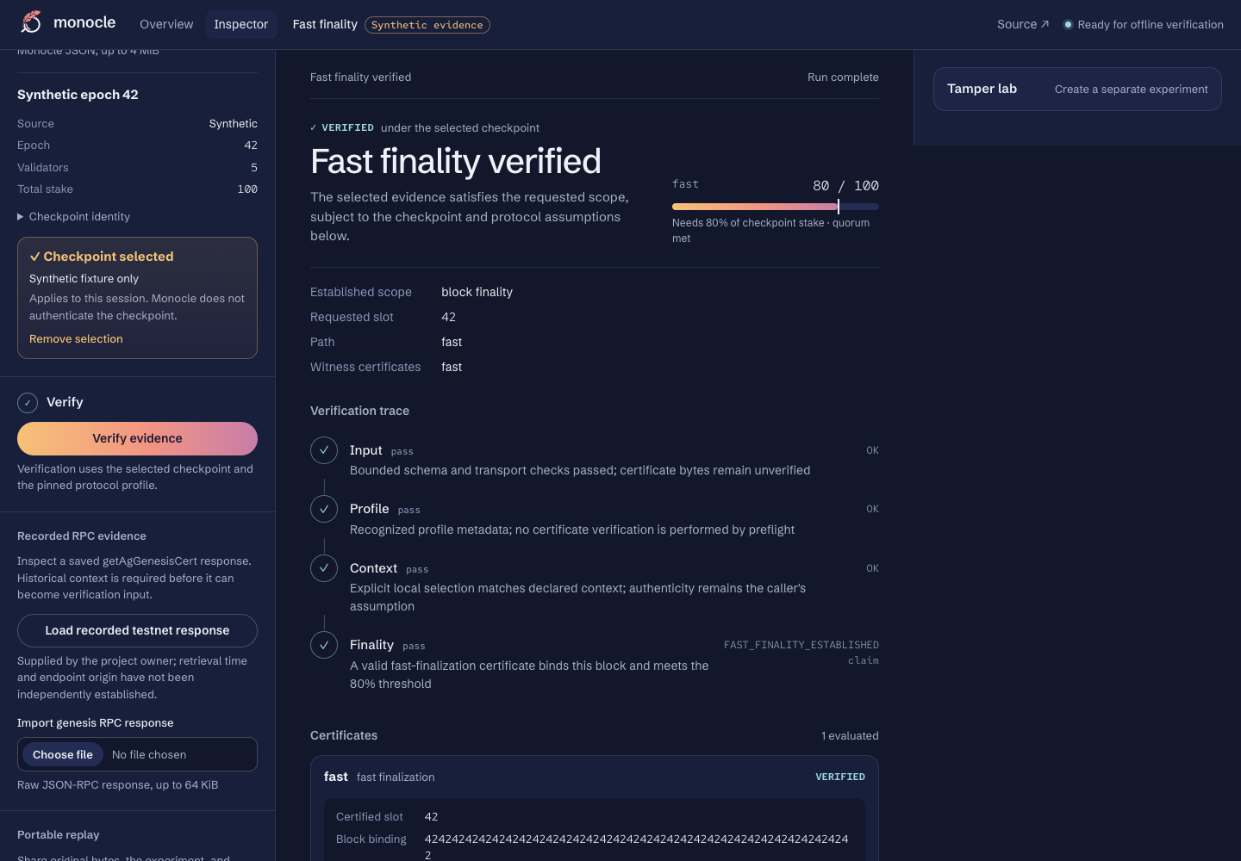
Start with a signed example.
npm ci --ignore-scripts --no-audit --no-fund
npm run dev
github.com/mansi0xc/monocle
Node 24.10+ and the pinned Rust toolchain.
Notes:
Close on the repo and the quickstart. Next: historical checkpoint context so a real capture can move from inconclusive to checked.

