Slide 1




GUDSKY RESEARCH FOUNDATION
Internship Program
Your documents
A research-driven foundation offering hands-on internship and volunteer opportunities in technology and applied AI.
Multimodal RAG Chatbot
Smart search index
Ask questions to your documents and get answers taken from them
Relevant answers
MENTOR
Abhishek Kumar Shukla
ROLE
Volunteer
PRESENTED BY
Mansi Suresh Shirode
Notes:
Introduce yourself: Mansi Suresh Shirode, volunteer at Gudsky Research Foundation, mentored by Abhishek Kumar Shukla. This talk explains one project, a Multimodal RAG chatbot, from scratch.

Slide 2
What you will learn in this talk
01
02
03
The problem
The idea (RAG)
The big picture
Why normal chatbots are not enough
Look it up first, then answer
Goals, tools and architecture
04
05
06
Under the hood
The code, step by step
Run it and next steps
Chunks, embeddings, vector DB
Ingestion, chat and images
Commands, learnings, future
Notes:
Six parts, from the simple idea to the code. No prior AI knowledge needed.

Slide 3

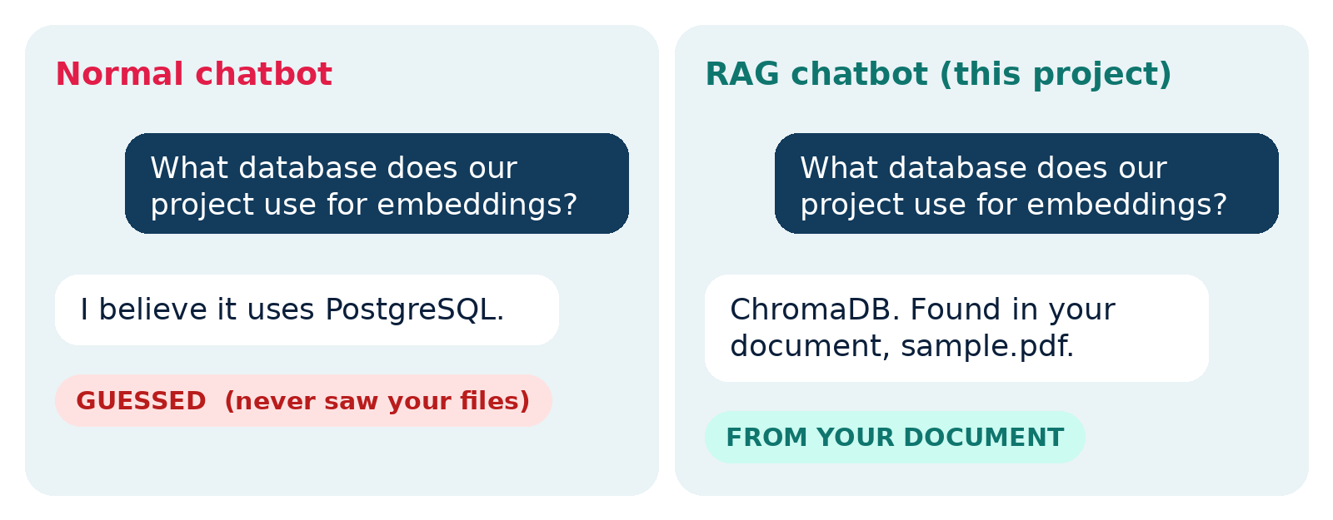



The problem: chatbots can guess wrongly
Makes things up
Sounds sure, may be wrong
Old knowledge
Only knows its training time
Cannot see your files
Your PDFs were never learned
Illustrative example
Often text only
Images are usually ignored
Notes:
Left: a normal chatbot guesses. Right: the RAG approach answers from your own document. The example is illustrative.

Slide 4



The idea: RAG, an open-book exam
RAG = Retrieval-Augmented Generation. Instead of answering from memory, the system first finds the right pages in your documents.
1. Retrieve
2. Augment
3. Generate
Find the parts of your documents that match the question.
Give those parts to the answering step as context.
Write the answer using only that context.
This project implements step 1, the Retrieve engine: it finds the best-matching passages from your documents.
Notes:
Be clear: the project covers the retrieval part of RAG. Adding a language model for step 3 is part of the future scope.

Slide 5




The project in one picture
You give
The system
You ask
You get
A PDF document (and an image)
Reads, splits and stores it as searchable data
A question in plain English
The most relevant passages back
Goals
Answer from your own documents, not from guesses
Run locally with free, open-source tools
Prepare the ground for text + image (multimodal) search
Notes:
Keep this slide simple: documents in, question in, relevant passages out.

Slide 6



Tools used, in plain English
Python
LangChain
ChromaDB
The language the project is written in
Ready-made parts for loading and splitting text
Stores the searchable data on disk
HuggingFace MiniLM
PyPDF
Pillow
Turns sentences into numbers that capture meaning
Reads the text inside PDF files
Opens and checks image files
Notes:
The embedding model is all-MiniLM-L6-v2. Every tool here is free and runs on a normal laptop.

Slide 7


How the parts connect
STEP A: BUILD THE KNOWLEDGE BASE (app.py, run once)
PDF in data/ folder
Split into small chunks
Convert to vectors
Save in ChromaDB
STEP B: ASK QUESTIONS (chat.py, any time)
You type a question
Convert to a vector
Find closest chunks
Show top 2 passages
Both steps use the same ChromaDB store and the same embedding model, so questions and documents can be compared fairly.
Notes:
Step A happens once. Step B repeats for every question. Both rely on the same model.

Slide 8
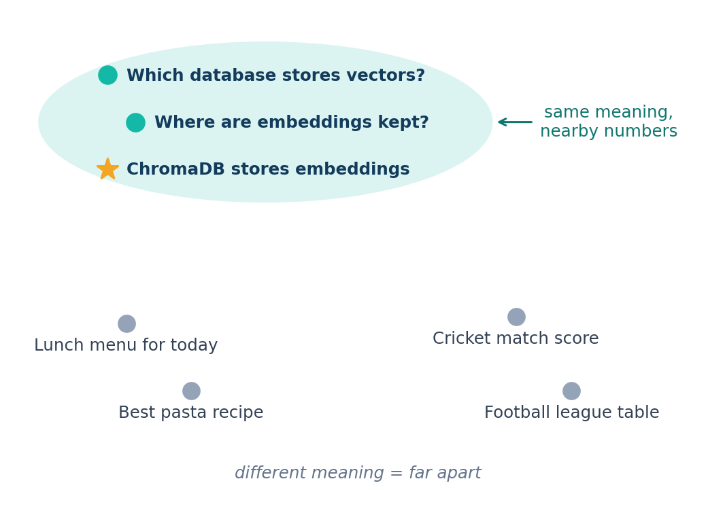


Three ideas that make it work
Chunk
A small piece of text, like a paragraph. Chunks overlap by 50 characters so no sentence is cut.
Embedding
Meaning as numbers, like GPS coordinates for meaning. Similar sentences land close together.
Vector database
A library catalogue that searches by meaning, not exact words.
Illustrative 2D map: similar meaning = nearby points
Notes:
This is the key slide for newcomers. The map is a simplified 2D picture; real embeddings have 384 numbers per chunk.

Slide 9
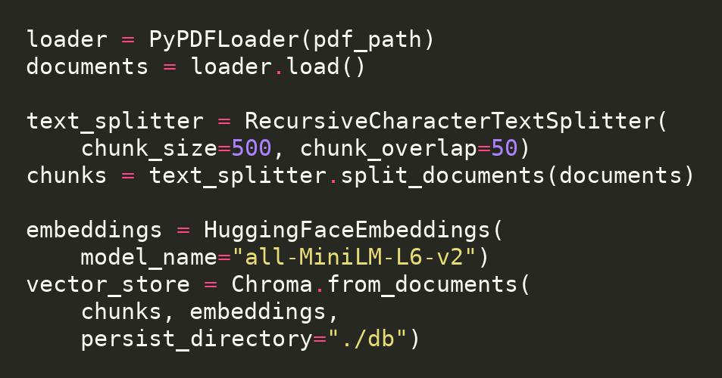
Step A in detail: app.py
1
Check the file
Stops with a clear error if data/sample.pdf is missing.
2
Load the PDF
PyPDFLoader reads every page.
3
Split into chunks
500 characters each, 50 overlapping.
Key lines from app.py (line breaks added for readability)
4
Embed and save
MiniLM makes vectors; Chroma saves them in ./db.
Notes:
chunk_size=500 and chunk_overlap=50 in RecursiveCharacterTextSplitter. HuggingFaceEmbeddings uses all-MiniLM-L6-v2. Chroma.from_documents saves to ./db.

Slide 10
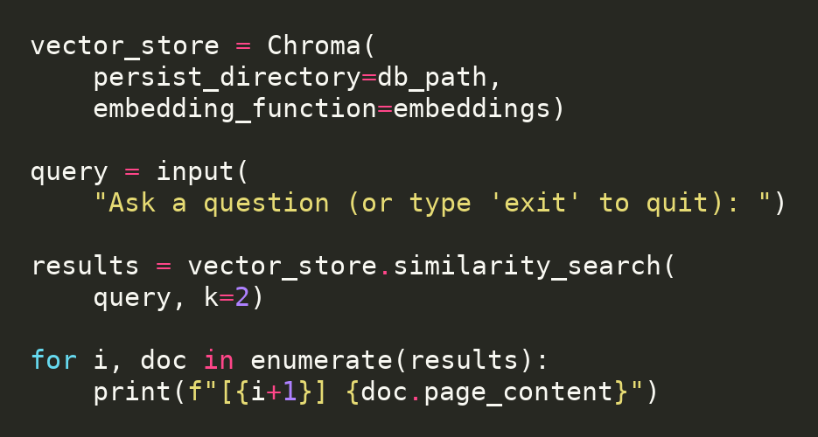
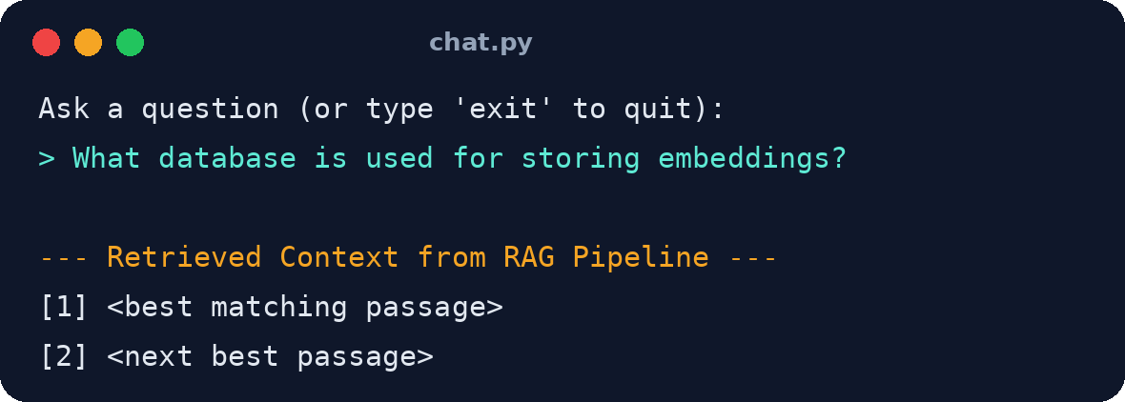
Step B in detail: chat.py
Load database
You ask
Find top 2 chunks
Show context
1
2
3
4
Illustrative output
Key lines from chat.py (line breaks added)
Notes:
query.py does the same for one fixed question. chat.py loops until you type exit. If the db folder is missing it asks you to run app.py first.

Slide 11

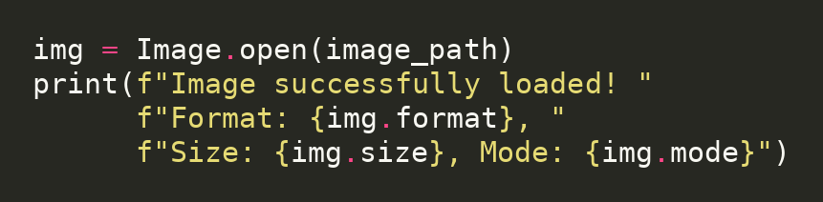

The multimodal part: images (multimodal.py)
Image file
Pillow opens it
Reads format, size, mode
Check passed
Next step
Turn image content into searchable text, so a question can also find pictures.
Key lines from multimodal.py
Example image
Notes:
Today the module loads and validates an image. Searching inside images is the next step.

Slide 12
Project files and how to run
INSTALL
app.py build knowledge base
chat.py interactive chat
query.py one test question
multimodal.py image check
make_pdf.py sample data
data/ db/ input, saved index
pip install -r requirements.txt
BUILD
python app.py
CHAT
python chat.py
Put your PDF in data/, run the commands in order.
Notes:
Three commands reproduce the whole project.

Slide 13
Learnings and what comes next
What I learned
Future scope
How RAG grounds answers in documents
How text becomes searchable vectors
Building an end-to-end AI pipeline
Add a language model to write answers
Make images searchable by content
Support many PDFs and show sources
A simple web app for everyone
Thank you
Mansi Suresh Shirode | Volunteer | Mentor: Abhishek Kumar Shukla
Notes:
Thank the mentor and the foundation. Invite questions.

