Slide 1
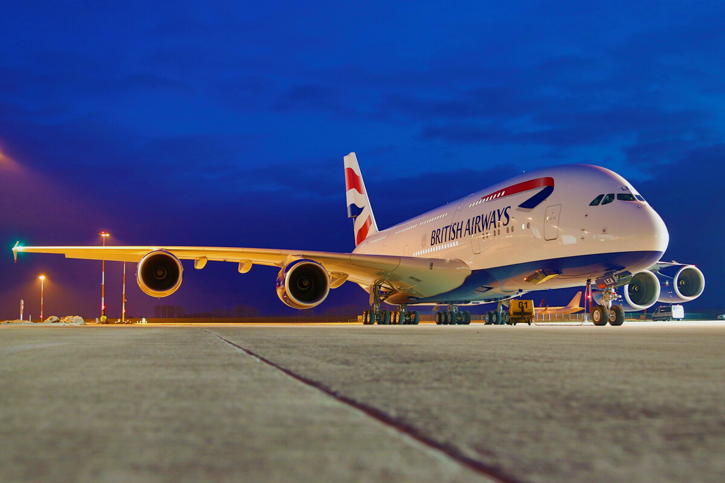
British Airways
Insights and findings from analyzing company reviews

Slide 2
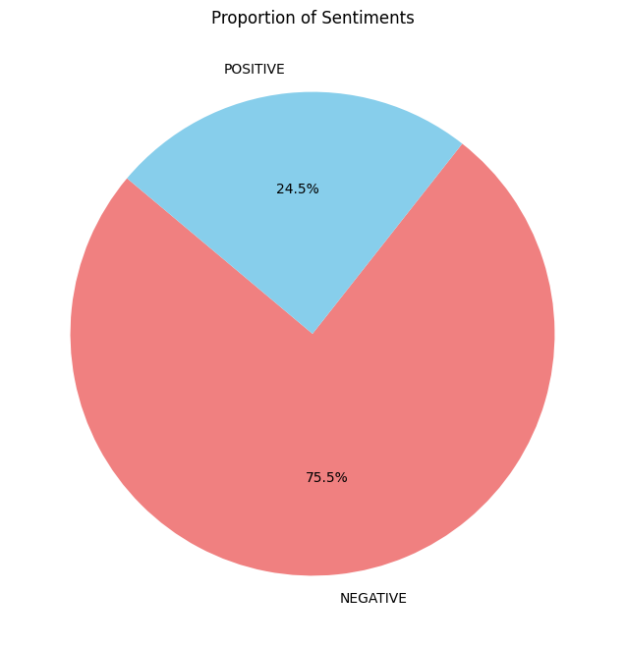
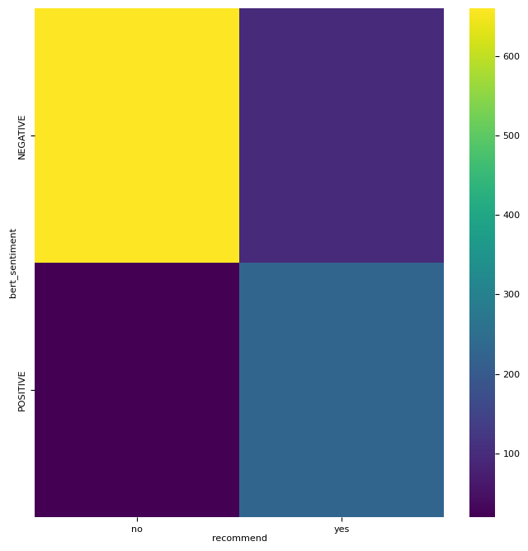
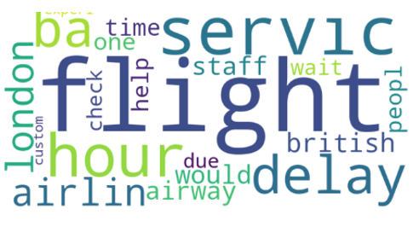
We have analysed over a 1000 user reviews to get a better understanding of where we can improve our services.
After collecting and cleaning the reviews, we performed the following tasks: - Apply different models like BERT and TextBlob for sentiment analysis and use the one with high accuracy (BERT), we calculated accuracy by comparing the analysis result to whether or not the customer recommended the airline in their review. - We then applied topic modelling with LDA to gather the key points from the reviews.
Our BERT model turned out to be 88.5% accurate when compared to whether or not the customer recommends the airline at the end of their review.
If suggested changes are made, we can ensure to keep up with competitors and provide top-notch service to our customers.
Over 75.5% of our customers faced discomfort, where majority of their issues were:
Flight delays (can create better predictive models to inform customers timely of any possible delays)
Seats, service, food, luggage and custom issues and cabin crew- concerned departments can be informed and trained accordingly.

