Slide 1
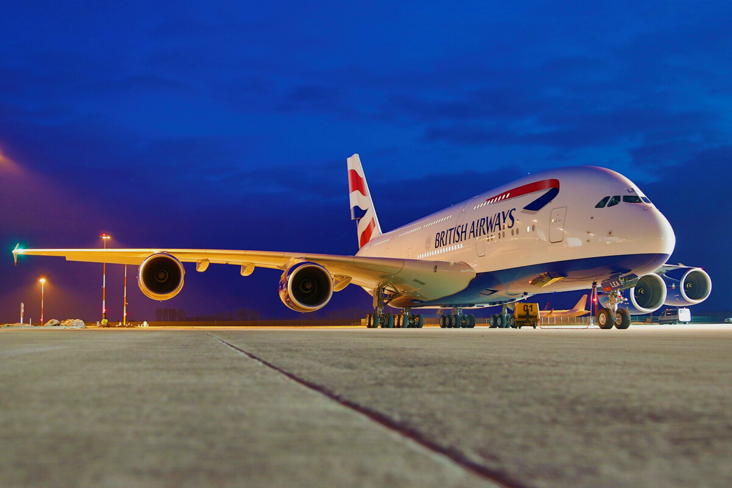
British Airways
Predictive Modelling to find factors influencing bookings

Slide 2
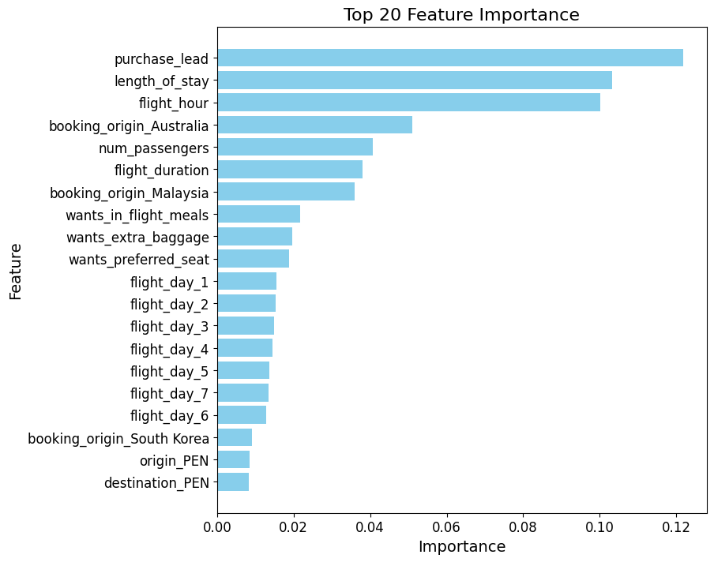
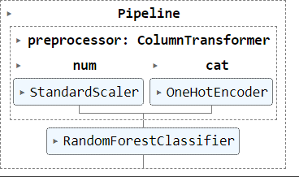
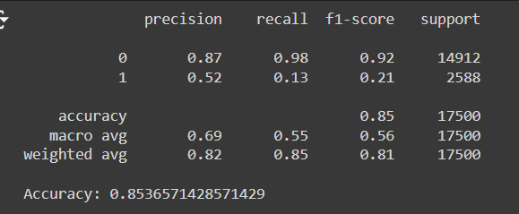
ML model was created to use categorical, as well as numerical features to predict what factors are affecting if someone purchases a ticket or not.
We cleaned and studied the data carefully and used StandardScalar for numeric data and OneHotEncoder for categorical data, and the model is using randomforest.
The accuracy and other metrics are presented here, where 0 is incomplete booking and 1 is completed booking.
Challenge faced:
As shown in the metrics table, class 1(completed booking) has poor results as there is a huge imbalance in the data and most of the bookings were incomplete.
The above graph shows the top 20 features and their importance in predicting whether or not someone completes their booking.

