Slide 1

Personalized Financial Advisor for Women
AI-Powered Financial Planning and Advisory Solution
Team Members:
1. Sathvika Vemireddy
2.Varshini S
3.Lavanya Pathak
4.Aditi Jeena
5.Mansi Ranjan Gupta

Slide 2

Problem Statement
Develop an AI-powered full-stack application that acts as a personalized financial advisor for women.The application should analyze the user’s financial data, spending habits, and goals to provide tailored financial advice, investment opportunities, and savings plans.
Tools and Tech Stack: React JS, Next.js, TailwindCSS, TypeScript, Preline, OpenAI API, Tabler Icons, JavaScript, AI, Drizzle, chadcn, Neon Console, API, Database

Slide 3
Solution
ML-driven financial analysis based on user inputs.
Personalized recommendations for savings, investments, and budgeting.
Secure data handling and an intuitive user interface for a seamless experience.

Slide 4
Success Criteria
Accurate financial analysis and personalized recommendations.
User-friendly interface with intuitive navigation.
High user engagement and satisfaction.
Secure handling of sensitive financial data.

Slide 5
Benefits of the Solution
Empowers women to make informed financial decisions.
Encourages better financial planning and savings.
Provides a personalized and accessible financial advisory service.

Slide 6
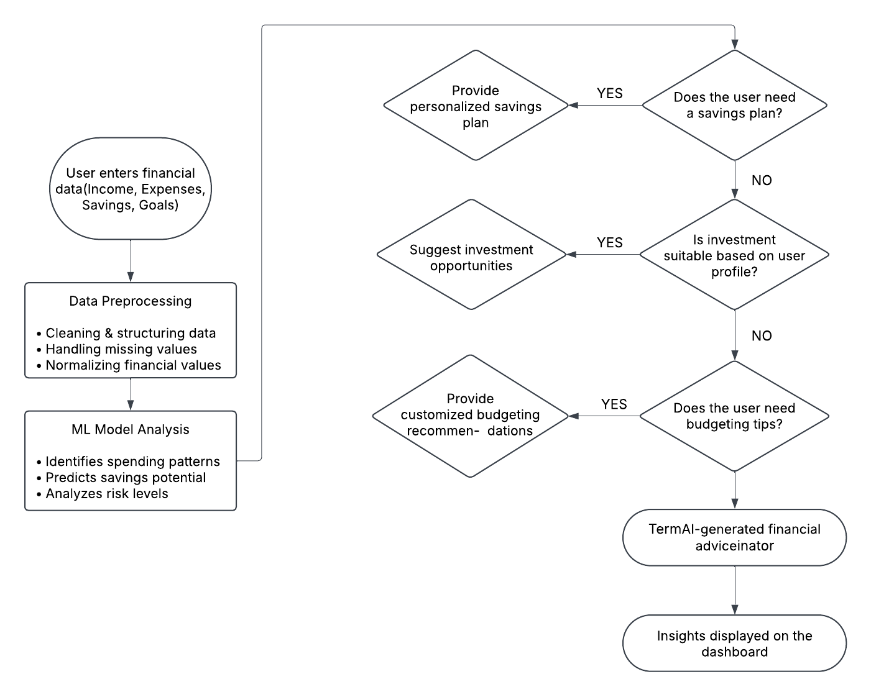
Flowchart

Slide 7
Implementation
Frontend: React JS, Next.js, TailwindCSS, TypeScript. User authentication and dashboard for financial insights.
Backend: APIs for data processing and financial calculations. Drizzle for state management and database interaction.
ML Integration: Financial advisory model trained on financial data for recommendations. Analysis of spending patterns to suggest savings and investment plans using a Decision Tree Model for better accuracy and interpretability.

Slide 8
Challenges
ML model integration with real-time financial data.
Ensuring data security and privacy compliance.
Debugging API connections and model responses.

Slide 9
Results
Successful integration of the financial advisory model.
Accurate personalized recommendations based on user data.
Positive user feedback on interface and advice accuracy.

Slide 10
Tools and Tech Stack
Frontend: React JS, Next.js, TailwindCSS, TypeScript, Preline.
Backend: API, Drizzle, chadcn, Neon Console, Database.
ML: Financial advisory model for personalized recommendations using a Decision Tree Model.
Others: JavaScript, Tabler Icons for UI elements.

Slide 11
Future Scope
Expand to include personalized tax planning.
Integration with banking APIs for automated tracking.
AI-based investment risk assessment and portfolio management.

Slide 12
Conclusion
Successfully developed an ML-powered financial advisory system focused on women.
Achieved accurate financial recommendations based on user data.
Future scope includes expanding to tax planning and investment risk management.

Slide 13
DEMO LINK:
https://drive.google.com/file/d/1faPLYUzH3_uR85L4GkXHiOelZfecKO24/view?usp=drivesdk

