Slide 1

SilentTalks Project Idea Presentation Date: 05/05/2023
Project Work Phase- 2 (ECS899)
Degree : B.Tech CSE (AI+ML+DL)
Project Guide
Mr. Saurabh Pathak
Submitted By:
Mansi Jain
TCA1959015
FACULTY OF ENGINEERING & COMPUTING SCIENCES
TEERTHANKER MAHAVEER UNIVERSITY, MORADABAD

Slide 2


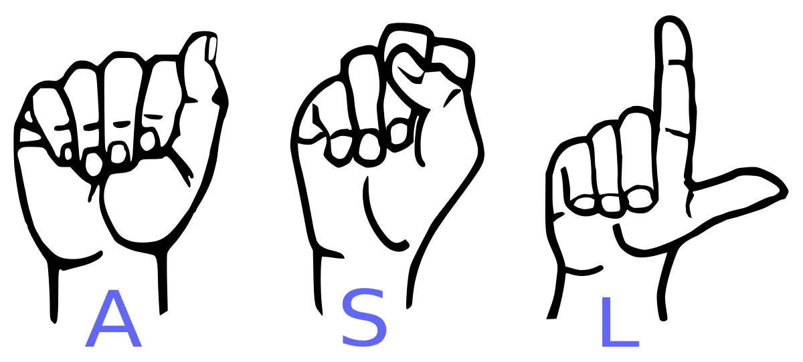
Introduction
SilentTalk is a website that converts sign language into text language.
This website is for the Dumb and Deaf
We use OpenCV and CNN models to train this website.
<number>

Slide 3
Problem Statement
Our project aims to create a computer application and train a model which when shown a real-time video of hand gestures of American Sign Language shows the output for that particular sign in text format on the screen.
<number>

Slide 4
Technologies
Front-end
HTML
CSS
Back-end
Python
Database
SQL
Tools
Jupyter Notebook
VS Code
<number>
T012C/ Template Version 5.0

Slide 5
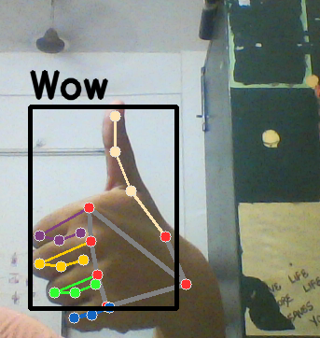
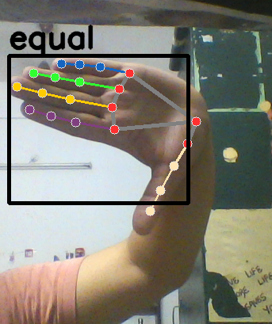
How we generated data set and did Data Preprocessing ?
<number>
T012C/ Template Version 5.0

Slide 6
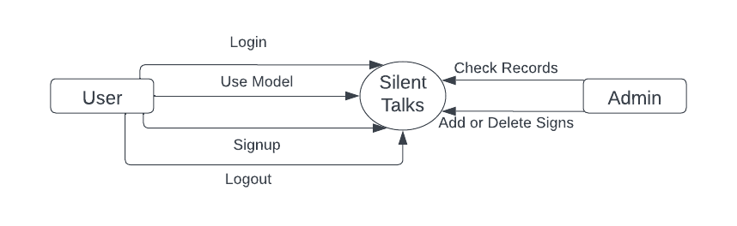
Data Flow Diagrams(Zero Level)
<number>
T012C/ Template Version 5.0

Slide 7
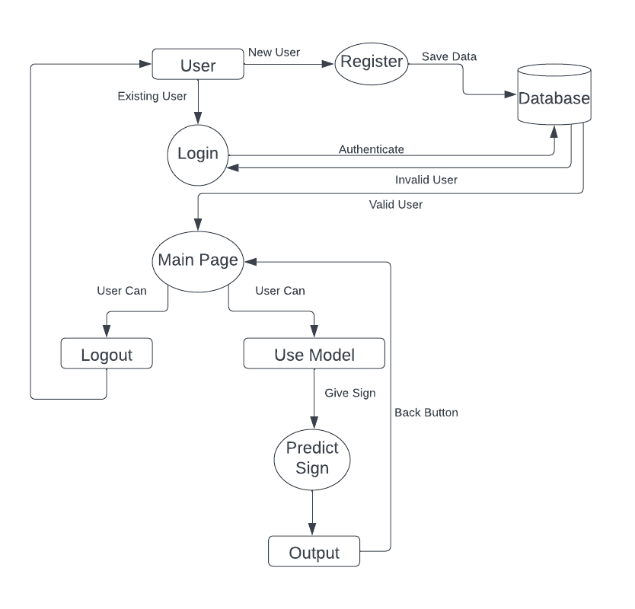
Data Flow Diagrams(One Level)
6

Slide 8
Advantages
Helps to communicate between Dumb/Deaf and normal people.
User Friendly interface.
User’s data will be secure
7

Slide 9
Conclusion
In this report, a functional real time vision based american sign language recognition for D&M people have been developed for asl alphabets.
We achieved an accuracy of 98.00% on our dataset.
Prediction has been improved after implementing two layers of algorithms in which we verify and predict symbols which are more similar to each other.
8

Slide 10
THANKS
T004/ Version 1.0

