Slide 1
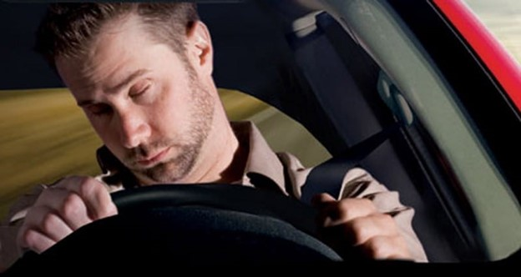
DRIVER AWARENESS DETECTION IN AUTONOMOUS CARS
Dhanashri Palodkar
Mansi Agrawal

Slide 2
TABLE OF CONTENTS
01
02
03
04
05
06
INTRODUCTION
METHODOLOGY
DATASET
RESULT & ANALYSIS
CONCLUSION
REFERENCES

Slide 3
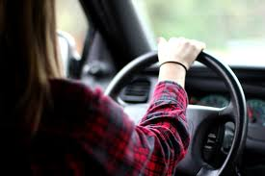
INTRODUCTION
01
In recent years, driver awareness has been one of the major causes of road accidents and can lead to severe physical injuries, deaths and significant economic losses. Statistics indicate the need for a reliable driver awareness detection system which could alert the driver before a mishap happens.

Slide 4
ABSTRACT
Drivers Awareness is one of the major cause behind road accidents
1.25 million world-wide accidents being specific
Tesla's new model X was our inspiration behind this project
All the current models available uses the same dataset with 80-90% accuracy
This project aims to increase the accuracy and model reliability

Slide 5
EARLIER METHODS OF DROWSINESS DETECTION
1
2
3
VEHICLE BASED MEASURES
BEHAVIORAL MEASURES
PHYSIOLOGICAL MEASURES

Slide 6
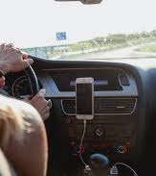
GOALS
Designing a hybrid drowsiness detection system that combines non-intrusive psychological measures with other measures one would accurately determine the drowsiness of the driver
Compare and increase the accuracy and reliability of drowsiness detection and emotion detection using new dataset
Using deep-learning and neural nets improving road safety in automatic vehicles
Compare and state the difference between EARSVM Model and present models

Slide 7
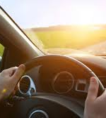
02
METHODOLOGY

Slide 8
PROBLEM ANALYSIS
A driver who falls asleep and when the wheel loses control of the vehicle, an action which often results in a crash with either another vehicle or stationary objects.
In order to prevent these devastating accidents, the state of drowsiness of the driver should be monitored.

Slide 9
OUR PLAN
Integration of multiple facial recognition datasets and CEW(closed eye in the wild)
Data preprocessing and dataset formation (conversion of all images to a standard format and standard color scale
Designing and training a convolutional neural network on our dataset.
Creating bottleneck features and training the model on the newly formed dataset
Selecting the model with best accuracy & using that model prediction for simulation
Creating an inference model to test on real world image

Slide 10



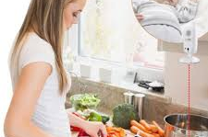
Used Cases
Front line workers in the factory
Security officers
Students monitoring in class
Reverse Used Cases
Monitor babies
Notes:
We need to pu images here

Slide 11

ALGORITHM
HAAR cascade for face detection
Haar Cascade is basically a classifier which is used to detect the object for which it has been trained for, from the source. The Haar Cascade is trained by superimposing the positive image over a set of negative images. The training is generally done on a server and on various stages. Better results are obtained by using high quality images and increasing the amount of stages for which the classifier is trained.

Slide 12
ARCHITECTURE
Layer (type) Output Shape Param # =================================================================
image_array (Conv2D) (None, 48, 48, 16) 800 _________________________________________________________________
batch_normalization_61 (Batc (None, 48, 48, 16) 64 ________________________________________________________________
conv2d_69 (Conv2D) (None, 48, 48, 32) 25120 _________________________________________________________________
batch_normalization_62 (Batc (None, 48, 48, 32) 128 _________________________________________________________________
activation_27 (Activation) (None, 48, 48, 32) 0 _________________________________________________________________
average_pooling2d_29 (Averag (None, 24, 24, 32) 0 _________________________________________________________________
dropout_25 (Dropout) (None, 24, 24, 32) 0 _________________________________________________________________
conv2d_70 (Conv2D) (None, 24, 24, 64) 51264 ________________________________________________________________
batch_normalization_63 (Batc (None, 24, 24, 64) 256 _________________________________________________________________
conv2d_71 (Conv2D) (None, 24, 24, 64) 102464 _________________________________________________________________
batch_normalization_64 (Batc (None, 24, 24, 64) 256 _________________________________________________________________
activation_28 (Activation) (None, 24, 24, 64) 0 _________________________________________________________________
average_pooling2d_30 (Averag (None, 12, 12, 64) 0 _________________________________________________________________
dropout_26 (Dropout) (None, 12, 12, 64) 0 _________________________________________________________________
conv2d_72 (Conv2D) (None, 12, 12, 64) 36928 _________________________________________________________________
batch_normalization_65 (Batc (None, 12, 12, 64) 256 _________________________________________________________________
conv2d_73 (Conv2D) (None, 12, 12, 128) 73856 _________________________________________________________________
batch_normalization_66 (Batc (None, 12, 12, 128) 512 _________________________________________________________________
activation_29 (Activation) (None, 12, 12, 128) 0 _________________________________________________________________
average_pooling2d_31 (Averag (None, 6, 6, 128) 0 _________________________________________________________________
dropout_27 (Dropout) (None, 6, 6, 128) 0 _________________________________________________________________
conv2d_74 (Conv2D) (None, 6, 6, 128) 147584 _________________________________________________________________
batch_normalization_67 (Batc (None, 6, 6, 128) 512 _________________________________________________________________
conv2d_75 (Conv2D) (None, 6, 6, 256) 295168 _________________________________________________________________
batch_normalization_68 (Batc (None, 6, 6, 256) 1024 _________________________________________________________________
activation_30 (Activation) (None, 6, 6, 256) 0 _________________________________________________________________
average_pooling2d_32 (Averag (None, 3, 3, 256) 0 _________________________________________________________________
dropout_28 (Dropout) (None, 3, 3, 256) 0 _________________________________________________________________
conv2d_76 (Conv2D) (None, 3, 3, 256) 590080 ________________________________________________________________
batch_normalization_69 (Batc (None, 3, 3, 256) 1024 _________________________________________________________________
conv2d_77 (Conv2D) (None, 3, 3, 8) 18440 _________________________________________________________________
global_average_pooling2d_4 ( (None, 8) 0 _________________________________________________________________
predictions (Activation) (None, 8) 0 =================================================================
Total params: 1,345,736
Trainable params: 1,343,720
Non-trainable params: 2,016

Slide 13
_________________________________________________________________
average_pooling2d_29 (Averag (None, 24, 24, 32) 0 _________________________________________________________________
dropout_25 (Dropout) (None, 24, 24, 32) 0 _________________________________________________________________
conv2d_70 (Conv2D) (None, 24, 24, 64) 51264 ________________________________________________________________
batch_normalization_63 (Batc (None, 24, 24, 64) 256 _________________________________________________________________
conv2d_71 (Conv2D) (None, 24, 24, 64) 102464 _________________________________________________________________
batch_normalization_64 (Batc (None, 24, 24, 64) 256 _________________________________________________________________
activation_28 (Activation) (None, 24, 24, 64) 0 _________________________________________________________________

Slide 14
average_pooling2d_30 (Averag (None, 12, 12, 64) 0 _________________________________________________________________
dropout_26 (Dropout) (None, 12, 12, 64) 0 _________________________________________________________________
conv2d_72 (Conv2D) (None, 12, 12, 64) 36928 _________________________________________________________________
batch_normalization_65 (Batc (None, 12, 12, 64) 256 _________________________________________________________________
conv2d_73 (Conv2D) (None, 12, 12, 128) 73856 _________________________________________________________________
batch_normalization_66 (Batc (None, 12, 12, 128) 512 _________________________________________________________________
activation_29 (Activation) (None, 12, 12, 128) 0 _________________________________________________________________
average_pooling2d_31 (Averag (None, 6, 6, 128) 0

Slide 15
_________________________________________________________________
dropout_27 (Dropout) (None, 6, 6, 128) 0 _________________________________________________________________
conv2d_74 (Conv2D) (None, 6, 6, 128) 147584 _________________________________________________________________
batch_normalization_67 (Batc (None, 6, 6, 128) 512 _________________________________________________________________
conv2d_75 (Conv2D) (None, 6, 6, 256) 295168 _________________________________________________________________
batch_normalization_68 (Batc (None, 6, 6, 256) 1024 _________________________________________________________________
activation_30 (Activation) (None, 6, 6, 256) 0 _________________________________________________________________
average_pooling2d_32 (Averag (None, 3, 3, 256) 0 _________________________________________________________________
dropout_28 (Dropout) (None, 3, 3, 256) 0 _________________________________________________________________

Slide 16
conv2d_76 (Conv2D) (None, 3, 3, 256) 590080 ________________________________________________________________
batch_normalization_69 (Batc (None, 3, 3, 256) 1024 _________________________________________________________________
conv2d_77 (Conv2D) (None, 3, 3, 8) 18440 _________________________________________________________________
global_average_pooling2d_4 ( (None, 8) 0 _________________________________________________________________
predictions (Activation) (None, 8) 0 =================================================================
Total params: 1,345,736
Trainable params: 1,343,720
Non-trainable params: 2,016

Slide 17
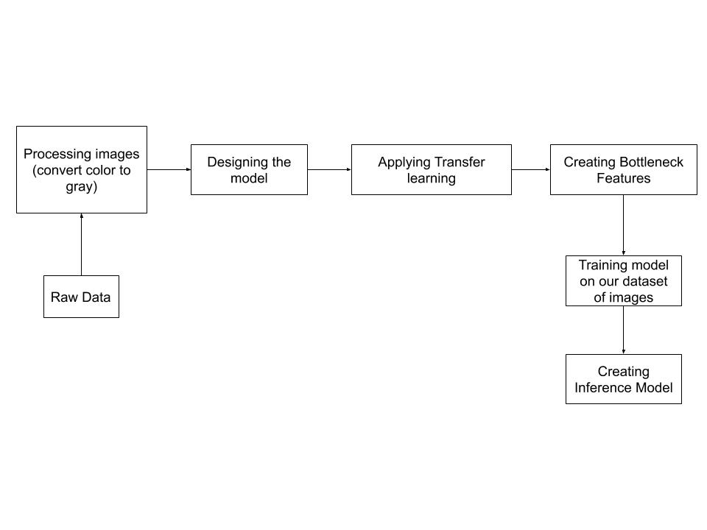
PIPELINE DESIGN

Slide 18
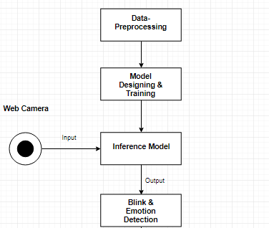
FLOWCHART DESIGN

Slide 19
IMPLEMENTATION DETAILS
In this project, the techniques which we are implementing are data-resizing, transfer learning, bottleneck features, inference predictions, docker implementation, simulation on Django environment.
Libraries: Tensorflow, Keras, OpenCV, Scipy

Slide 20
STEP 1-Data-Resizing
Resizing an image helps to adjust the size of the image to the desired proportions ,whether it is in pixels,inches or in a specified percentage of change.
Resize serves the same purpose, but allows to specify an output image shape instead of a scaling factor.
We have resized the all the original images to 48x48 dimensions
The dataset created had nearby 32000 images which belonged to 8 classes

Slide 21
STEP 2-Transfer learning
Transfer learning is a machine learning technique where a model trained on one task is re-purposed on a second related task.
Train a base network on a base dataset and task, and then we repurpose the learned features, or transfer them, to a second target network to be trained on a target dataset and task.
This process will tend to work if the features are general, meaning suitable to both base and target tasks, instead of specific to the base task.

Slide 22
STEP 3-Bottleneck Features
The basic technique to get transfer learning working is to get a pre-trained model (with the weights loaded) and remove final fully-connected layers from that mode
Use the remaining portion of the model as a feature extractor for our smaller dataset.
These extracted features are called "Bottleneck Features" We then train a small fully-connected network on those extracted bottleneck features in order to get the classes we need as outputs for our problem.

Slide 23
DETAILS ON RUNNING THE MODELS
The model for this project has various functions such as detection, sleep checker, and emotion detection. It is explained as follows:
Load Detection model: This function deals with a cascaded classifier where it loads the pre-trained model which has trained modules of the face and eye detection with the listed expression. The pre-trained data for face is 32000 and for eye-detection is 2000.
Offsets - This function deals with the coordinate mapping on face and eyelids.

Slide 24
Blink Detect - This function works on blink detection where it captures the time for which eyes are closed or open. Blink detect works on the eye dataset.
Predict Emotions: We have given 6 flags to 6 different emotions which involve angry, neutral, happy, sad, surprised. ‘Predict emotions function’ uses face features from face data to predict the emotions of faces in real time. It helps to understand the driver's current mood. The data set used in this function is 32000.
To download pre-trained models please use the following link- Click Here

Slide 25

03
DATASET

Slide 26
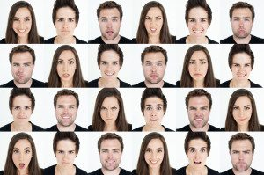
DATASET
01
02
03
04
FacesDB
Closed Eye Database
Japanese Female Facial Expression (JAFFE) Database
Facial Expression Recognition

Slide 27




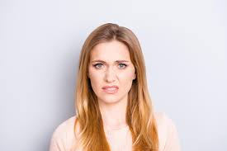
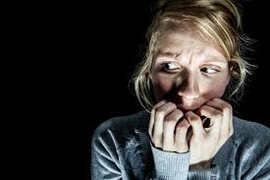
The database IMPA-FACE3D was created in 2008 to assist in the research of facial animation. In particular, for analysis and synthesis of faces and expressions. We take the six universal expressions between human races proposed:
HAPPINESS
SADNESS
SURPRISE
ANGER
DISGUST
FEAR
Notes:
We need to pu images here

Slide 28
This dataset includes acquisitions of 38 individuals with a neutral face sample, samples corresponding to six universal facial expressions and other expressions referring to 5 samples containing mouth and eyes open and / or closed. Also two samples were considered corresponding to the lateral profiles of individuals. Altogether, the data set is composed of 22 men and 16 women, with the majority of individuals aged between 20 and 50 years. 14 samples were acquired for all individuals, summarizing 532 samples in total.

Slide 29

04
RESULT &
ANALYSIS
ANALYSIS OF MODELS

Slide 30
Emotion Detection Models
Model No | No. of Epochs | Layers | Training Accuracy | Training Loss | Validation Accuracy | Validation Loss
CNN Model 1 | 5 | Convo2D :4 Dense : 2 | 0.3495 | 1.7063 | 0.3523 | 1.6901
CNN Model 2 | 30 | Convo2D :4 Dense : 2 AvgPool: 3 | 0.4348 | 1.5039 | 0.4631 | 1.4335
CNN Model 3 | 41 | Convo2D :4 Dense : 2 AvgPool: 4 | 0.8892 | 0.2858 | 0.8907 | 0.2800

Slide 31
Model No | No. of Epochs | Layers | Training Accuracy | Training Loss | Validation Accuracy | Validation Loss
CNN Model 4 | 60 | Convo2D :5 Dense : 3 AvgPool: 1 | 0.5615 | 1.1753 | 0.5635 | 1.1649
CNN Model 5 | 56 | Convo2D :4 Dense : 3 AvgPool: 3 | 0.5349 | 1.2426 | 0.5425 | 1.2060
CNN Model 6 | 25 | Convo2D :2 Dense : 2 AvgPool: 2 | 0.8870 | 0.2933 | 0.8890 | 0.2859

Slide 32
Model No | No. of Epochs | Layers | Training Accuracy | Training Loss | Validation Accuracy | Validation Loss
CNN Model 7 | 72 | Convo2D :4 Dense : 2 | 0.8965 | 0.2624 | 0.8987 | 0.2554
CNN Model 8 | 75 | Convo2D :2 Dense : 2 AvgPool : 1 | 0.7850 | 0.2783 | 0.7981 | 0.2134
CNN Model 9 | 85 | Convo2D :3 Dense : 3 | 0.6970 | 1,1369 | 0.5481 | 1.1428
CNN Model 10 | 17 | Convo2D :4 Dense : 3 AvgPool: 3 | 0.8510 | 0.3633 | 0.8528 | 0.3509

Slide 33
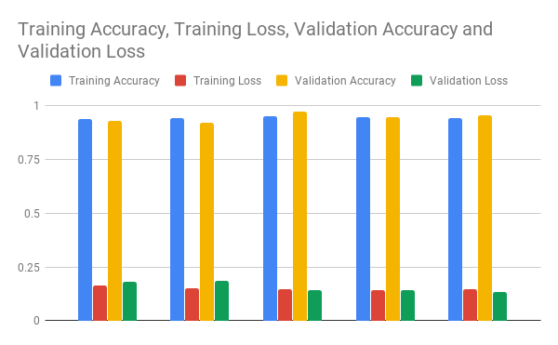

Slide 34
Eye-classifier Recognition Models:
Model No | No. of Epochs | Layers | Training Accuracy | Training Loss | Validation Accuracy | Validation Loss
1 | 22 | Conv2D-4 Dense- 2 | 0.9384 | 0.1642 | 0.9317 | 0.1825
2 | 47 | Conv2D-4 Dense - 2 | 0.9421 | 0.1521 | 0.9202 | 0.1873
3 | 17 | Conv2D-4 Dense - 2 | 0.9517 | 0.1477 | 0.9746 | 0.1420

Slide 35
Eye-classifier Recognition Models:
Model No | No. of Epochs | Layers | Training Accuracy | Training Loss | Validation Accuracy | Validation Loss
4 | 63 | Conv2D-4 Dense -2 | 0.9454 | 0.1431 | 0.9462 | 0.1437
5 | 58 | Conv2D-4 Dense- 2 | 0.9417 | 0.1478 | 0.9561 | 0.1354

Slide 37
05
Conclusion

Slide 38
Conclusion
we can say that currently available technologies use EAR technology or coordinate mapping with accuracy till 90%.
Our model uses CNN and transfer learning for blink detection which helps to increase the model accuracy to 96% with less validation and training loss.
We have compared this model with the currently available pretrained models and can arguably say that the model developed by aforementioned process is better and if more data is provided.

Slide 39

06
Reference

Slide 40
Reference
https://towardsdatascience.com/real-time-face-liveness-detection-with-python-keras-and-openc-c35dc70dafd3
https://medium.com/datadriveninvestor/real-time-facial-expression-recognition-f860dacfeb6a
https://blog.keras.io/building-powerful-image-classification-models-using-very-little-data.html
https://www.pyimagesearch.com/2017/05/08/drowsiness-detection-opencv/

