Slide 1

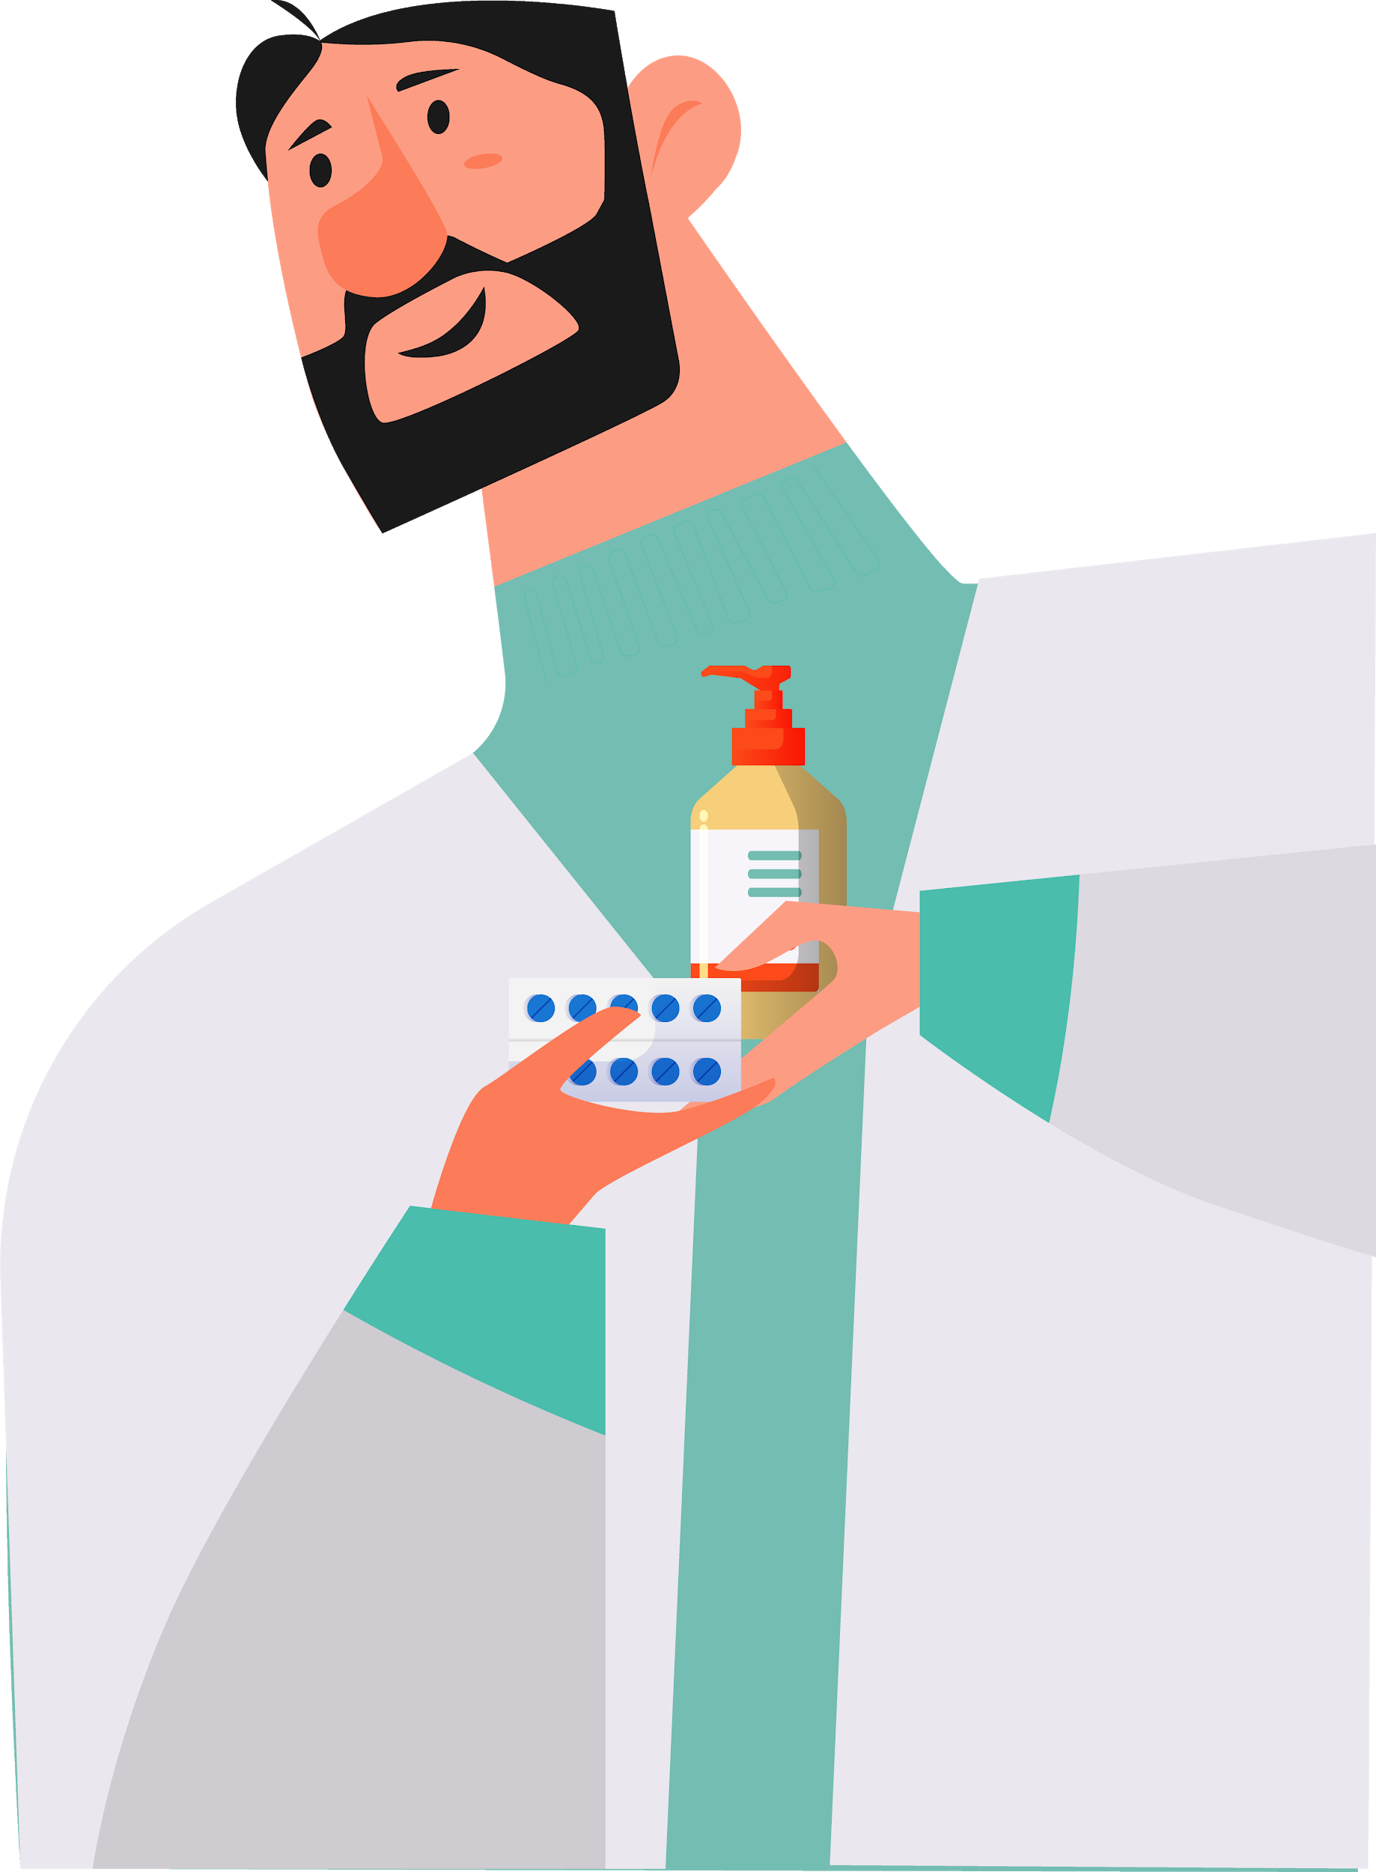
BookMed
Team 1
Shweta Chaudhary
Arun Samudrala
Sahithi Cherukuri
Rishabh Shrivastava
Mansi Agarwal

Slide 2
Mid Term Summary
We created an interactive application called BookMed for doctors and patients
In the application a user can search for a doctor online and book an appointment
Doctors can list their practices and edit/cancel appointments based on their availability
We created user personas to understand target audience and information architecture to understand the flow of the website
The user-interface of BookMed is simple and easy to navigate

Slide 3

Skeleton Plane
Interface Design
Navigation Design
Information Design
Product as functionality
Defined through buttons, fields and interactive elements
Product as information
Interface design tailored to presenting information spaces
Product as information & functionality
Presentation of information for effective communication

Slide 4
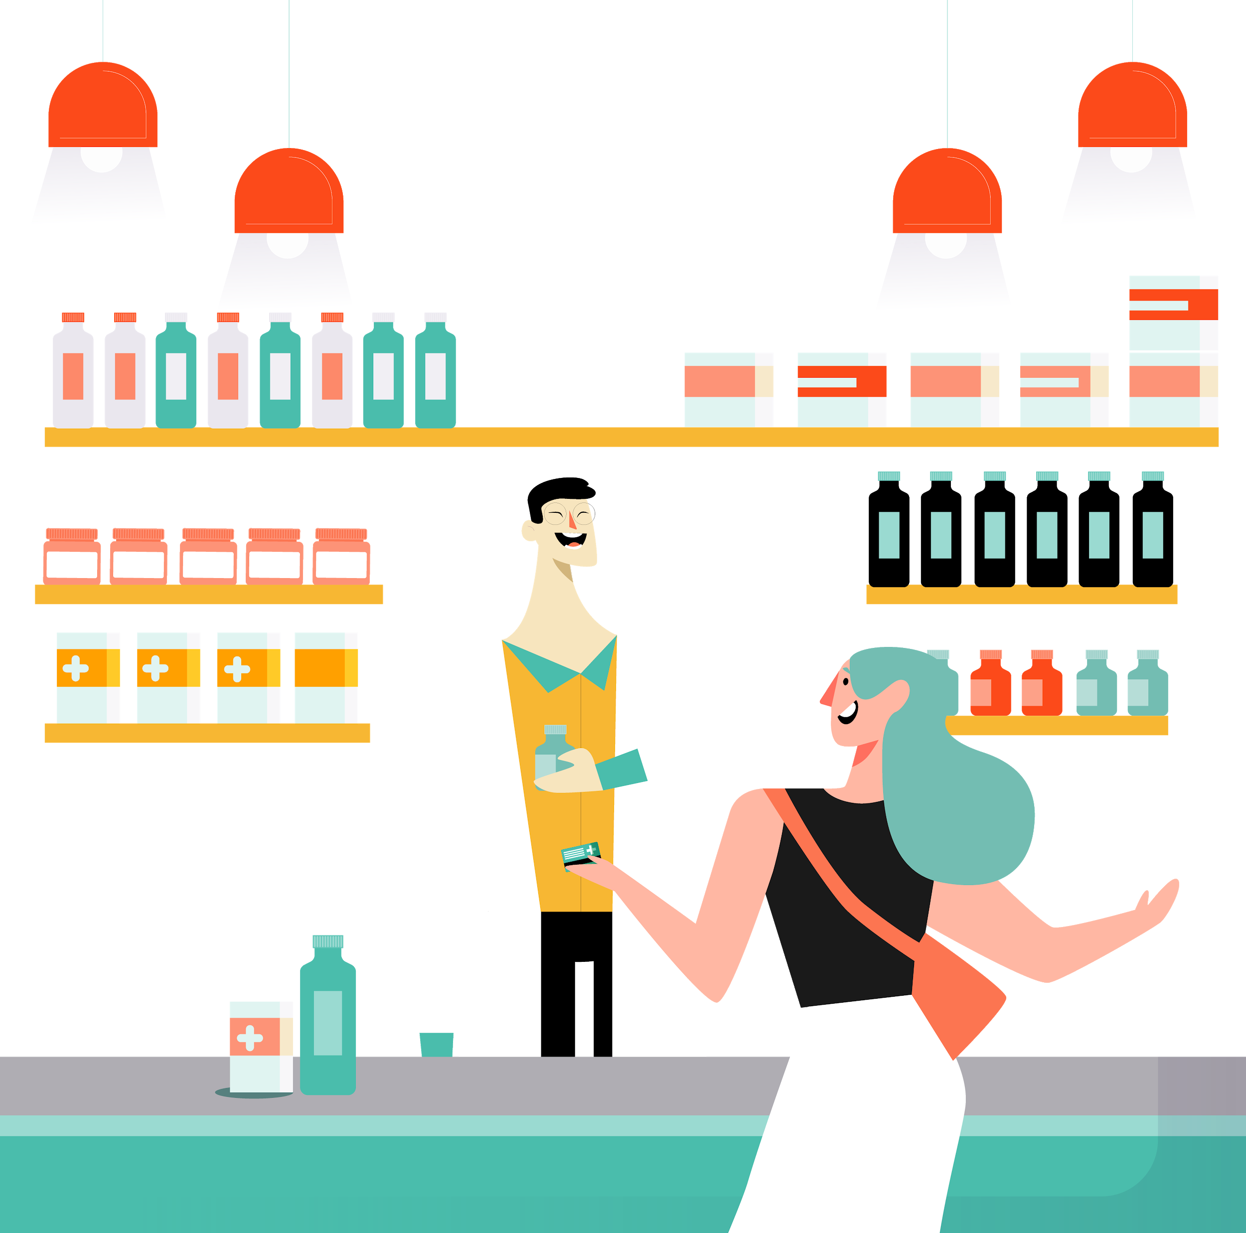

Interface Design
The interface of the website is designed in a way that makes it easy for the user to accomplish his tasks
Radio buttons, drop down menus, search bars and action buttons were implemented to accomplish this.

Slide 5

Navigation Design
The user will be able to navigate to any web page he wants
All the webpages are well defined and informative so the user understands what tasks he can achieve in those webpages.
Contextual navigation is implemented by linking actual maps for addresses
Courtesy navigation is implemented by providing FAQs about the website

Slide 6
Information design
The information is presented in a way that allows the user focuses on the most important areas by using different font sizes and colors
Error labels are provided to point out the mistakes while filling forms
Designed multiple wireframes to depict the aesthetics, structure and the presentation of information on our websites

Slide 7
Surface Plane
Surface plane concerns itself with sensory design
For websites only sense of hearing and sense of vision are applicable
For sense of hearing tones could be implemented for user actions

Slide 8
Sense of Vision
This the area of the most importance and sophistication for UX designers
A consistent template is followed throughout the website
Made the interactive areas standout by using styles that attract attention
Our primary and secondary colors are contrasting in nature and so we have used them for interactive elements such as buttons to catch the user’s eye.
We have enforced internal consistency by maintain the same aesthetic patterns for similar elements used all over the website
The colors of our logo are used as primary and secondary colors throughout the website to increase the familiarity of our product with users

Slide 9
The Elements Applied
Conventional design for ease of use
Colors used were consistent throughout
Designed a clean and interactive UI to provide the best user experience
Constantly reiterated the design based on user’s feedback

Slide 10
Google Material Design
Definition
Material
Use
It’s a visual and interactive concept from google to decrease cognitive overload
A material is an entity out of which the UI elements are made of
Created some standards if followed provides a consistent design and great UX

Slide 11
Applying for BookMed
Bold colors have been used for areas that needs user’s attention
The primary and secondary colors are contrasting
Used shadows to provide a sense of depth
Colored text was used to represent important information
Icons and images were used for better illustrations
Graphical motions were implemented for popups
A consistent font and template was maintained throughout

Slide 12
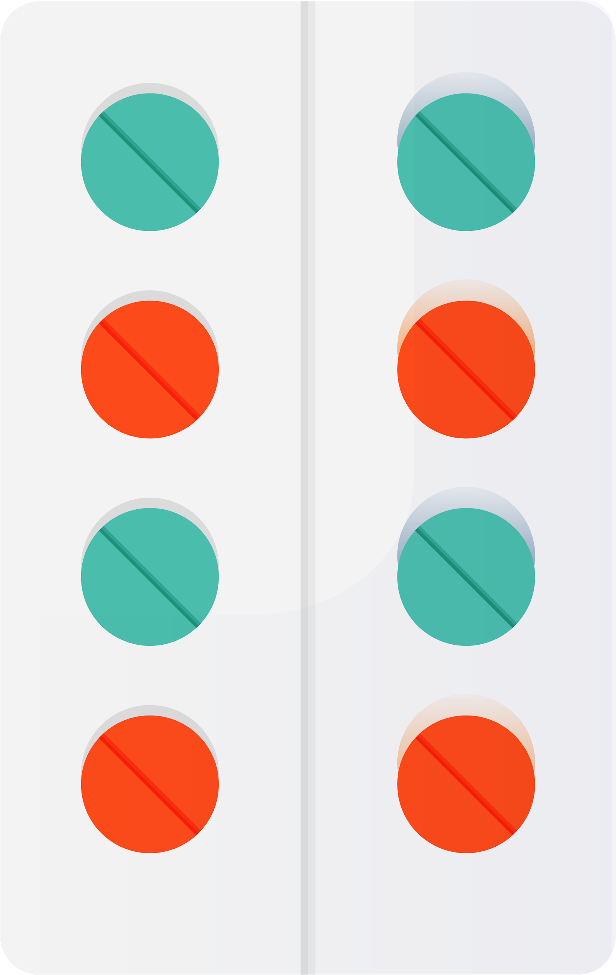
UX PRINCIPLES
MEET USER NEEDS
LESS IS MORE
SIMPLE LANGUAGE
CONFIRM BEFORE COMMIT
USABILITY FIRST

Slide 13
IBM DESIGN THINKING
UNDERSTAND
EXPLORE
PROTOTYPE
No shows
Reason patients miss medical appointments
How to mitigate this?
Doctor’s dashboard with reminder feature
TEST
Out of scope

Slide 14
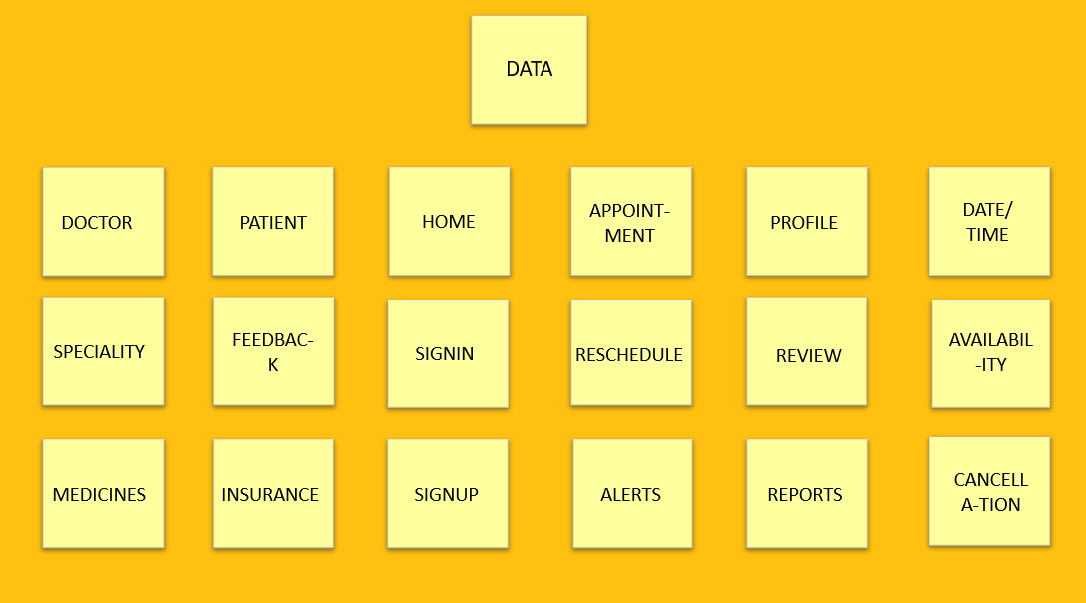
UX Research Methods
Card Sorting
We organized data into categories and subcategories with card sorting
Card sorting was useful for building and evaluating the information architecture of BookMed
Image to the right contains the data we sorted

Slide 15

User Groups/Focus groups
We held interviews with our target audience to find out their preferred features of a website
Conducted discussions and took written and verbal feedback
User groups helped improving certain features pertaining to our website services

Slide 16
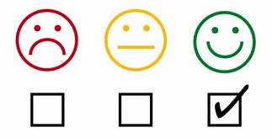

Customer Feedback
Customers will give their feedback for the website after their appointment
Based on customers feedback we can improve the features and user interface of the website

Slide 17

Concept Testing
We did concept testing by asking people there thoughts on our concepts and ideas
We conducted interviews and surveys to understand peoples insights
It is a good way to prevent launching an unsuccessful product
Percentage of positive response | Concepts tested
70% | Booking doctor appointments online
60% | Buying medicines online
85% | Get to know more about the doctors they are going to visit for consultation
75% | Buy insurance on a website
55% | Comfortable sharing medical history online

Slide 18
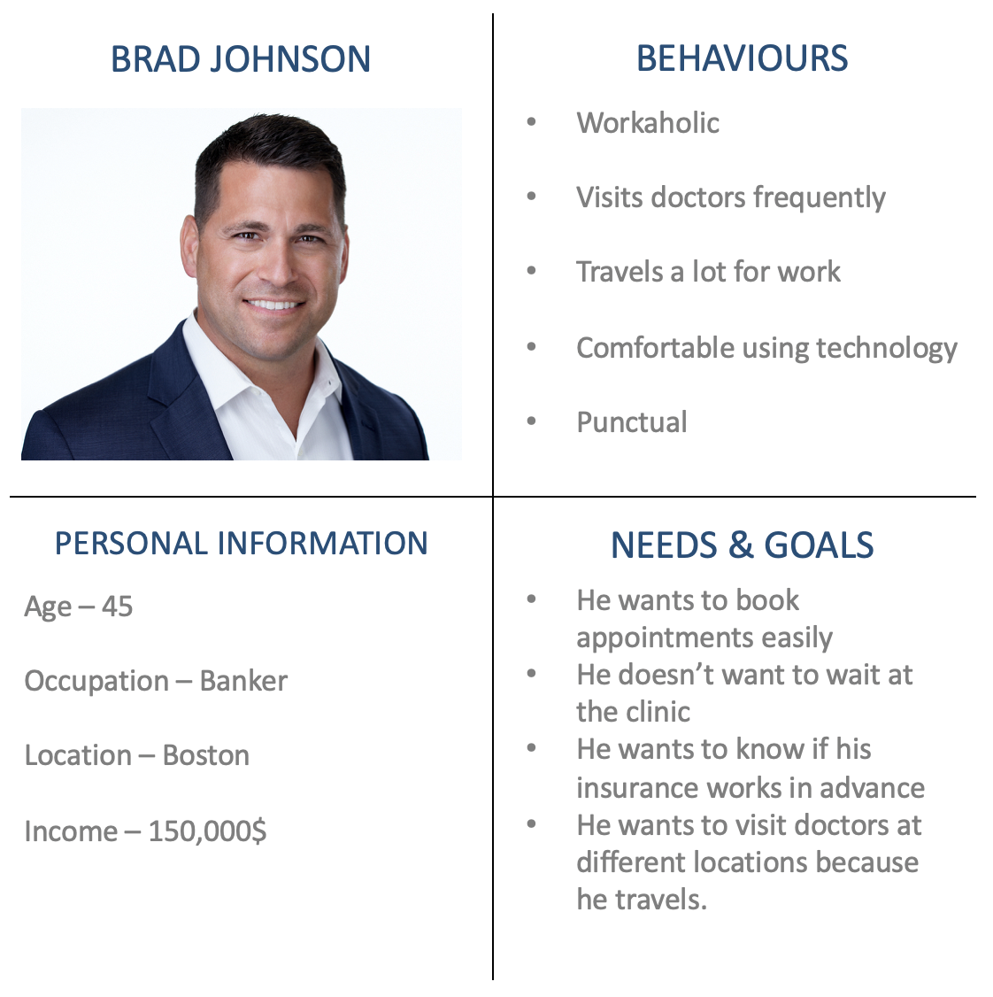
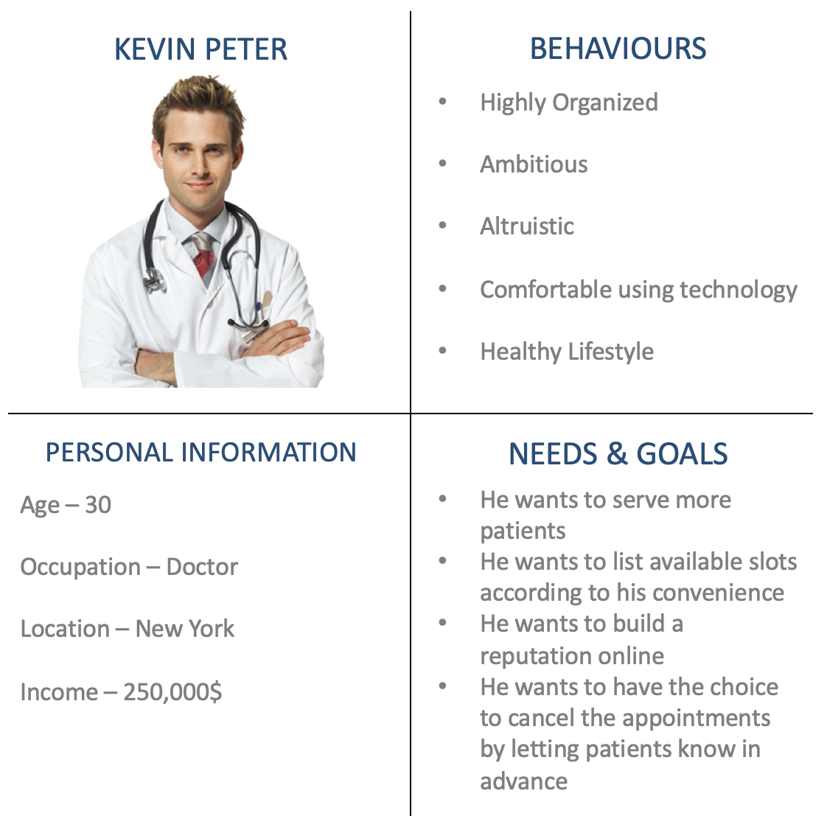
User Personas
User Personas helped in understanding the target audience
We created fictional characters with the data we have, and their character traits helped in implementing different features in BookMed

Slide 19
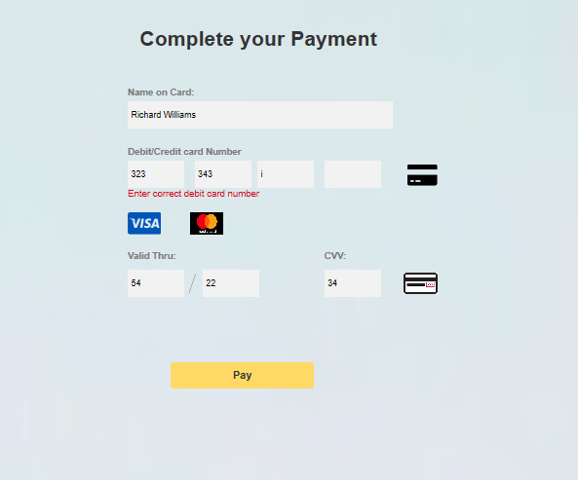
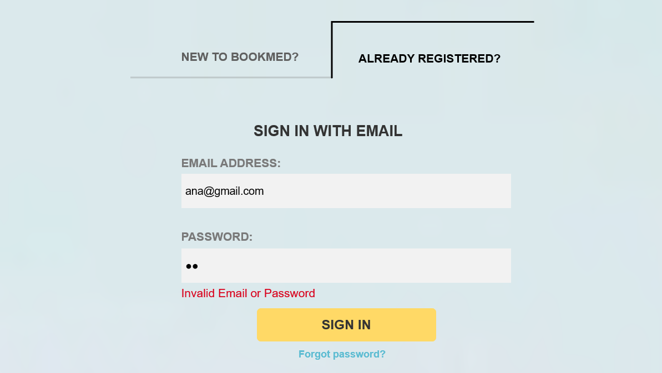
Testing

Slide 20
