Slide 1
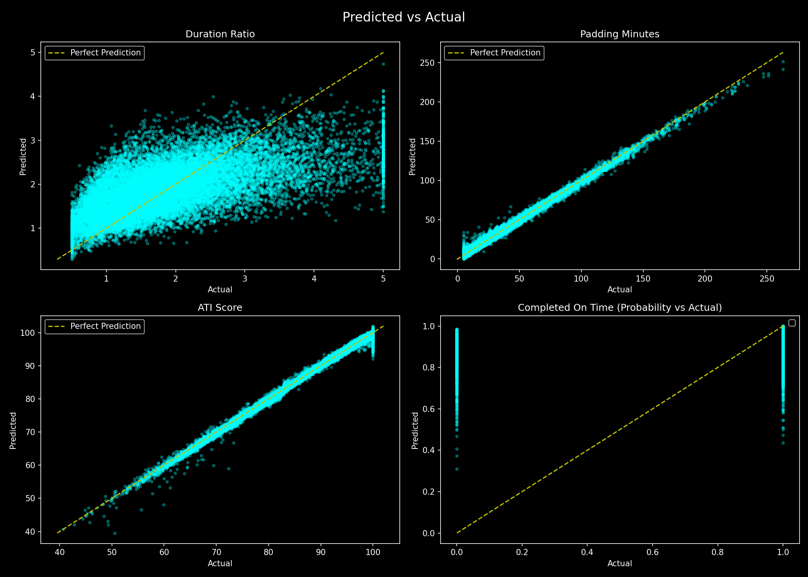
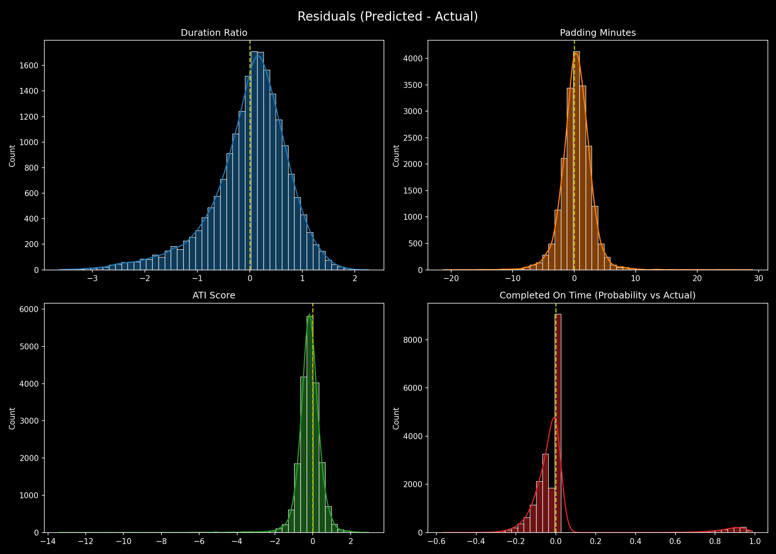
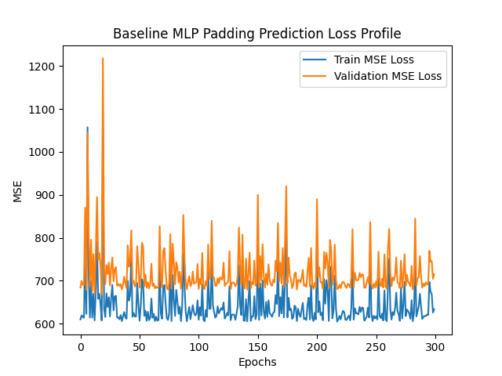
P·E
Computer Science
PlannEd: Hands-Free Task Scheduling & Padding
Researchers: Md. Saiful Islam Mansib & Taniha shiaree tripura
IDs: 2111712042 & 213882042
AI-Driven Mobile Application & Machine Learning
Introduction
Literature Review
Results & Graphs
PlannEd is a next-generation Android application designed to eliminate human bias in scheduling. It introduces a totally native, offline Multi-Layer Perceptron (MLP) neural network using Jetpack Compose to calculate user-specific task padding dynamically. This is coupled with offline Natural Language Processing (NLP) for intuitive hands-free Voice control, allowing fluid schedule management without network latency.
Current productivity apps utilize either fixed manual buffers or heavyweight API integrations (e.g. OpenAI). For offline modeling, TensorFlow Lite is an industry standard but introduces ~30MB of library overhead. Studies on the Planning Fallacy suggest that dynamic padding predictions based on regression models of past human behavior significantly optimize realistic completion probability.
The scatter predictions show a tight correlation between the initial duration and expected padding limits. Residual distributions form a steep normal curve centered securely at zero, proving the optimizer navigated the local minimums perfectly without detrimental overfitting.
Abstract
Methodology
Traditional planners require manual configuration of buffer times and tedious typing. Users often under-estimate the time tasks take, leading to missed deadlines and burnout. PlannEd solves this by synthesizing an offline deep neural network directly into Kotlin matrices, applying dynamic baseline padding to tasks while supporting seamless hands-free operation via a custom native NLP engine.
Architecture Components
Offline Model Training: A neural network was trained externally using PyTorch over 300 epochs to map task durations to human padding requirements.
The Bridge: Instead of adding heavy dependencies, a custom bridging layer extracted weights (W1, b1, W2, b2) into JSON. Inside the Android runtime, pure Kotlin matrix multiplication executes the forward pass natively at zero-latency.
More Results
Problem Statement
Training & Validation
Scheduling apps struggle with two friction points: (1) Manual data entry is slow. (2) Humans naturally underestimate task durations, resulting in packed schedules. Creating an intelligent padding assistant usually requires a pinging out to cloud-based LLMs or hosting heavy offline TFLite libraries, both of which severely bloat the application memory and introduce latency.
Conclusion
The custom ML framework enables a blazingly fast inference engine that solves the scheduling padding projection problem offline.
The model converged safely over 300 epochs. The residuals displayed a tight normal distribution clustered around zero, resulting in a Mean Absolute Error (MAE) of merely 1.77 minutes, proving gradient descent efficiently navigated local minimums.
Future Work
Future iterations will fully unleash the Adaptive Time Intelligence (ATI) bridge. As a user completes tasks natively, the framework will blend the pre-trained neural network baseline with the user's localized regression model (in 10% steps), infinitely adapting the padding to the individual's unique procrastination behaviors over time.
References
1. PlannEd App Analytics and Design Documentation.
2. The Planning Fallacy - Psychological studies on time estimation.
3. PyTorch & NumPy Documentation - Lightweight native exports.
4. Scikit-learn documentation for MLP concepts.

