Slide 1
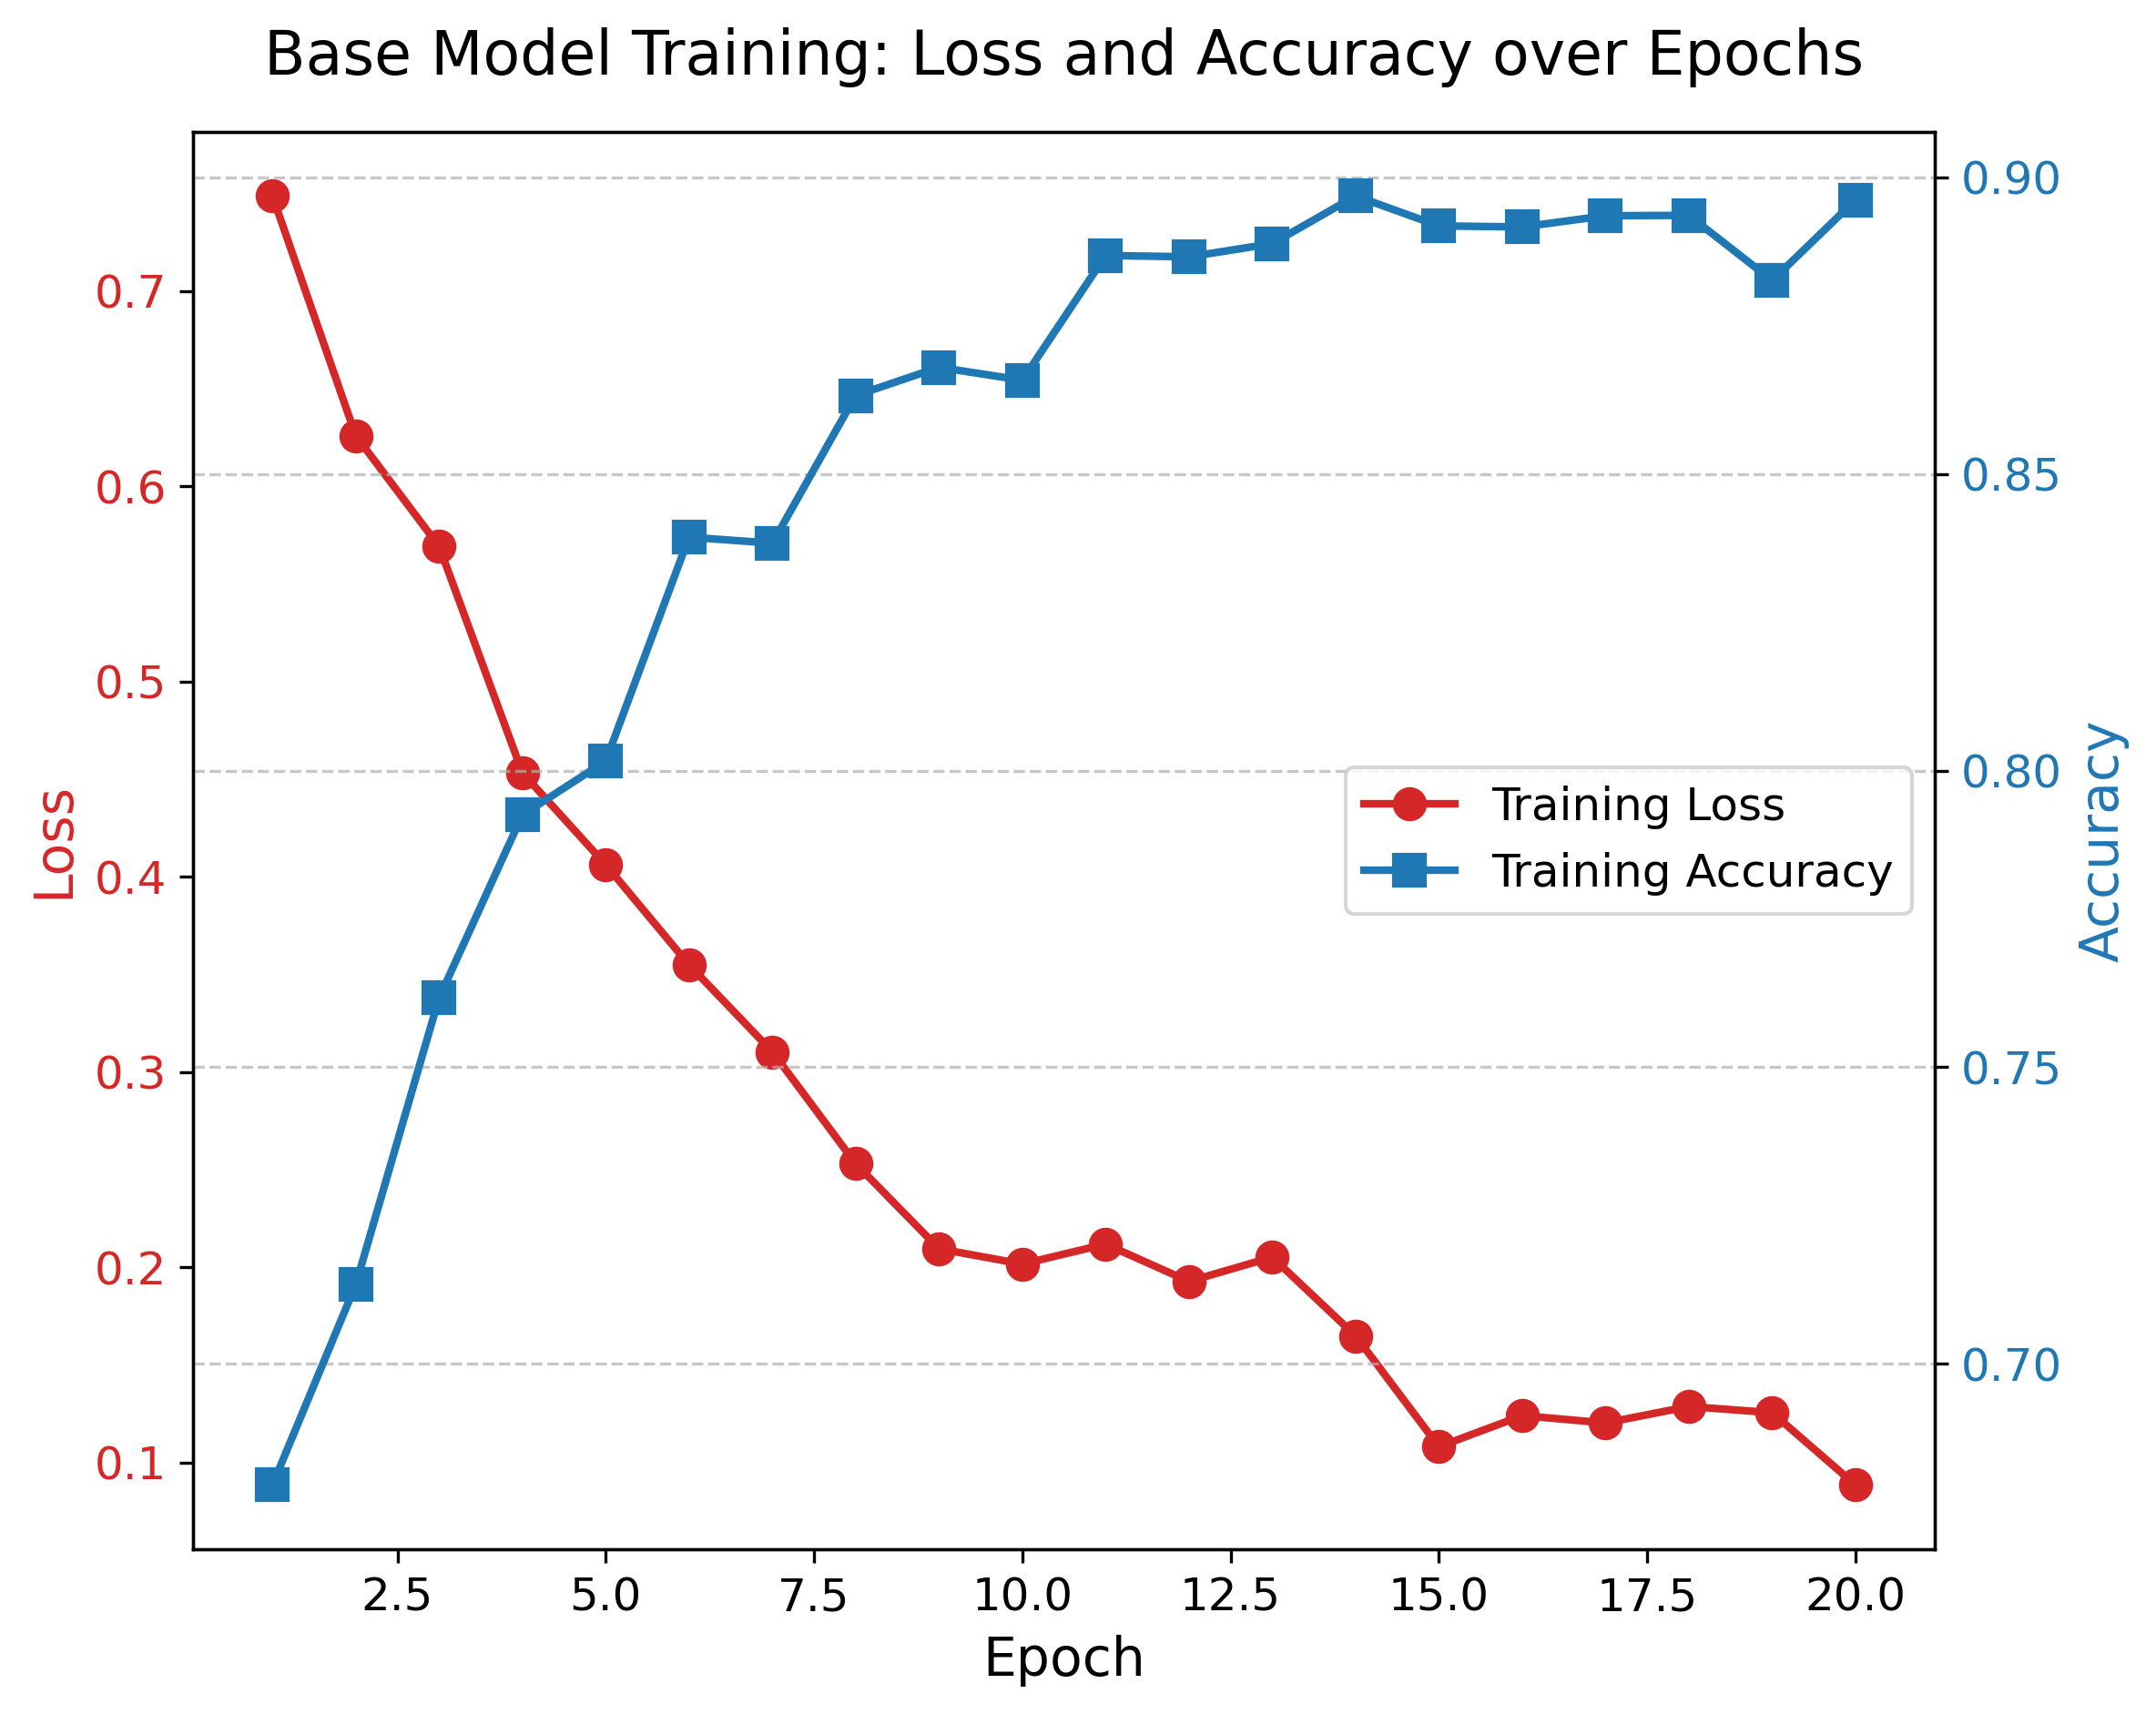
PlannEd: AI-Driven Task Scheduling & Management
App Overview & Features
• Dynamic Task Padding: Automatically adjusts task durations via ML models to prevent procrastination.
• Voice Assistant Integration: Full CRUD capabilities with NLP parsing for hands-free task management.
• Adaptive Task Intelligence (ATI): Linear regression model calculating real-time productivity scores.
AI Model Architecture
• Multi-output Neural Network Prediction: Calculates optimal time buffer, completion odds, and duration multipliers.
• Hybrid Learning Approach: Base neural network sets defaults; user-specific regression refines behavioral profiles over time.
Figure 1: Neural Network Base Model Training Loss & Accuracy. Demonstrating steady convergence across 20 epochs.

