Slide 1

Innovation in social finance
YWCC 307 – 119
Team – Unnamed
Team Members –
Mansi Dinakar, Harsh Patel
Notes:
Hi my name is Harsh Patel - ( I introduce myself) –
Our team is called Unnamed and today we are going to talk about social finance

Slide 2


Our Prompt:
The intersection of social and finance—as well as shifting attitudes around what we share about money online—have given way to an ambitious new wave of financial products. Your team is preparing an analysis for a client about a potential new product in social finance area. Research the current state of art products on the market and make a case for a new app (product) for an under-served market. Your analysis should include strategy, innovation as well and disruption in the target market.
Notes:
Our prompt is to present a potential new product in the social finance sector to cater to an under served market

Slide 3
What is Social Finance?
Innovative finance that is an intersection of finance and social impact
Innovative solutions for financial inclusion and community development
Encourages a collaborative economy
It includes themes like:
- Impact Investing
- Crowdfunding
- Peer-to-peer lending
- Financial education and awareness
Notes:
So first let us understand what is social finance
- Social finance as the name says for itself, it is an intersection of finance and social impact . It provides innovative methods to conduct financial actions while creating a positive attitude in the community.
- Because of its nature of creating an impact to a community or environment it encourages a collaborative economy rather than functioning just as a traditional financial institute
- Some themes of social finance are:
Impact investing : it's about investing money with the intention of making a difference in the world, alongside seeking a financial return
Crowdfunding: it's getting many people to chip in small amounts to support an idea, business, or cause.
Peer-to-peer lending: it's a platform that connects people who want to borrow money with those who are willing to lend money.
Financial education and awareness: Financial education and awareness involves providing information and resources to help individuals understand and manage their finances better.

Slide 4
Market Overview
Products available in the market :
- Vanguard ESG ETFs (Impact Investing)
- Prosper ( Peer-to-Peer Lending)
- Venmo ( Digital wallet )
- Coinbase ( Cryptocurrency)
- Compliance.ai ( Regulatory Technology Finance)
- Chime ( Financial Inclusion)
- Even ( Employee Wellness)
- NerdWallet ( Financial Education)
- Localstake ( Crowdfunding)
Notes:
Talking about market overview, I’d like to present to you some top companies operating currently in the social finance area under different themes that we just discussed
- The first is Vanguard ESG ETFs and this falls under impact investing, ( basically read everything on the screen)
- Now that we know there are multiple apps available in the social finance field, we want to propose to you an app that focuses on a specific market. Mansi will explain more about it

Slide 5
Identifying Opportunities
One specific market – New Immigrants
The US is home to the world’s largest number of immigrants – 46 million as of 2022
The credit system plays a crucial role in finance
Focus on financial and credit-building education
Notes:
Yes, I’ll take from here. So identifying opportunities
As Harsh has mentioned, we are going to focus on one particular segment of the market that is new immigrants
We chose this because the united states is a home to world’s largest number of immigrants, approximately 46 million as of 2022 out of which 14% were foreign born and everyday new people come to the us with a hope to achieve their American dream and we this focusing on this market can be beneficial both for the company and the users.
As you might know the credit system has a major role to play in deciding what kind of lifestyle you can lead and new immigrants might nit have the same system back home because of which they might make mistakes and sabotage themselves.
We want to create a plat form to educate them about the financial structure in the US, good financial habits and a guide to build and maintain good credit

Slide 6
Competitive Landscape
Current apps in the market serving the new immigrant population
- Finhabits : Investment Planning
- MYRA Wealth : Assist with investment planning and tax
- Nova Credit : Provides credit cards to new immigrants
- Remitly : Overseas money transfer with a fee
- Propel : Helps families in financial hardship
Notes:
There are apps in the market already that cater to immigrants :
Some of the most popular ones are
- Finhabits which is an investment planning app that charges a subscription fee to access its platform
- MYRA wealth is a platform that assists in investment planning, net worth calculation and tax but there is no access without paying $250 upfront
- Nova Credit does provide credit card by making use of their international financial history but it is B2B and does not sell directly to consumers
- Remitly allows ffor sending money back to their home country and they charge a fee for every transaction
- Propel assists families with financial hardships by providing discount cupons, assisting in job search and Manage food stamp benefits

Slide 7
Our Approach - FinEase
Educating through mini-games and user stories
Posting short videos daily to provide tips on good financial habits
Virtual legal assistant to clarify any questions related to finance and immigrant law
Multilingual
Assistance in opening bank accounts and applying for credit cards
24-hour customer support for app-related queries
Future aspects:
Integrating digital wallets
Foreign money transactions with annual interest on overall transfers
Paid feature:
A personal advisor to assist with queries – ( Easy and secure payment options)
Notes:
Now let’s talk about our approach : The platform is called FinEase and we offer something very new in the area of social finance
- Ofc there is a lot of information about, finance, credit handling and immigrant rules and regulations all over the internet but going through the can be overwhelming and the information can be inconsisten. So we bring all of this together in one platform. We want to educate our users through mini games and user stories which will make the learning process fun and less intimidating. So every mini game like puzzle or crossword they complete they will unlock a new level and move forward.
- And we will post one or two short videos like reels on the app that provides useful tips for maintain good financial habbits – again I said short because as we know our attention spans are very low
- We will have a virtual assistant wihich will answer any questions they might have regarding finance and immigrant rules and regulations
- The app will be mutilingual to cater to people coming here from all over the world who’s first language might not be English
- As you might know new immigrants do not social security number, so we will filter out the banks that offer accounts to new immigrants and tie up with them, so that our user can set up their account or apply for a credit card using our guide
- and then we will have 24 hours customer support to assist with any app related queries
For future aspects we want to propose integrating a digital wallet into the app and also allowing for foreign money transfer with an annual interest charged for transcations all over the year
We also propose a paid feature where our users can take the benefit of a personal advisor to help and guide them with their finances and Immigrant rules and regualtions, if they have some very specific case that has to be addressed

Slide 8
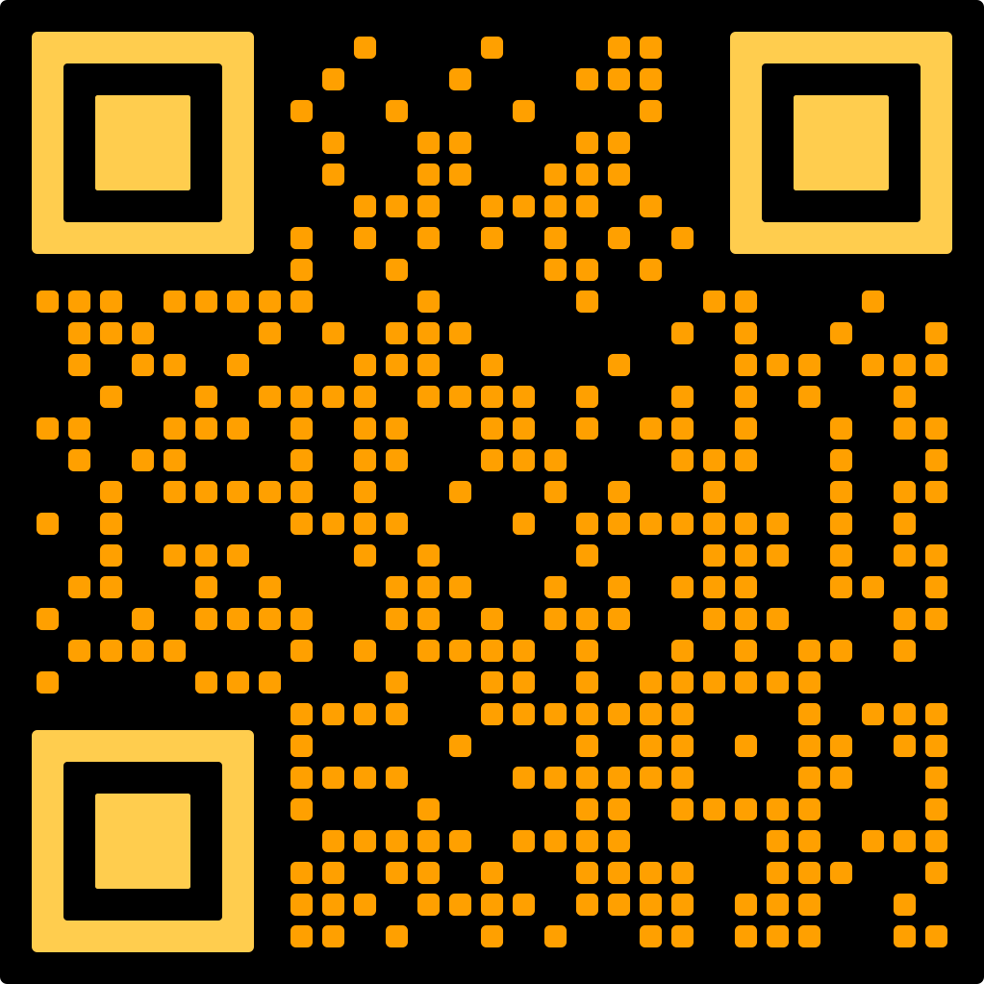
Conclusion - Feedback
Notes:
This brings us to the end of the presentation
I Would like to conclude by saying that we propose an app called FinEase that caters to the new immigrant market to help and educate them about the US’s financial and credit system.
This is a qr code that you can scan to leave a feedback on our app itself, which ask simple questions like what features do you think we should include and what features do you think is unnecessary. This will help us design the app better.
Thank you for your time.

Slide 9
Bibliography
https://www.nyc.gov/assets/dca/downloads/pdf/partners/Research-ImmigrantFinancialStudy-FullReport.pdf
https://www.boundless.com/blog/immigrant-population-hits-record-high/#:~:text=Sep%2018%2C%202023,from%20the%20U.S.%20Census%20Bureau

