Slide 1
INF 551 “DECIQUEST” Theme: A Cloud-based Metadata Extraction & Search Webpage.
Project Proposal

Slide 2
Project Description
Deciquest is a web page that allows user to search over a collection of audio files using the metadata associated with it.
We plan to obtain the audio files from online audio repositories such as these listed below:
https://archive.org/
https://www.americanrhetoric.com/top100speechesall.html

Slide 3
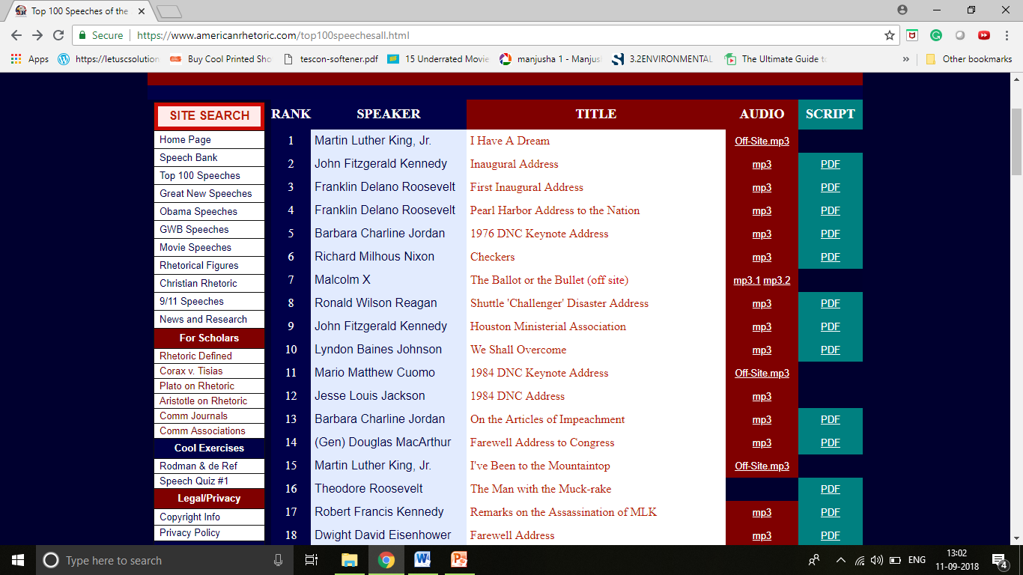
Data Source

Slide 4
Data Storage: Firebase
Details about metadata: name of the artist, original date, file size, duration, genre, copyrights, title, type of the audio file etc.
Extraction and Uploading: python scripts, Apache Tika and Pytaglib libraries.
User interface: Web Browser
Programming languages and libraries: Python, Java, JavaScript, HTML,CSS, Apache Tika library, PyTagLib library etc.

Slide 5
• Group formation:
i. Name: Mansi Ganatra
USC ID: 4669963813
Individual responsibilities include: Programming to extract metadata from source and upload the metadata to Firebase, connecting Firebase to the web browser, design and development of the key word based search etc.
ii. Name: Radhika Rao Annamraju
USC ID- 2800000280
Individual responsibilities include : Data collection from different sources, programming for metadata extraction from the source, design and development of facets, metadata-based search, indexing for the web browser etc.

Slide 6
• Milestones:
Submission of initial proposal: 9th September
Data collection from different sources: 2weeks
Programming to extract metadata: 3 weeks
Programming to upload metadata to the Firebase: 2 weeks
Design and create a webpage around the meta data and data collected: 2 weeks
Connecting web app to firebase: 1week
Test the developed web application: 1 week.
Modification and improvements to the web-page (if needed): 1 week.

