Slide 1
DeciQuest
Cloud-based app for Famous Speeches
Mansi Ganatra(4669963813)
Radhika Rao Annamraju(2800000280)

Slide 2
Features
DeciQuest allows the user to search for famous speeches delivered by historically significant figures.
Key Features:
Faceted Search
Keyword Search
Downloadable MP3 Audio
PDF Transcripts for speeches
[Future] Full-text Search

Slide 3
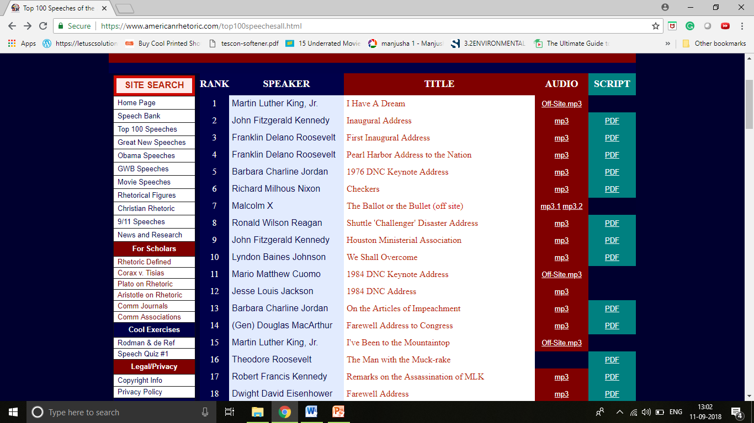
Data

Slide 4
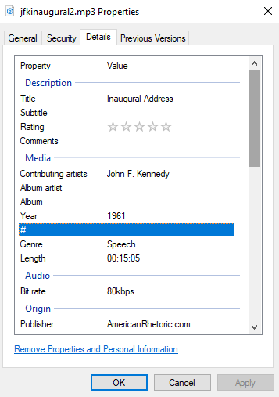
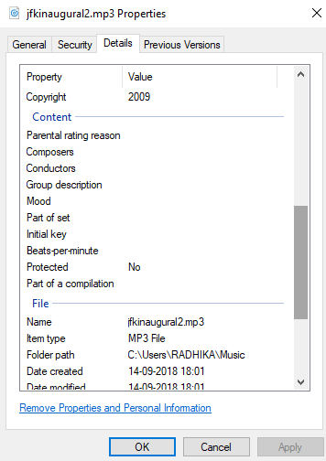
Metadata

Slide 5
Implementation
Metadata Extraction: Pytika( Apache Tika library for python)
User Interface: Javascript, HTML, CSS, Bootstrap, Jquery
Database: Firebase
Datastore: Amazon S3
Codebase: https://github.com/mansiganatra/DeciQuest

Slide 6
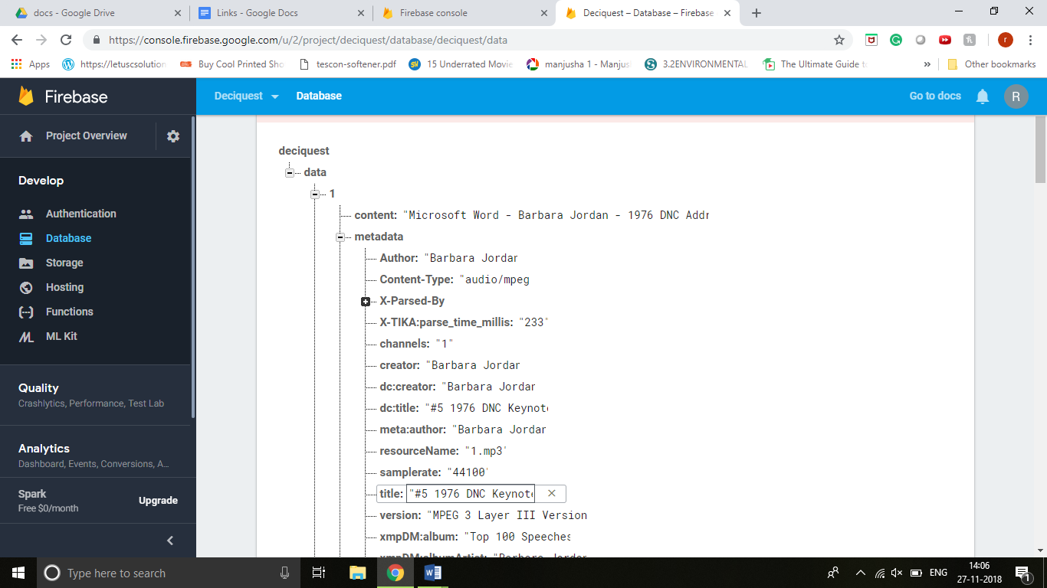
Metadata on Firebase

Slide 7
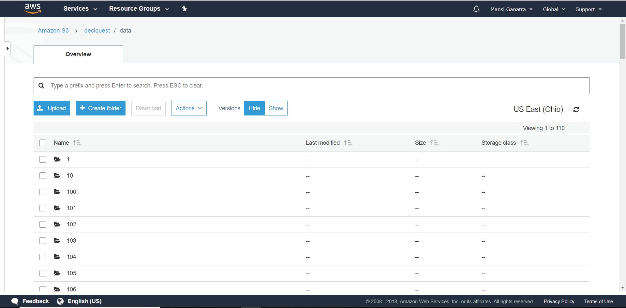
Data on Amazon S3

Slide 8
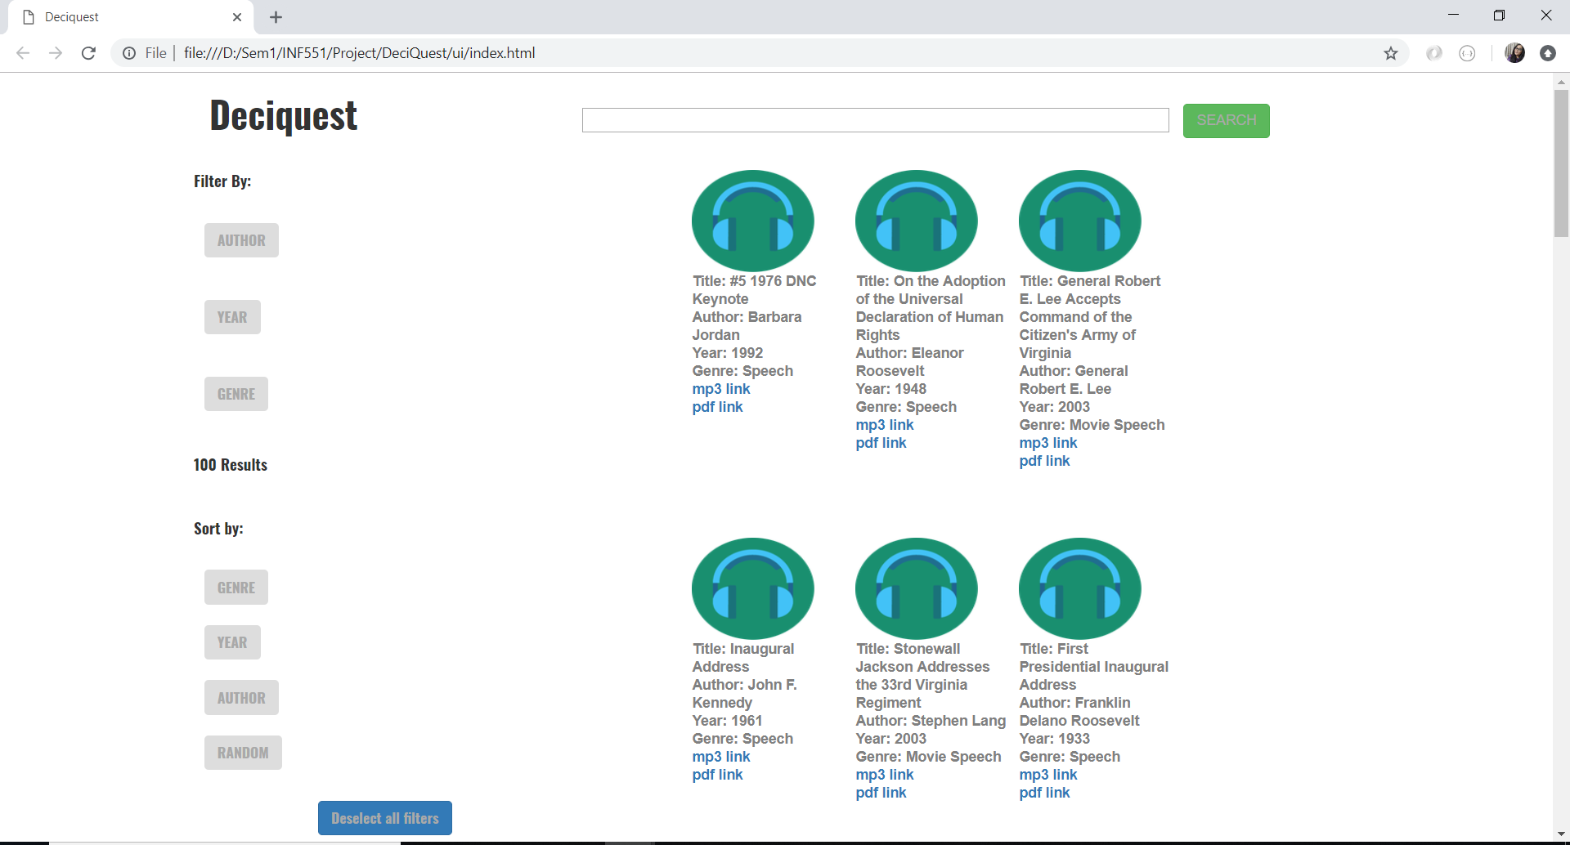
User Interface

Slide 9
Thank You

