Slide 1
Project Poirot
Machine Learning based Predictive Crime Analysis

Slide 2
Team Members
Mansi Ganatra
Naga Ritwik Indugu
Uma Kanumuri
Mentor:
Prof. Ion Muslea
Officer Wyman Thomas (USC DPS)

Slide 3
Data Source
Los Angeles Open Data: Crime Data from 2010 to Present
Size: ~ 1.8 million records
URL: https://data.lacity.org/A-Safe-City/Crime-Data-from-2010-to-Present/y8tr-7khq
Previous Work: https://www.crimemapping.com/map/ca/losangeles

Slide 4
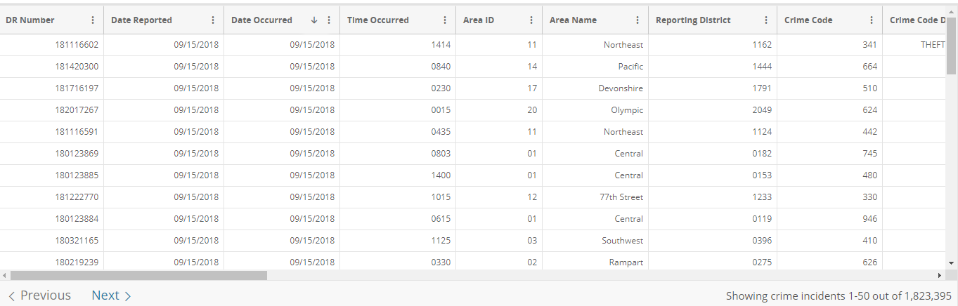
Sample Dataset

Slide 5
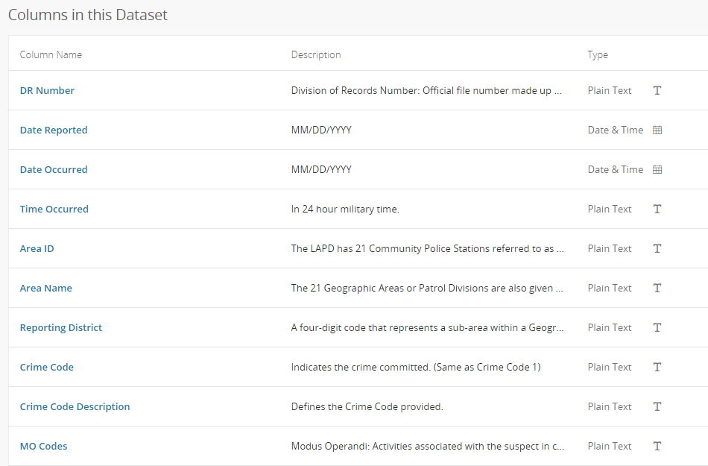
Features

Slide 6
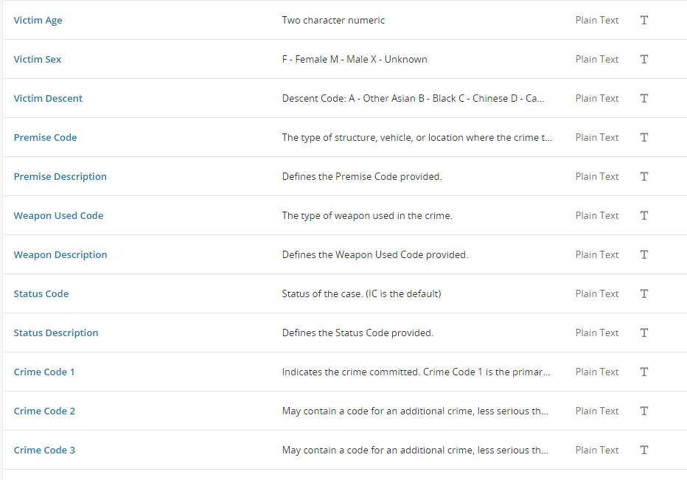
Features

Slide 7
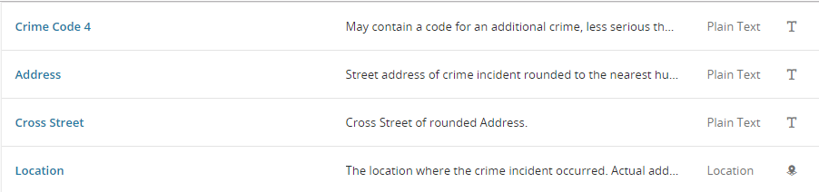
Features

Slide 8
Exploratory Data Analysis

Slide 9
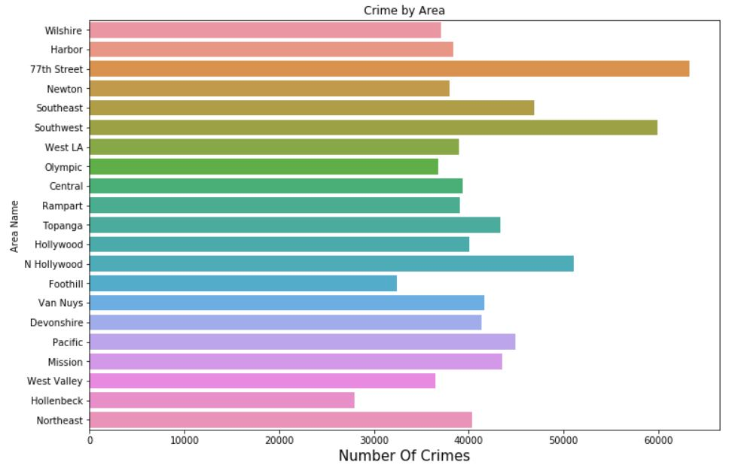
NUMBER OF CRIMES PER AREA

Slide 10
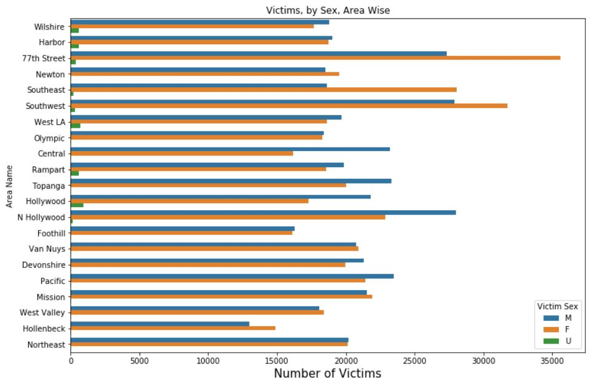
NUMBER OF VICTIMS PER AREA

Slide 11
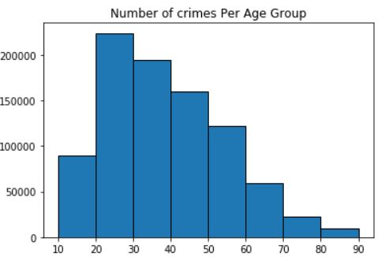
NUMBER OF CRIMES PER AGE GROUP

Slide 12
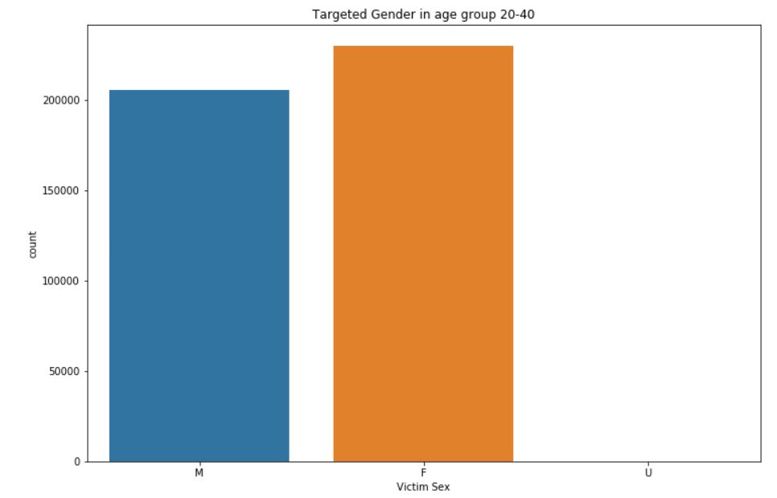
CRIME COUNT BY GENDER

Slide 13
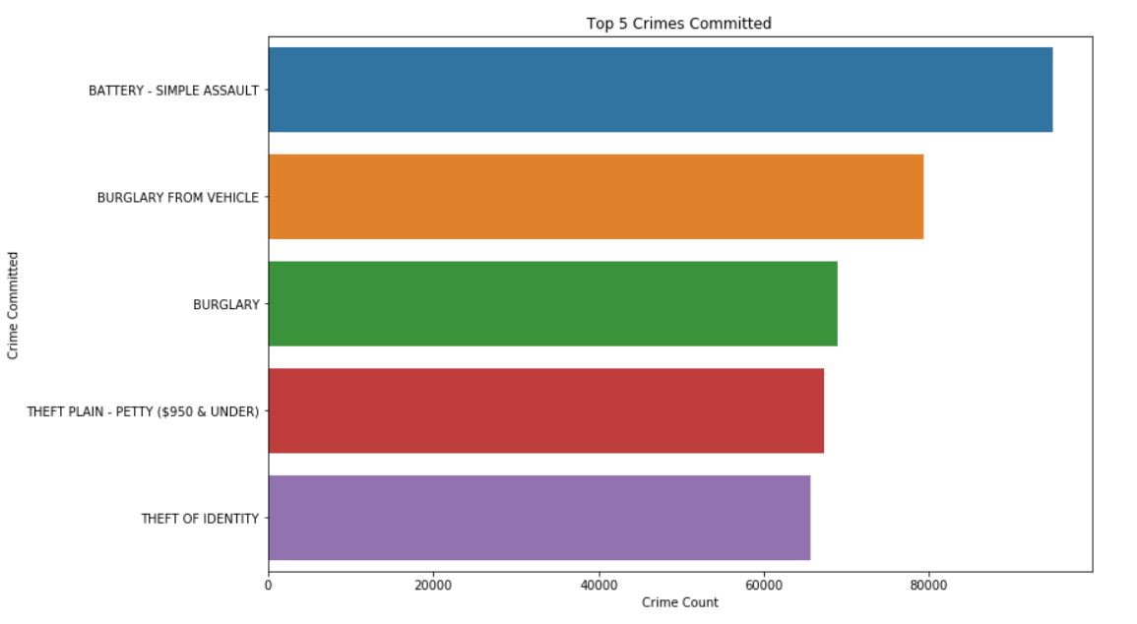
TOP FIVE CRIMES

Slide 14
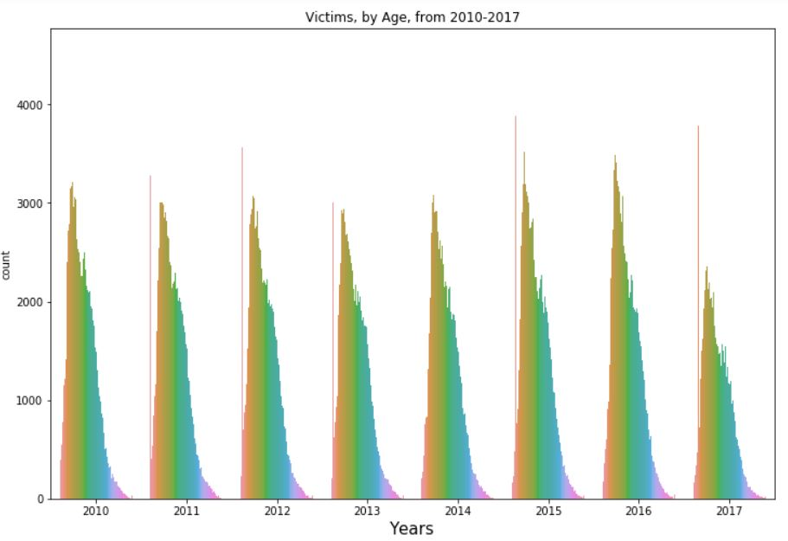
NUMBER OF VICTIMS PER YEAR

Slide 15
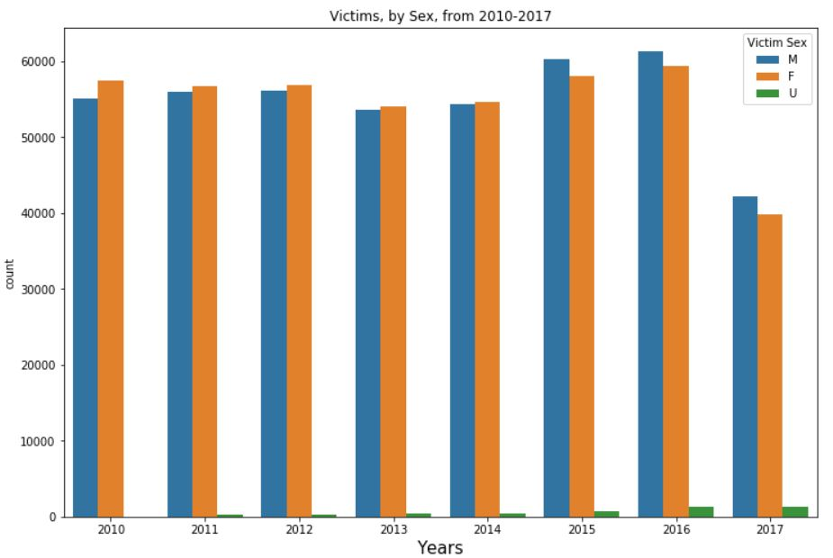
NUMBER OF CRIMES PER GENDER FROM 2010 TO 2017

Slide 16
Current Progress
Questions currently working on: | Questions to be answered:
Prediction of crime code given victim age and victim sex. | Which are the hot spots for various crime categories, crime patterns ?
Prediction of time occurred given date occurred. | Prediction of crime given days of week.

Slide 17
Prediction of crime code given victim age and victim sex
From EDA we can see that there are significant amount of crimes correlated with age and gender. Hence we decided to predict the crime code given victim age and sex.
We used Logistic Regression, SVM, KNN and Decision trees to get this prediction.

Slide 18
Prediction of time occurred given weekday
Prediction of time given a day is very important to detect crimes.
We used Linear Regression for this which did not yield very favorable results.
We have now pre-processed the time data available to us to fit the model – we plan to apply the following algorithms which are more useful for time-series prediction:
Autoregression (AR)
Moving Average (MA)
Autoregressive Moving Average (ARMA)
Autoregressive Integrated Moving Average (ARIMA)
Seasonal Autoregressive Integrated Moving-Average (SARIMA)
Seasonal Autoregressive Integrated Moving-Average with Exogenous Regressors (SARIMAX)
Vector Autoregression (VAR)
Vector Autoregression Moving-Average (VARMA)
Vector Autoregression Moving-Average with Exogenous Regressors (VARMAX)
Simple Exponential Smoothing (SES)
Holt Winter’s Exponential Smoothing (HWES)
Multivariate LSTM Forecast Model
Prophet
(source: https://machinelearningmastery.com/time-series-forecasting-methods-in-python-cheat-sheet/ )

Slide 19
Prediction of Area Code using date occurred, time occurred and crime type
Prediction of area code given date occurred and time occurred of crime.
We used Logistic Regression, SVM, KNN algorithms for this prediction.
Pre-processed date occurred to its ordinal value (datatype=long)

Slide 20
Technologies
Python libraries and frameworks: pandas, numpy, scikit-learn, pytorch, theano, etc.
Visualization libraries and frameworks: matplotlib, d3.js, etc.

Slide 21
Accuracies
Question | Logistic/Linear Regression | Decision Trees | SVM | KNN
Prediction of crime code given victim age and victim sex | With grouping: ~33.12% Without grouping: ~11.55% | With grouping: ~19.96% Without grouping: ~13.32% | H/W unable to handle | With grouping: ~21.61% Without grouping: ~16%
Prediction of time occurred given weekday | rmse: 646.66 | - | - | -
Prediction of area code given date occurred, time occurred and crime type | ~7% | ~6.2% | H/W unable to handle | ~6.7%

Slide 22
Responsibilities
Task | Team Member(s)
Data Gathering & Cleaning | All
Predict the time of day, the days of a week, month, year in which different kind of crimes are most likely to happen. What is the probability of an offender repeating the crime? | Uma
Which are the hot spots for various crime categories, crime patterns? | Mansi
Crime’s correlation with age Severity of crime by area - which crime is highest in each area? | Ritwik
Documentation(Proposals, Reports, Presentations) | All

Slide 23
Milestones
TIMELINE | ACTIVITY | STATUS
SEP 1st – SEP 7th | Requirement Gathering | Completed
SEP 8th – SEP 11th | Project Proposal | Completed
SEP 12th – SEP 23rd | Analyze the Dataset | Completed
SEP 25th | Project Idea Presentation | Completed
SEP 26th – OCT 15th | Cleaning the data and trying to answer one question each per member | Continued
OCT 16th | Presentation and mid term report | Completed
OCT 17th – NOV 16th | Answer the remaining questions | To be Completed
NOV 20th | Final report submission and presentation | To be Completed
NOV 27th | Present the final results | To be Completed

Slide 24

Questions/ Suggestions

Slide 25
Thank You ☺

