Slide 1
Industrial Management
UNIT-3

Slide 2
What is Production?
Production consists of a sequence of operations that transforms material from a given form to a desired form (products).
The highest efficiency in production is obtained by manufacturing the required quantity of products, of the required quality, at the required time, by the best and cheapest method.

Slide 3
Continued…
To achieve the objective, production management employs production planning and control function

Slide 4
Stages of PPC
Planning: The choice from several alternatives of the best means of utilizing the resources available to achieve the desired objectives.
Operations: Performance in accordance with the details set out in the production plan.
Control: The monitoring of the performance through a feedback by comparing the results achieved with the planned targets so that performance can be improved through proper corrective action.

Slide 5
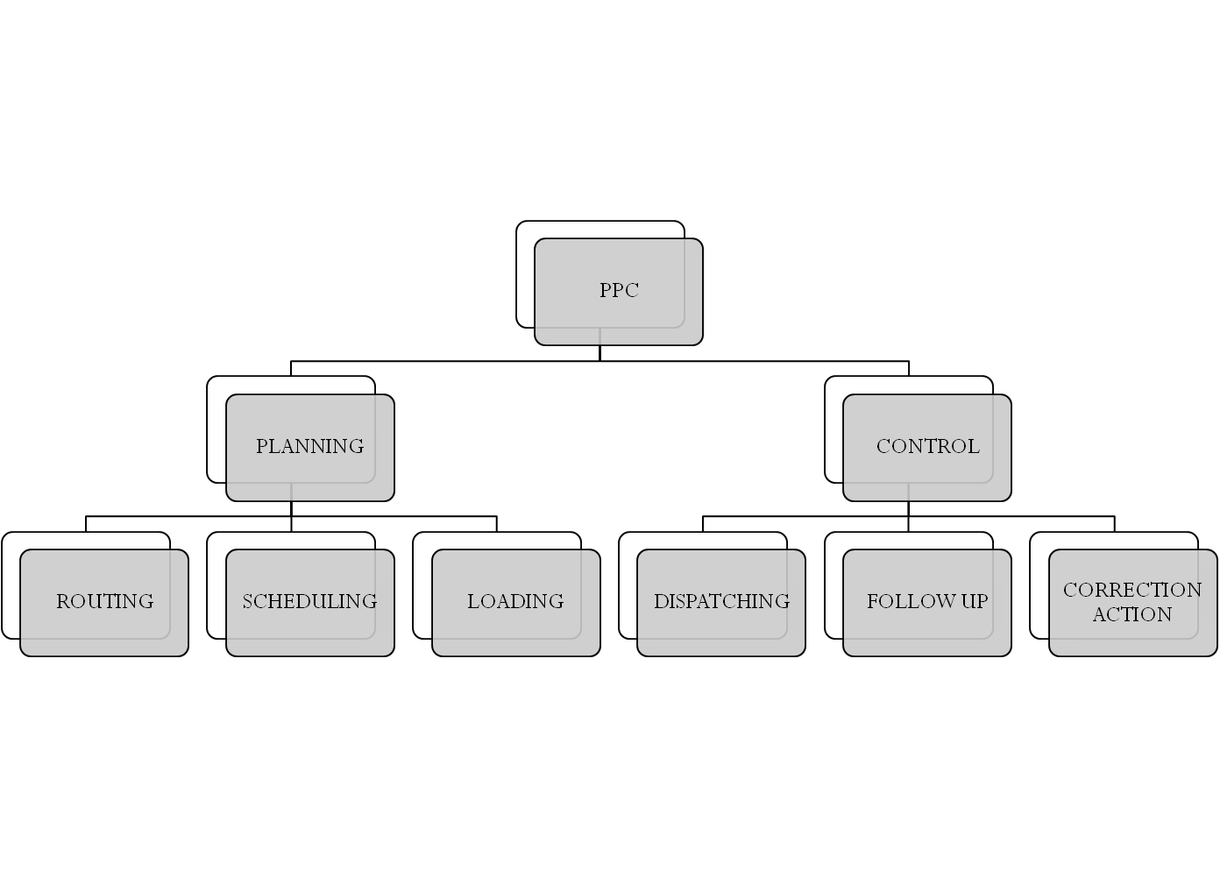

Slide 6
FUNCTIONS OF PPC
3 PHASES
PLANNING
ACTION
FOLLOW UP/ CONTROL

Slide 7
PLANNING PHASE
PRIOR PLANNING
Forecasting
Order writing
Product design
ACTION PLANNING
Process planning & routing
Material control
Tool control
Loading
Scheduling

Slide 8
ACTION PHASE
DISPATCHI NG
CONTROL PHASE
Progress reporting
Data collection
Data interpretation
Control
Follow up
Re-planning

Slide 9
Routing Decisions
Routing: It defines what work has to be done, where it has to be performed, how it will be done.
It is the process of determining the sequence of operations to be performed in the production process which in turn establish the route/path of flow of materials from the raw materials stage to the finished product stage.

Slide 10
Objective of Routing
To select the best and cheapest method to manufacture the product.

Slide 11
Factors affecting Routing Decisions
Availability of Machines and Equipments
Efficiency of Workers
Availability of Physical Facilities
Type of manufacturing process( i.e., fabrication, assembly, chemical process)

Slide 12
Routing Procedure
Analysis of the product to determine the materials and parts required for manufacturing the product.
Determination of the manufacturing operations required and their sequences.
Determination of lot sizes i.e., the quantity of the parts to be manufactured in each lot.
Deciding the operation procedure for each operation.
Determining the allowed time for each operation.
Analysis of estimated cost of manufacturing the product in order to improve the method for cost reduction.

Slide 13
What is Route Sheets?
It is a written specification or document which provides information and working data for conversion of raw material into finished products.
Each step in the production operation is indicated in route sheets.

Slide 14
Data required for preparing Route Sheets
Detail drawing of parts and assemblies.
Bills of materials
Quality specifications
Sequence of operations to be followed at each work centre
Machines to be used
Tools, fixtures required
Speed of machines
Machine set up and operation time standards.

Slide 15
Production Planning Techniques
Production planning is a three-step process. It involves scheduling, estimating and forecasting. To perform this task, the customers' orders, production capacities and foreseeing of future inventories and trends are essential.

Slide 16
Five techniques of production planning
1. Job Method
This technique is used if either one single worker or a group of workers are needed to produce the product. That is, if the work cannot be broken down into parts, this method is used.
The method is often used when customer specifications are important in the production.
Examples of professionals who use the Job Method of production planning are hairdressers, cooks and tailors.
In simple words they are jobs that are small-scale in nature, on which the production is fairly easy and simple and for which the worker possesses the required skill set.
Equipment required for these jobs is also easy to procure and maintain.

Slide 17
2.Batch Method
In this method, the work is broken down into parts.
To produce on a large scale, one batch of workers works one part while another group works on another.
A constraint in this method is that for any part of work to proceed, it is essential that the work in the previous batch is totally completed.
This method requires specialization of labor for every division of the business.
An example of businesses that use the Batch Method would be manufacturers of electronic parts.

Slide 18
3.Flow Method
  This method is an improvisation on the batch method.
  The intent here is to improve on the quality of work and on the flow of material being worked, reduction in labor costs and faster delivery of the end product.
  Work is once again distributed but the process on all parts progresses simultaneously as a flow.
  Once all the parts are manufactured, they are all assembled together in the end.
  An example :Television manufacturing utilizes the Flow Method

Slide 19
4. Process Method
  The production uses a uniform sequence.
  Here the production is always continuous.
  The raw materials are few and received from few sources.
  The end product is made on the latest and most sophisticated machinery.

Slide 20
5. Mass Production Method
  The organization uses some standardized techniques for the production, focusing on quantity once sufficient quality has been achieved, with quality checks routinely scheduled.
  There is usually a product-specific layout and balanced production.

Slide 21
Line-of–Balance (LOB)
Line-of–Balance (LOB) method is a project planning and control method which in projects with repetitive nature has proved to be more efficient than the network techniques like CPM and Petri-nets.
The "Line of Balance" itself is a graphic device that enables a manager to see at a single glance which of many activities comprising a complex operation are "in balance" - i.e., whether those which should have been completed at the time of the review actually are completed and whether any activities scheduled for future completion are lagging behind schedule.

Slide 22
Importance of LOB
1. Comparing actual progress with a formal objective plan.
2. Examining only the deviations from established plans, and gauging their degree of severity with respect to the remainder of the project.
3. Receiving timely information concerning trouble areas and indicating areas where appropriate corrective action is required.
4. Forecasting future performance.

Slide 23
Scheduling
It may be defined as the assignment of work with the specification of times(when to start and when to complete) and the sequence in which work has to be carried out.
It involves the preparation of a time table, which would indicate the total time needed for the manufacture of a part, a subassembly and a finished product.
Definition: “ Scheduling ensures that the right things are done at the right time with the right machines and tools and right people to create the product through most efficient utilization of resources.”

Slide 24
Types of Scheduling
There are 3 types of scheduling:
Master Production Schedule: It determines the overall production of the end products for monthly or quarterly basis for one or two years.
Detailed Scheduling: It makes the detail time table indicating “start” and “finish” time(dates) for every part or sub-unit needed to build the end product. This will help in the estimation of work load for each work center.
Machine Loading: It shows the allocation of machine on weekly basis, taking into consideration the priority and utilization of machine and labor.(deciding which job should be assigned to which machine).

Slide 25
Principles of Scheduling
Demand Forecast: It forms the basis for scheduling. It may be a long range forecast or a short range forecast.
Aggregate Scheduling: It is a tentative schedule based on quarterly or monthly demand.
Production Plan: It shows the output levels planned, resource requirements, capacity limitations and inventory levels.
Master Production Plan: It specifies in detail exactly what products are to be produced during the short-term planning horizon (i.e., a quarter or year).
Priority Planning: Material Requirement planning and time placed order point(TPOP) systems are two systems of priority planning.

Slide 26
Master Production Schedule
Meaning: It sets the quantity of each finished product to be completed in each time period of the short range planning horizon.
The MPS are developed by reviewing market forecasts, customer orders, inventory levels, facility loading and capacity information regularly.

Slide 27
Objectives of MPS
To schedule end items to be completed promptly and when promised to customers.
To avoid overloading or under loading the production facility so that production capacity is efficiently utilized and low production cost result.

Slide 28
Functions of MPS
Translating aggregate plans: It sets the level of operations that roughly balances market demands with the material, labor and equipment capabilities of the firm.
Evaluating alternative master schedule: Master scheduling is done on trial basis.
Generating material requirements: It provides the basis for purchasing and manufacturing the necessary items required in sufficient time to meet the final assembly dates specified for end products.

Slide 29
Continued…
Facilitating information processing: MPS determines the deliver schedule for end product both for make-to-stock and make-to-order items.
Maintaining valid priorities: MPS focus on their priorities according to time. Example: When customers change their order or materials get scrapped than the priority of MPS is to modify change.
Effectively utilizing the capacity: Effective utilization of the labor and equipment .Example: Shifts work, overtime.

Slide 30
Inventory Management
Meaning: It involves the development and administration of policies, systems, and procedures which will minimize total costs relative to inventory decisions and related functions such as customer service requirements, production scheduling and purchasing.

Slide 31
Objectives of Inventory Management
To ensure that the supply of raw material & finished goods will remain continuous so that production process is not halted and demands of customers are duly met.
To minimize carrying cost of inventory.
To keep investment in inventory at optimum level.
To reduce the losses of theft, obsolescence & wastage etc.
To make arrangement for sale of slow moving items.
To minimize inventory ordering costs(cost to acquire the item).

Slide 32
Factors Influencing Inventory Management
1. Type of Product
If the materials used in the manufacture of the product have a high unit value when purchased, a much closer control is usually in order. Jewelers are much more careful with their stock of diamonds than they are with display cases full of low-priced costume jewelry. This same principle holds in manufacturing.
2. Type of Manufacture
Continuous manufacture is common to the manufacture of standard products. However, some standard products are made in batches. Where continuous manufacture is employed, the rate of production is the key factor. Here, as a matter of fact inventory control is of major importance and in reality controls the production of the product.

Slide 33
Continued…
3. Volume
The volume of product to be made, as represented by the rate of production, may have little effect on the complexity of the inventory problem.

Slide 34
Process of Inventory Management
Step-1. Determination of optimum inventory levels and procedures of their review and adjustment: Excess inventories however guarantee uninterrupted supply of materials and components, and finished goods to meet customer demands . Too less of inventories releases carrying costs and increases ordering costs.
An interesting aspect is that the level of inventories is not static. What is the optimum level today may not be so tomorrow, Hence inventory management must plan for the review of the stock often.

Slide 35
Continued….
Step-2. Determination of Degree of Control:
The second aspect is to decide just how much control is needed to realize the objectives of inventory management. The difficulty is best overcome by classification of inventory on the basis of value.
ABC approach is useful in deciding the degree of control.
A class items are high in value but low in quantity.
C class items are opposite to A.
B class items are more or less equal in value and quantity proportion.

Slide 36
Continued….
Tight control is exercised on ‘A’ category items through accurate records of receipts and issues and by co-ordination of incoming shipments and production requirements.
‘C’ class items may simply ordered in large quantities covering several months need, no record being made of their issue to manufacturing.
‘B’ class items receive not so tight control but are not neglected also.

Slide 37
Continued….
Step-3. Planning and Design of the Inventory System:
The system is responsible for ordering and receipt of goods, timing the order placement, and keeping track of what has been ordered, how much, and from whom.
There are two general approaches to inventory systems:
Fixed order quantity system or ‘Q’ system
Fixed order period system or ‘P’ system

Slide 38
Distinction between ‘Q’ and ‘P’ system
Point of Difference | Q System | P System
1. Initiation of order | Stock on hand reaches to reorder point | Based on fixed review period and not on stock level
2. Period of order | Any time when stock level reaches to reorder point | Only after the predetermined period
3. Record Keeping | Continuously each time a withdrawal or addition is made | Only at the review period
4. Order Quantity | Constant the same quantity ordered each time | Quantity of order varies each time order is placed
5. Size of Inventory | Less than the ‘P’ system | More than the ‘Q’ system
6. Time to maintain | Higher due to perpetual record keeping | Less time due to records only at the review period.

Slide 39
Continued…
Step-4. Determining Organizational Arrangement Structure:
The last aspect is to determine an organizational structure to handle inventory.
Inventory control system is not once set, goes automatic type and needs to be reset from time to time as the conditions such as the lead time, consumption pattern.. Keeps changing.

Slide 40
An optimum inventory level involves three types of costs
Ordering costs:-
Quotation or tendering
Requisitioning
Order placing
Transportation
Receiving, inspecting and storing
Quality control
Clerical and staff
Stock-out cost
Loss of sale
Failure to meet delivery commitments
Carrying costs:-
Warehousing or storage
Handling
Clerical and staff
Insurance
Interest
Deterioration, shrinkage,
evaporation and obsolescence
Taxes
Cost of capital

Slide 41
Classification of inventory
ABC Classification
HML Classification
XYZ Classification
VED Classification
FSN Classification
SDF Classification
GOLF Classification
SOS Classification
SDE Classification

Slide 42
A – B – C analysis
One of the widely used techniques for control of inventories is the ABC (always better control) analysis.
Objective: To vary the expenses associated with maintaining appropriate control according to the potential savings associated with a proper level of such control.
ABC analysis is often called the Selective Inventory Control Method (SIM).
The inspiration behind the ABC analysis has been drawn from Vilfredo Pareto, an Italian economist and sociologist(1842-1923).

Slide 43
Origin of ABC analysis
Pareto’s principle was brought to the attention of people concerned with inventory management by H.Ford Dickle. who applied Parteo’s Law to inventory and developed the general concept of ABC analysis.

Slide 44
Procedure for developing ABC analysis
List each item carried in inventory by number or some other designation.
Determine the annual volume of usage and rupee value of each item.
Multiply each item’s annual volume of usage by its rupee value.
Compute each item’s percentage of the total inventory in terms of annual usage in rupees.
Select the top ten percent of all items which have the highest rupee percentages and classify them as ‘A’ items.

Slide 45
Continued…
Select the next 20 percent of all items with the next highest rupee percentages and designate them ‘B’ items.
The next 70 percent of all items with the lower rupee percentages are ‘C’ items.

Slide 46
Inventory Item | Annual Use (in Rs.) | Percentage of total Inventory Usage
101 | 3,000 | 0.3
102 B | 40,000 | 4.0 B
103 | 2,000 | 0.2
104 | 10,000 | 1.0
105 | 5,000 | 0.5
106 A | 4,00,000 | 40.0 A
107 | 7,000 | 0.7
108 | 9,000 | 0.9
109 | 8,000 | 0.8
110 A | 3,00,000 | 30.0 A
111 | 1,000 | 0.1
112 B | 50,000 | 5.0 B
113 | 15,000 | 1.5
114 B | 20,000 | 2.0 B
115 B | 90,000 | 9.0 B
116 | 8,000 | 0.8

Slide 47
117 | 7,000 | 0.7
118 | 11,000 | 1.1
119 | 9,000 | 0.9
120 | 5,000 | 0.5
Total 20 items | Rs. 10,00,000 | 100.0
Items A | Items B | Items C
10% of 20 items | 20% of 20 items | 70% of 20 items

Slide 48
After ABC analysis, Broad Policy Guidelines can be established in each category.
A items | B items | C items
1. Very Strict control | Moderate Control | Loose Control
2. No safety stocks | Low safety Stocks | High safety stocks
3. Frequent ordering or weekly deliveries | Once in 3 months | Bulk ordering once in 6 months
4. Weekly control statements | Monthly control statements | Quarterly reports
5. Maximum follow-up | Periodic Follow-up | Follow-up in exceptional cases
6. Rigorous value analysis | Moderate value analysis | Minimum value analysis
7. Accurate forecasts in material planning | Estimates based on past data | Rough estimates
8. Minimization of waste, obsolete(review after every 15 days) | Quarterly review | Annual review
9. To be handles by senior officers | To be handled by middle management | Can be fully delegated

Slide 49
VED Classification
The degree of criticality can be stated as whether the material is vital to the process of production, or essential to the process of production or desirable for the process of production.
Mainly for spare parts because their consumption pattern is different from raw materials.
V – Vital, E – Essential, D – Desirable
Therefore V items has to be stocked more
and D Items has to be less stocked

Slide 50
FSN Analysis
It refers to :
F- FAST MOVING
S- SLOW MOVING
N- NON- MOVING
This classification is based on the pattern of issues from stores and is useful in controlling obsolescence.
To carry out FSN analysis, the date of receipt or the last date of issue, whichever is later, is taken to determine the number of months which have lapsed since the last transaction.
It is helpful in indentifying active items which needed to be reviewed regularly and surplus items which have to be examined further.
Non-moving items can be examined further and their disposal can be considered.

Slide 51
SDE Classification
The SDE classification is based upon availability of items and is very useful in the context of scarcity of supply.
This analysis refers to
S- SCARCE(generally imported, and which are in short supply)
D- DIFFICULT(difficult items to procure and items which come from distant places)
E-EASY(easy to acquire and which are available in the local markets).

Slide 52
Basic EOQ Model
Economic Order Quantity
Assumptions
Demand for the product is constant and uniform throughout period
Lead time is constant(time from ordering to receipt)
Price per unit of product is constant
Inventory holding cost is based on average inventory
Ordering costs are constant
All demands for the product will be satisfied (no back orders are allowed)

Slide 53
EOQ – Three Approaches
Trial and Error method
Order-formula approach
Graphical approach

Slide 54
EOQ & Re-order point
EOQ – gives answer to question “How much to Order”
Re-order point – gives answer to question “when to order”

Slide 55
Trial & Error Method
Assumptions:-
Annual requirement (C)=1200 units
Carrying cost (I) = Rs.1
Ordering cost (O) =Rs.37.5
Order size Q | 1200 | 600 | 400 | 300 | 240 | 200 | 150 | 120 | 100
Average inventory Q/2 | 600 | 300 | 200 | 150 | 120 | 100 | 75 | 60 | 50
No. of orders C/Q | 1 | 2 | 3 | 4 | 5 | 6 | 8 | 10 | 12
Annual carrying cost I* Q/2 | 600 | 300 | 200 | 150 | 120 | 100 | 75 | 60 | 50
Annual ordering cost O*C/Q | 37.5 | 75 | 112.5 | 150 | 187.5 | 225 | 300 | 375 | 450
Total annual cost ACC+ AOC | 637.5 | 375 | 312.5 | 300 | 307.5 | 325 | 375 | 435 | 500

Slide 56
Order- Formula approach
EOQ =(2CO/I)
C = Annual demand
O = Ordering cost per order
I = Carrying cost per unit
EOQ =(2*1200*37.5/1) = 300 units

Slide 57
Graphical method to find EOQ
Total cost
Carrying cost
Cost in (RS.)
Ordering cost
0
EOQ
Order quantity Size (Q)

Slide 58


