Slide 1
UNIT-4

Slide 2
Basic Concepts of Quality
Quality may be defined as sum total of features of a product which influence its ability to satisfy a given demand.
The quality of products and services is a customer’s perception of the degree to which the product or service meets his or her expectation.

Slide 3
Continued….
Quality is:
Conformance to specifications
Conformance to requirements
What the customer thinks it is
Measure of the conformance

Slide 4
Meaning of Quality
Meaning of Quality
Producer’s Perspective
Consumer’s Perspective
Quality of Conformance
Quality of Design
Production
Conformance to specifications
Cost
Quality characteristics
Price
Marketing
Fitness for
Consumer Use

Slide 5
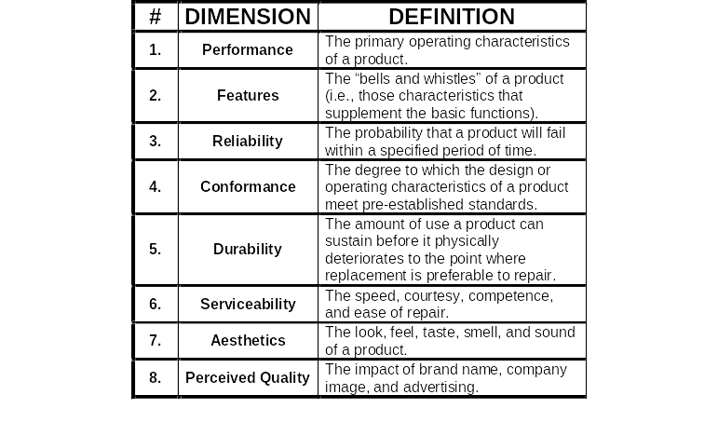
The Dimensions of Product Quality

Slide 6
Continued…
Performance
  basic operating characteristics of a product; how well a car is handled or its gas mileage
Features
  “extra” items added to basic features, such as a stereo CD or a leather interior in a car
Reliability
  probability that a product will operate properly within an expected time frame; that is, a TV will work without repair for about seven years

Slide 7
Continued…
Conformance
  degree to which a product meets pre–established standards
Durability
  how long product lasts before replacement
Serviceability
  ease of getting repairs, speed of repairs, courtesy and competence of repair person
Aesthetics
  how a product looks, feels, sounds, smells, or tastes
Safety
  assurance that customer will not suffer injury or harm from a product; an especially important consideration for automobiles
Perceptions
  subjective perceptions based on brand name, advertising, and the like

Slide 8
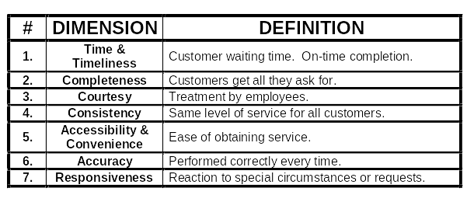
The Dimensions of Service Quality

Slide 9
Continued…
Time and Timeliness
  How long must a customer wait for service, and is it completed on time?
  Is an overnight package delivered overnight?
Completeness:
  Is everything customer asked for provided?
  Is a mail order from a catalogue company complete when delivered?

Slide 10
Continued…
Courtesy:
  How are customers treated by employees?
  Are catalogue phone operators nice and are their voices pleasant?
Consistency
  Is the same level of service provided to each customer each time?
  Is your newspaper delivered on time every morning?

Slide 11
Continued…
Accessibility and convenience
  How easy is it to obtain service?
  Does a service representative answer you calls quickly?
Accuracy
  Is the service performed right every time?
  Is your bank or credit card statement correct every month?
Responsiveness
  How well does the company react to unusual situations?
  How well is a telephone operator able to respond to a customer’s questions

Slide 12
Juran: Quality Trilogy
Managing for quality consists of three basic quality-oriented processes:
quality planning,
quality control, and
quality improvement.
The role of quality planning is to design a process that will be able to meet established goals under operating conditions.
The role of quality control is to operate and when necessary correct the process so that it performs with optimal effectiveness.
The role of quality improvement is to devise ways to take the process to new levels of performance.

Slide 13
Juran Trilogy
1. Quality Planning
The subject of planning can be anything -- an engineering process for designing new products, a production process for making goods, or a service process for responding to customer requests.
Quality Planning involves
  Identifying customers, both internal and external
  Determining their needs
  Specifying the product features that satisfy those needs at minimum cost.
  Designing the processes that can reliably produce those features.
  Proving that the process can achieve its goals under operating conditions.

Slide 14
Juran Trilogy
2. Quality Control
The process of managing operations to meet quality goals.
The process of Quality Control involves:
  Choosing control subjects
  Choosing units of measurement
  Establishing a measurement procedure
  Measuring
  Interpreting differences between measurement and goal
  Taking action to correct significant differences

Slide 15
Juran Trilogy
3. Quality Improvement
Assuming the process is under control, any waste that occurs must be inherent in the design of the process.
The object of quality improvement is to reduce chronic waste to a much lower level.
The steps in Quality Improvement:
  Prove the need for improvement
  Identify specific projects for improvement
  Organize to guide the projects
  Organize for diagnosis -- discovery of causes
  Diagnose the causes
  Provide remedies
  Prove that the remedies are effective under operating conditions
  Provide for control to maintain the gains.

Slide 16
Deming’s 14 Points
Create constancy of purpose
Adopt philosophy of prevention
Cease mass inspection
Select a few suppliers based on quality
Constantly improve system and workers

Slide 17
Deming’s 14 Points (cont.)
Institute worker training
Instill leadership among supervisors
Eliminate fear among employees
Eliminate barriers between departments
Eliminate slogans

Slide 18
Deming’s 14 Points (cont.)
Remove numerical quotas
Enhance worker pride
Institute vigorous training and education programs
Develop a commitment from top management to implement above 13 points

Slide 19
Continued…
PRINCIPLE 1 : "Create a constancy of purpose"
Define the problems of today and the future
Allocate resources for long-term planning
Allocate resources for research and education
Constantly improve design of product and service
PRINCIPLE 2 : "Adopt the new philosophy"
The call for major change
Stop looking at your competition and look at your customer instead
PRINCIPLE 3 : "Cease (End) dependence on inspection"
Quality does not come from inspection
Mass inspection is unreliable, costly, and ineffective
Inspectors fail to agree with each other
Inspection should be used to collect data for process control

Slide 20
Continued…
PRINCIPLE 4 : "Do not award business based on price tag alone"
Price alone has no meaning
Change focus from lowest initial cost to lowest total cost
Work toward a long term relationship
Establish a mutual confidence and aid between purchaser and vendor
PRINCIPLE 5 : "Improve constantly the system of production and service"
Quality starts with the intent of management
Teamwork in design is fundamental
Forever, continue to reduce waste and continue to improve
Putting out fires is not improvement of the process
PRINCIPLE 6 : "Institute training"
Management must provide the setting where workers can be successful
Management must remove the inhibitors to good work
Management needs an appreciation of variation
This is management's new role.

Slide 21
Continued…
PRINCIPLE 7: "Adopt and institute leadership"
Leaders must:
Remove barriers to pride of workmanship
Know the work they supervise
Know the difference between special and common cause of variation
Principle 8 : "Drive out fear"
The common denominator of fear
The fear of knowledge
Performance appraisals
PRINCIPLE 9 : "Break barriers among staff areas"
Know your internal suppliers and customers
Promote team work
PRINCIPLE 10 : "Eliminate slogans, exhortations and targets
They are directed at the wrong group
They generate frustration and resentment (bitterness)
Use posters that explain what management is doing to improve the work environment

Slide 22
Continued…
PRINCIPLE 11 :"Eliminate numerical quotas"
They impede (jam/hinder) quality
They reduce production
A person's job becomes meeting a quota
PRINCIPLE 12 : "Remove barriers"
Performance appraisal systems
Production rates
Financial management systems
Allow people to take pride in their workmanship

Slide 23
PRINCIPLE 13 :"Institute a program of education and self-improvement"
Commitment to lifelong employment
Educate employees people around you
Work with higher education of needs
Develop team building skills
PRINCIPLE 14 : "Take action to accomplish the transformation"
Management must:
Struggle over the fourteen points
Take pride in the new philosophy
Include the critical mass of people in the change

Slide 24
Deming Wheel: PDCA Cycle
4. Act
Institutionalize improvement; continue cycle.
1. Plan
Identify problem and develop plan for improvement.
3. Study/Check
Assess plan; is it working?
2. Do
Implement plan on a test basis.

Slide 25
STEPS IN PDCA
Lay down policies and objectives of TQM. Determine what the customer is supposed to receive & what they are actually receiving.
Chalk out the methods to achieve TQM objectives.
Educate & train workers & managers to understand & meet the requirements of TQM.
Start the operation of TQM by introducing new product, machines, procedures, etc.

Slide 26
Check the causes of non-conformance to quality standards.
Determine the consequences of non-conformance & place the report before the top management.
Meet with suppliers and enlist their help in Quality improvement.
Work on problem prevention rather than on problem correction.

Slide 27
Quality Circle
Organization
8-10 members
Same area
Supervisor/moderator
Training
Group processes
Data collection
Problem analysis
Presentation
Implementation
Monitoring
Problem Identification
List alternatives
Consensus
Brainstorming
Solution
Problem results
Problem Analysis
Cause and effect
Data collection and analysis

Slide 28
QUALITY CIRCLE
It is a small group of employees doing similar or related work who meet regularly to identify, analyse and solve product-quality problems & to improve general operations.
They are relatively autonomous units ( ideally about 10 workers), usually led by a supervisor or a senior worker and organised as work units.

Slide 29
Seven Quality Control Tools
Pareto Analysis
Flow Chart
Check Sheet
Histogram
Scatter Diagram
Control Chart
Cause-and-Effect Diagram

Slide 30
New Seven Q.C. Tools
Affinity Diagrams
Relations Diagrams
Tree Diagrams
Matrix Diagrams
Arrow Diagrams
Process Decision Program Diagrams
Matrix Data Analysis

Slide 31
Summary
New Seven Q.C. Tools
Benefits of New Seven Q.C. Tools
1- Provide Training in Thinking
2- Raise People’s Problem Solving Confidence
3- Increase People’s Ability to Predict Future Events
Roles of New Seven Q.C. Tools
1- Express verbal data diagrammatically
2- Make information visible
3- Organize information intelligibly
4- Clarify overall picture and fine details
5- Get more people involved
Notes:
Review each bullet!
The N7 Tools were created for a complete design approach to promote Total Quality Management. The benefits as well as the roles of the N7 Tools will ensure that a complete Organizational Reform will occur as well as a system-wide Culture of not only “Thinking TQM” but actually “Creating TQM”.

Slide 32
The Basics of ISO
Say What You Do
This means document your systems so you will consistently do the job the same way every time. We must make sure we have appropriate documentation.
Do What You Say
  This is what the auditors want to see. Objective
  evidence that what you say you are doing in your documentation is what you are doing in practice.

Slide 33
ISO is a network of the national standards institutes of 156 countries, on the basis of one member per country, with a Central Secretariat in Geneva, Switzerland, that coordinates the system.
ISO is a non-governmental organization: its members are not, as is the case in the United Nations system, delegations of national governments. Nevertheless, ISO occupies a special position between the public and private sectors. This is because, on the one hand, many of its member institutes are part of the governmental structure of their countries, or are mandated by their government. On the other hand, other members have their roots uniquely in the private sector, having been set up by national partnerships of industry associations.
Therefore, ISO is able to act as a bridging organization in which a consensus can be reached on solutions that meet both the requirements of business and the broader needs of society, such as the needs of stakeholder groups like consumers and users.

Slide 34
ISO 9000 Standards
The success in war was assigned to the systems adopted and they were maintained as Military secrets.
In 1976, British Standard 5750 was introduced.
In 1987, ISO 9000 standards were adopted by 92 countries
First amendment was taken place in 1994
In Dec 2000, the system was completely reviewed and new standards ISO 9000:2000 series was released.

Slide 35
ISO 9000:1987 vs. ISO 9000:2000
ISO 9000:1987
There were 3 standards Viz. ISO 9001, ISO 9002 and ISO 9003.
There were 4 main clauses and 20 sub clauses in Clause No 4
ISO 9000:2000
All have to go for ISO 9001 only, and can get exemption for any clause from Clause No 7, provided it is not affecting the ability to meet customer and regulatory requirements.
There are 8 clauses in ISO 9001:2000.

Slide 36

Objectives
Develop understanding of Six Sigma
Develop understanding of Six Sigma Quality

Slide 37
What Is Six Sigma?
Measure of Quality
Six Sigma is a measure of quality that strives for near perfection. The Six Sigma process uses data and rigorous statistical analysis to identify "defects" in a process or product, reduce variability, and achieve as close to zero defects as possible.

Slide 38
What Is Six Sigma?
Measure of Quality
Using a universal measurement scale, Six Sigma defines and estimates the opportunities for error and calculates defects in the same way every time, thus offering a means for measuring improvement. In fact, Six Sigma takes its name from the Greek letter "sigma," which is used in statistics to indicate standard deviation.
The Six Sigma methodology incorporates this data and statistical analysis into a project-based workflow that allows businesses to make intelligent decisions about where and how to incorporate improvements.

Slide 39
What Is Six Sigma?
Measure of Quality
6 Sigma is a Statistically based Quality Program.
It is a rigorous methodology to improve
process control.

Slide 40
What Is Six Sigma?
Process For Continuous Improvement
6 Sigma provides a process based approach
to continuous improvement.
It is independent of the measurement involved
& can be used to improve any business process

Slide 41
Two Routes to choose from :
D
M
A
I
C
1) Improved Control
Define
Measure
Analyze
Improve
Control
The Process is capable
- the Issues lie with the Variation

Slide 42
How to do ?
The DMAIC Model
At the hThe DMAIC Model
At the heart of Six Sigma is a systematic method for analyzing and improving business process called DMAIC. The DMAIC model includes five phases:
Define opportunities
Measure performance
Analyze opportunity
Improve performance
Control performance
:

Slide 43
D
F
S
S
2) New Process
Design For Six Sigma
New Process Development -
Creating 6 Sigma Process Capability

Slide 44
It’s all about Getting Results
Significantly Higher Net Income
Simpler Processes - Speed everywhere
True Focus on What the Customer Wants
Improved Employee Satisfaction

Slide 45

TPM is a Lean(Rely) tool for Quality and Productivity

Slide 46
What is TPM??
TPM is a Lean tool to optimize the effectiveness of manufacturing equipment and tooling.
  Starts with 5S / Visual Factory
  Builds a comprehensive Downtime Database by cause, frequency, and duration
  Predicts and prevents downtime by PM system
  Expands role of Operator as first point of early warning and prevention
  Develops Professional Maintenance skills

Slide 47
5S Workplace
A safe, clean, orderly workplace is fundamental to quality, efficiency, and teams
Sort (organize)
Shine (clean)
Set in order (make orderly and neat)
Standardize (visual place for everything)
Sustain (maintain the system)

Slide 48
TPM starts with 5S
You can’t see problems clearly when the workplace is in disarray
Cleaning and organizing the workplace helps the team to uncover problems
Making problems visible is the first step of improvement
Clean machines and workplace create pride & Safety

Slide 49


