Slide 2

LEVEL UP YOUR LIFE

Slide 3


Slide 4


Slide 5
All citizens have a certain set of responsibilities towards the “better citizen” status quo. The app basically promotes the spirit that- “The chance to help someone out in between our daily life, and to do something good everyday, is given to only few lucky ones”. This app would allow us to keep a track of our own responsibility as an individual towards society. The project will allow the user to set goals for themselves in various different categories and then work on those goals and keep adding EXP points/ Badges till they reach the goal they desired from the start. Whether it is helping the old granny help cross the road, or shovel the pavement after snow or planting a tree etc. The user can either take up a task shown as pending or perform a task and upload it later.

Slide 6
The system will let the user track their daily achievements, big or small, gaining motivation while progressing in a video game-style online platform. All the achievements will be accomplishments that the user can do to improve themselves; their life, and the world around them can be tracked and documented. Through this system, the points/XP points/Badges the user earns by performing these tasks of social responsibility can be used towards a ‘Better Citizen’ Program. These maximum points earned by the user are later on beneficial to them in different ways as they get extra privileges from the Government such as these badges count in as their Credit History while giving them loans on a lower interest rate, they could also avail benefits on their taxes, insurance schemes, pension plans, etc.

Slide 7
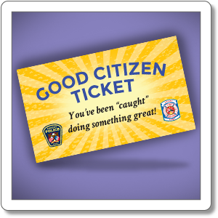

Slide 8


Slide 9
As the user earns XP (experience points), they'll level up and unlock increasingly difficult achievements, providing new experiences and challenges. The higher the ‘Better Citizen!’ points, the greater the benefits, like the levels of a game!

Slide 10
The user has a defined time limit to finish the task in order to keep better track of their achievements. If that particular task is not completed within the given time frame, the user loses all his points and badges earned, and has to start it all over again from Level1. Logging in an achievement even though the user didn’t do it will only have repercussions on the user in the end.

Slide 11
The world needs your help. Reach out, when you can!

Slide 12
THANK YOU!
Team: DataDiggers

