Slide 1



Skills Visibility. Business Agility.
AI-powered skills intelligence layer for smarter workforce decisions
Master Deck, 2026

Slide 2
Business Outcomes
Who | What | Why | Strategic Outcome | Impact
Employee | Avenue to benchmark one’s proficiency on primary skill(s) | Showcase validated skill, and ride a differentiated career journey Understand specific skill gaps, to undertake related learning | Self-directed Career Trajectory | ↑ Engagement ↑ Happiness ↑ Promotion
Manager | View of skill update of team | View of dynamic skill mix for planning task/role allocation Coaching and motivating team on skill/career enhancement | Delivery Optimization | ↑ Project profitability ↑ Client relationships
L&D | Skills benchmarking Skill gap analysis | Enable your workforce at scale by providing your people with hyper-personalized learning plans Built for the precise skills they need to succeed today and tomorrow. | Personalized Learning Programs Automated Career Path | ↑ Revenue & billability ↓ Hiring & training costs
Recruitment | Continuous inflow of qualified talent​ Pre-vetted talent pool | Hire Job fit candidates​ Build competitive advantage ​ | Enhancing Talent Quality | ↓ Time to hire ↓ Hiring cost ↑ Offer to join ratio
WFM/RMG | Mechanism to have validated primary skill in system | More accurate demand-supply match, reduced cycle time Better/confident proposals to account/client | Supply Chain Effectiveness | ↓ Project staffing & execution time ↑ New deal win rates
HRBP | Additional qualitative measure to associate’s career profile | Support Talent segmentation initiative Better differentiation and reduced subjectivity in HR processes like career advancement, internal mobility, etc. | Differentiated Total Rewards | ↑ Engagement & retention ↑ Compensation costs optimization
Sales/ BD | Validated skills summary | Showcase skills summary to client Data for RFP responses | Market Positioning | ↑ New deal win rates ↓ RFP turnaround time ↑ Client trust & retention
Org./ CEO/ CHRO | Dashboard for associates Dashboard for management | Organization transformation towards a new vision Skills based data decisions for all the employees Data-drive based workforce planning | Anticipate Change Respond Efficiently & Effectively | ↑ Workforce agility ↑ Organizational transformation strength

Slide 3
iMocha AI Governance – Built for Enterprise Trust
Supply
Skills Matching
Demand
Verified Skills from the Source
Explainable, Deterministic & Fair
Curated & Controlled by the Business
Employees review and confirm the inferred skills.
Built-in governance workflows ensure accuracy and ownership
Audit trails eliminate assumptions and unverified data
GenAI powered, transparent, logic-based matching
Scoring rationale and confidence levels for every match
Consistent, bias-free decisions designed for audit and scale
HR and business approve role and competency requirements
Standardized taxonomy prevents drift and duplication
Creates a consistent, enterprise-grade demand signal
Fairness
Reliability & Safety
Privacy & Security
Inclusiveness
Transparency
Accountability
iMocha AI Vision -> AI that understands skills, powers careers, and prepares organizations for the future of work
Notes:
Integration: The Missing Link in Your Skills Tech Stack Even the most advanced HR tech ecosystems fall short without one crucial layer: real-time, validated skills intelligence. That’s where iMocha completes the picture.
3

Slide 4

iMocha at a Glance

Slide 5
AI-first Approach
Al Skills
Inference Hub
Conversational
Al Interview - Tara
Al-Enhanced Assessment Solutions
Adjacent
Skills Inference
AI-Driven
Career Paths
Al-Powered Job
Profile Creation
Adjacent Learning
Recommendations
Automated
Skills Rubric

Slide 6
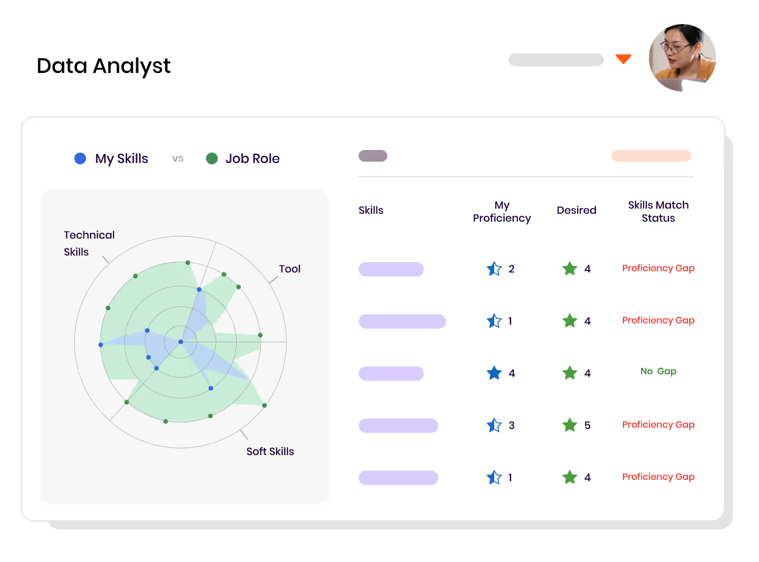
Skill Gap Analysis
Uncover the skill gaps. Build a future-ready workforce.​
Identify gaps vs. business needs with visual insights aligned to internal benchmarks and market standards.
Build live skill profiles via AI inference, assessments, and LMS/LXP integrations.
Aggregate skills data to reveal strengths and gaps across teams for smarter reskilling, succession, and optimization.

Slide 7

Why iMocha Created the Product (SI)?
Enrich Skills Ecosystems
Integrate Seamlessly with Existing HR Tech
Validate Skills Objectively
Enable Skills-First Decision Making
Drive Workforce Agility
Bridge the Skills Data Gap
Support Strategic Talent Planning

Slide 8
Skills Visibility. Business Agility.

