Slide 1

Final project – Blackjack Simulator
Python 2131
Section: 01598
Mansi Verma
Professor: Aysar Alshakargy

Slide 2
Basic rules of Blackjack
Objective: The objective of blackjack is to beat the dealer's hand without going over 21.
Card Values:
Number cards (2-10) are worth their face value.
Face cards (Jack, Queen, King) are usually worth 10 points each.
Aces can be worth either 1 or 11 points, depending on which value benefits the player more.
Gameplay:
The game begins with each player, including the dealer, receiving two cards.
Players can see one of the dealer's cards, while the other remains hidden.
Players take turns deciding whether to "hit" (receive another card) or "stand" (keep their current hand).
If a player's hand exceeds 21 points, they "bust" and lose the round automatically.
The dealer must hit until their hand value reaches 16 or higher.
If the dealer busts, all remaining players win.
If the dealer does not bust, the hands of the remaining players are compared to the dealer's hand.
Players with a hand value higher than the dealer's win, while those with a lower value lose.
A tie between the player and dealer results in a ”draw".
Notes:
While face cards traditionally have specific names and values (e.g., King = 10, Queen = 10, Jack = 10) in standard playing card games, the simulation simplifies the representation by assigning them numerical values randomly between 1 and 10. This approach allows for a straightforward implementation of the simulation without the need for additional logic to handle face cards separately.
In the context of a blackjack simulation, "hit winner" and "stand winner" refer to different strategies used by the player to play the game.
Hit Winner: A "hit winner" refers to a situation where the player wins the round by choosing to "hit," which means requesting an additional card to be dealt from the deck. In blackjack, the player typically hits if their hand value is below a certain threshold (often 17 or lower) and stands if their hand value is at or above that threshold. If the player's final hand value is higher than the dealer's but does not exceed 21, they win the round. This outcome is categorized as a "hit win" because the player achieved victory by choosing to hit during their turn.
Stand Winner: Conversely, a "stand winner" refers to a situation where the player wins the round by choosing to "stand," which means declining any additional cards and keeping their current hand value. If the player's final hand value is higher than the dealer's but does not exceed 21, they win the round. This outcome is categorized as a "stand win" because the player achieved victory by choosing to stand during their turn.
In both cases, the player's objective is to achieve a final hand value that is higher than the dealer's without exceeding 21, which would result in a bust. The terms "hit winner" and "stand winner" simply distinguish between rounds where the player achieved victory by hitting or by standing, respectively.

Slide 3
Project instructions
Single "player" vs the dealer
Ace can always count as 11 if you want
‘Play' 100,000 hands, and count how often the player wins/draws/loses for each starting value when Standing and Hitting
End up with a table of results for starting values from 4-22 ( that's bad but it's ok ), and then a count of win/loss/draw for hit and win/loss/draw for stand
Dealer will always take another card if their total is <= 16

Slide 4
Flowchart
---> Run Simulation function
---> Calls Calculate Hand Value, Dealer Turn, Simulate Player Turn, and Determine Winner functions
---> Output: Results of the simulation

Slide 5
Flowchart for Functions (Hand Value)
---> Input: Hand of cards
--> Initialize total value = 0
---> Initialize number of aces = 0
---> Loop through each card in the hand
---> Add card value to total value
---> If card is an ace, increment number of aces
---> While total value is greater than 21 and number of aces is not zero
---> Subtract 10 from total value
---> Decrement number of aces
---> Output: Total value of the hand
Notes:
This function, calculate_hand_value, calculates the total value of a hand by summing up the values of all cards in the hand. It then checks if the total value exceeds 21 and if there are any Aces (having a value of 11) in the hand. If both conditions are met, it reduces the total value by 10 for each Ace (since an Ace can be counted as either 11 or 1) until the total value is less than or equal to 21 or there are no more Aces.
Therefore, in this code, an Ace is counted as 11 unless doing so would cause the player to bust (i.e., exceed a total value of 21). If counting the Ace as 11 would result in busting, it is counted as 1 instead.
This approach reflects the common rule in blackjack where Aces can be counted as 11 or 1, depending on which value benefits the player more without causing them to bust.

Slide 6
Flowchart for Functions (Dealer Turn)
---> Generate random hand of cards for the dealer
---> Initialize dealer hand
---> Loop while total value of dealer hand is less than 17
---> Draw a card and add it to dealer hand
---> Output: Dealer hand after completing the loop

Slide 7
Flowchart for Functions (Player Turn)
---> Input: Starting value for player's hand
---> Initialize player hand
---> Loop while total value of player hand is less than or equal to 21
---> Generate random choice (hit or stand)
---> If choice is hit, draw a card and add it to player hand
---> If choice is stand or total value exceeds 21, exit loop
---> Output: Updated player hand after simulating the turn

Slide 8
Flowchart for Functions (Determine winner)
---> Input: Player's hand, Dealer's hand
---> Calculate total value of player's hand
---> Calculate total value of dealer's hand
---> If player's hand value is greater than 21
---> Output: "Player loses"
---> If dealer's hand value is greater than 21
---> Output: "Player wins"
---> If player's hand value is greater than dealer's hand value
---> Output: "Player wins"
---> If player's hand value is less than dealer's hand value
---> Output: "Player loses"
---> Otherwise (player's hand value is equal to dealer's hand value)
---> Output: "Draw"

Slide 9
Flowchart for Functions (Run Simulation)
---> Initialize results dictionary
---> Loop through each starting value from 4 to 22
---> Initialize win, loss, and draw counts for hitting and standing to 0
---> Loop 100,000 times
---> Generate random starting value for player's hand
---> Simulate player's turn
---> Simulate dealer's turn
---> Determine winner for hitting
---> Determine winner for standing
---> Update win, loss, and draw counts accordingly
---> Store results for the current starting value in the results dictionary
---> Output: Results dictionary

Slide 10
Flowchart for Functions (Print the results into a table)
---> Define function: print_results_table
---> Input: Results dictionary
---> Print table headers for each result category
---> Print a horizontal line to separate headers from data rows
---> Loop through each starting value from 4 to 22
---> Retrieve win, loss, and draw counts for hitting and standing for the current starting value
---> Print the starting value followed by counts for hit wins, hit losses, hit draws, stand wins, stand losses, and stand draws in a formatted manner
---> End function
---> Call function: print_results_table
---> Pass results dictionary as input

Slide 11
Pseudocode
Define a function to simulate one round of blackjack:
Input: Starting value for player's hand
Output: Result of the round (win, lose, draw), updated player's hand
Define a function to calculate the value of a hand:
Input: List of cards in hand
Output: Total value of the hand
Define a function to simulate the dealer's turn:
Input: List of cards in dealer's hand
Output: Updated list of cards in dealer's hand
Define a function to simulate the player's turn:
Input: Starting value for player's hand
Output: Updated player's hand after simulating the turn
Define variables to keep track of win, loss, and draw counts for hitting and standing for each starting value
Loop for each starting value from 4 to 22:
Initialize win, loss, and draw counts for hitting and standing to 0
Loop for 100,000 rounds:
Generate a random starting value for the player's hand
Simulate the player's turn using the simulate_player_turn() function
Simulate the dealer's turn using the dealer_turn() function
Determine the winner of the round
Update win, loss, and draw counts accordingly
Print results for the current starting value:
Print starting value
Print win, loss, and draw counts for hitting
Print win, loss, and draw counts for standing

Slide 12
Full Python Code for Blackjack Simulator
import random # Function to calculate the value of a hand def calculate_hand_value(hand): total_value = sum(hand) num_aces = hand.count(11) while total_value > 21 and num_aces: total_value -= 10 num_aces -= 1 return total_value # Function to simulate the dealer's turn def dealer_turn(): dealer_hand = [random.randint(1, 10) for _ in range(random.randint(4, 22))] while calculate_hand_value(dealer_hand) < 17: dealer_hand.append(random.randint(1, 10)) return dealer_hand # Function to simulate the player's turn def simulate_player_turn(start_value): player_hand = [random.randint(1, 10) for _ in range(start_value)] while calculate_hand_value(player_hand) <= 21: choice = random.choice(['hit', 'stand']) if choice == 'hit': player_hand.append(random.randint(1, 10)) else: break return player_hand # Function to determine the winner of the round def determine_winner(player_hand, dealer_hand): player_value = calculate_hand_value(player_hand) dealer_value = calculate_hand_value(dealer_hand) if player_value > 21: return 'lose' elif dealer_value > 21: return 'win' elif player_value > dealer_value: return 'win' elif player_value < dealer_value: return 'lose' else: return 'draw' # Function to run the simulation for each starting value def run_simulation(): results = {} for start_value in range(4, 23): hit_win = hit_loss = hit_draw = stand_win = stand_loss = stand_draw = 0 for _ in range(100000): player_hand = simulate_player_turn(start_value) dealer_hand = dealer_turn() # Dealer's turn result_hit = determine_winner(player_hand, dealer_hand) result_stand = determine_winner(player_hand, dealer_turn()) # Update counts if result_hit == 'win': hit_win += 1 elif result_hit == 'lose': hit_loss += 1 else: hit_draw += 1 if result_stand == 'win': stand_win += 1 elif result_stand == 'lose': stand_loss += 1 else: stand_draw += 1 # Store results for the current starting value results[start_value] = { 'hit_win': hit_win, 'hit_loss': hit_loss, 'hit_draw': hit_draw, 'stand_win': stand_win, 'stand_loss': stand_loss, 'stand_draw': stand_draw } # Print results table print_results_table(results) return results # Function to print results in table form def print_results_table(results): print("Starting Value | Hit Wins | Hit Losses | Hit Draws | Stand Wins | Stand Losses | Stand Draws") print("-" * 85) for start_value in range(4, 23): hit_win = results[start_value]['hit_win'] hit_loss = results[start_value]['hit_loss'] hit_draw = results[start_value]['hit_draw'] stand_win = results[start_value]['stand_win'] stand_loss = results[start_value]['stand_loss'] stand_draw = results[start_value]['stand_draw'] print( f"{start_value:^14} | {hit_win:^9} | {hit_loss:^11} | {hit_draw:^9} | {stand_win:^10} | {stand_loss:^13} | {stand_draw:^11}") # Run the simulation run_simulation()

Slide 13
Output
tarting Value | Hit Wins | Hit Losses | Hit Draws | Stand Wins | Stand Losses | Stand Draws
-------------------------------------------------------------------------------------
4 | 27682 | 72192 | 126 | 27659 | 72209 | 132
5 | 10215 | 89735 | 50 | 10223 | 89730 | 47
6 | 2813 | 97167 | 20 | 2818 | 97168 | 14
7 | 608 | 99388 | 4 | 607 | 99389 | 4
8 | 112 | 99887 | 1 | 112 | 99888 | 0
9 | 14 | 99986 | 0 | 13 | 99986 | 1
10 | 1 | 99999 | 0 | 1 | 99999 | 0
11 | 0 | 100000 | 0 | 0 | 100000 | 0
12 | 0 | 100000 | 0 | 0 | 100000 | 0
13 | 0 | 100000 | 0 | 0 | 100000 | 0
14 | 0 | 100000 | 0 | 0 | 100000 | 0
15 | 0 | 100000 | 0 | 0 | 100000 | 0
16 | 0 | 100000 | 0 | 0 | 100000 | 0
17 | 0 | 100000 | 0 | 0 | 100000 | 0
18 | 0 | 100000 | 0 | 0 | 100000 | 0
19 | 0 | 100000 | 0 | 0 | 100000 | 0
20 | 0 | 100000 | 0 | 0 | 100000 | 0
21 | 0 | 100000 | 0 | 0 | 100000 | 0
22 | 0 | 100000 | 0 | 0 | 100000 | 0

Slide 14
Visualize the output in a plot
1. Import matplotlib module. Define a function named plot_results.
2. Accept a dictionary named results as input.
3. Extract the counts of hit and stand outcomes from the results dictionary.
4. Create a list of starting values from 4 to 22.
5. Create six empty lists to store counts for hit wins, hit losses, hit draws, stand wins, stand losses, and stand draws.
6. Iterate over each starting value in the range from 4 to 22:
7. Extract the counts of hit and stand outcomes for the current starting value from the results dictionary.
8. Append the counts to the respective lists.
9. Create a bar plot using the extracted data:
10. Set the width of the bars.
11. Plot bars for hit wins, hit losses, hit draws, stand wins, stand losses, and stand draws using matplotlib's bar function.
12. Set the x-axis labels to the starting values.
13. Set appropriate labels for the x-axis and y-axis.
14. Add a legend to the plot.
15. Set the title of the plot.
16. Display the plot.

Slide 15
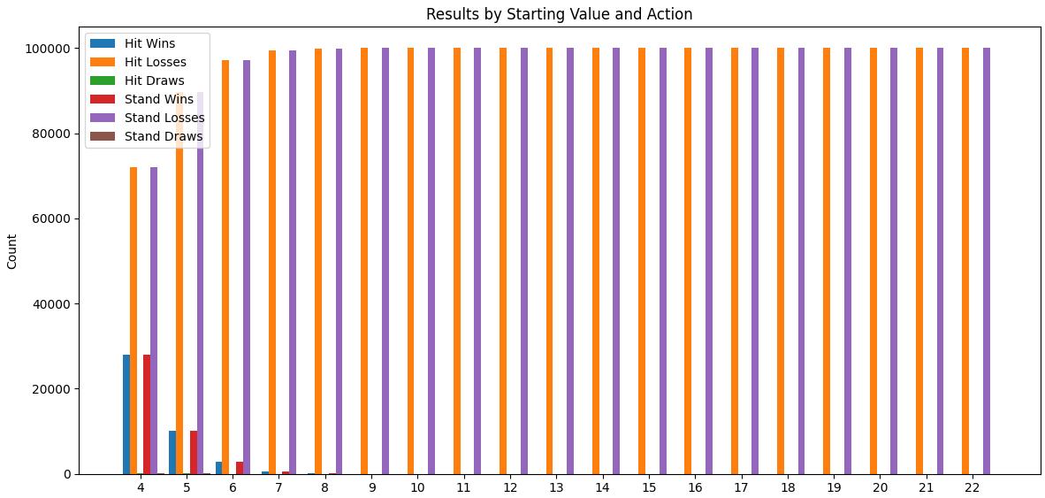
Output plot

Slide 16

Thank you

