Slide 1

Product Analyst– Coretek
Mansi Verma
04/23/2024

Slide 2
Hi, I’m Mansi!
I’m passionate about using project management and data analysis to contribute to advancements that make people’s lives easier.
I have four years of experience working in Biotech, including my time as a Graduate Research Assistant at Oakland University and as part of the project management team at Novogene.
I grew up in New Delhi, India, and currently based out of Commerce, MI. I love spending time with my dog and am excited for the opportunity to meet with you and for being considered for this role!

Slide 3
Work Experience and Education
Project Management| NGS Research Project Coordinator
Novogene Corp.,
Graduate Research & Teaching Assistant
Oakland University
2022- Present
Commerce, MI (Remote)
Auburn Hills, MI
2019-2021
Master of Science
Present
Oakland Community College
Biotechnology
2015-2019
Certificate of Information Science
Bachelor of Technology
JIIT, Noida, India,
Oakland University
2019-2021
Biology
Data Science

Slide 4
Project Management - Novogene
Communicate data insights to stakeholders.
Use analytical and problem-solving skills to troubleshoot projects deviating from time, scope or budget.
Contribute to the development of the resources, recommend improvements through data and reporting.
Complete assigned tasks according to established timeline.
Support risk analysis and risk mitigation planning for projects
Establish and maintain partnerships with internal and external stakeholders.
Builds productive working relationships with departments that are key partners (e.g., R&D)
Skills: Microsoft Excel, LIMS (Laboratory information management system]

Slide 5
Graduate Research Assistant – Oakland University
Contributes data analysis expertise for short- and long-term strategic planning process activities.
Complete assigned tasks according to established timeline.
Present data insights in weekly and monthly team meetings.
Demonstrate lab experiments
Conduct lectures to explain concepts. Provide feedback towards enhancing learning
Answering student queries in person and online
Skills: Microsoft Excel, R, Power BI and Python

Slide 6
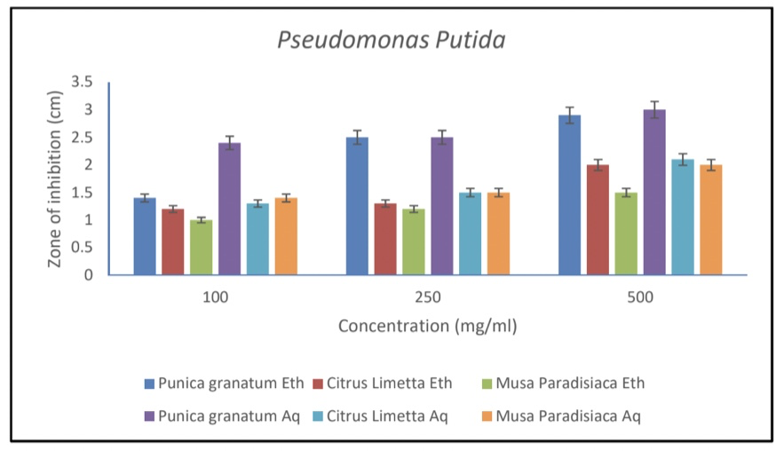
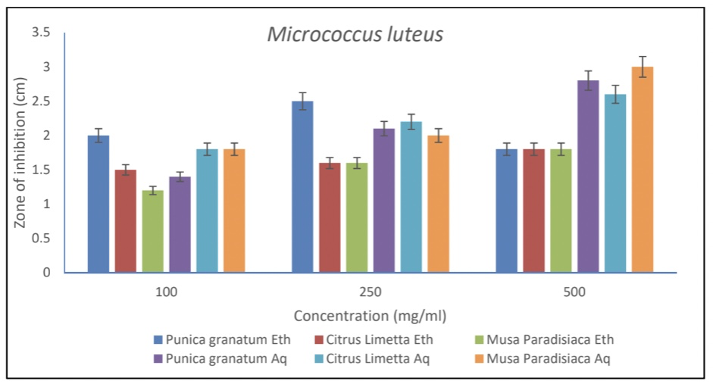
Project I Antimicrobial activity displayed by Punica granatum, Citrus limetta and Musa paradisiaca peel extracts on Micrococcus luteus and Pseudomonas putida
Zone of inhibition measured in Punica granatum, Citrus limetta and Musa paradisiaca peel extracts on Pseudomonas putida and Micrococcus luteus
Notes:
Disc diffusion was performed with Micrococcus luteus and Pseudomonas putida, in different
sets of experiments to obtain a safe and optimum dose range of Punica granatum, Citrus limetta
and Musa paradisiaca peel extracts. In this assay, the extracts dipped in the discs were diffused
over the bacterial spread agar plates which correlate to the activity of the extracts on microbial
cells under various treatment conditions.
To analyze the anti-inflammation potential of Punica granatum, Citrus limetta and Musa
paradisiaca peel extracts on Micrococcus luteus and Pseudomonas putida, the microbial cells
were exposed to varying concentration of doses and MIC was determined. Gentamycin, an
antibiotic, was used as a negative control that inhibits the growth of Micrococcus luteus and
Pseudomonas putida

Slide 7
Project II
Aim: Impact of mutations in the FACT complex on transcription.
Summary: Roles of FACT CTRs in regulating chromatin structure and transcription were investigated using chromatin immunoprecipitation (ChIP) followed by DNA sequencing (ChIP-seq).
Methods: PCR, Western Blot, RNA Purification, ChIP-seq, DNA electrophoresis, Cell culture.
Results: CTR mutants showed increased histone occupancies in promoters, NDRs, and 5’ ends of the CDSs. In vivo evidence for FACT in disassembling nucleosomes.
Notes:
Computational analysis of Analysis of genes associated with FACT complex in Saccharomyces cerevisiae and its comparison with Homo sapiens, Mus musculus, and Musca domestica

Slide 8
Project III
Aim: Analysis of genes associated with FACT complex in Saccharomyces cerevisiae and its comparison with Homo sapiens, Mus musculus, and Musca domestica
Methods: The nucleotide and amino acid sequences for SPT16 and Pob3/SSRP1 of Saccharomyces cerevisiae, Homo sapiens, Mus musculus, and Musca domestica were retrieved, aligned using multiple tools and finally phylogenetic trees were constructed. The amino acid sequences retrieved were also used to compare the primary and secondary structure of the proteins.
Tools, servers and software used: NCBI, UniProt KB, CLUSTALW, MAFFT and MUSCLE, ProtParam, Expasy, SOPMA, MEGAX
Results: Primary and secondary structure comparison of the amino acid sequence shows an overall trend that these proteins have similar properties across the species.
Phylogenetic trees constructed from the aligned sequences suggest that Homo sapiens, Mus musculus and Saccharomyces cerevisiae are closely related

Slide 9
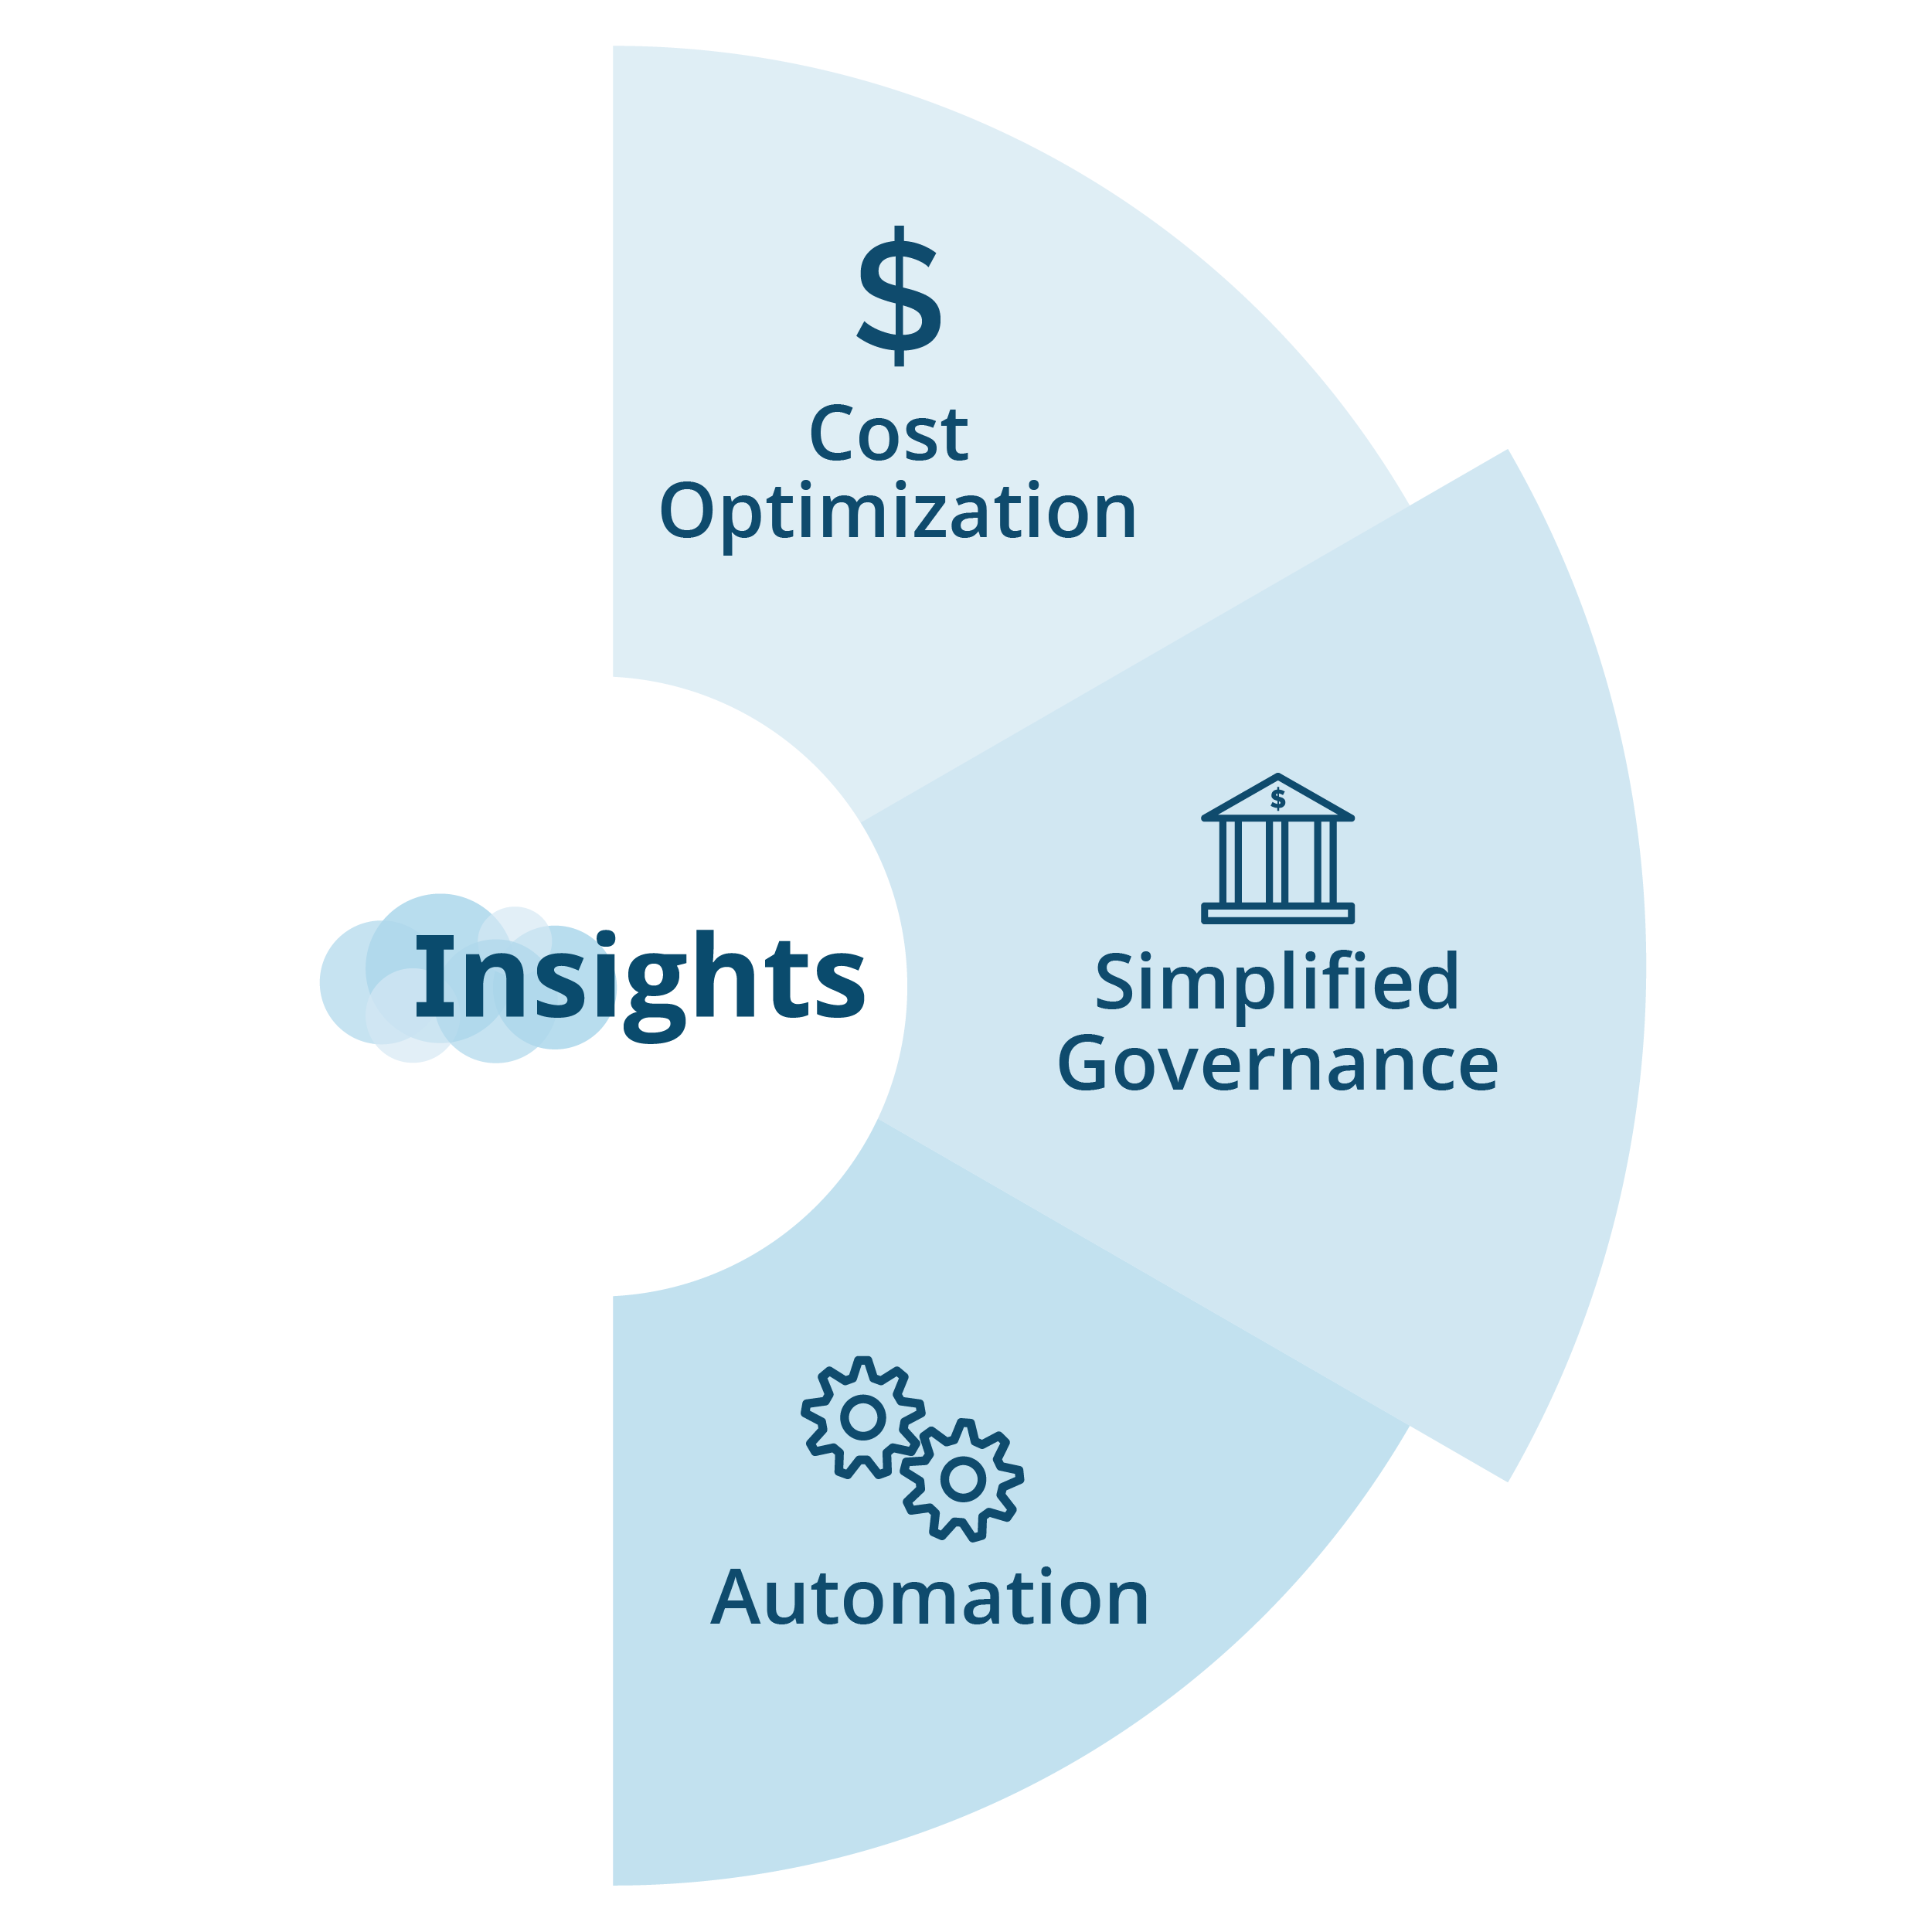
Area of interest

Slide 10
Summary
I believe my educational background and work experience make me a great fit for this role.
I’m passionate about learning more about Coretek Services and utilizing my technical knowledge and communication skills to support the team.
Happy to take more questions.

Slide 11

Thank you!
Notes:
Questions:
Ben:
1. Are there any specific quality metrics that the group is currently focusing on?
2. how does the group stay informed about the latest developments and how can this role support in keeping the team updated on relevant advancements?
Dave:
1. What are the current measures in place to ensure communication within the group and how can the coordinator best support this?
2. Are there any specific challenges you notice that this role can help overcome?
Sam Tam:
1. How does the group currently approach root cause analysis and what methods or ttools are used?
2. Any challenges or barriers that coordinator can support with?
Franco:
1.How does the group foster a culture of continuous learning and improvement?
2.

