Slide 1
Project – Bankruptcy Prevention
Team – 2
Mentor – Varun Sir
09/11/2021

Slide 2
EDA (exploratory Data Analysis)

Slide 3
What is exploratory data analysis
Exploratory Data Analysis (EDA) is the process of visualizing and analysing data to extract insights from it.
In other words, EDA is the process of summarizing important characteristics of data in order to gain better understanding of the dataset.
Extracting important variables and leaving behind useless variables
Identifying outliers, missing values, or human error Understanding the relationship(s), or lack of, between variables
Ultimately, maximizing your insights of a dataset and minimizing potential error that may occur later in the process

Slide 4
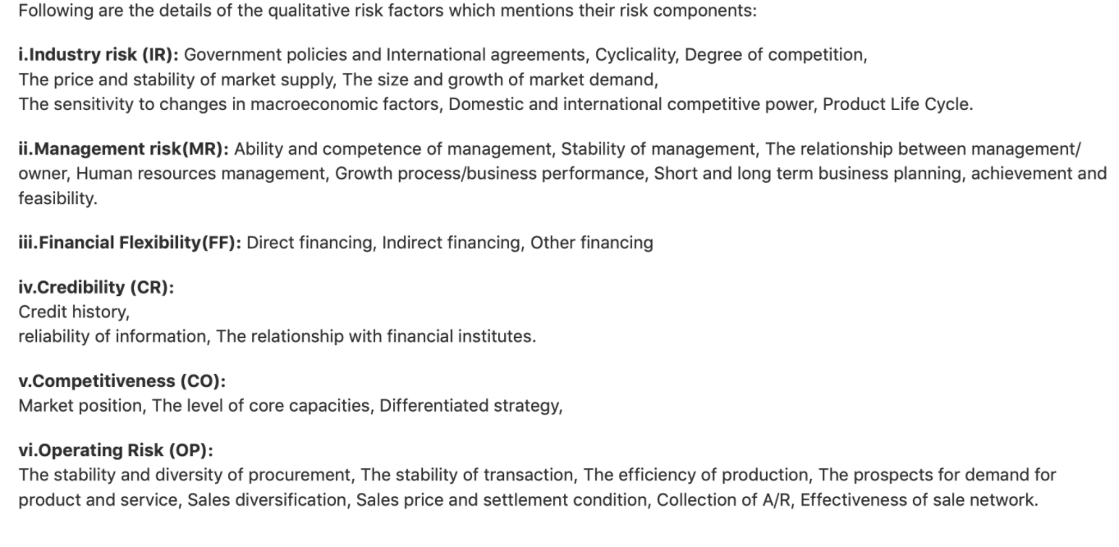

Slide 5
Data description
The data set includes the following variables:
1. industrial_risk: 0=low risk, 0.5=medium risk, 1=high risk.
2. management_risk: 0=low risk, 0.5=medium risk, 1=high risk.
3. financial flexibility: 0=low flexibility, 0.5=medium flexibility, 1=high flexibility.
4. credibility: 0=low credibility, 0.5=medium credibility, 1=high credibility.
5. competitiveness: 0=low competitiveness, 0.5=medium competitiveness, 1=high
competitiveness.
6. operating_risk: 0=low risk, 0.5=medium risk, 1=high risk.
7. class: bankruptcy, non-bankruptcy (target variable).
 | ReplyForward

Slide 6
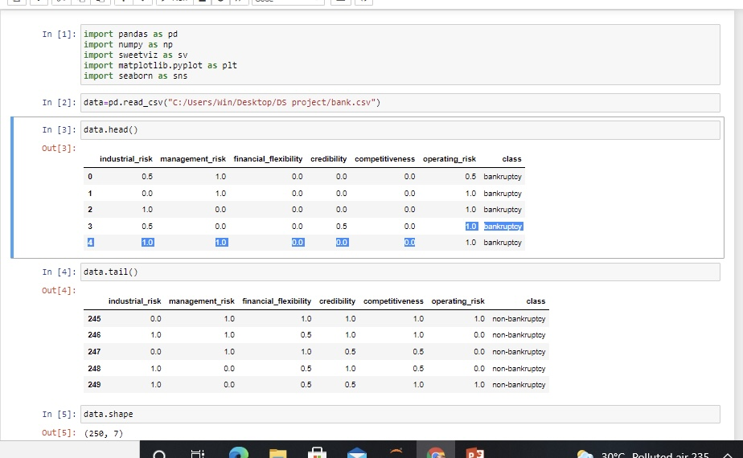
Code

Slide 7
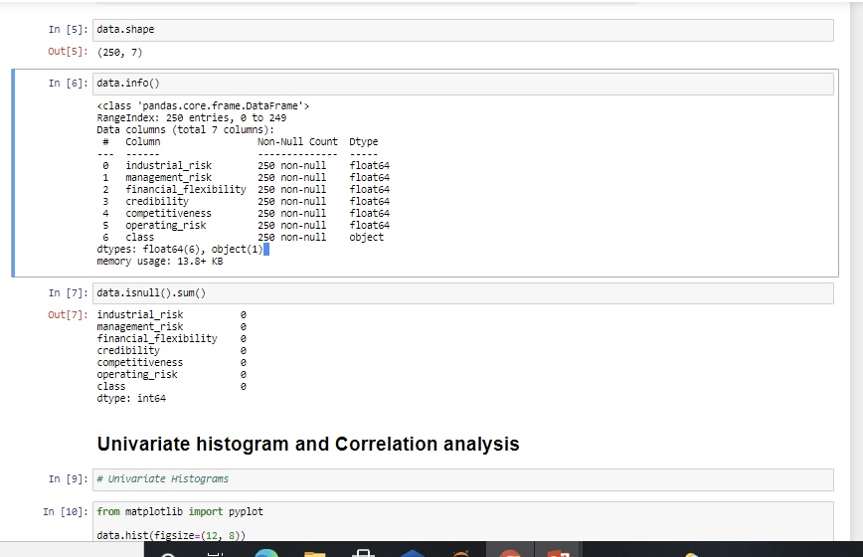

Slide 8
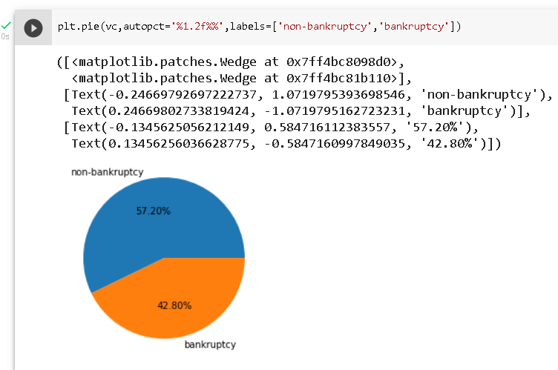
Pie chart of the class feature

Slide 9
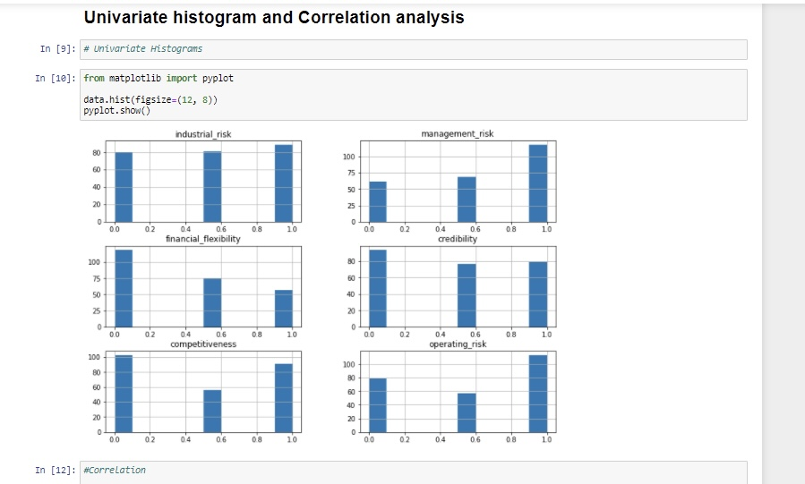

Slide 10
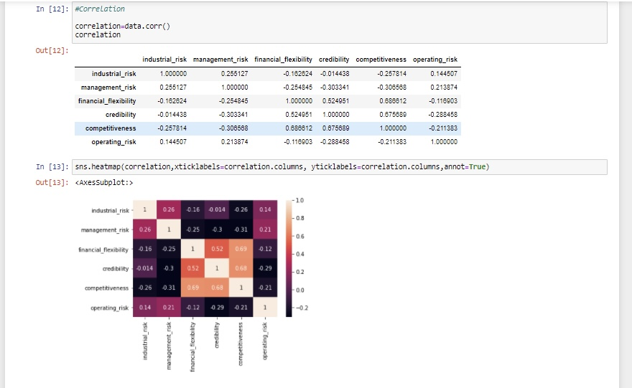

Slide 11
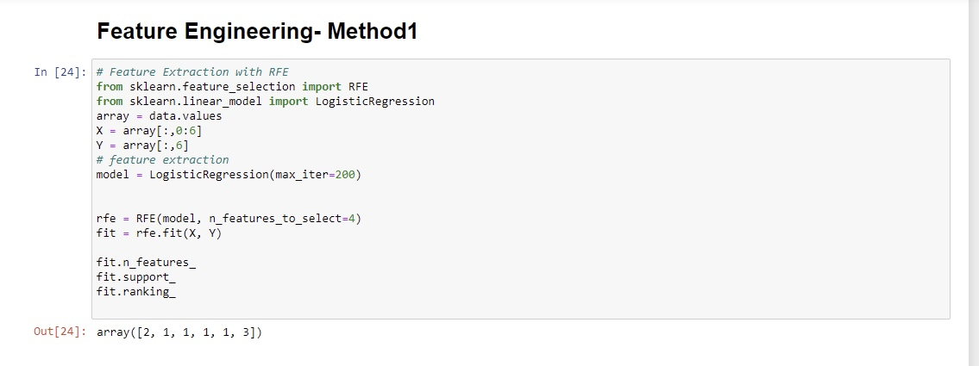

Slide 12
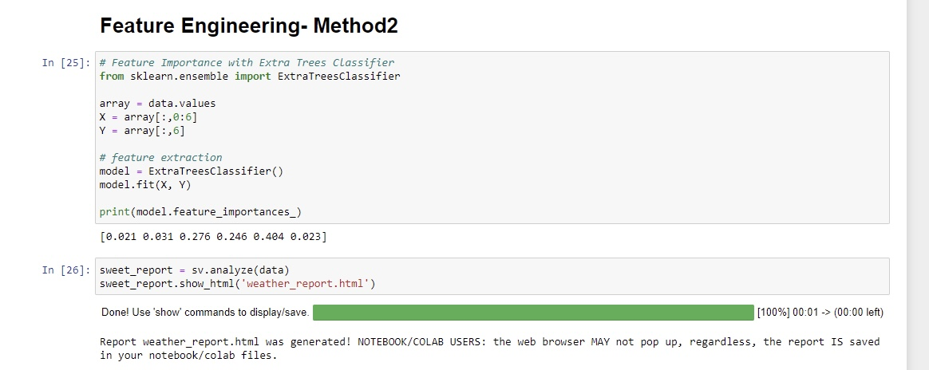

Slide 13
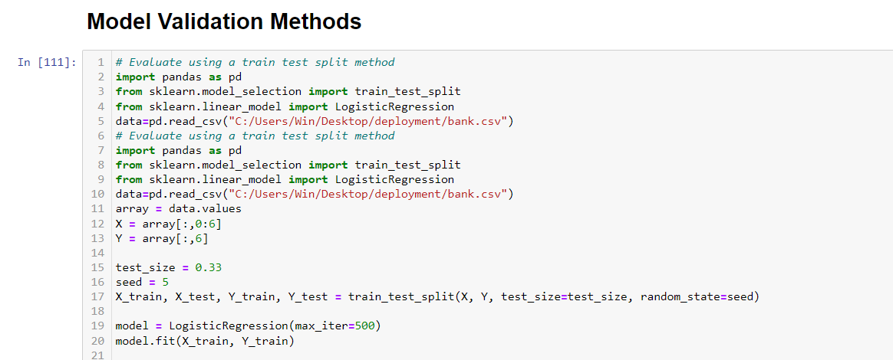

Slide 14
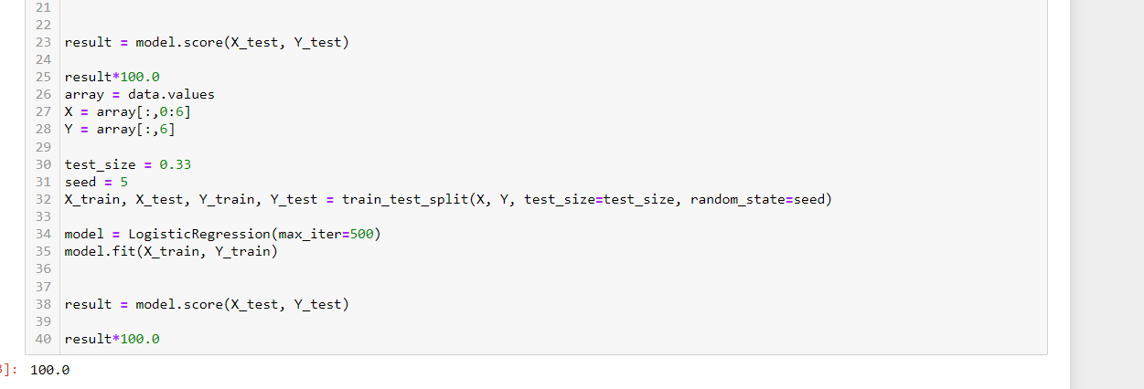

Slide 15
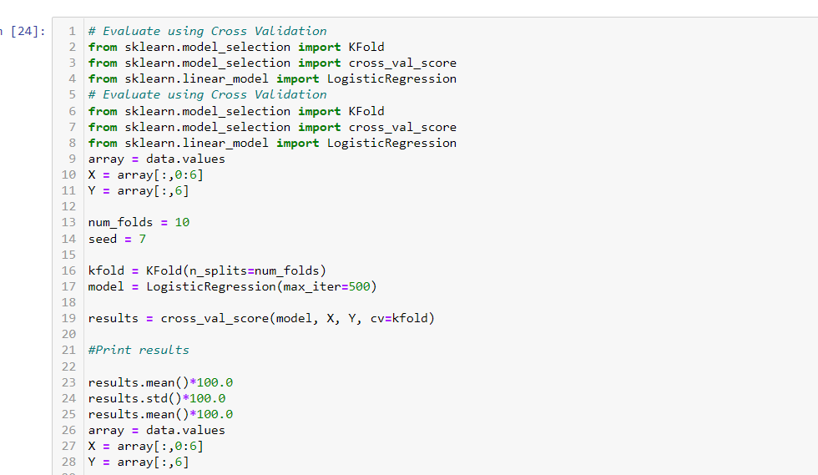

Slide 16
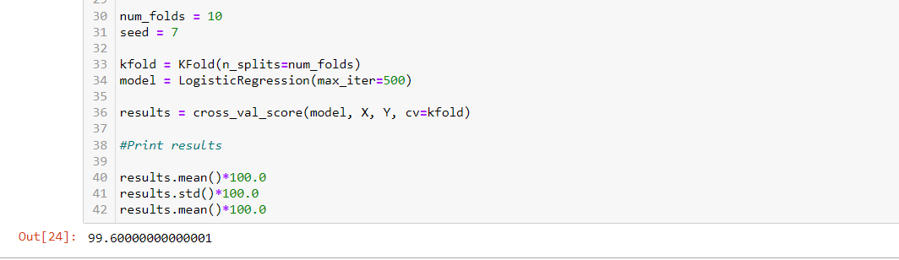

Slide 17
What is Precision score ?
Precision: Model precision score represents the model’s ability to correctly predict the positives out of all the positive predictions it made. The precision score is a useful measure of the success of prediction when the classes are very imbalanced. Mathematically, it represents the ratio of true positive to the sum of true positive and false positive.
Precision Score = TP / (FP + TP)

Slide 18
What is Recall Score?
Recall: Model recall score represents the model’s ability to correctly predict the positives out of actual positives. This is unlike precision which measures how many predictions made by models are actually positive out of all positive predictions made. For example: If your machine learning model is trying to identify positive reviews, the recall score would be what percent of those positive reviews did your machine learning model correctly predict as a positive. In other words, it measures how good our machine learning model is at identifying all actual positives out of all positives that exist within a dataset. The higher the recall score, the better the machine learning model is at identifying both positive and negative examples. Recall score is a useful measure of success of prediction when the classes are very imbalanced. Mathematically, it represents the ratio of true positive to the sum of true positive and false negative.
Recall Score = TP / (FN + TP)

Slide 19
What is Accuracy Score?
Model accuracy is a machine learning model performance metric that is defined as the ratio of true positives and true negatives to all positive and negative observations. In other words, accuracy tells us how often we can expect our machine learning model will correctly predict an outcome out of the total number of times it made predictions. For example: Let’s assume that you were testing your machine learning model with a dataset of 100 records and that your machine learning model predicted all 90 of those instances correctly. The accuracy metric, in this case, would be: (90/100) = 90%. The accuracy rate is great but it doesn’t tell us anything about the errors our machine learning models make on new data we haven’t seen before.
Mathematically, it represents the ratio of the sum of true positive and true negatives out of all the predictions.
Accuracy Score = (TP + TN)/ (TP + FN + TN + FP)

Slide 20
What is F1-Score?
Model F1 score represents the model score as a function of precision and recall score. F-score is a machine learning model performance metric that gives equal weight to both the Precision and Recall for measuring its performance in terms of accuracy, making it an alternative to Accuracy metrics (it doesn’t require us to know the total number of observations). It’s often used as a single value that provides high-level information about the model’s output quality. This is a useful measure of the model in the scenarios where one tries to optimize either of precision or recall score and as a result, the model performance suffers.
F1 Score = 2* Precision Score * Recall Score/ (Precision Score + Recall Score/)

Slide 21
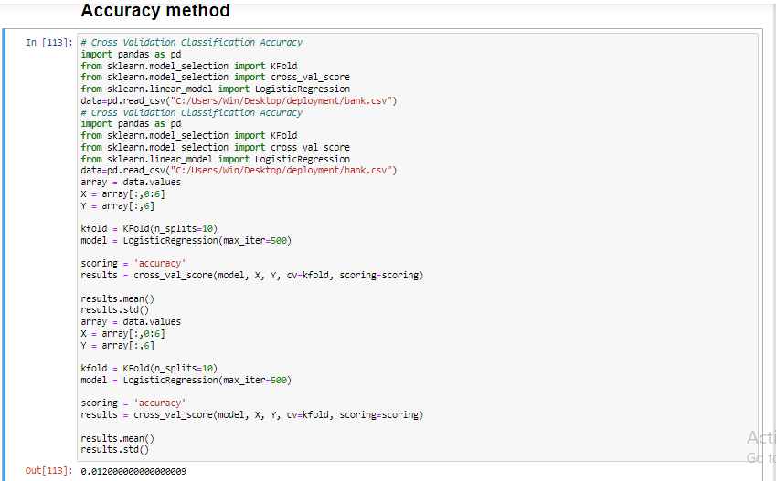

Slide 22
Highest accuracy As you can see in Accuracy method we have used Logistic Regression model and got the highest accuracy which is 99.60. Comparing to the other models Logistic regression is giving us the highest accuracy.

Slide 23
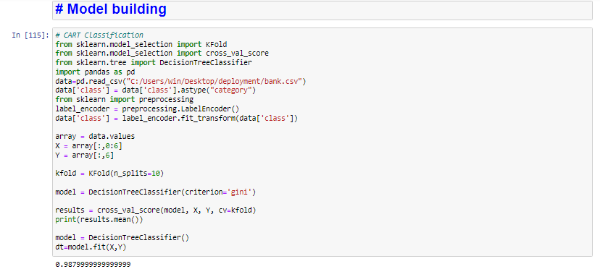

Slide 24
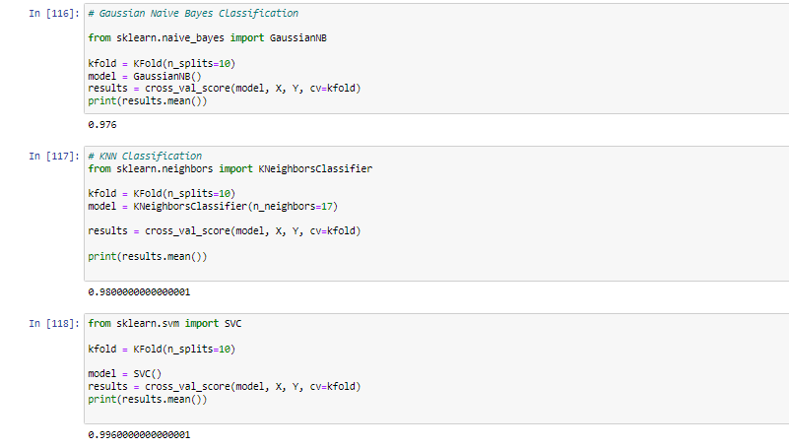

Slide 25
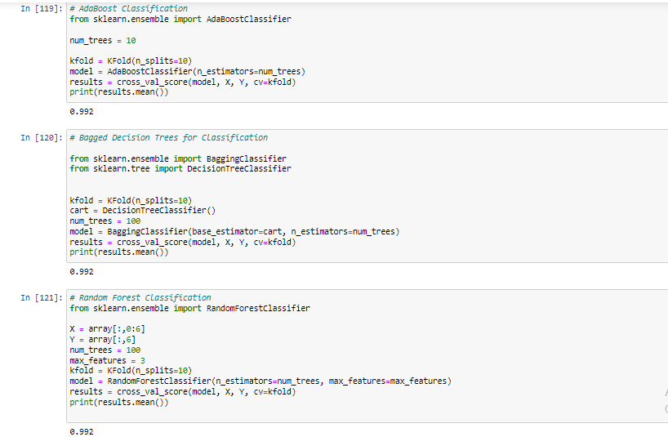

Slide 26
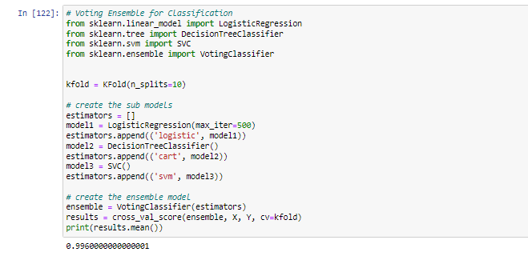

Slide 27
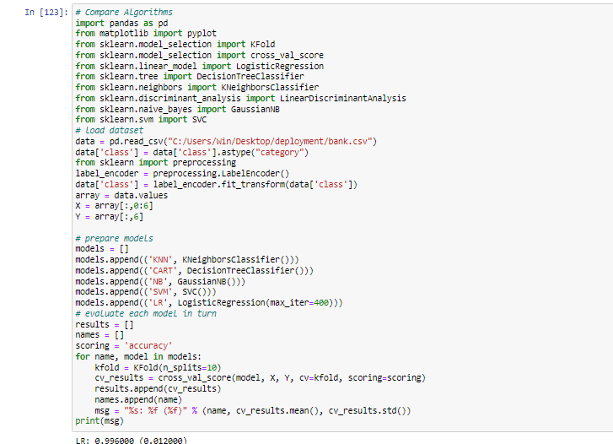
Compare the algorithms

Slide 28
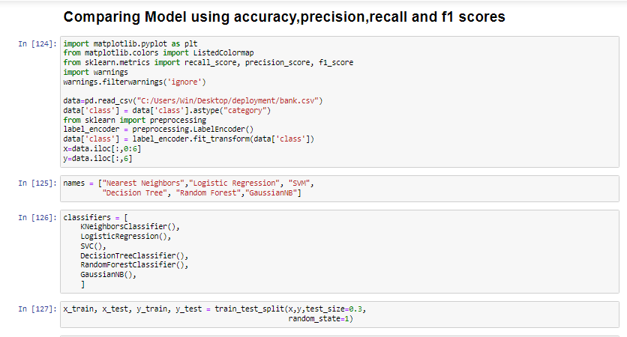

Slide 29
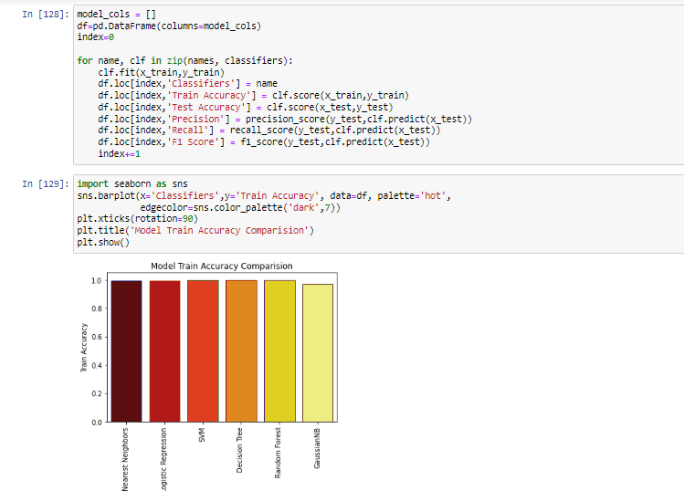

Slide 30
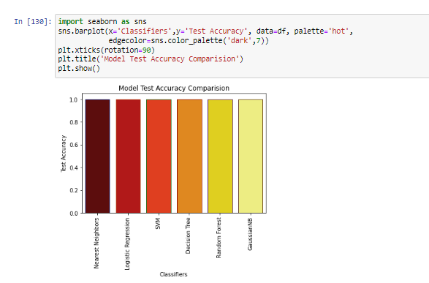

Slide 31
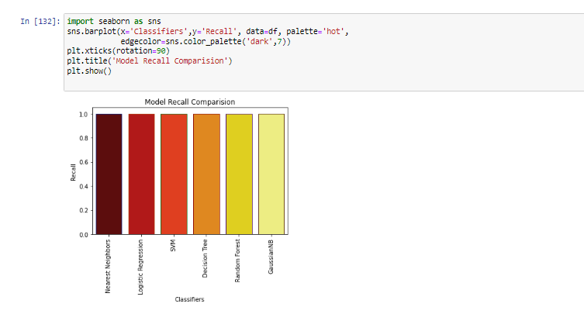

Slide 32
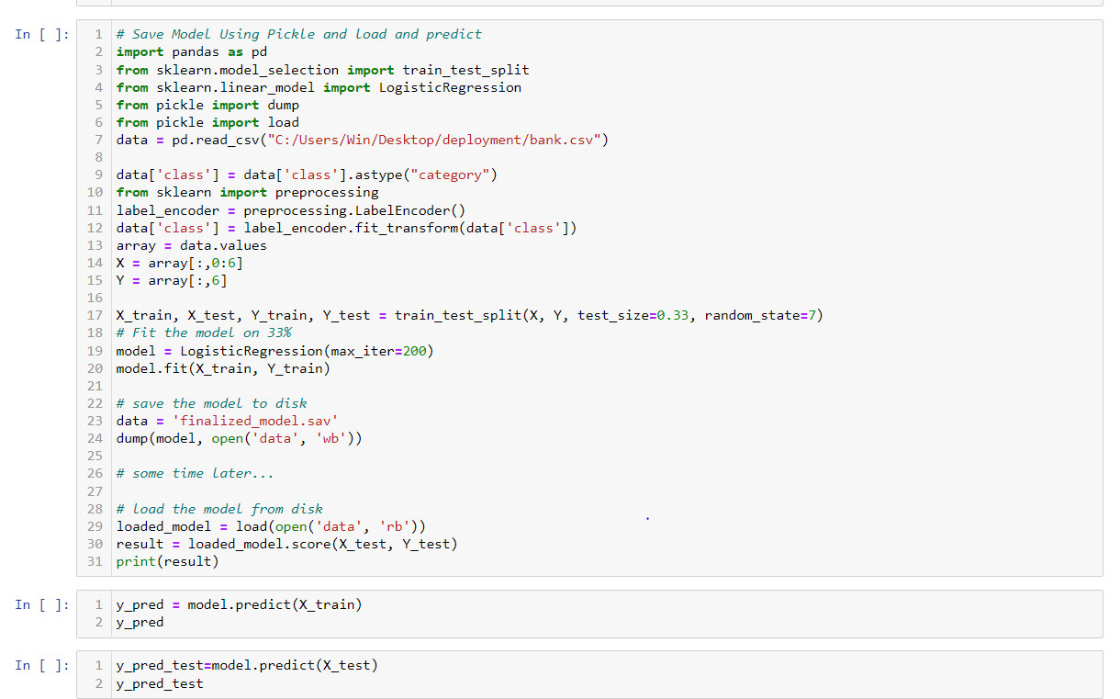

Slide 33
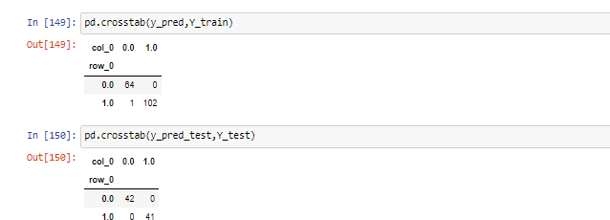

Slide 34
Model Deployment

Slide 35
What is Model Deployment? Deployment is the method by which you integrate a machine learning model into an existing production environment to make practical business decisions based on data. It is one of the last stages in the machine learning life cycle and can be one of the most cumbersome. Why is Model Deployment Important? In order to start using a model for practical decision-making, it needs to be effectively deployed into production. If you cannot reliably get practical insights from your model, then the impact of the model is severely limited.

Slide 36
Deployment: The engineering task of exposing an ML model to the rest of the world. Inference: The model's computational task of transforming questions into answers. Testing: The engineering task of building automated tests to verify baseline functionality and infrastructure robustness. Monitoring: The supervision of the model's health and performance once deployed.

Slide 37
What is Streamlit? Streamlit is an open-source python framework for building web apps for Machine Learning and Data Science. We can instantly develop web apps and deploy them easily using Streamlit. Streamlit allows you to write an app the same way you write a python code. Streamlit makes it seamless to work on the interactive loop of coding and viewing results in the web app.

Slide 38
Why Streamlit? Streamlit is a popular open-source framework used for model deployment by machine learning and data science teams. And the best part is it’s free of cost and purely in python. Streamlit lets you create apps for your Machine Learning project using simple code. It also supports hot-reloading that lets your app update live as you edit and save your file. Using streamlit creating an app is very easy, adding a widget is as simple as declaring a variable. No need to write a backend, No need to define different routes or handle HTTP requests.

Slide 39
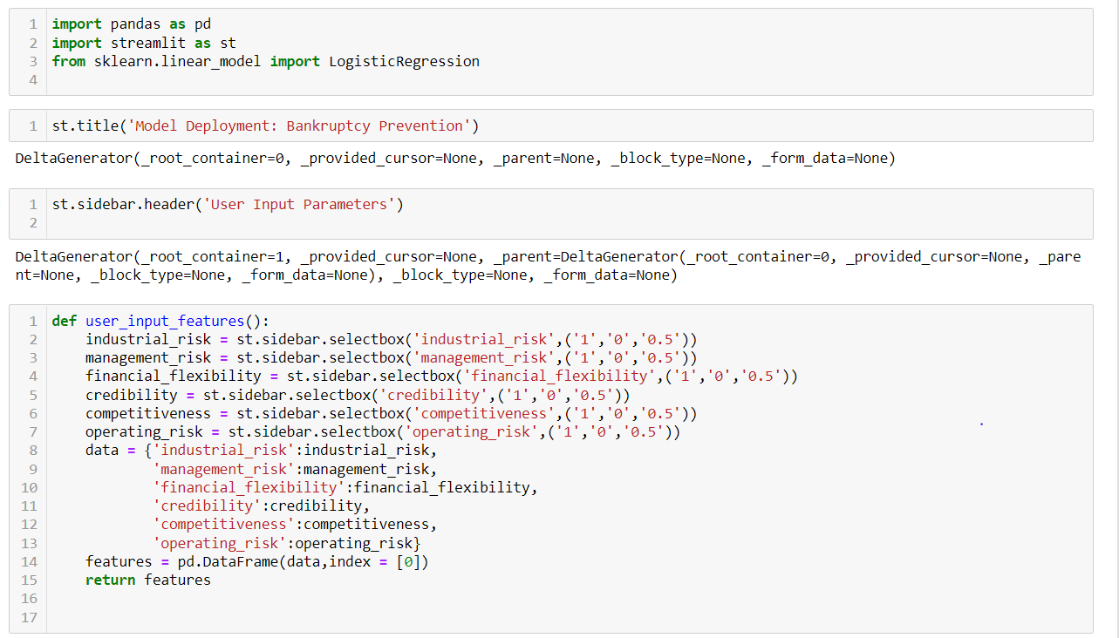

Slide 40
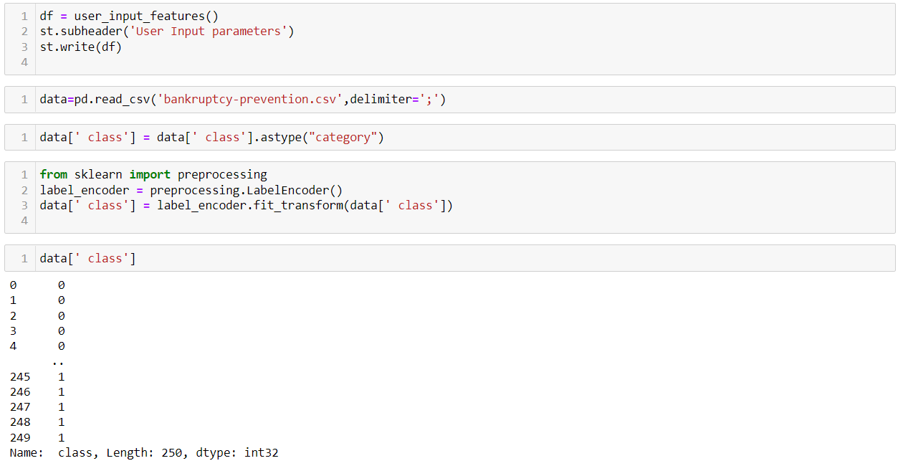

Slide 41
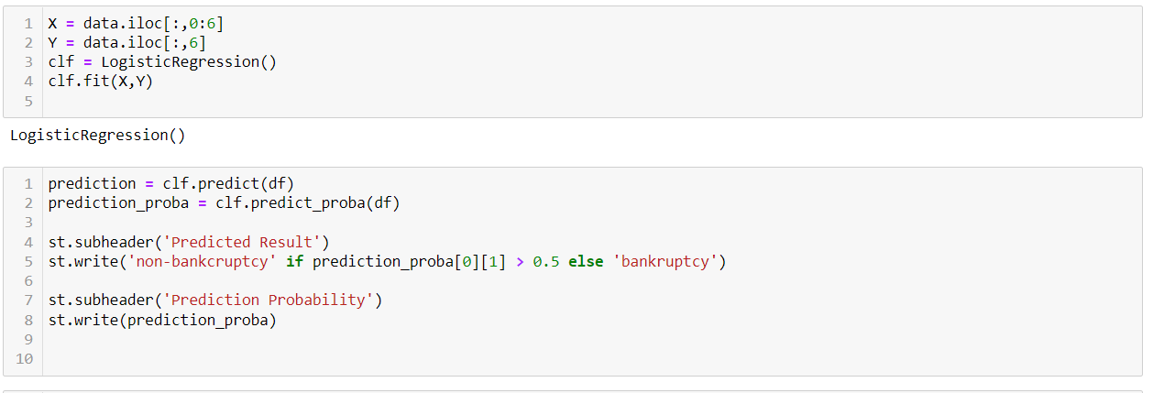

Slide 42
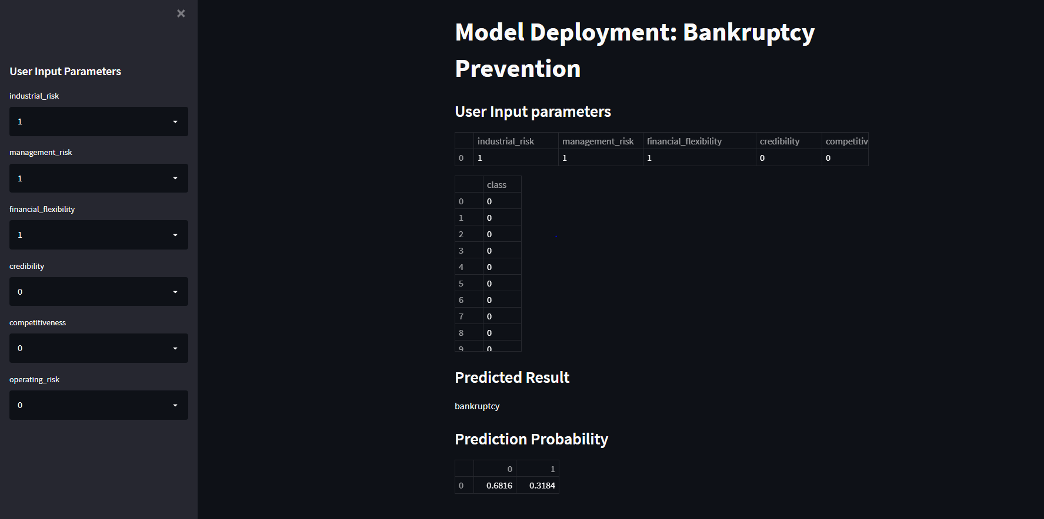

Slide 43
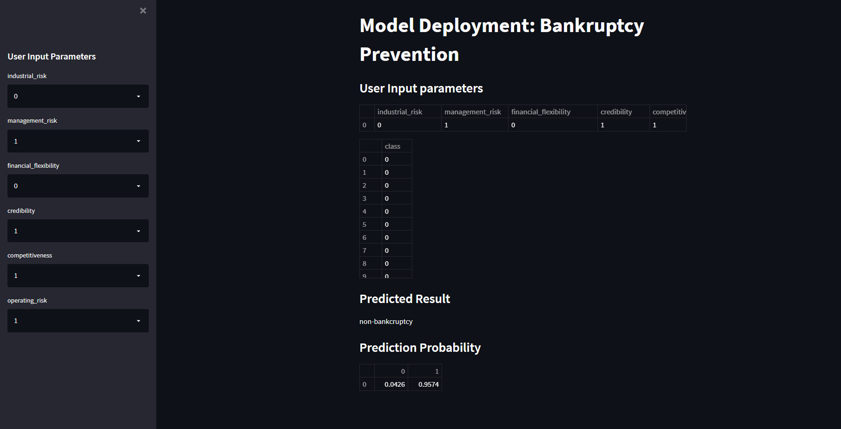

Slide 44
Thank you!

